Slide 1

OUTLIERS
We are the Outliers
We believe in working as a team and using technology to solve the problem around us.
Normal is boring, We love to make a difference.

Slide 2
LOANING SYSTEM AND SAFER BANKING USING SMART CONTRACTS AND BLOCK CHAIN TECHNOLOGY

Slide 3
OTM SOLUTION TO BANKING AND LOANING
OTM will bring ease to the financial loan management system and also make banking easier.

Slide 4
INTRODUCTION
In Nigeria today, banks and other financial institutions rely on large and complicated information systems and database to conduct their businesses and maintain efficiency and convenience of financial services. To overcome this challenge, we propose OTM, a financial banking and loan management system based on smart contracts using the block chain technology.

Slide 5
SMART CONTRACTS
Smart contracts are collections of codes and data that resides at a specific address on a blockchain.The terms of a transaction are written as a protocol that exists across a distributed decentralized blockchain system( an agreement between two people in form of a computer code ). Smart contracts have the potential to automate manual banking processes and useful for functions like compliance, claims processing and loan assessment eligibility.

Slide 6
HOW DOES SMART CONTRACT WORK?
Smart contract run on the block chain, so they are stored on a public database and cannot be changed.
The transactions are processed by the blockchain which means they can be sent automatically without a third party.
The transactions only happen when the conditions in the agreement are met. There is no third party hence no issues with trust.

Slide 7
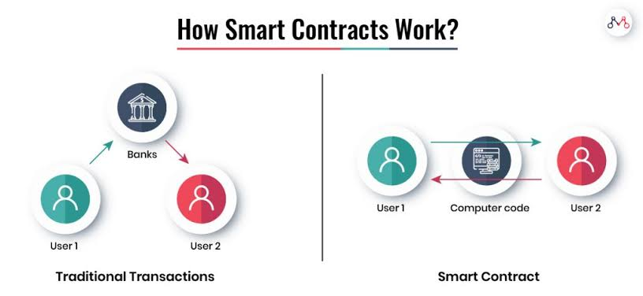

Slide 8
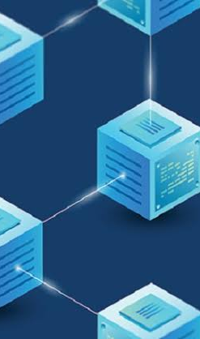
BLOCKCHAIN
Block chain is cryptograhically based distributed database. It forms transactional data into blocks withing a certain period of time and then connect these blocks to form a chain structure.

Slide 9
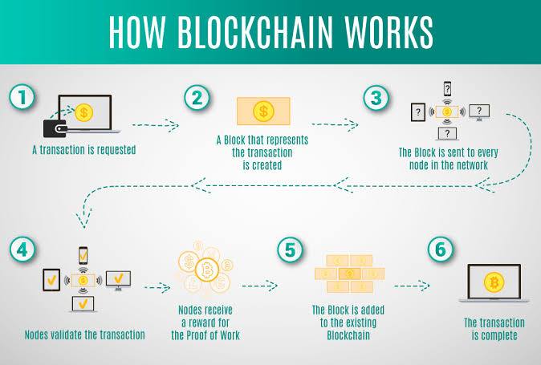

Slide 10
OUR NETWORK
Banking and other financial services
Lender
OTM
(smart contract and block chain technology)
Assets in VGG token and naira
Borrower

Slide 11
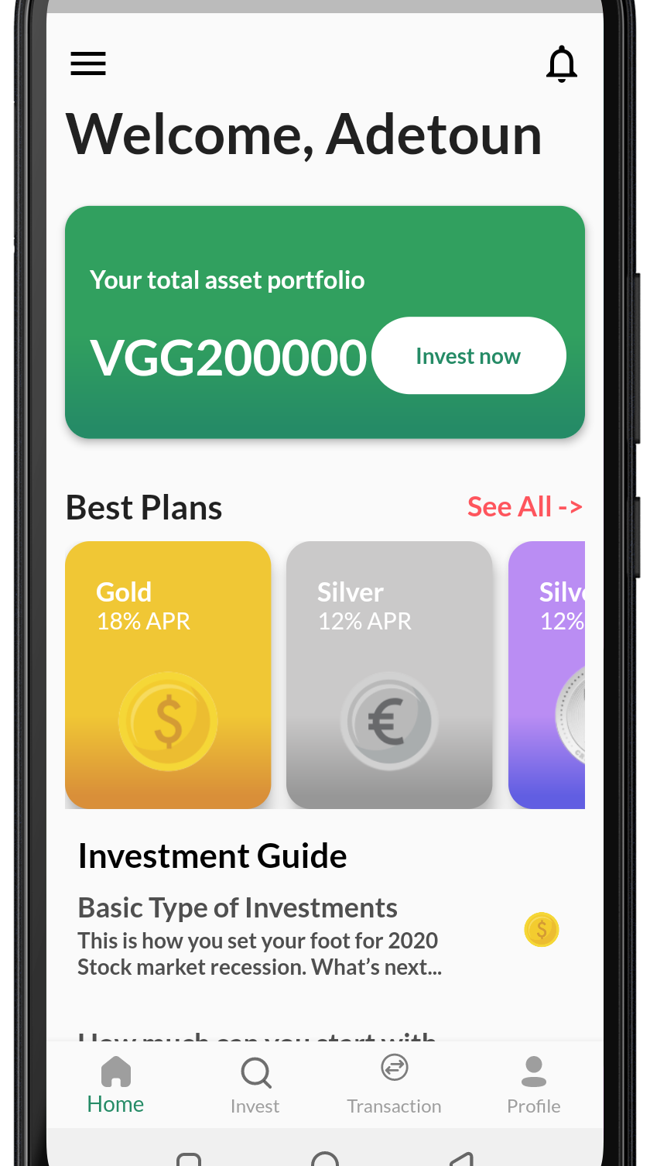
OTM
MOBILE
APP
REALIZATION
The mobile app was realized using flutter and dart programming language.
Flutter is Google's free and open source UI framework for creating native mobile application while dart is the programming language used to code flutter apps.

Slide 12
THE REALIZATION
Our system provides a faster banking through peer to peer model and easy access to loans and investments. A borrower in any part of the world can access the loan market and lenders can bid to deliver funds either using Naira or VGG on the OTM mobile platform.
By using blockchain technology and through the help of smart contracts, the lending process is made faster as all the terms and conditions and regulations of the loan has been encoded in the contract.

Slide 13
SYSTEM ALGORITHM FOR LOANS
People who are willing to borrow or lend open accounts on our OTM app
Assesment and validity of personal information is done and legal documents are provided
Once a loan is accepted, both parties establish the transaction on smart contract where all informations are encoded
Borrowers make interest payment through venture golden wallet

Slide 14
BETTER BANKING
The Mobile App has been designed to be user friendly. Sending and receiving of funds are faster and less expensive (with blockchain ) than with traditional systems.
With blockchain in OTM, users can choose how they identify themselves and with whom they agree to share their identity.
Auditors can automatically verify important data behind financial statements.
Transactions take place in real time so recipient don't have to wait for days before getting their money.

Slide 15
WHAT OUR SYSTEM OFFERS
Error free processing
Reduced transaction costs
Transparent auditing
Increased speed
Streamlined KYC process
Smooth transactions

Slide 16
CONCLUSION
OTM proposes a loan and banking platform based on smart contracts and blockchain, which digitizes traditional lending contracts and deploy them to the blockchain environment.
Our system achieved absolutely honest lending behavior and banking between users using the decentralization and non tamperable transaction of blockchain.

Slide 17
THANK YOU VGG!

Slide 18
REFERENCE
Croman, K., et al. On scaling decentralized blockchains. In:Clark, J., Meiklojohn, S., Ryan, P.Y.A, Wallachi, D., Brenner, M., Rohloff, K. (eds.) FC 2016. LNCS, volume. 9604, pp. 106-125. Springer, Heidelberg(2016).
Nakamoto, S.: Bitcoin: A peer-to-peer electronic cash system. Consulted 1-2 (2008).

