Slide 1

MOodak
Presented by :
Ahmed Abdel fatah
Engy El-Moshrify

Slide 2

Agenda
Introduction
Why Moodak !
What’s next ?!
Used Technologies
References

Slide 3
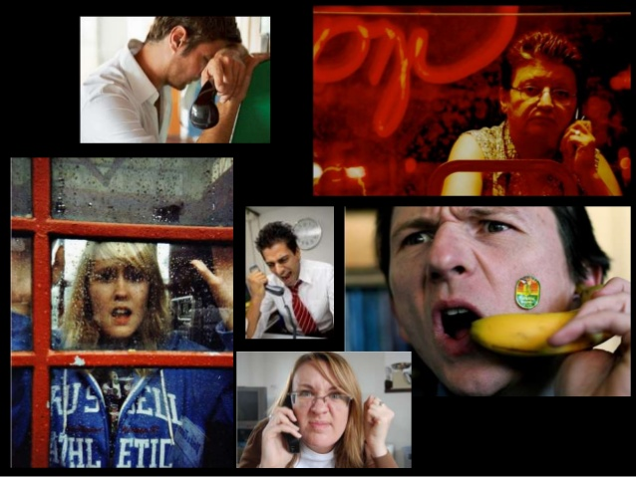
Introduction
Moodak is a desktop application used to detect user emotions by recording your voice for 3 seconds and get user emotions right now

Slide 4
Why Moodak !
Detection : detect your exact emotion out of three ones (Happy, Angry or Surprised).
Accuracy : Moodak accuracy is +90%
Usability : Its easy to use
Speed : process is done in less than 1 second.

Slide 5
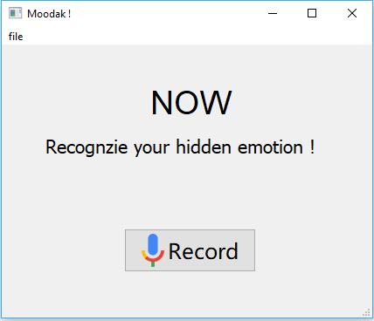
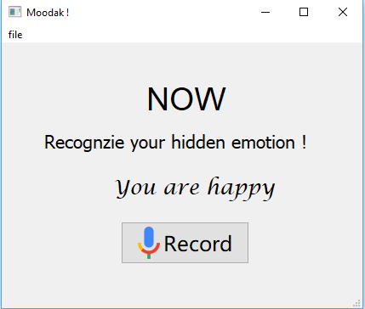
Screen shots
Processing ..

Slide 6
What’s Next ?!
Customization can be done to match your own voice, tone and frequency .. To be more accurate ;)
Real time streaming while recording.

Slide 7
Used Technologies
Language : Python 3
Tools :Jupterlap , QT5,Anaconda
Libraries : librosa , glob , numpy , sklearn , soundfile, Sounddevice
Algorithm : MLPClassifier

Slide 8
References
https://librosa.github.io/librosa/
https://librosa.github.io/librosa/generated/librosa.feature.melspectrogram.html
https://doc.qt.io/qtforpython/
https://www.geeksforgeeks.org/saving-a-machine-learning-model/

