Slide 1

Exploratory Data Analysis
G2M Case Study of Two Cab Companies
26th June, 2021

Slide 2
Go-2-Market Cab Company Case Study
A private equity firm (XYZ) in the US is planning an investment in the Cab industry. Due to the growth and the multiple key players in the industry, XYZ would like to have a better understanding of the profitability of two possible Cab companies (‘Yellow’ and ‘Pink’) in order to more accurately invest their funds.
Our objective is to provide some actionable insights to help XYZ equity firm in their investment decision.
First we will load and understand the datasets provided.
Then we will analyze certain features based on assumptions we make.
Finally, based on our findings we will recommend the better Cab company for future investment.

Slide 3
Dataset Exploration
We have been provided with 4 .csv file datasets (Cab_Data, Transaction_ID, Customer_ID, City) which will make up our master dataset of 355.032 rows and 18 features.
Time frame of data points is from 2016-21-31 until 2018-12-31.
No outliers are considered and no missing data was found.

Slide 4
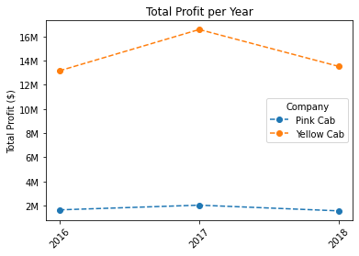
Profit Analysis
Yellow Cab company has almost 10 times as much yearly profit as Pink Cab company.
We can also see that both companies had increase in their profits from 2016 to 2017 and a loss from 2017 to 2018 with similar percentages.

Slide 5
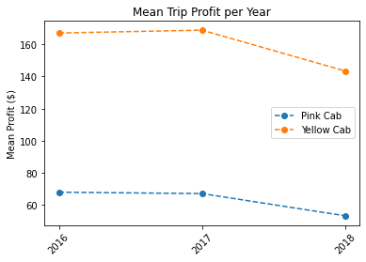
Mean Trip Profit by year for the two companies
There is about 100 $ difference in the means of the two companies each year, where Yellow company is more profitable than Pink company.

Slide 6
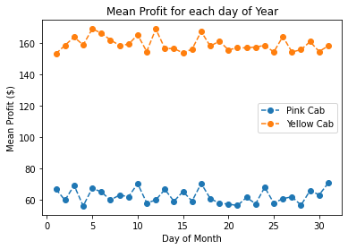
Mean Profit for each day of the month
We can see that the result from the previous plot is also found here, where the mean trip profit of the Yellow company is greater than that of the Pink company.
There appears to be seasonality in the profit lines of the two companies.

Slide 7
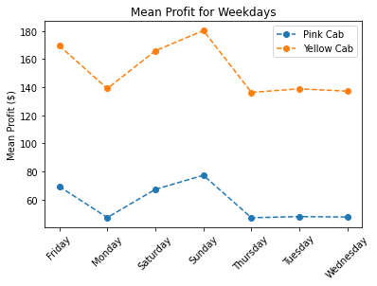
Mean Trip Profit for each day of the week
We can confirm the seasonality in the profit lines that we observed before.
Sundays, Fridays and then Saturdays seem to be the most profitable days of the week for both companies.

Slide 8
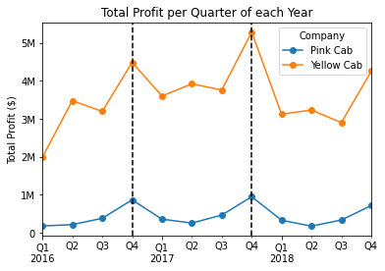
Total profit per yearly Quarter
We can also observe seasonality in the quarters, with the 4th quarter being the most profitable for both companies in each year.

Slide 9
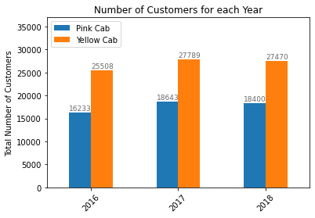
Analysis of Customers
Yellow company has more customers each year than Pink company.

Slide 10
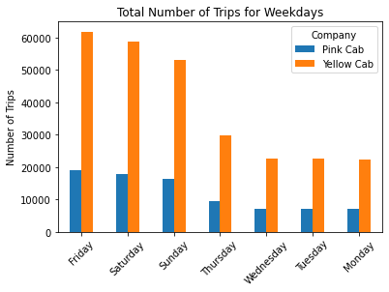
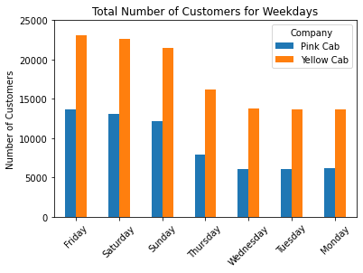
Customers and Trips for each day of the week
We can see that there is a bigger difference in the number of trips that the customers of the two companies make, than the difference of the total number of customers.

Slide 11
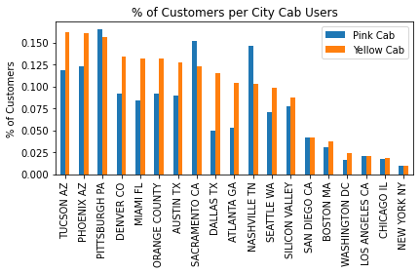
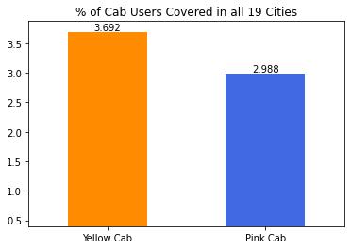
Percentage of Customers per City
We can see that Yellow company has greater customer reach than Pink company overall, as well as in most cities, except San Diego CA, Sacramento CA, Pittsburgh PA and Nashville TN.

Slide 12
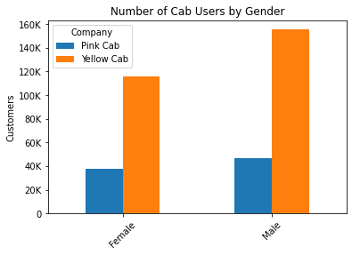
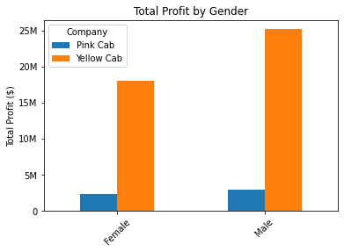
Analysis by Gender
There are 153.074 female and 201.958 male customers and we can see that most customers are male and so, most of the profit generated is from male customers.

Slide 13
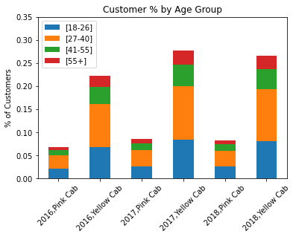
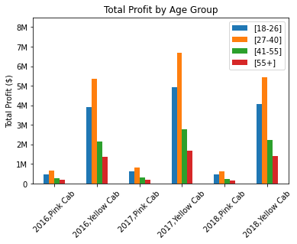
Analysis by Customer Age Group
The age groups with most customers and generating the most profit for both companies are [27-40] and [18-26]

Slide 14
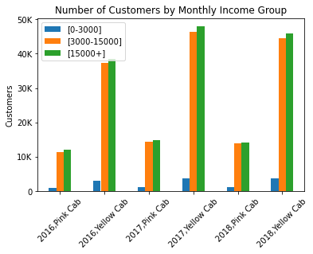
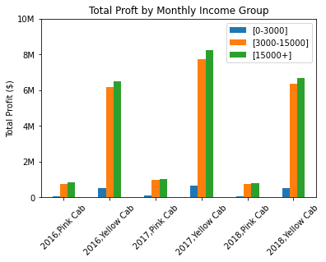
Analysis by Income Group
The income groups with most customers and generating the most profit for both companies are [3000$-15000$] and [15000+,]

Slide 15
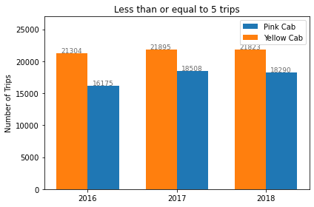
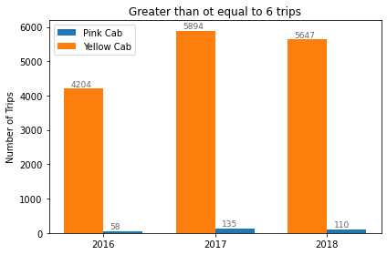
Customer Retention Analysis
We calculate the number of customers using the same company for multiple trips for the 3 years. We consider those with [1-5] trips and [6+,] trips. There are similar results in the first group, but there is a very big difference in the second group, with Yellow company faring much better than Pink company.

Slide 16
Final Recommendations
We provide below what we consider the most important points to take into account when making the investment decision.
Profit: Yellow company is more profitable than Pink company. Both in total Profit (almost 10 times higher) and in mean trip Profit (almost 100$ more) considering all of the 3 years that span our dataset.
Customers: Yellow company has more customers than Pink company in 15 out of the 19 cities. But a very big difference between the two companies lies in the number of trips their customers are willing to make, where Yellow company is in a much better position than Pink company in both the groups we considered [1-5] and [6+,] trips.
Age and Income Groups: The age groups generating most of the profit are [18-26] and [27-40] for both companies. The income groups are [3000-15000] and [15000+,]. Yellow company is in a better position than Pink in all these groups.
According to all the above we can recommend Yellow company as a better possible investment than Pink company

Slide 17

Thank You

