Slide 1

Data Science Project
ABC Pharma Case Study of Drug Persistency
15th August, 2021

Slide 2
Drug Persistence Case Study
One of the challenges for all Pharmaceutical companies is to understand the persistence of a drug as per the physician’s prescription.
Medical Persistence refers to the act of continuing the treatment for the prescribed duration, or the duration of time from initiation to discontinuation of therapy.
Numerous studies have demonstrated that inadequate compliance and non persistence with prescribed medication regimens result in increased morbidity and mortality from a wide variety of illnesses, as well as increased healthcare costs.
This source of wasted healthcare spending every year had an estimate in the US of the potential to reach even $300 billion, while also affecting pharmaceutical companies.

Slide 3
Drug Persistence Case Study
A lot of factors could contribute to a patient stopping, or altering their medication regimen, to name a couple:
Competing priorities for patients: their lifestyle, their finances as well as emotional factors “Will the medicine make them feel sick?”, “Will it be a daily reminder of their illness?”
Competing priorities for doctors, such as lack of time to properly talk with the patients and explain them their situation and the need for medicatio. At times, less than a minute is given to the “what and why” about prescribed medication therapies, including side effects. Failure to adequately explain what the medication is and why it is important is a massive barrier to persistence.

Slide 4
ABC Pharma’s Case and Dataset
Our particular case involves patients treated for an affliction which originates from a family of common organisms found in water and soil, which is Nontuberculous Mycobacterial.
It is a rare affliction and can affect people with damaged lungs, or with a weakened immune system.
If diagnosed, a patient might need up to two years of treatment and could get infected again in the future.
This makes it very important for patients to remain persistent with their medication, since therapy could take a long time.

Slide 5
ABC Pharma’s Case and Dataset
The dataset provided to us had 3424 patients with 67 features for each patient. The features could be grouped in four buckets:
Demographics: such as Age, Race, Gender, etc. for each patient.
Provider Attributes: some information about the provider that prescribed the medication to the patient, with variables such as the Specialty of the Physician.
Clinical Factors: certain physiological attributes which could be associated with the disease, with variables such as Frequency of a Dexa Scan.
Disease/Treatment Factors: such as a Comorbidity factor, divided into two categories – Acute and Chronic and a Concomitancy factor, i.e. concomitant drugs recorded prior to starting with the therapy.

Slide 6
Dataset Exploration
Out of the 67 features, only 2 can be considered numerical, the rest are categorical, such as Race, or Physician’s Speciality.
Out of the 2 numerical, 1 is removed ‘Count of Risks’, since it is a linear combination of all other Risk Factors.
No missing values were found (NAs) but 5 features had ‘Unknown’ categories, which were considered as missing.
One of these 5 was removed, as over 65% of its data points were missing, the other variables’ values imputed from all other features of the dataset.

Slide 7
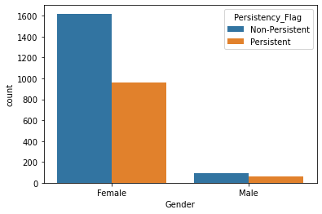
Demographics Analysis
The overwhelming majority of patients were women, 95.3%. Could be due to the fact that this affliction tends to affect women more frequently.
Both gender appear to have more Non-Persistent cases, than Persistent ones.

Slide 8
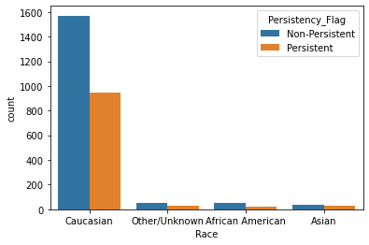
Demographics Analysis
Most of the patients, 91.75%, were Caucasian in Race, followed by Other, then African American and then Asian.
Again, in all categories, we have more Non Persistent than Persistent cases.

Slide 9
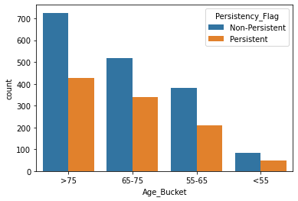
Demographics Analysis
The largerst percentage of patients belongs to the [>75] years of age bucket, with 42.17%, followed by the [65-75] bucket with 31.4%.
Then [55-65] with 21.58% and [<55] years old with 4.9%.
This categorisation seems to represent the population, as NTM tends to affect older people more.

Slide 10
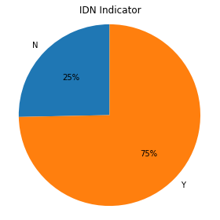
Demographics Analysis
This is the percentage of patients that were mapped to an Integrated Delivery Network (IDN), at 75%.
An estimation of 76% of patients in the US are mapped to an IDN, so our dataset seems to follow that trend.

Slide 11
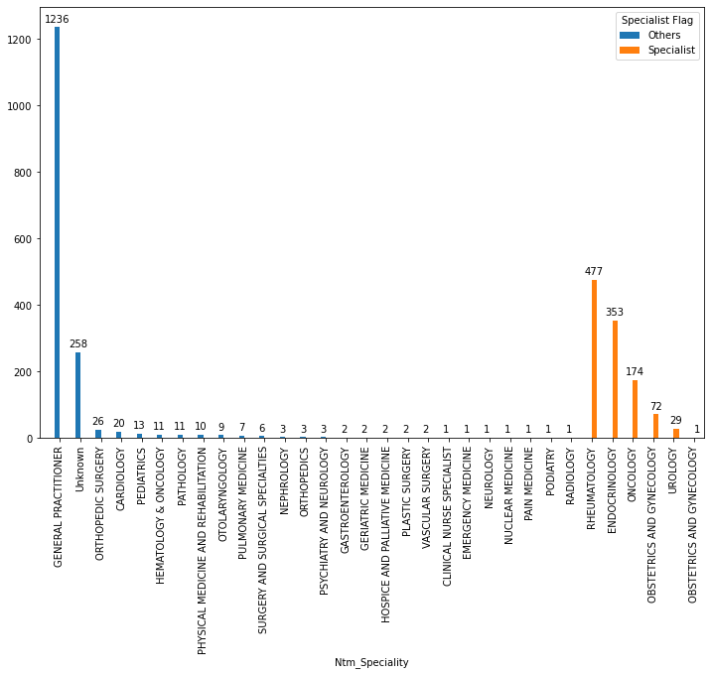
Physician Attributes
There are 1106 Specialists in total and 1633 Others.
Almost half of all our patients, 45%, received their prescription from a General Practitioner. This could indicate how people are being informed on whether they have the NTM infection or not, and how they are then given treatment.
There are 258 Unknown values, which will be imputed from the rest of the categories.

Slide 12
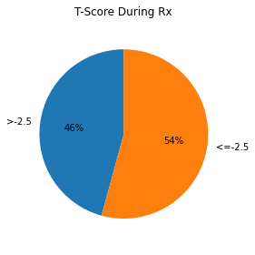
Clinical Factors Analysis
A T-Score is produced from a bone densitometry scan (DEXA) and it determines bone mineral density. These values are during the patients’ treatment period.
Values below -2.5 indicate presence of osteoporosis, while values above -2.5 indicate low bone density.
T-Scores before and during treatment for NTM showed an 88% of ‘No Change’.

Slide 13
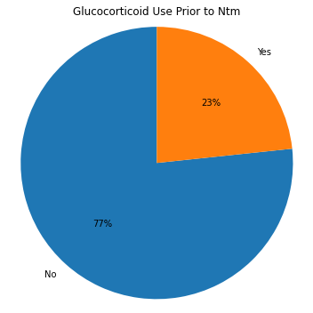
Clinical Factors Analysis
Glucocorticoids are powerful medicines that fight inflammation and work with the patient’s immune system to treat a wide range of health problems.
We can see that most patients, 77%, did not use any Glucocorticoids before their treatment and a similar picture could be seen during their treatment, with 74%.

Slide 14
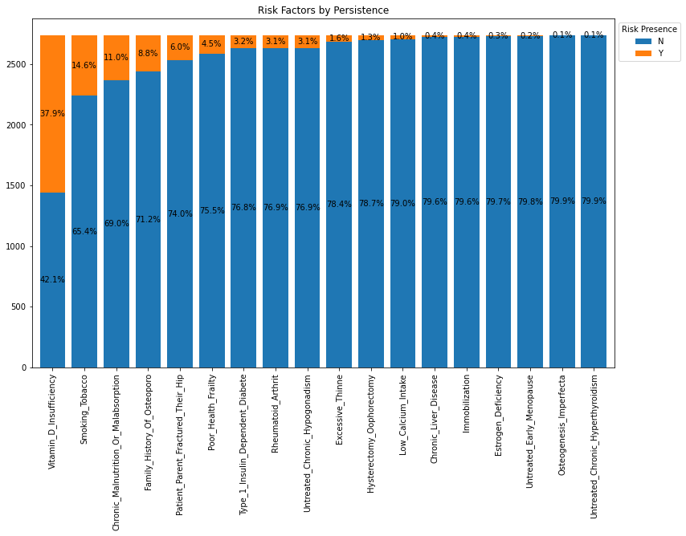
Disease / Treatment Factors
Almost for each Risk Factor presence, patients were Non Persistent.
An exception is seen where 37.9% of patients with ‘Vitamin D Insufficiency’ were Persistent.
Followed by 14.5% by those who smoke tobacco.

Slide 15
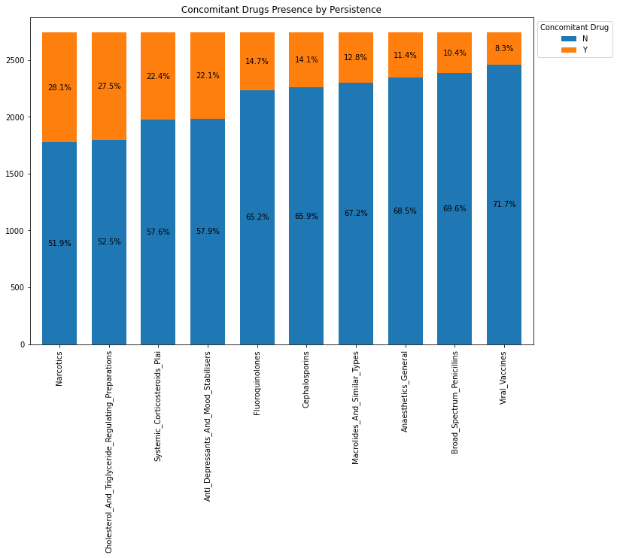
Disease / Treatment Factors
Concomitant drugs are two or more drugs used/given within 365 days prior to 1st prescription date.
The cases with Concomitant drugs and highest patient Persistence were for various ‘Narcotics’, ‘Cholesterol Regulators’, ‘Systemic Corticosteroids’ and ‘Anti Depressants’.

Slide 16
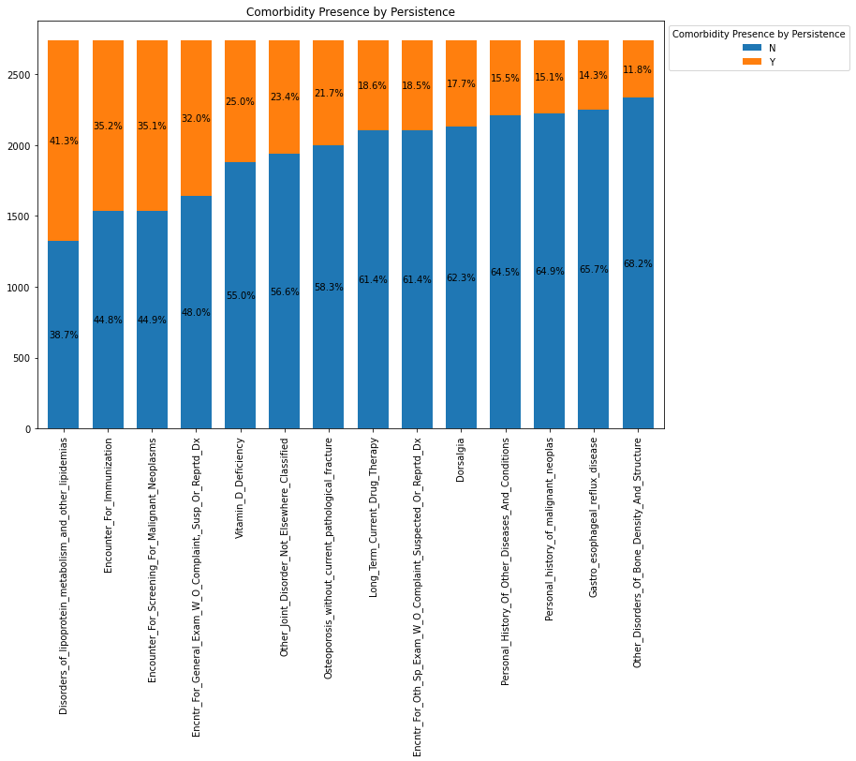
Disease / Treatment Factors
Comorbidity is the presence of one or more additional conditions, often co-occurring, with a primary condition.
Patients with ‘Lipoprotein Metabolism Disorder’ tend to be more Persistent, with 41%.

Slide 17
Univariate Relationships
Variable | pvalue
Gender | 0.426
Age_Bucket | 0.416
Gluco_Record_Prior_Ntm | 1.0
Frag_Frac_Prior_Ntm | 0.845
Risk_Segment_Prior_Ntm | 0.618
. . . | . . .
Risk_Hysterectomy | 0.408
Risk_Estrogen_Deficiency | 0.548
Risk_Recurring_Falls | 0.699
Race | 0.420
Ethnicity | 0.463
One-on-One relationships of variables considered to be independent from our target variable, ‘Persistence’. In total there are 20 such variables.
Pvalues are between 0 and 1, and anything above 0.05 indicates an independent relationship.
13 out of 19 Risk variables were on this table.

Slide 18
EDA Results
Following the Exploratory Data Analysis (EDA) we have noted:
The majority of patients were Non Persistent than Persistent, about 63%.
Most patients are Caucasian Females, over the ages of 65 and come from either the Midwest of South regions of the US.
Almost half of all the patients, received their prescription from a General Practitioner.
From the Persistent patients, there are people with high Vitamin D Defficiency, some with Lipoprotein Metabolism Disorder, Malignant Neoplasms.
When it comes to one-on-one relationships with our target variable, almost all Risk Factors seem to be independent from it.

Slide 19
Recommendations
Further analysis of all/almost all predictors and our target variable should be done in order to determine whether or not they can affect it.
This can be achieved through Machine Learning (ML) models that will classify each data point according to the predictors’ values.
Some ML model could be Logistic Regression Classification, Trees Classification and ensemble methods, such as AdaBoost.

Slide 20
Feature Selection
In this part of the analysis the features that seemed most important in the training of our model on the ‘Train’ dataset were chosen.
An 87% accuracy was achieved with 31 features.
An 86% accuracy was achieved with 20 features.
We choose the 31 features since there is not much difference in computational speed.

Slide 21
Feature Selection
Feature
Whether or not patient had a Dexa Scan during Rx
Comorbidity of Bone Density Disorders
Comorbidity for Malignant Neoplasms
Concomitancy of Fluoroquinolones
Physician Speciality_Oncology
Comorbidity of Long Term Drug Therapy
Comorbidity of Systemic Corticosteoids Plain
Dexa Scan Frequency During Rx
Gluco Record During Rx
Concomitancy of Narcotics
Comorbidity of Vitamin D Defficiency
Some of the features chosen are presented here.
Dexa Scans are important features.
Some comorbidities and concomitancies as well.
As far as Risk factors are concerned, none were picked up as features.

Slide 22
Machine Learning Models Results
Classification Method | Accuracy | Precision | AUC
Logistic Regression | 80.44 | 80.57 | 88.55
RandomForest | 81.31 | 81.26 | 88.44
K Nearest Neighbors | 81.31 | 81.47 | 88.18
Gradient Boosting | 84.10 | 84.00 | 90.05
ExtraTrees | 80.09 | 80.08 | 87.40
The Gradient Boosting ensemble method seems to be most accurate, with Random Forest following.
The resulting models do not differ by much, which can also be observed from their ROC curves plotted below.

Slide 23
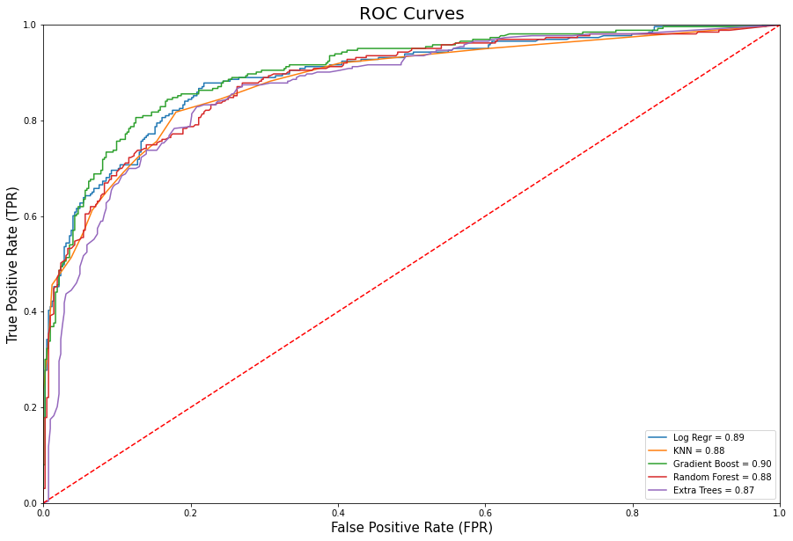
ROC Curves of ML Models

Slide 24

Thank You
Group Name: BetterHealth Analytics
Name: Enias Vontas Country: Greece Email: vondas100@gmail.com Specialization: Data Science

