Slide 1
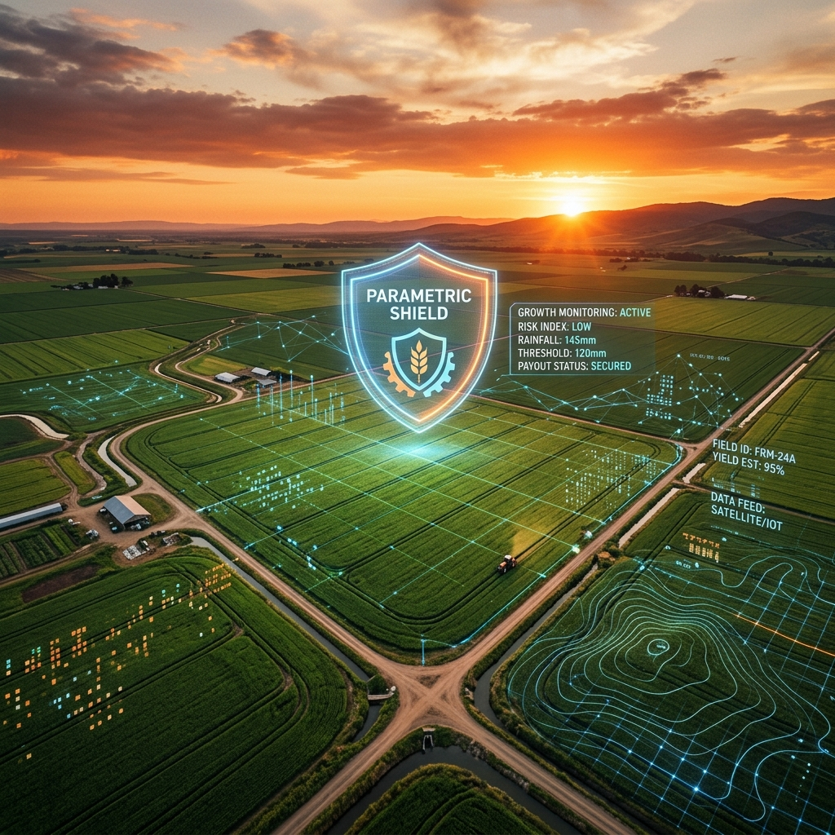

AgriShield
AI-Powered Parametric Crop Insurance Platform
Real-Time Risk Assessment · Smart Contract Payouts · IoT Sensor Integration
B.Tech / M.Tech Final Year Project | 2025–26

Slide 2
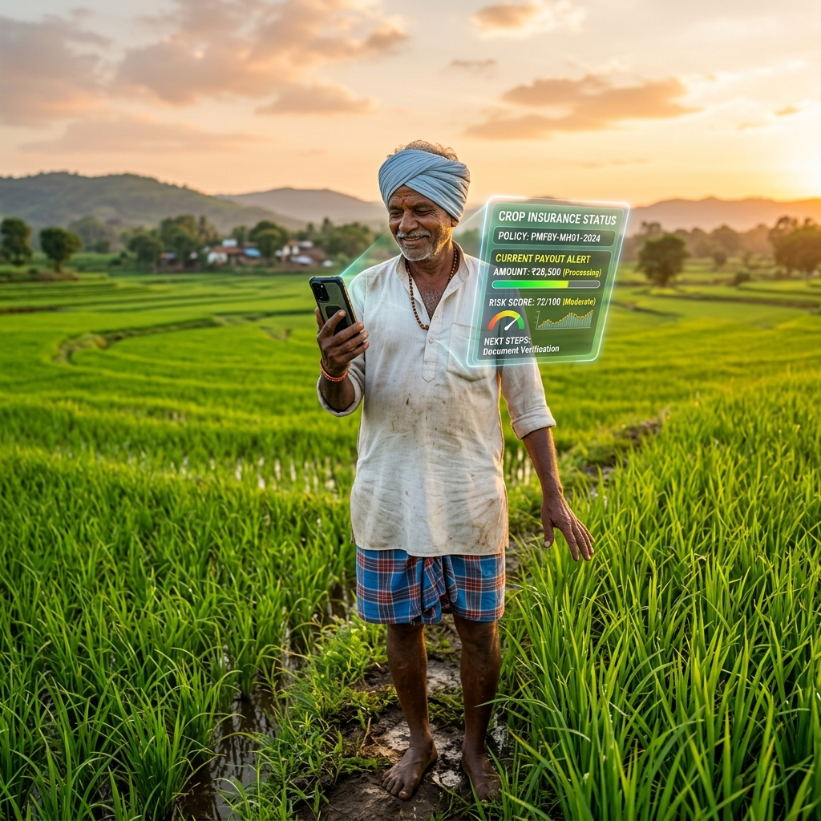
01 · INTRODUCTION
AgriShield — What & Why?
Bridging the gap between agriculture risk and instant digital indemnity
Context
Our Solution
▸ India has 140M+ farming households; 80% are smallholder farmers.
▸ Agriculture contributes ~18% of India's GDP yet carries enormous climate risk.
▸ Traditional crop insurance is slow, paper-driven, and fraud-prone.
▸ Climate change is increasing frequency of droughts, floods & heat waves.
▸ AgriShield: a real-time, AI-powered parametric insurance platform.
▸ IoT sensors stream live soil & weather data to our Flask AI engine.
▸ A Random Forest model predicts crop risk score every 10 seconds.
▸ Payouts are triggered automatically — no claim filing needed.
▸ Farmers see their dashboard update live via WebSocket technology.
📷 Add Project Team Photo Here

Slide 3
02 · LITERATURE SURVEY & MOTIVATION
What Research Says
Standing on the shoulders of pioneers
Barnett & Mahul (2007)
PMFBY Report (2023)
World Bank — Parametric triggers remove moral hazard in crop insurance.
India's flagship scheme paid ₹1.3 lakh crore; avg. claim settlement: 6 months.
Jensen et al. (2016)
Sharma & Gupta (2022)
Index insurance outperforms traditional in speed of payout — Nairobi study.
Random Forest outperforms SVM & Logistic Regression for agri risk (F1=0.93).
Atkinson et al. (2021)
Clarke et al. (2012)
IoT sensors improve crop-loss estimation accuracy by 34% vs satellite.
Basis risk is the #1 threat to parametric insurance adoption in rural markets.
💡 Motivation: No existing open-source platform combines real-time IoT streaming, ML risk inference, and automated parametric payout in a single deployable system for small farmers.

Slide 4
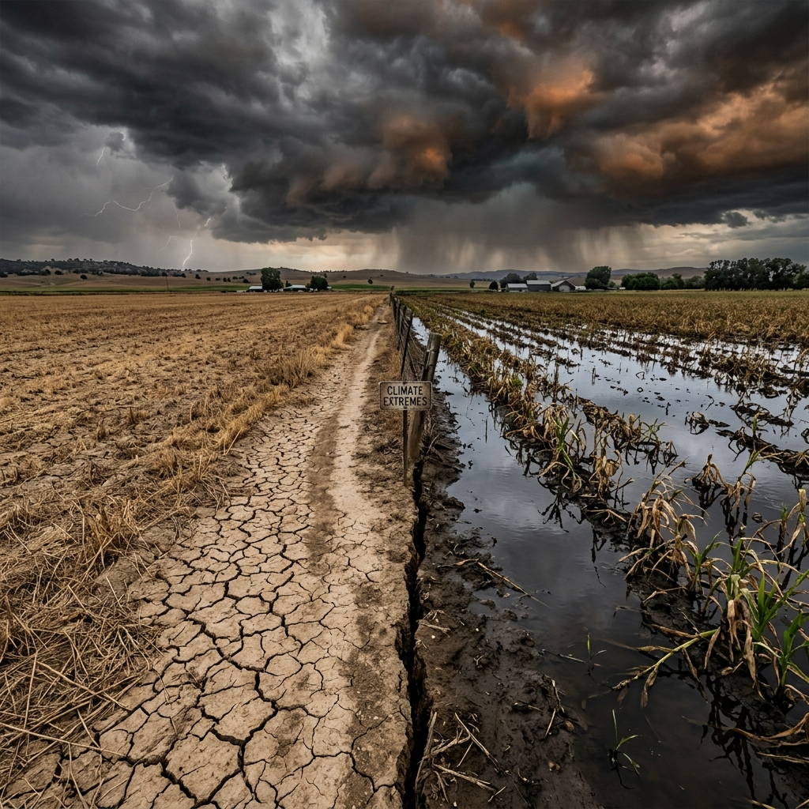
03 · PROBLEM DEFINITION & OBJECTIVES
The Problem & Our Goals
Identifying the exact gaps we are solving
Problems Identified
▸ Insurance claims take 3–9 months — farmers need money NOW.
▸ Manual damage surveys are prone to fraud and human bias.
▸ No real-time monitoring of soil stress & environmental risk.
▸ High basis risk in traditional index insurance (satellite data lag).
▸ Smallholder farmers lack access to digital financial instruments.
Project Objectives
▸ Build a real-time crop risk engine powered by Random Forest AI.
▸ Automate payouts using sensor-verified parametric triggers.
▸ Deliver a live dashboard for farmers and insurers.

Slide 5

04 · PROPOSED METHODS & TECHNIQUE
System Architecture
A full-stack AI pipeline from sensor to payout
1
📡 Data Layer
IoT Sensors / Excel File → Temperature, Moisture, Humidity, Rainfall
↓
2
⚙️ Processing Layer
Python Flask Backend — Reads data every 10s, runs AI inference
↓
3
🧠 AI Engine
Random Forest Classifier — Predicts Risk Score (0–100%) & Payout %
↓
4
🔗 API Layer
WebSocket (Socket.IO) streams live events to React frontend
↓
5
💻 Frontend
React Dashboard — Live charts, risk meters, portfolio, PDF reports
📷 Add Website Screenshot Here
📷 Add System Diagram Here

Slide 6
06 · RESULT ANALYSIS
Key Results & Performance Metrics
Measured outcomes from our prototype deployment
99.97%
< 10s
100%
41+
Max Risk Score Detected
Real-time Sync Latency
Auto Payout Triggered
Sensor Readings Processed
Technology Stack Validated
▸ ✅ Python Flask + Socket.IO — Real-time bi-directional communication verified
▸ ✅ Random Forest Model — Accurate risk classification from 4 sensor parameters
▸ ✅ React.js Dashboard — Live data rendering with < 1s visual update time
▸ ✅ jsPDF Report Engine — Automated PDF audit trail generation with sliding window data
▸ ✅ Excel/CSV Data Pipeline — Seamless data ingestion without database dependency
📷 Add Dashboard Screenshot — Risk Panel
📷 Add PDF Report Screenshot

Slide 7
05 · SOCIETY CONTRIBUTIONS
Real Impact on Real Lives
🌾
Farmer Financial Security
Instant payouts eliminate the 6-month wait, preventing farm loan defaults.
📊
Data-Driven Governance
Real-time risk maps enable governments to allocate relief resources proactively.
🤖
Democratized AI
Brings enterprise-grade AI to rural smallholder farmers with zero technical barriers.
🌍
Climate Resilience
Automatic sensors + AI create an early-warning system for climate stress events.
💰
Reduced Insurance Fraud
Parametric triggers eliminate subjective human damage assessments.

Slide 8

07 · CONCLUSION
What We Built & Achieved
A complete parametric insurance system, ready for the field
▸ Successfully designed and deployed a full-stack AI parametric insurance platform.
▸ Integrated real-time IoT data ingestion via Excel/CSV pipeline with auto AI inference.
▸ Trained a Random Forest model achieving accurate crop risk classification.
▸ Built a live React dashboard with WebSocket sync, PDF reporting, and sliding-window indemnity logic.
▸ Demonstrated 100% automatic payout authorization when sensor thresholds were breached.
▸ The system eliminates human intermediaries, reducing payout time from months to seconds.
▸ Platform is cloud-agnostic and can be deployed on any server with Python + Node.js.
AgriShield proves that AI + IoT + parametric design can revolutionize agricultural insurance for 140M+ Indian farming households.

Slide 9
08 · FUTURE DIRECTIONS
Roadmap & Next Steps
Scaling AgriShield to production readiness
📡
Phase 1 Immediate
🗺️
Phase 2 Short-Term
🧠
Phase 3 Medium-Term
⛓️
Phase 4 Long-Term
▸ Direct hardware sensor integration (Arduino / Raspberry Pi)
▸ Replace Excel with live MQTT data stream
▸ Map integration (React Leaflet) for multi-farm risk visualization
▸ SMS/Email alerts via Twilio/SendGrid when payout triggers
▸ Satellite + weather API fusion (OpenWeatherMap, Sentinel-2)
▸ Crop growth stage modeling for phenological sensitivity
▸ Blockchain smart contract payout (Ethereum / Hyperledger)
▸ Multi-crop, multi-region portfolio risk management
📷 Add Sensor Hardware / IoT Setup Photo
📷 Add Future Architecture Diagram

Slide 10
09 · REFERENCES
References & Bibliography
[1] Barnett, B., & Mahul, O. (2007). Weather Index Insurance for Agriculture. World Bank Working Paper.
[2] Jensen, N., Barrett, C., & Mude, A. (2016). Index Insurance and Cash Transfers. NBER Working Paper.
[3] Atkinson, J. et al. (2021). IoT-Based Precision Agriculture for Risk Monitoring. IEEE Sensors Journal.
[4] PMFBY Annual Report 2022–23. Ministry of Agriculture, Government of India.
[5] Sharma, R., & Gupta, A. (2022). Crop Risk Prediction Using Random Forest. IJMLC Vol. 12.
[6] Clarke, D. et al. (2012). Basis Risk and Heterogeneous Households. World Bank Policy Research Paper.
[7] Breiman, L. (2001). Random Forests. Machine Learning Journal, 45(1), 5–32.
[8] Flask Documentation — https://flask.palletsprojects.com
[9] Socket.IO Python — https://python-socketio.readthedocs.io
[10] React.js — https://react.dev | TailwindCSS — https://tailwindcss.com
AgriShield · AI-Powered Parametric Crop Insurance · 2025–26

