Slide 1
Data Visualization - HTML
Dr Douglas Kelly

Slide 2
Basic HTML
If plain text is placed into a html document, it can be displayed in a browser but it doesn’t change
Raw Text
Web Browser Display
Hello World!
Hello World!
Hello
World!
Hello World!
Browsers read the mark-up language and use his to render what you see on the screen
<p>Hello</p>
<p>World!</p>
Hello
World!
<p><b>Hello</b></p>
<p>World!</p>
Hello
World!
Notes:
Pure text is shown as plain text in the browser.
A browser takes plain text, parses it for special markup and displays it in the browser.
If the plain text has no markup, then the browser will just display it as plain text since there is nothing special about it..
If you put a new line/return statement, the browser remains the same because it is the markup language that controls how the text is displayed.
The solution to separating content and instructions is to enclose the instructions in <> or “tags”
By wrapping hello and world in paragraph tags, we can force different words or sentences onto different lines.
Words can be made bold by wrapping them in a bold element.

Slide 3
Basic HTML
HTML is used to structure content for web browsers
It consists of various tags used to mark-up content
The simplest HTML5 web page consists of the following:
The Doctype declaration tells the web browser which set of rules to apply when rendering the page
<!DOCTYPE html>
<html lang="en">
<head>
<title>Page Title</title>
<meta charset="utf-8" />
</head>
<body>
<!-- content goes here -->
</body>
</html>
The html tag indicates the text is encoded in HTML. The optional lang=“en” attribute indicates the content is in English
The head element contains information for the browser about the page and links to related documents
The meta tag explains that we are using “universal text format with each character represented by 8 bits
The body element contains the actual visible page content
This is where our data visualisations will go
Notes:
Earlier versions of HTML (pre HTML5) used document type definitions and were extremely complex
The HTML5 doctype declaration has been simplified
In early versions the doctype declaration refers to a DTD, because HTML 4.01 was based on SGML. The DTD specifies the rules for the markup language, so that the browsers render the content correctly. Html5 is not based on SGML and so it is no longer required

Slide 4
Basic HTML
A Tag is a key word surrounded by angular brackets
An Element is everything between a matching start and closing tag
<!DOCTYPE html>
<html lang="en">
<head>
<title>Page Title</title>
<meta charset="utf-8" />
</head>
<body>
<!-- content goes here -->
</body>
</html>
Tags generally come in pairs with an Opening and a Closing tag
Closing tags start with </
Open head tag
Close head tag
Everything from the opening tag to the closing tag including the tags itself is referred to as an element
This region is the body element
Close html tag
Notes:
HTML is simply a Mark-up Language.
A mark-up language doesn’t manipulate information it simply presents it in some form.
This means it has to be combined with other technologies if dynamic content is required.
HTML is the main mark-up language for creating web pages and other information that can be displayed in a web browser.
HTML is written in the form of HTML Elements consisting of tags enclosed in angle brackets.
HTML tags are generally paired (open and closed) although some tags, known as Empty Elements are unpaired
HTML documents are just text documents that contain special mark-up tags that define formatting instructions along with the text that is to be displayed in the web page in a web browser.
Tags are enclosed in opening and closing brackets (<> </>).
The purpose of a web browser is receive and render HTML documents to the end user that requested them.
The browser does not display the HTML tags, but uses the tags to interpret the content of the page and display it as intended by the creator.
Websites made up entirely of HTML pages with no user interactivity other than classic hypertext links are referred to as static websites.
Although the technology to create dynamic websites is now widely available and relatively easy to use, many web pages are still static.

Slide 5
Basic HTML
The basic HTML page
<!DOCTYPE html>
<html>
<head>
<title>A Mandatory Title</title>
<!-- Page Links are added here -->
</head>
<body>
<!-- Page Content is added here -->
</body>
</html>
It is important to specify the HTML5 DOCTYPE as this is necessary for many of the HTML elements used for Data Visualisation

Slide 6

HTML Nesting Elements
HTML documents are built up by nesting elements
Creating a page requires combining elements and attributes
Nesting is the process of placing one element inside of another
The outside element is called the parent and the inner the child
<p>I do <strong>love</strong> little kittens</p>
Child element
Parent element
I do love little kittens
7

Slide 7

HTML Formatting
Note that excessive white space is ignored
A single white space between elements/content has meaning
Multiple white spaces do not – they are equals to 1 space
Line breaks are ignored – use to improve readability of nested elements
<p>
I do
<strong>love</strong>
little kittens
</p>
<p>I do <strong>love</strong> little kittens</p>
I do love little kittens
8
Notes:
Note here that adding lots of white space does nothing other than to improve readability.
Line breaks are also the same – use them to improve readability, but it does nothing to the final rendered output

Slide 8
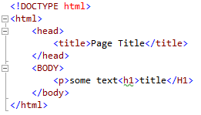
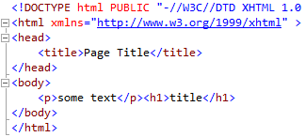
HTML5 and XHTML5
HTML5 vs XHTML5
XHTML (Extensible-HTML) is more restrictive
Validated using XML rules:
All tags are lower case
All tags must be closed/self closing and
All elements must be nested properly
All attributes must have a value
They are just different standards that validate against different rules.
Even when using HTML5 it is best to use XHTML best practices
Valid sloppy HTML
Equivalent well formed XHTML
6

Slide 9
HTML Terminology
Terminology and Syntax

Slide 10
HTML Basics - Terminology
HTML elements can contain more html elements or text
HTML start tags can contain attributes
innerText
<a href="http://www.unisa.edu.au"><em>UniSA</em></a>
Start Tag
Attribute
Value
Element
End Tag
Element
10

Slide 11
HTML Basics - Attributes
A HTML start tag can contain attributes
Name-value pairs that modify or describe a HTML element
Each element has a specific list of attributes that can be used with it
Some attributes are global and can be used on any element
style, title, class, id, data-
Others are tag specific (src, href, height, width etc)
Attributes are only ever applied to the start tag
11

Slide 12
HTML Basics - Attributes
Example attributes:
id attribute to identify a specific element
<h1 id="secificHeading">A specific Heading</h1>
style attribute
<p style="color:red;">some red text</p>
title attribute
<p title="some tool tip text!">text with a tooltip</p>
class attribute
<p class="series1">some text</p>
The class name refers to a class in a style sheet
Used to group elements together
12

Slide 13
HTML Attributes
Class names can appear on many elements
This includes elements of different types
A class attribute can have more than one name separated by a space
It is often used to style elements a certain way or to logically group elements
An ID name can appear on only once on a given page
<div class="link">
<a class="link selected" id="link1" href="www.unisa.edu.au">UniSA</a>
<a class="link" id="link2" href="www.news.com.au">News</a>
<div>
Unique ID names
Reused class names
13

Slide 14
HTML Basics - Terminology
Empty Tags
An empty tag is one that is self closing (in strict HTML/XHTML)
<img /> <br /> <hr /> <input />
An empty tag is also by definition, an element
In HTML empty tags can be left open
<img alt=“”> OR <img alt=“” /> is acceptable
<br> or <br />, <hr> or <hr />
14

Slide 15
Basic HTML Elements
A List of common elements you should know
Type | Element/Tag | Name | Example
Block | <h1> to <h6> | heading 1 to 6 | <h1>Heading 1 Example</h1> <h6>Heading 6 Example</h6>
 | <div> | division | <div>other html</div>
 | <p></p> | paragraph | <p>Your paragraph text </p>
 | <figure></figure> | Figure | <figure> image or vector graphic <figcaption>Image Description</figcaption> </figure>
 | <figcaption>… </figcaption> | Figure caption
<!-- comment --> | comment tag | Non executable text (not rendered by web browser)
15

Slide 16
Basic HTML Elements
A List of common elements you should know
Type | Element/Tag | Name | Example
Inline | <span></span> | span | <span>some text</span>
 | <a></a> | anchor | <a href="http://www.yourdomain.com/[yourfile.html]">Link</a>
 | <b></b> | bold | <b>Bold Type</b>
 | <i></i> or em | Italic/emphasis | <i>Some italic text</i> or <em>Some emphasised text</em>
Empty | <br /> | line break | <p>some text <br /> new line of text in same paragraph.</p>
 | <hr /> | horizontal rule | <p>some text</p><hr />
 | <img /> | image | <img src=“images/smile.jpg height=“10” width=“20” alt=“be happy” />
 | These must be self closing in XHTML but can be left open in HTML. HTML allows <hr> , <br> and <img src=“….jpg” alt=“xx”> (all left open) XHTML allows <hr/>,<br /> and <img src=… /> (all self closing)
16

Slide 17
Basic HTML Elements
A List of common elements you should know
Type | Element/Tag | Name | Example
Table | <table> | Table element | <table> <thead> <tr> <th>col heading</th><th>col heading</th> </tr> </thead> <tbody> <tr> <td>data 1</td><td>data 2</td> </tr> <tr> <td>data 1</td><td>data 2</td> </tr> </tbody> </table>
 | <thead> | Header group
 | <tbody> | Body
 | <tfoot> | Footer
 | <tr> | Table Row
 | <th> | Heading Cell
 | <td> | Data Cell
17

Slide 18
Styling HTML
Cascading style Sheets - CSS

Slide 19
Overview – Cascading Style Sheets
CSS was introduced to separate html content from presentation
CSS = Cascading Style sheets
It is used to specify the layout of HTML pages
Leaving HTML for marking up content only
Allows presentation of the HTML to be tailored to different devices
Many formatting elements were removed from HTML5 to ensure more consistent performance
<font><center>
Any tags that modify appearance/location on the HTML page
Improves compatibility across web browsing devices
19
Notes:
The introduction of CSS is one of the major contributing factors to a number of deprecated elements. These elements were generally to “style” some text (eg centre the text, change the font size and so on). CSS is now used for this purpose and allows all the rules to be separated from the html mark-up and content.

Slide 20
Overview – Cascading Style Sheets
There are three methods for styling HTML documents:
Inline
Uses the style attribute in a HTML start tag: <p style="color:darkred"></p>
Embedded/Internal
Uses a <style> element in the <head> element of a HTML document
External
Uses a link to an external CSS file in the <head> element of a HTML document
The same rules apply regardless of the approach
Like HTML, CSS errors show as…nothing, no result…no change
Wrong properties, values and syntax will not style a HTML element no matter how hard you try…
20

Slide 21

Inline Styles
Inline style sheets apply to the content of a single HTML element
useful for one-off styling tasks where a unique style is to be applied to one single occurrence of an element:
Inline CSS styles override all other forms of CSS styling
If overused can complicate the ability to achieve consistent appearance
Avoid using them except for testing or data-specific styling
21

Slide 22
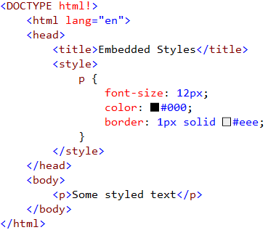
Embedded Styles
Embedded style sheets apply to a single HTML page
Used to style elements within a whole page independently of other pages
Embedded Styles
22

Slide 23

External Styles
External style sheets contain style rules in a separate linked file
They can be applied to one or more HTML documents that link them
Best for a consistent appearance across an entire website
Easy to update the appearance of an entire website as changes in an external style sheet propagate across all pages that use it
Style link inside head
23
Notes:
This is what you will be using to style your entire website as it provides the best separation between presentation and information

Slide 24
CSS Selectors
Styling Elements in a page

Slide 25

CSS Rule Sets
Selector
Style Declaration
Declaration Block
Value
Property
Rule Set = Selector + Declaration Block
CSS styles are created from a property and a value
These form the style declaration and determine the appearance of the appearance
25
Notes:
Note the syntax here.
The Selector identifies the elements within a html page that will be formatted by the rule
The Declaration block tells the browser the rules for rendering that element
The Property defines what it is about the element you intend to modify/style
The Value defines the exact style you wish to implement for the chosen property
In Style declarations, properties are not assigned a value using an equals sign but a colon.
Selectors may be simple html tags (h1) or a based on nested elements and other attributes (class, id)
Properties and values can also be complex (border assigns 3 values in one line)

Slide 26
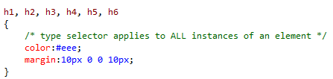
CSS Selectors - Type
Type selector
HTML Element
Applies to all instances of a specific HTML element
26

Slide 27
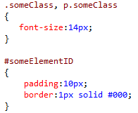
CSS Selectors - ID
ID selector
#idName
Specifies a style for a single, unique element (<p id="someElementID"></p>)
27

Slide 28


CSS Selectors - Class
Class selector
.className (which is really *.className)
Specifies a style for a group of elements (any type) that have the same class name
Note here that the selector “.someClass” would affect both the div and p element text
28
Notes:
Note that class selectors are still technically type selectors.
.someClass is the same as the specific class selector: *.someClass

Slide 29
CSS Selectors – Specific Class
Specific class selector
HTMLtypeSelector.className
Specifies a style for a specific type of elements that have the same class name
Note here that the selector “p.someClass” would affect only the p element with the matching class name
29
Notes:
Note that class selectors are still technically type selectors.
.someClass is the same as the specific class selector: *.someClass

Slide 30

CSS Selectors - Combination
Combination selector
selector1, selector2 … selectorn
Specifies a style for a number of elements that match given selectors
Can include ID, class, type or any other selector
Note here that the selector covers all elements shown
30
Notes:
Note that class selectors are still technically type selectors.
.someClass is the same as the specific class selector: *.someClass

Slide 31
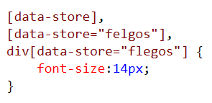

CSS Selectors - Attributes
Attribute selector
[attribute]
[attribute="value"]
Specifies a style for an element with a specific attribute and/or attribute value
31
Notes:
Note that class selectors are still technically type selectors.
.someClass is the same as the specific class selector: *.someClass

Slide 32


CSS Selectors - Descendants
Descendent selector
selector1 selector2
Specifies a style for an element that is a child/descendent of another element
Selectively styles nested elements
32
Notes:
Note that class selectors are still technically type selectors.
.someClass is the same as the specific class selector: *.someClass

Slide 33
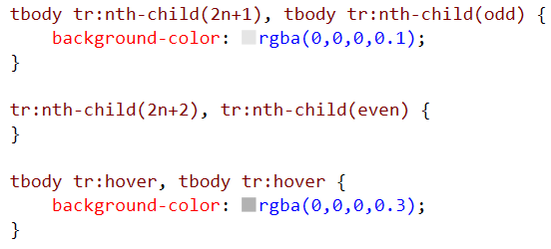
CSS Selectors - Descendants
Pseudo selectors
:condition
Specifies a style for an element in response to a condition
:hover Selectively styles elements on mouse over
:nth-child(2n+1|odd) Selectively styles every odd/even element
32
Notes:
Note that class selectors are still technically type selectors.
.someClass is the same as the specific class selector: *.someClass

Slide 34
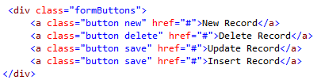
CSS Selectors
Class is an attribute of all HTML elements
HTML elements may be assigned more than one class (class stacking)
New Record
New Record
Delete Record
On Mouse Hover
Delete Record
Update Record
Update Record
Insert Record
Insert Record
In this example the “button” class creates the default appearance of each button
The second className then specifies the unique style for each button
33

Slide 35
CSS Properties

Slide 36
CSS Properties - Shorthand's
color and background-color
Effects Forecolour (font) and background respectively
Can use basic names, HEX, RGB, RGBA, HSL
Use the 6 or 3 digit HEX colour code in preference to other formats or the pre-defined names like red, aqua, yellow etc
#ff0000 and #f00 are the same
#cc6699 and #c69 are the same
rgb(255,0,0) or rgba(255,0,0,1)
red
hsl(100,100%,10%)
Remember for data visualizations to be colour blind aware
36
Notes:
The age of 256 “web safe colours” has been over for years so make use of your 16,777,216 colour choices…

Slide 37
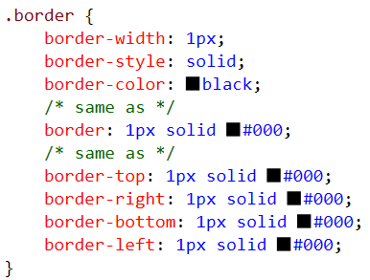
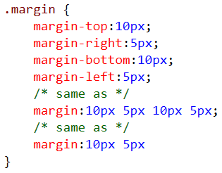
CSS Properties – Box Model
Padding, borders, margins
margin is the invisible space outside of the element
padding is the space inside the element
border is the line around the padded element
All have long and shorthand notations:
margin
border
Padding
Element <p>some text</p>
CSS margin|padding shorthand:
individually
[top][Right][Bottom][Left]
[top&bottom] [left&right]
[all] - If all values are the same then just specify the one number
37
Notes:
The age of 256 “web safe colours” has been over for years so make use of your 16,777,216 colour choices…

Slide 38
CSS Properties - Lengths and Percentages
Used for many CSS property values like font-size, width height and other equivalent CSS properties
px is the unit for pixels (screen pixel)
font-size: 12px; (similar to font size in MS Word)
width: 500px
em is the unit for making the size proportional to the current element size
font-size:1.6em; (1.6x current font size/60% larger)
% is the unit for percentages...
font-size: 80%;
width: 80%
If the value is set to [0] then no unit measure needs to be specified
38

Slide 39
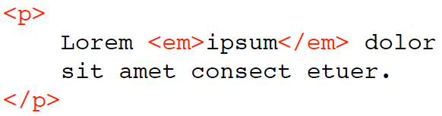
CSS Inheritance
Inheritance is where specific CSS properties are passed down to descendant elements
Example: elements within a paragraph
Styling the parent paragraph also styles the <em></em> element within
Inner elements (children) can inherit properties from their parent element
Inheritance is useful for setting default properties and appearances
Default styles can be specified for the body element and apply to all descendants within the page
font-family, color, font-size , text-align etc are examples of inheritable properties
39
Notes:
Common inherited properties include:
Font color
Font size

Slide 40
CSS Inheritance
To block inheritance, specify a new rule set or a more specific rule set
Later styles can overrule earlier styles
Rules from a CSS file are applied from top to bottom with later rules overriding earlier rules (assuming they have the same weighting)
Default styles applied to descendants of the body can be overridden using CSS selectors
The same selector if used again
More specific selectors will also override more general ones
!Important can also be used to override inherited styles
!important applies to a declaration, so it plays no role in specificity and overrides all inherited styles
40

Slide 41
CSS3 Transforms
Useful Properties for graphs

Slide 42
CSS3 - Transforms
The transform includes a number of different transforms such as
Rotate
Skew
Translate
The transform-origin is the centre point but this can be shifted as well!
42

Slide 43
CSS Transforms - Rotate
Rotate
Text can be rotated upside down (180deg)
Text can be rotated upside down (180deg)
span.tilt {
transform: rotate(15deg);
}
Awesome Tilted Text
<span class="tilt">Awesome Tilted Text</span>
43

Slide 44
CSS Transforms - Scale
Scale:
Resize an element by some multiple
0.5 = half
2 = double etc
Note that scaling also has a transform origin in the center point. Thus increasing the size may cause an element to overlap with other neighbouring elements.
<style>
span.zoomIn {
transform: scale(2);
}
span.zoomOut {
transform: scale(0.5);
}
</style>
44
Notes:
Scaling is useful to modify the size of elements on the page as feedback or the environment changes. For example, increasing image size on hover etc. Could combine with transition and z-index
Note that the actual element/object is rendered first and then the transform is applied.

Slide 45
Transform - Translate
Transform simply shifts an element on the screen by x,y units
This is useful for positioning bars and dots on a graph along with any text
<style>
span.translate {
transform: translate(9px,9px);
}
</style>
X-axis
Y-axis
45
Notes:
These are available in codeshow transitions

Slide 46
Graphics SVG/Canvas
Simple Primer to Graphics in html

Slide 47
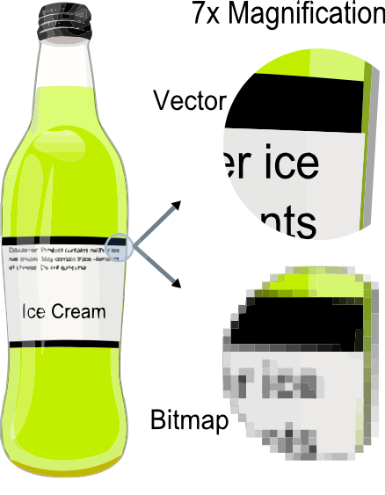
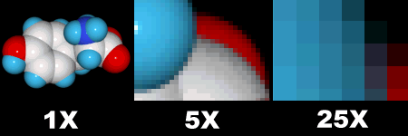
Images and Graphics in HTML
There are two types of graphics in HTML:
Raster images (Bitmaps)
Good for photos with fine detail
Bad for scaling, speed
Scalar Vector Graphics (SVG)
Good for graphs, simple graphics
Bad for photos
47
Notes:
There are two types of graphics in HTML:
Raster images (Bitmaps)
Images composed of pixels
Stores the RGB values of each pixel (or groups of pixels) in an image
jpg, bmp, gif, png
Contain fine detail (good for photographs)
Scalar Vector Graphics (SVG)
Drawings composed of simple shapes, lines and curves
Consists of a series of XML instructions on how to position shapes and where lines start and finish
Instructions contain coordinates of each vector/shape and colour used to construct the image
Circles, rectangles, lines (paths) etc
The image is constructed when the file is opened or the vector instructions are read

Slide 48
Images and Graphics in HTML
SVG
Scalar and vector graphics
Creates shapes declaratively using HTML elements and coordinates
Specific elements (<rectangle><circle> etc)
You declare via the element types what it is you want to draw
You declare the position/size/shape using [x,y] coordinates
48
Notes:
Scalable means not limited to single fixed units (fixed shape sizes – they can be changed)
SVG graphics is scalable to different display resolutions and color spaces
The same SVG graphic can be placed at different sizes on the same Web page, and re-used at different sizes on different pages
SVG graphics can be magnified to see fine detail, or to aid those with low vision

Slide 49
Images in HTML – Vector Graphics
SVG images are created from a series of XML instructions and have several advantages over raster images
They can be created and edited using a simple text editor
Their vector coordinates and descriptions can be searched and compressed
The coordinates can be manipulated making the image scalable without pixilation
SVG images can be created with any text editor, but it is often more convenient to create SVG images with a drawing program, like Inkscape, drawSVG
49

Slide 50
Images in HTML – Vector Graphics
SVG Images are created using both simple HTML shapes and vectors
Simple Shapes include:
Rectangle <rect>
Circle <circle>
Ellipse <ellipse>
Polygon <polygon>
Vectors or lines include
Line <line>
Polyline <polyline>
Path <path>
Note: Since SVG is written in XML, ALL elements must be lower case and have a matching closing tag
50
Notes:
Polygon – used to create a graphic with at least 3 sides
Polyline – used to create a graphic containing only straight lines
Path – used to create a graphic that consists of strait or curved lines that can be closed to make a shape and filled with colour

Slide 51
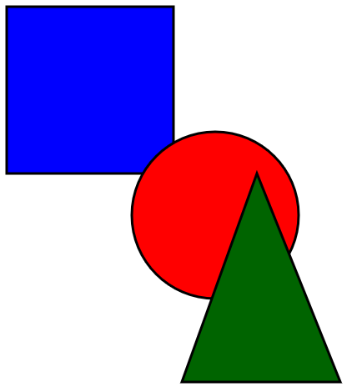
Images in HTML – Vector Graphics
<svg width="1000px" height="1000px">
<g stroke="black" stroke-width="3">
<rect x="50" y="50" width="200" height="200" fill="blue" />
<circle cx="300px" cy="300px" r="100" fill="red" />
<polygon points="260,500 450,500 350,250" style="fill:darkgreen;" />
<line x1="0" x2="1000" y1="0" y2="1000" stroke="orange" />
</g>
</svg>
Applying styles to the <g> group element applies the style to all elements
51
Notes:
SVG Code explanation:
An SVG image begins with <svg> and ends with a </svg> tag
The width and height attributes of the <svg> element define the width and height of the SVG image
The <circle> element is used to draw a circle
The cx and cy attributes define the x and y coordinates of the centre of the circle.
If cx and cy are omitted, the circle's center is set to (0, 0)
The r attribute defines the radius of the circle
The stroke and stroke-width attributes control how the outline of a shape appears.
If the same style is to be applied to a number of elements then group them together with the <g></g> group element
The fill attribute refers to the color inside the circle.
Note: Since SVG is written in XML, all elements must be properly closed!

Slide 52
Images in HTML – Vector Graphics
Rectangle
The x attribute defines the left position of the rectangle
e.g. x="50" places the rectangle 50px from the left margin
The y attribute defines the top position of the rectangle
e.g. y="20" places the rectangle 20px from the top margin
The CSS fill property defines the colour used to fill the shape
Can be used as a fill property or a fill style
The CSS fill-opacity property defines the opacity of the fill color
The CSS stroke-opacity property defines the opacity of the stroke color
Both have a legal range: 0 to 1
<rect x="50" y="20" width="150px" height="150px" style="fill:blue;stroke:pink;stroke-width:5;fill-opacity:0.1;stroke-opacity:0.9" />
52

Slide 53
Images in HTML – Vector Graphics
Rectangle
The width and height attributes of the <rect> element define the height and the width of the rectangle
This is the width and height in px (can use other measures like em etc)
The style attribute is used to define CSS properties for the rectangle
The CSS fill property defines the fill color of the rectangle
The CSS stroke-width property defines the width of the border of the rectangle
The CSS stroke property defines the color of the border of the rectangle
<rect width="300px" height="100px" style="fill:rgb(0,0,255); stroke-width:3;
stroke:rgb(0,0,0)" />
53

Slide 54
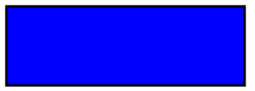

Images in HTML – Vector Graphics
Rectangle
To add round corners to a rectangle set the values for rx and the ry attributes (in px)
<rect x="50" y="20" rx="20" ry="20" width="150" height="150" style="fill:red;stroke:black;stroke-width:5;opacity:0.5" />
54

Slide 55
Images in HTML – Vector Graphics
Ellipse <ellipse>
The cx attribute defines the x coordinate of the center of the ellipse
The cy attribute defines the y coordinate of the center of the ellipse
The rx attribute defines the horizontal radius
The ry attribute defines the vertical radius
<ellipse cx="200" cy="80" rx="100" ry="50"
style="fill:rgba(255, 0, 0, 0.6); stroke:purple; stroke-width:5px" />
55

Slide 56
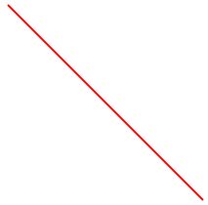
Images in HTML – Vector Graphics
Lines <line>
The x1 attribute defines the start of the line on the x-axis
The y1 attribute defines the start of the line on the y-axis
The x2 attribute defines the end of the line on the x-axis
The y2 attribute defines the end of the line on the y-axis
<line x1="0" y1="0" x2="200" y2="200" style="stroke:rgb(255,0,0); stroke-width:2" />
56

Slide 57
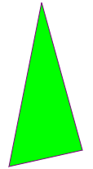
Images in HTML – Vector Graphics
Polygons <polygon>
The points attribute defines the x and y coordinates for each corner of the polygon
[x,y] coordinates are separated by spaces: x1,y1 x2,y2 x3,y3 etc…
<polygon points="200,10 250,190 160,210"
style="fill:lime;stroke:purple;stroke-width:1" />
<polygon points="100,10 40,198 190,78 10,78 160,198"
style="fill:rgba(0,0,255, 0.4); stroke:purple; stroke-width:5px;
fill-rule:nonzero" />
57

Slide 58
Images in HTML – Vector Graphics
Paths <path>
Different from lines/polyline because each pair of points can be a straight line or a curve
M = moveto
L = lineto
H = horizontal lineto
V = vertical lineto
C = curveto
S = smooth curveto
Q = quadratic Bézier curve
T = smooth quadratic Bézier curveto
A = elliptical Arc
Z = closepath
Paths are generally created by editors or javascript
<path d="M 100 350 l 150 -300" /> <path d="M 250 50 l 150 300" /> <path d="M 175 200 l 150 0" /> <path d="M 100 350 q 150 -300 300 0" />
58

Slide 59

Images in HTML – Vector Graphics
Text <text>
Used to add text to an SVG image
Text can also be arranged in any number of sub-groups with the <tspan> element
Each <tspan> element can contain different formatting instructions and position attributes
<tspan> can be used to place text in an image across multiple lines with precision
<text x="10" y="20" style="fill:red;">Several lines: <tspan x="10" y="45">First line.</tspan> <tspan x="10" y="70">Second line.</tspan> </text>
59

Slide 60
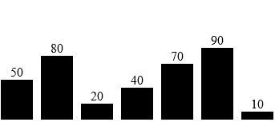
Images in HTML – Vector Graphics
<svg class="chart" width="500" height="200">
<g transform="translate(0, 150)">
<rect width="40" height="50" />
<text x="12" y="-4" dy="0">50</text>
</g>
<g transform="translate(50, 120)">
<rect width="40" height="80"/>
<text x="12" y="-4" dy="0">80</text>
</g>
<g transform="translate(100, 180)">
<rect width="40" height="20"/>
<text x="12" y="-4" dy="0">20</text>
</g>
<g transform="translate(150, 160)">
<rect width="40" height="40"/>
<text x="12" y="-4" dy="0">40</text>
</g>
<g transform="translate(200, 130)">
<rect width="40" height="70"/>
<text x="12" y="-4" dy="0">70</text>
</g>
<g transform="translate(250, 110)">
<rect width="40" height="90"/>
<text x="12" y="-4" dy="0">90</text>
</g>
<g transform="translate(300, 190)">
<rect width="40" height="10"/>
<text x="12" y="-4" dy="0">10</text>
</g>
</svg>
Why SVG?
The creator specifies what an image should look like by generating simple mark-up code
The resulting image can be modified using CSS rules
SVG can be used to create interactive charts
Will cover this more in D3!
Note all heights add to 200px
Translate-y (150px) + rect height (50px)
= 200px
Notes:
http://www.themaninblue.com/experiment/Blobular/

