Slide 1
INFS 5102 Unsupervised Methods in Analytics
Module 3 – Cluster Analysis
Part 1: Basics

Slide 2
Outline
Basics
What is cluster analysis
Types of clustering and types of clusters
Major clustering approaches
Similarity/dissimilarity measures
Methods
Partition based method – K-means
Hierarchical clustering
Density based method
Validation of clusters

Slide 3
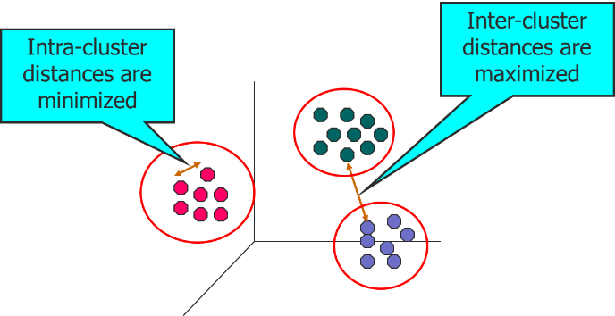
What is Cluster Analysis?
Cluster analysis: Finding groups of objects such that the objects in a group will be similar (or related) to one another and different from (or unrelated to) the objects in other groups
The obtained groups are called clusters
Cluster analysis is also known as clustering, data segmentation, …
Unsupervised learning: no predefined classes
Notes:
*clustering: sometimes also refers to the entire collection of clusters obtained

Slide 4
Why Cluster Analysis?
For understanding: as a stand-alone tool to get insight into data distribution
Clusters are potential classes
Cluster analysis finds the classes and their characteristics
Outlier/anomaly detection: Outliers are often viewed as those “far away” from any cluster
For utility: as a preprocessing step
Find the clusters and then representative cluster prototypes
Use the cluster prototypes as the basis for other algorithms
Removing outliers

Slide 5
What is not Cluster Analysis?
Supervised classification
Have class label information
Simple segmentation
Dividing students into different registration groups alphabetically, by last name
Results of a query
Groupings are a result of an external specification
Clustering is a grouping of objects based on the data

Slide 6
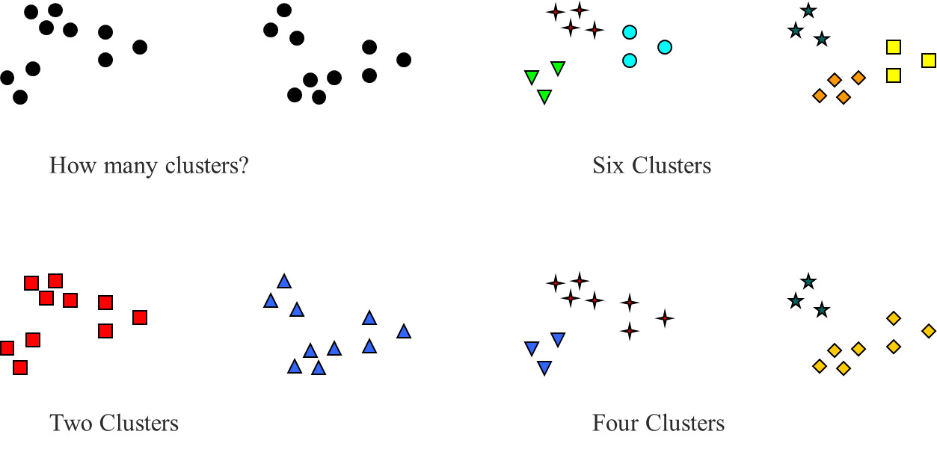
Notion of a Cluster can be Ambiguous
In many applications, the notion of a cluster is not well defined
The best definition depends on the nature of data and the desired results

Slide 7
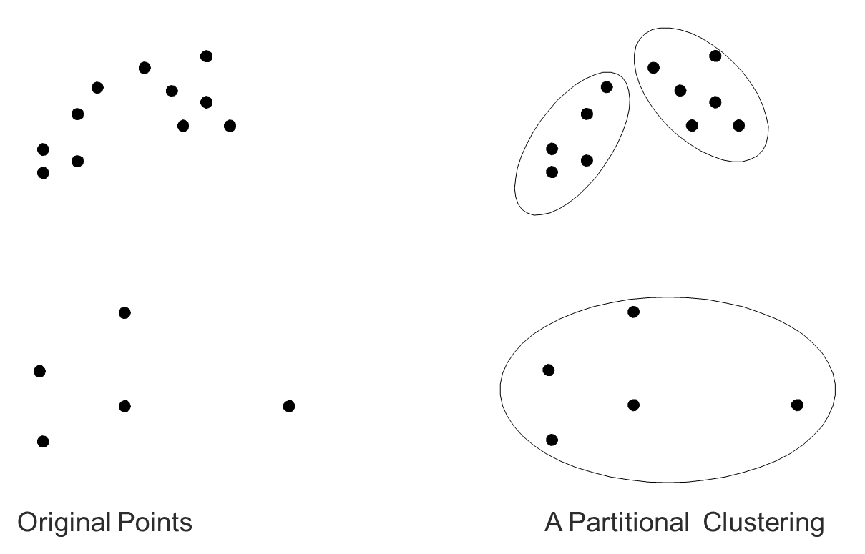
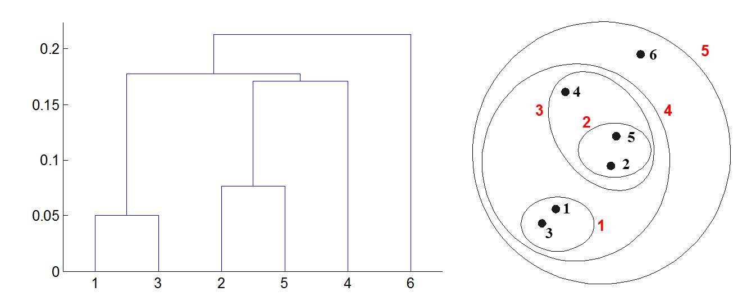
Types of Clustering
Partitional clustering
A division of data objects into “non-overlapping” subsets (clusters) such that each data object is in exactly one subset
Hierarchical clustering
A set of nested clusters organized as a hierarchical tree

Slide 8
Clustering Variations
Non-exclusive vs. Exclusive
Non-exclusive (or overlapping): an object can belong to multiple clusters simultaneously
Exclusive: each object is assigned to a single cluster
Fuzzy vs. Non-fuzzy
Fuzzy clustering: a data point is associated with a “degree of belongingness” to a cluster
Partial vs. Complete
In some cases, we only want to cluster some of the data, e.g., discard outliers or data points that are not of interest

Slide 9
Types of Clusters
Type of clusters:
Well-separated clusters
Center-based or prototype-based clusters
Contiguous clusters
Density-based clusters
Property or Conceptual
Described by an objective function

Slide 10
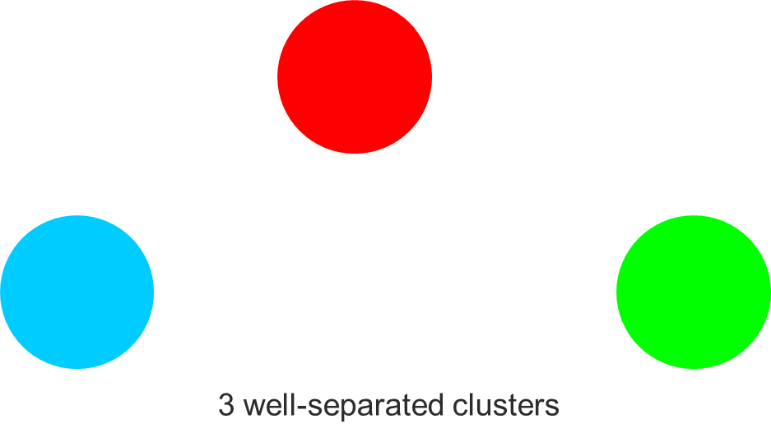
Types of Clusters: Well-Separated
Well-separated clusters:
A cluster is a set of points such that any point in a cluster is closer (or more similar) to every other point in the cluster than to any point not in the cluster

Slide 11
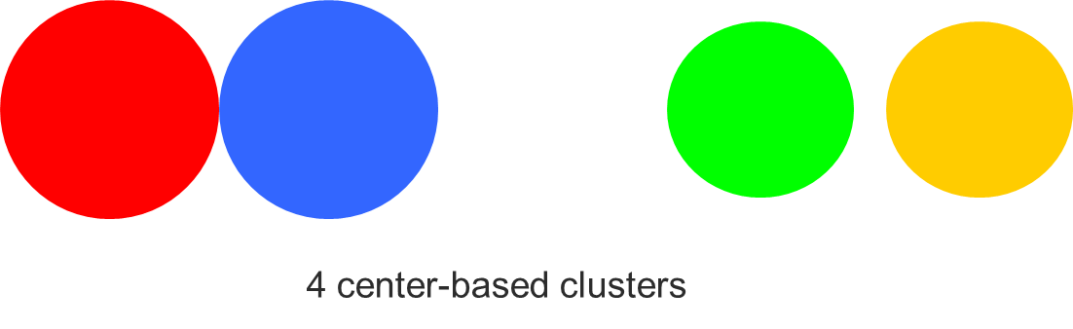
Types of Clusters: Center-Based
Center-based
A cluster is a set of objects such that an object in a cluster is closer (more similar) to the “center” of a cluster, than to the center of any other cluster
The center of a cluster is often a centroid (the average of all the points in the cluster) or a medoid (the most “representative” point of a cluster)

Slide 12
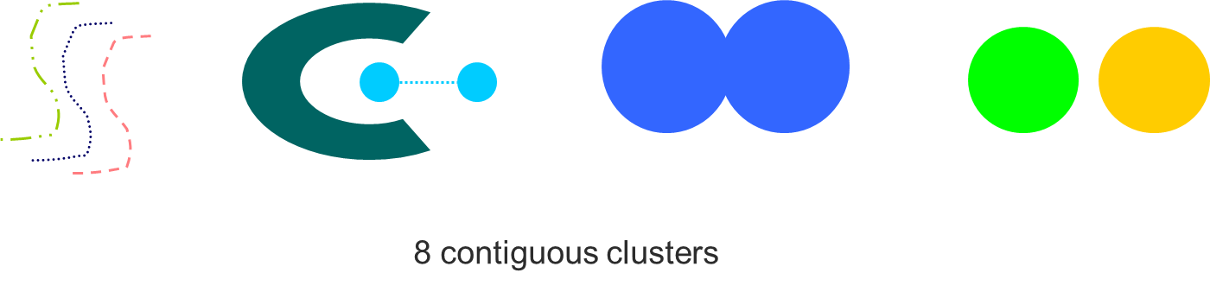
Types of Clusters: Contiguity-Based
Contiguous cluster (nearest neighbor or transitive)
A cluster is a set of points such that a point in a cluster is closer (or more similar) to one or more other points in the cluster than to any point not in the cluster

Slide 13

Types of Clusters: Density-Based
Density-based
A cluster is a dense region of points, which is separated by low-density regions, from other regions of high density
Used when the clusters are irregular or intertwined, and when noise and outliers are present

Slide 14
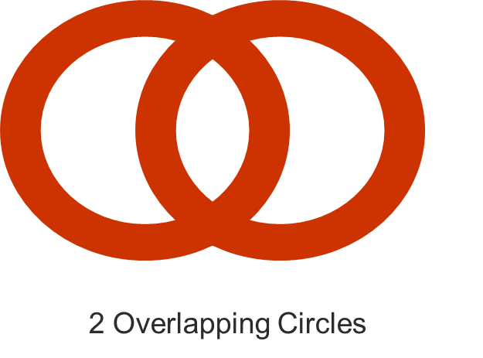
Types of Clusters: Conceptual Clusters
Shared Property or Conceptual Clusters
Find clusters that share some common property or represent a particular concept

Slide 15
Types of Clusters: Cluster defined by Objective Function
Find clusters that minimize or maximize an objective function, e.g., K-means aims at minimize:
Enumerate all possible ways of dividing the points into clusters and evaluate the `goodness' of each potential set of clusters by using the given objective function (computationally expensive or prohibitive)
Can have global or local objectives
Hierarchical clustering algorithms typically have local objectives
Partitional algorithms typically have global objectives
A variation of the global objective function approach is to fit the data to a parameterized model
Parameters for the model are determined from the data.
Mixture models assume that the data is a ‘mixture' of a number of statistical distributions.

Slide 16
Map Clustering Problem to a Different Problem
Map the clustering problem to a different domain and solve a related problem in that domain
Example:
Proximity matrix defines a weighted graph, where the nodes are the points being clustered, and the weighted edges represent the proximities between points
Clustering is equivalent to breaking the graph into connected components, one for each cluster.
Want to minimize the edge weight between clusters and maximize the edge weight within clusters

Slide 17
Major Clustering Approaches
Partitioning approach:
Construct various partitions and then evaluate them by some criterion, e.g., minimizing the sum of square errors
Hierarchical approach:
Create a hierarchical decomposition of the set of data (or objects) using some criterion
Density-based approach:
Based on connectivity and density functions
Others: Grid-based, Model-based, Frequent pattern-based, link-based …

Slide 18
Characteristics of the Input Data Are Important
Type of proximity or density measure
Central to clustering
Depends on data and application
Data characteristics that affect proximity and/or density are
Dimensionality
Sparseness
Attribute type
Special relationships in the data
For example, autocorrelation
Distribution of the data
Noise and Outliers
Often interfere with the operation of the clustering algorithm

Slide 19
Proximity: Similarity and Dissimilarity
Similarity
Numerical measure of how alike two data objects are.
Is higher when objects are more alike.
Often falls in the range [0,1]
Dissimilarity
Numerical measure of how different are two data objects
Lower when objects are more alike
Minimum dissimilarity is often 0
Upper limit varies
Proximity refers to a similarity or dissimilarity

Slide 20
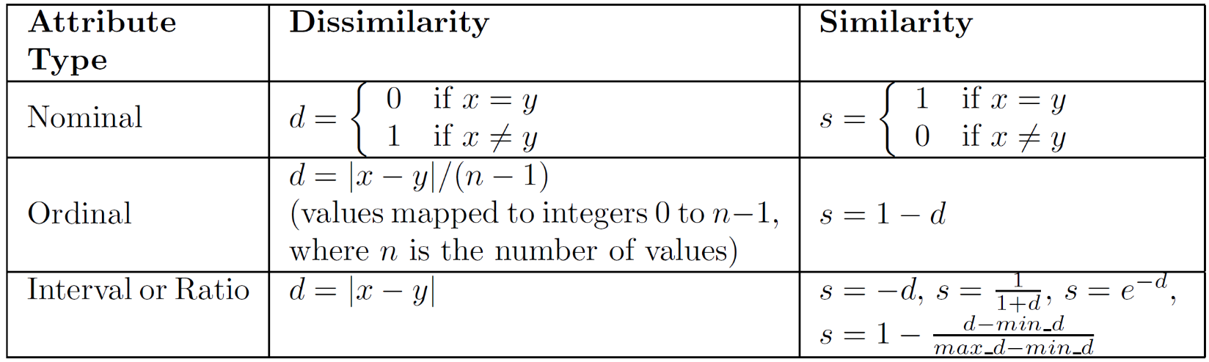
Similarity/Dissimilarity – single attribute
The following table shows the similarity and dissimilarity between two objects, x and y, with respect to a single, simple attribute
Notes:
Nominal attributes only convey information about the distinctness of objects, all we can see that two objects either have the same value or they don’t.
For ordinal attributes, information about order should be taken into account. However, the above definition assumes equal interval, which may not be fair – is the difference between good and fair is really the same as the difference between wonderful and good?

Slide 21
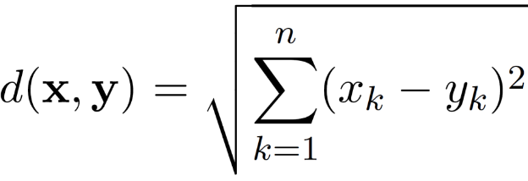
Euclidean Distance
Euclidean Distance
where n is the number of dimensions (attributes) and x_{k} and y_{k} are, respectively, the k^{th} attributes (components) or data objects x and y.
Distance Matrix

Slide 22
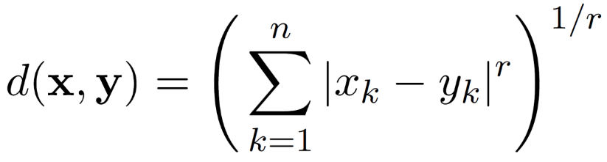
Minkowski Distance
Minkowski Distance is a generalization of Euclidean Distance
where r is a parameter, n is the number of dimensions (attributes) and x_{k} and y_{k} are, respectively, the k^{th} attributes (components) or data objects x and y.

Slide 23

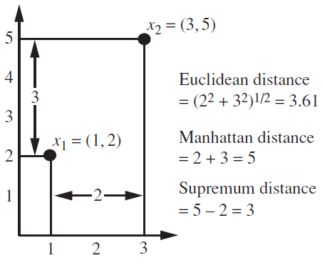
Minkowski Distance
r = 1. City block (Manhattan, taxicab, L₁ norm) distance
A common example of this is the Hamming distance, which is just the number of bits that are different between two binary vectors
r = 2. Euclidean distance
r → ∞. “supremum” (L_{max} norm, L∞ norm) distance.
This is the maximum difference between any component of the vectors
Do not confuse r with n

Slide 24
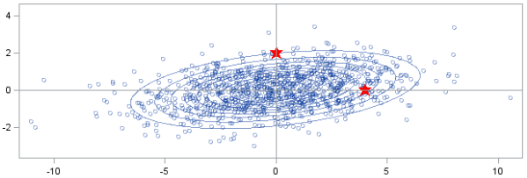
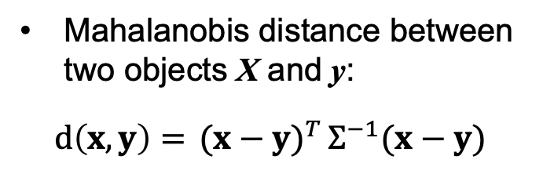
Mahalanobis Distance
Mahalanobis distance between two objects X and y:
$$d\left(x,y\right)={ (x−y)}^{T}Ʃ^{−1}(x−y)$$
Which point is closer to the centre of the distribution/cluster, A or B?
Answer: it depends on how we measure the distance
If we use Euclidean distance, the answer is A, but if we use Mahalanobis distance, the answer is B
where Σ is the covariance matrix
Mahalanobis distance accounts for:
the differences of variances in different directions/dimensions.
The covariance/correlation between variables
A
B
Source: SAS Blog (https://blogs.sas.com/content/iml/2012/02/15/what-is-mahalanobis-distance.html)

Slide 25
Common Properties of a Distance Measure
Distances, such as the Euclidean distance, have some well known properties:
d(x, y) ≥ 0 for all x and y and d(x, y) = 0 only if x = y. (Positive definiteness)
d(x, y) = d(y, x) for all x and y. (Symmetry)
d(x, z) ≤ d(x, y) + d(y, z) for all points x, y, and z. (Triangle Inequality)
where d(x, y) is the distance (dissimilarity) between points (data objects), x and y.

Slide 26
Normalization for Distance Measures
When attributes do not have the same range of values (i.e., they have different scales), normalization is needed.
For example:
P = (x, y) where x and y are currencies, in Australian Dollars and Japanese Yens.
Consider three data points A=(0,0), B=(0,80), C=(20,0)
At the first glance, one might seem that C is more “similar” to A, than B to A.
If we normalize them to the same currency,…
80 Yen ~ 1 AUD
B is in fact more similar to A

Slide 27
Similarity Between Binary Vectors
When objects, x and y, have only binary attributes, can measure the similarity between the objects using:
Simple Matching Coefficient (SMC), or
Jaccard Coefficient (JC)
Computing SMC and JC requires the following quantities:
M₀₁ = the number of attributes where x has 0 and y has 1
M₁₀ = the number of attributes where x has 1 and y has 0
M₀₀ = the number of attributes where x has 0 and y has 0 (0-0 match)
M₁₁ = the number of attributes where x has 1 and y has 1 (1-1 match)
SMC = (M₁₁ + M₀₀) / (M₀₁ + M₁₀ + M₁₁ + M₀₀),
which is number of matches / number of attributes
JC = (M₁₁) / (M₀₁ + M₁₀ + M₁₁)
which is the number of 1-1 matches / number of not-both-zero
attributes values
Example:
x = 1 0 0 0 0 0 0 0 0 0
y = 0 0 0 0 0 0 1 0 0 1
M₀₁ = 2 M₁₀ = 1 M₀₀ = 7 M₁₁ = 0
SMC = (M₁₁ + M₀₀)/(M₀₁ + M₁₀ + M₁₁ + M₀₀)
= (0+7) / (2+1+0+7) = 0.7
JC = (M₁₁) / (M₀₁ + M₁₀ + M₁₁)
= 0 / (2 + 1 + 0) = 0
Do you see the difference between SMC and JC?

Slide 28
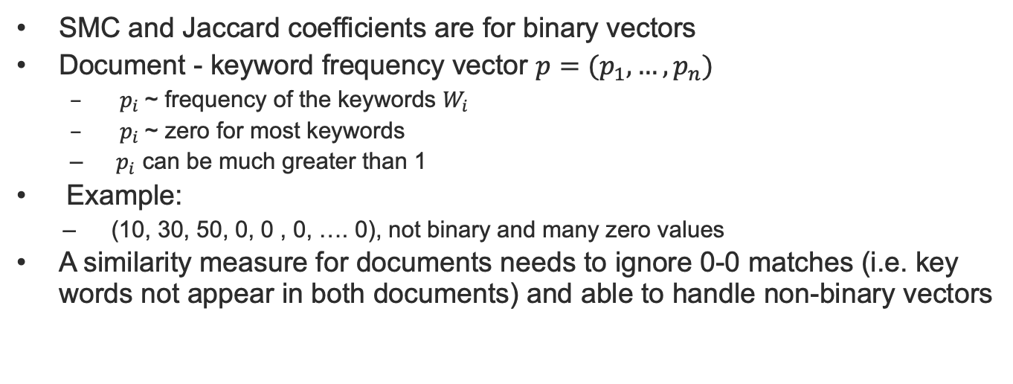
Cosine Similarity
SMC and Jaccard coefficients are for binary vectors
Document - keyword frequency vector $p=(p_{1},…,p_{n})$
${ p}_{i}$~ frequency of the keywords $W_{i}$
${ p}_{i}$~ zero for most keywords
${ p}_{i}$ can be much greater than 1
Example:
(10, 30, 50, 0, 0 , 0, …. 0), not binary and many zero values
A similarity measure for documents needs to ignore 0-0 matches (i.e. key words not appear in both documents) and able to handle non-binary vectors

Slide 29
Cosine Similarity
If d₁ and d₂ are two document vectors, then
cos( d₁, d₂ ) = (d₁ • d₂) / ||d₁|| ||d₂|| ,
where • indicates vector dot product and || d || is the length of vector d.
cos( d₁, d₂ ) measures the cosine of the angle between d₁ and d₂ .
Example:
d₁ = 3 2 0 5 0 0 0 2 0 0
d₂ = 1 0 0 0 0 0 0 1 0 2
d₁ • d₂= 3*1 + 2*0 + 0*0 + 5*0 + 0*0 + 0*0 + 0*0 + 2*1 + 0*0 + 0*2 = 5
||d₁|| = (3*3+2*2+0*0+5*5+0*0+0*0+0*0+2*2+0*0+0*0)^{0.5} = (42) ^{0.5} = 6.481
||d₂|| = (1*1+0*0+0*0+0*0+0*0+0*0+0*0+1*1+0*0+2*2) ^{0.5} = (6) ^{0.5} = 2.449
cos( d₁, d₂ ) = 0.3150

Slide 30
Extended Jaccard (Tanimoto) Coefficient
Variation of Jaccard for continuous or count attributes, such as document data
Reduces to Jaccard for binary attributes

Slide 31



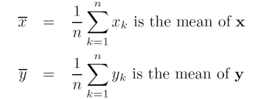




Correlation
Correlation can be used to measures the linear relationship between two objects
The (Pearson) correlation between two data objects x and y is calculated as:
where
and

Slide 32
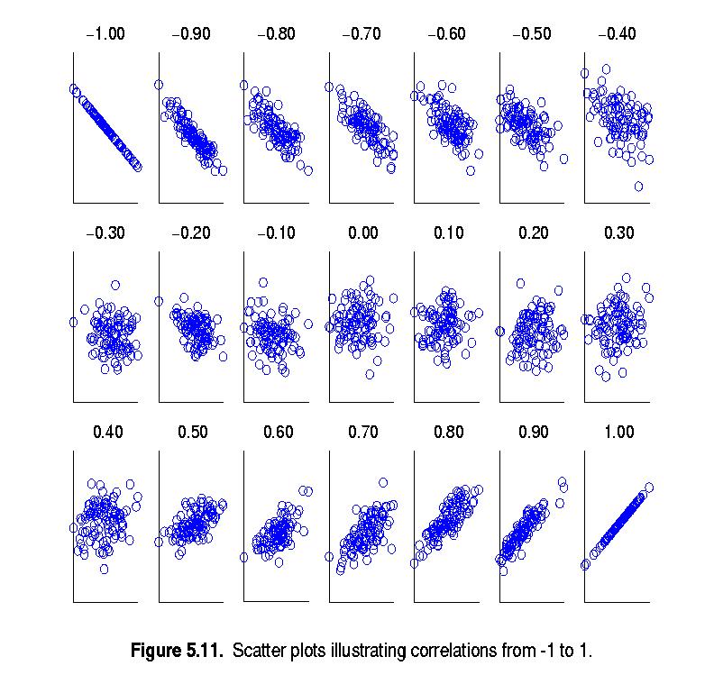
Visually Evaluating Correlation
Scatter plots showing the similarity from –1 to 1.
In a plot, objects x and y each has 30 real values, i.e. x={x₁, x₂, …, x₃₀} and y={y₁, y₂, …, y₃₀}, and a circle represents a pair (x_{i}, y_{i})

Slide 33
Drawback of Correlation
Example:
x = (-3, -2, -1, 0, 1, 2, 3), y = (9, 4, 1, 0, 1, 4, 9)
Underlying relationship between x and y: y_{i} = x_{i}² (i.e. they have some similarity, as non-lindear relationship)
However, if we calculate the correlation between x and y, we get
mean(x) = 0, mean(y) = 4, std(x) = 2.16, std(y) = 3.74,
Then
corr (x,y) = (-3)(5)+(-2)(0)+(-1)(-3)+(0)(-4)+(1)(-3)+(2)(0)+3(5) / ( 6 * 2.16 * 3.74 ) = 0
Correlation indicates linear relationship only

Slide 34
Correlation vs Cosine vs Euclidean Distance
Compare the three proximity measures according to their behavior under variable transformation
Example
x = (1, 2, 4, 3, 0, 0, 0), y = (1, 2, 3, 4, 0, 0, 0)
y_{s} = y * 2 (scaled version of y),
y_{t} = y + 5 (translated version)
Property | Cosine | Correlation | Euclidean Distance
Invariant to scaling (multiplication by a value) | Yes | Yes | No
Invariant to translation (adding a constant) | No | Yes | No
Measure | (x , y) | (x , y_{s}) | (x , y_{t})
Cosine | 0.9667 | 0.9667 | 0.7940
Correlation | 0.9429 | 0.9429 | 0.9429
Euclidean Distance | 1.4142 | 5.8310 | 14.2127

Slide 35
Common Properties of a Similarity Measure
Similarity measures also have some well-known properties:
s(x, y) = 1 (or maximum similarity) only if x = y.
s(x, y) = s(y, x) for all x and y. (Symmetry)
where s(x, y) is the similarity between points (data objects), x and y.

Slide 36
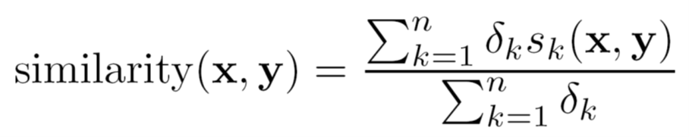
General Approach for Combining Similarities
Sometimes attributes are of many different types (heterogeneous), but an overall similarity is needed.
A straightforward approach is to compute similarity between each attribute of the two objects separately, then combine these similarities such that the final similarity is between [0,1].
For example:
1. For the k^{th} attribute, compute a similarity, s_{k}(x, y), in the range [0, 1].
2: Define an indicator variable, δ_{k}, for the k^{th} attribute as follows:
δ_{k} = 0 if the k^{th} attribute is an asymmetric attribute and both objects have a value of 0, or if one of the objects has a missing value for the k^{th} attribute
δ_{k} = 1 otherwise
3. Compute:

Slide 37


Using Weights to Combine Similarities
May not want to treat all attributes the same
Use non-negative weights $ω_{k}$
Can also define a weighted form of distance

Slide 38
Selection of the Right Proximity Measure
The type of measure chosen should fit the type of data
For many types of dense, continuous data, distance measures such as Euclidean distance are often used.
For sparse data, which often consists of asymmetric attributes, similarity measures ignoring 0-0 match are often used
In some cases, data transformation is needed to obtain a proper proximity measure values.
The measure must be applicable to the data and produce results that agree with domain knowledge
A number of different measures may be tried to see which one produces results that make the most sense

Slide 39
Density
Density-based clustering and anomaly detection requires a notion of density
Density Measures the degree to which data objects are close to each other in a specified area
The notion of density is closely related to that of proximity
Examples:
Euclidean density
Euclidean density = number of points per unit volume
Probability density
Estimate what the distribution of the data looks like
Graph-based density
Connectivity

Slide 40
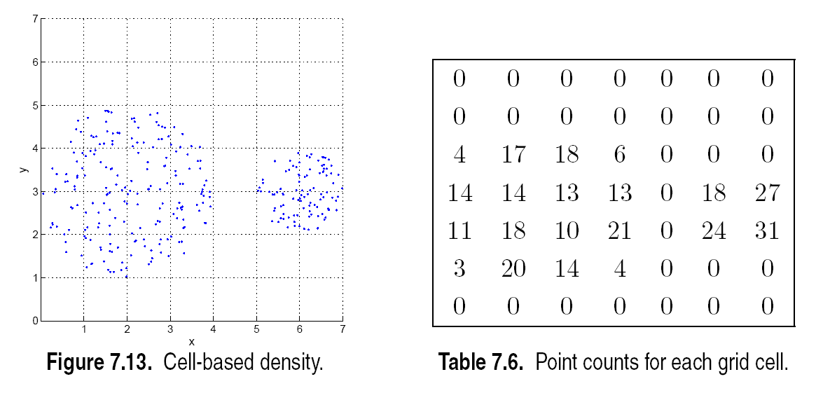

Euclidean Density – Grid-based approach
Simplest approach is to divide region into a number of rectangular cells of equal volume and define density as # of points the cell contains

Slide 41
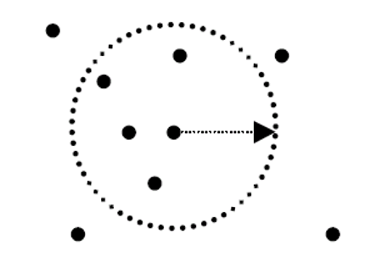
Euclidean Density – Center-based
The number of points within a specified radius of a point is considered as the Euclidean density (of the neighbourhood of the point)

Slide 42
References
Most of the slides are from or have their materials taken from the following sources (unless otherwise indicated):
https://www-users.cs.umn.edu/~kumar001/dmbook/firsted.php
https://www-users.cs.umn.edu/~kumar001/dmbook/index.php
http://web.engr.illinois.edu/~hanj/bk3/

