Slide 1
INFS 5102 Unsupervised Methods in Analytics
Module 3 – Cluster Analysis
Part 2B: Methods （B）

Slide 2
Outline
Concepts
What is cluster analysis
Types of clustering and types of clusters
Major clustering approaches
Similarity/dissimilarity measures
Methods
Partition based method – K-means
Hierarchical clustering
Density based method
Validation of clusters

Slide 3
Hierarchical Clustering
Produces a set of nested clusters organized as a hierarchical tree
Can be visualized as a dendrogram
A tree like diagram that records the sequences of merges or splits, and the hierarchy of the clustering results
Two dimensional hierarchical clusters can also be viewed using a nested cluster diagram

Slide 4
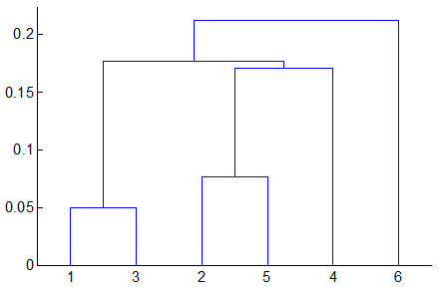
Hierarchical Clustering
More on dendrograms
X axis: data objects; Y axis: (normally) distance between clusters
A horizontal link represents that two clusters are merged and the Y axis value of the link is the distance of the two merged clusters.
Examples:
Clusters (1) & (3) are merged and their distance is 0.05
Clusters (2) & (5) are merged and their distance is about 0.08
Clusters (2,5) & (4) are merged and their distance is about 0.17
Clusters (1,3) & (2,5,4) are merged and their distance is about 0.18
Clusters (1,3,2,5,4) & (6) are merged and their distance is about 0.21
Cutting the tree:
Examples:
Cut the tree at height (Y axis) 0.1, we get 4 branch corresponding to 4 clusters: (1,3), (2,5), (4), and (6),
and within each of the 4 clusters, the distance between two objects is smaller than 0.1 on average
Cut the tree at height 0.2, we get 2 clusters: (1,3,2,5,4) & (6), and within each of the two clusters, the distance between two objects is smaller than 0.2 on average.

Slide 5
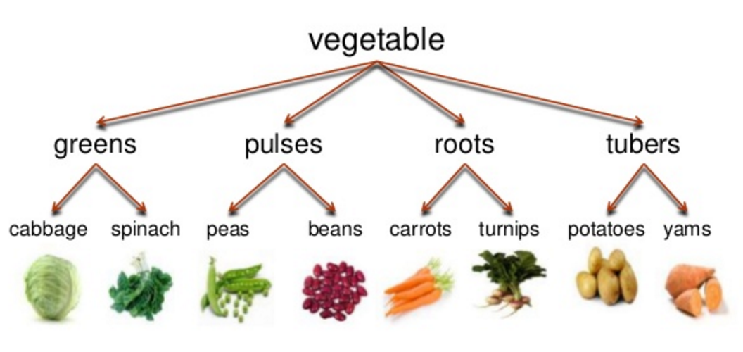
Strengths of Hierarchical Clustering
Do not have to assume any particular number of clusters
Any desired number of clusters can be obtained by ‘cutting’ the dendogram at the proper level
They may correspond to meaningful taxonomies
More examples such as those in biological sciences (e.g., animal kingdom, phylogeny reconstruction, …)
http://www.slideshare.net/Andriyanieka12/13-semantics-synonym-antonym-homonym-hyponym-polyseme-idioms-18509523

Slide 6
Hierarchical Clustering
Two main approaches to hierarchical clustering
Agglomerative (bottom-up):
Start with the points as individual clusters
At each step, merge the closest pair of clusters until only one cluster left （or until k cluster left as user has required)
Divisive (top-down):
Start with one, all-inclusive cluster
At each step, split a cluster until each cluster contains a point (or until there are k clusters as user has required)
Challenging and high computational cost to decide how to divide a cluster properly.
Agglomerative approach is more commonly used than the divisive approach

Slide 7
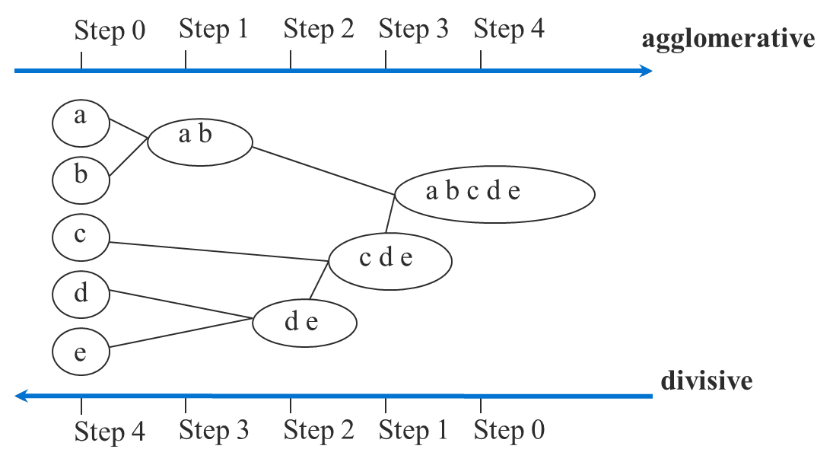
Hierarchical Clustering
Often use a similarity or distance matrix, and merge or split one cluster at a time.
Do not require the number of clusters k as an input, but needs a termination condition

Slide 8
Agglomerative Clustering Approach
More popular than divisive hierarchical clustering
Basic procedure is straightforward
Compute the proximity matrix
Let each data point be a cluster
Repeat
Merge the two closest clusters
Update the proximity matrix
Until only a single cluster remains
Key operation is the computation of the proximity of two clusters
Different approaches to defining the distance between clusters distinguish the different algorithms

Slide 9
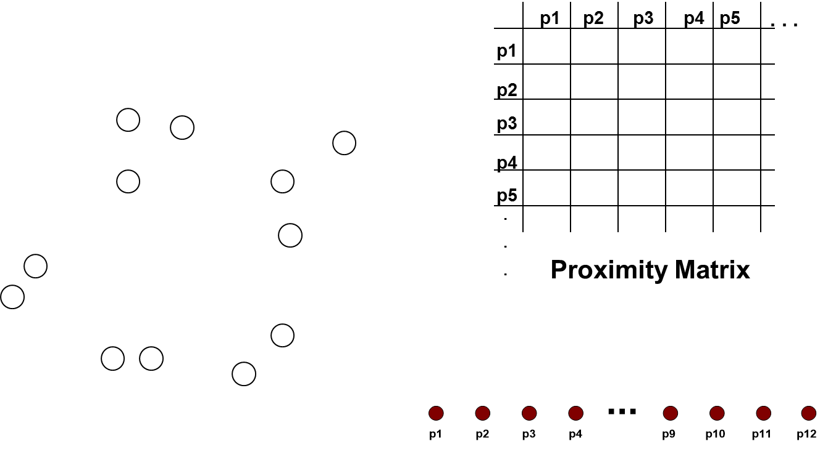
Starting Situation
Start with clusters of individual points and a proximity matrix

Slide 10
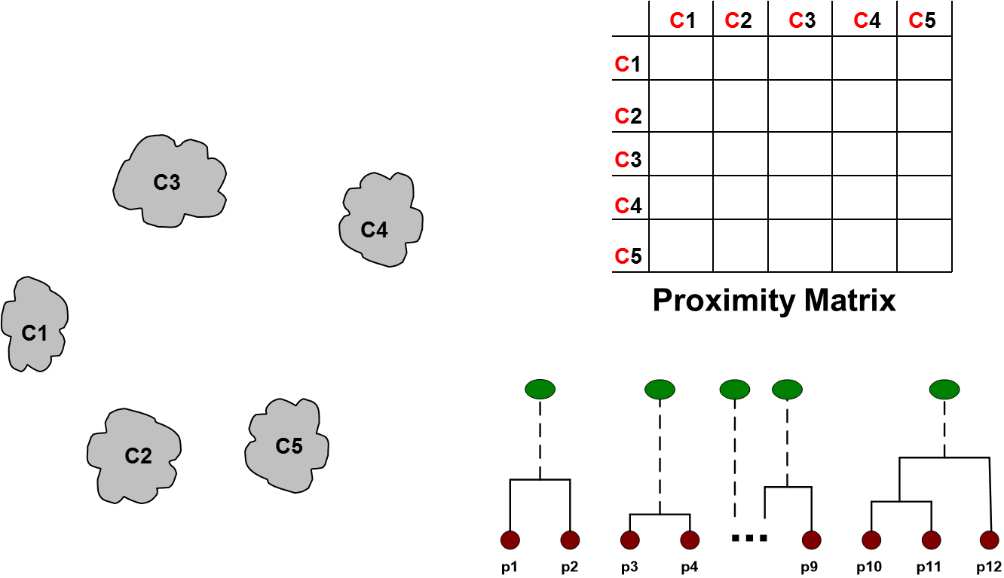
Intermediate Situation
After some merging steps, we have some clusters

Slide 11
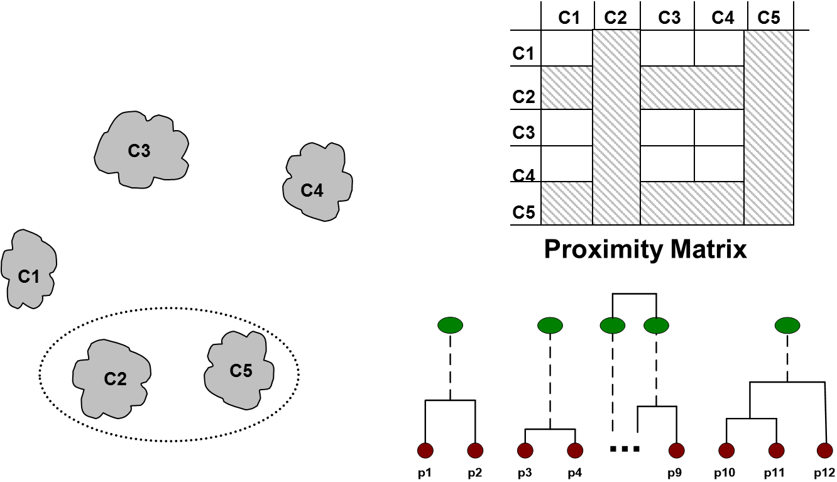
Intermediate Situation
At each step, we merge the two closest clusters and update the proximity matrix

Slide 12
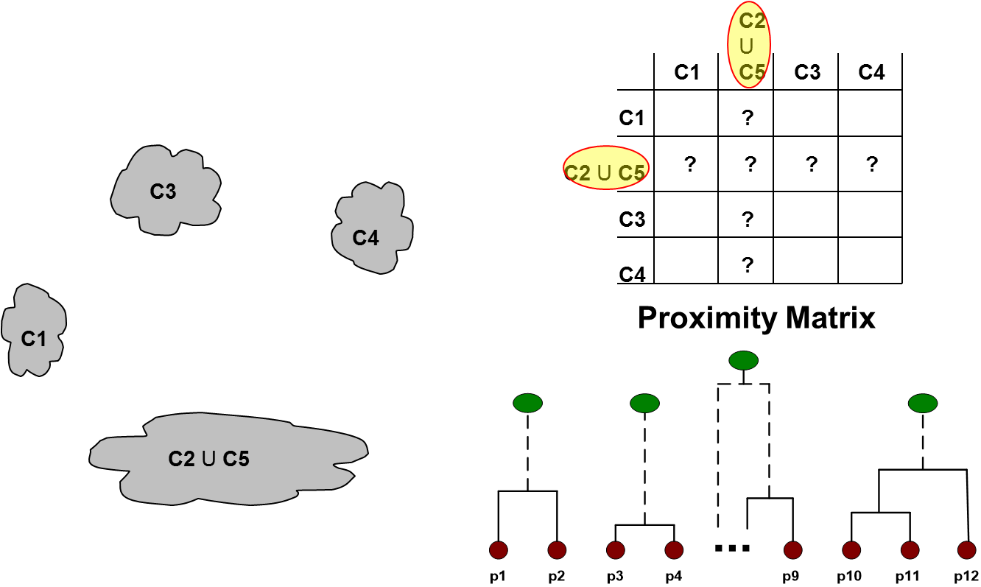
Intermediate Situation
The question is “How do we update the proximity matrix?”, that is, how to define inter-cluster similarity?

Slide 13
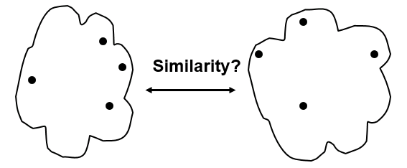
How to Define Inter-Cluster Similarity
MIN (aka Single link)
MAX (aka Complete link or Clique)
Distance between centroids
Group average
Other methods driven by an objective function
e.g., Ward’s Method (uses squared error)

Slide 14
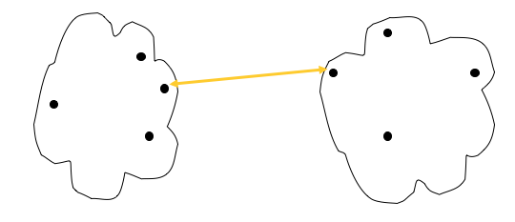
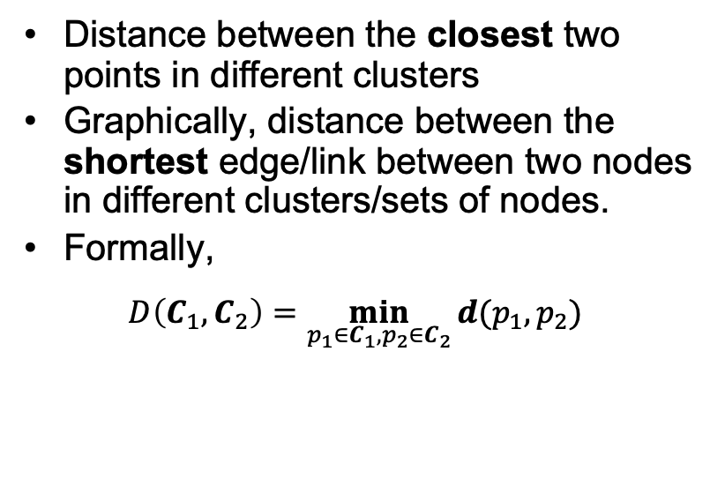
MIN (Single Link)
Distance between the closest two points in different clusters
Graphically, distance between the shortest edge/link between two nodes in different clusters/sets of nodes.
Formally,
$$D\left(C_{1},C_{2}\right)=\min_{p_{1}∈C_{1}, p_{2}∈C_{2}}{d(p_{1},p_{2})}$$

Slide 15
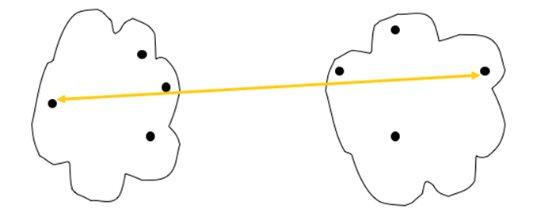
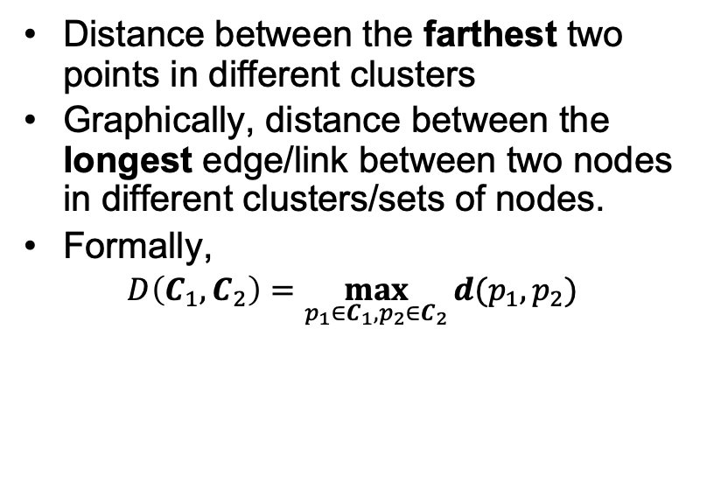
Max (Complete Link or Clique)
Distance between the farthest two points in different clusters
Graphically, distance between the longest edge/link between two nodes in different clusters/sets of nodes.
Formally,
$$D\left(C_{1},C_{2}\right)=\max_{p_{1}∈C_{1}, p_{2}∈C_{2}}{d(p_{1},p_{2})}$$

Slide 16
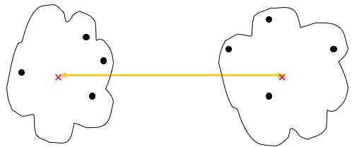
Distance between Cluster Centroids
Distance between two clusters is defined as the distance between the centroids of the two clusters

Slide 17
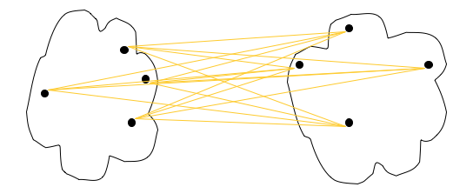
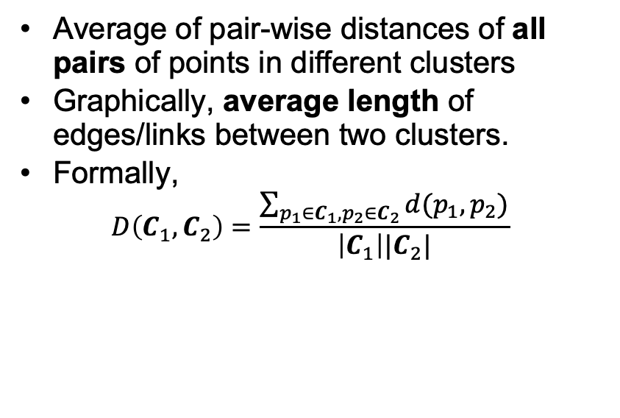
Group average
Average of pair-wise distances of all pairs of points in different clusters
Graphically, average length of edges/links between two clusters.
Formally,
$$D\left(C_{1},C_{2}\right)=\frac{\sum_{p_{1}∈C_{1}, p_{2}∈C_{2}}{d(p_{1},p_{2})}}{\left|C_{1}\right||C_{2}|}$$

Slide 18
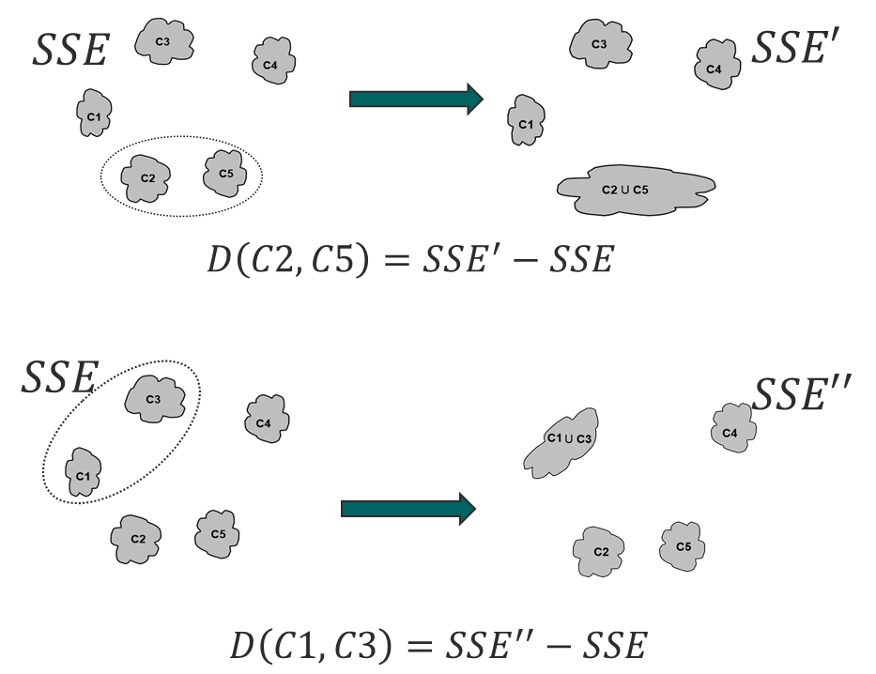
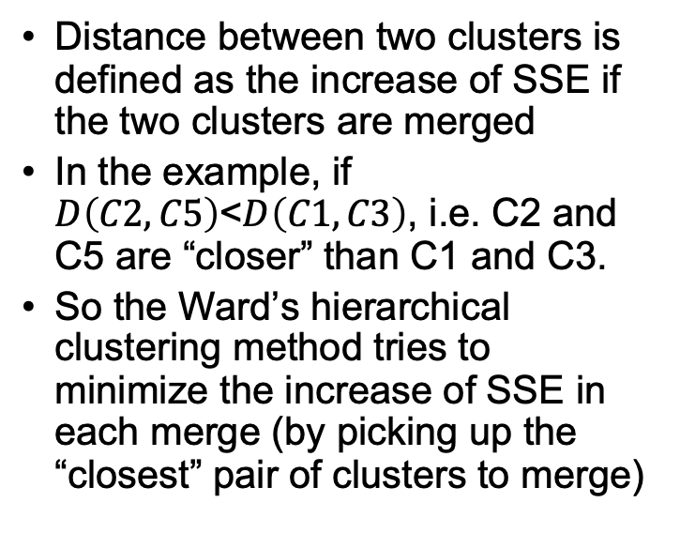
Ward’s Method
Distance between two clusters is defined as the increase of SSE if the two clusters are merged
In the example, if $D\left(C2,C5\right)$<$D\left(C1,C3\right)$, i.e. C2 and C5 are “closer” than C1 and C3.
So the Ward’s hierarchical clustering method tries to minimize the increase of SSE in each merge (by picking up the “closest” pair of clusters to merge)

Slide 19
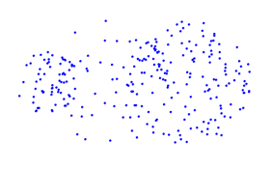
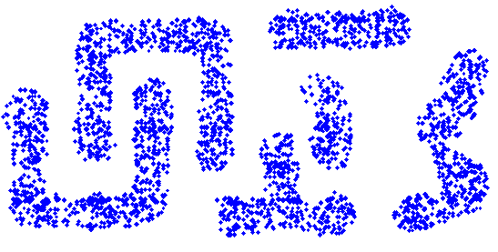
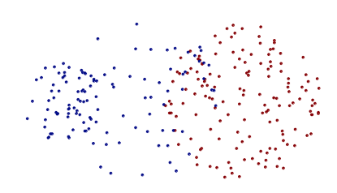
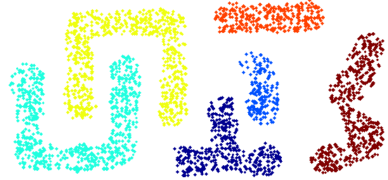
Pros and Cons - MIN
Can handle non-elliptical shapes
Sensitive to noise and outliers
Original Points
After Clustering

Slide 20
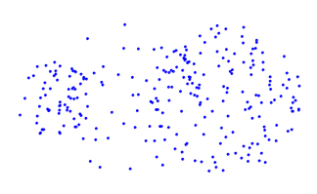
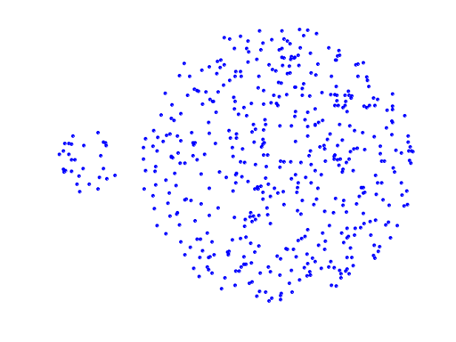
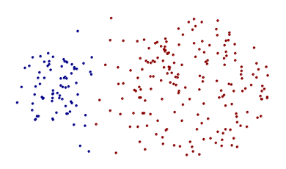
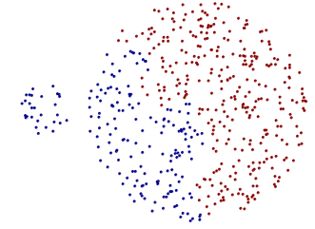
Pros and Cons - Max
Less susceptible to noise and outliers
Tends to break large clusters
Original Points
After clustering
Biased towards globular clusters

Slide 21
Pros and Cons: Group Average
Compromise between Single and Complete Link
Strengths
Less susceptible to noise and outliers
Limitations
Biased towards globular clusters

Slide 22
Pros and Cons: Ward’s Method
Less susceptible to noise and outliers
Biased towards globular clusters
Hierarchical analogue of K-means
Can be used to initialize centroids of K-means
Can be used to pick up K for K-means: reduce k (merging) until the SSE jumps, and then use the K just before the jump

Slide 23
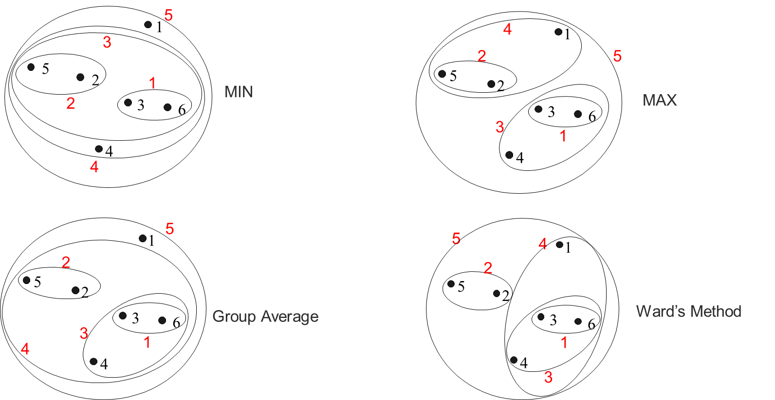
Hierarchical Clustering: Comparison

Slide 24
Hierarchical Clustering: Time and Space Requirements
O(N²) space since it uses the proximity matrix
N is the number of points
O(N³) time in many cases
There are N steps and at each step the size, N², proximity matrix must be updated and searched
Complexity can be reduced to O(N² log(N) ) time for some approaches

Slide 25
Hierarchical Clustering: Problems and Limitations
Once a decision is made to combine two clusters, it cannot be undone
No objective function is directly minimized
Different schemes have problems with one or more of the following:
Sensitivity to noise and outliers
Difficulty handling different sized clusters and convex shapes
Breaking large clusters

Slide 26
Density-Based Clustering Methods
Clustering based on density (local cluster criterion), such as density-connected points
Major features:
Discover clusters of arbitrary shape
Handle noise
One scan
Need density parameters as termination condition

Slide 27
DBSCAN
DBSCAN: Density-Based Spatial Clustering of Applications with Noise
DBSCAN is a density-based algorithm
Density = number of points within a specified radius (Eps)
A point is a core point if it has more than a specified number of points (MinPts) within Eps
These are points that are at the interior of a cluster
A border point has fewer than MinPts within Eps, but is in the neighborhood of a core point
A noise point is any point that is not a core point or a border point

Slide 28
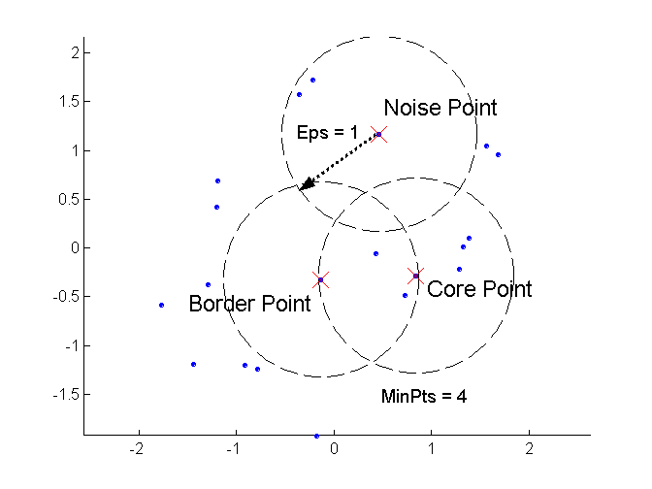
DBSCAN: Core, Border, and Noise Points

Slide 29
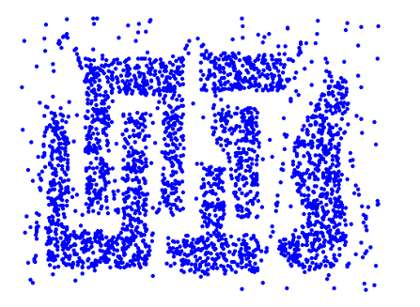
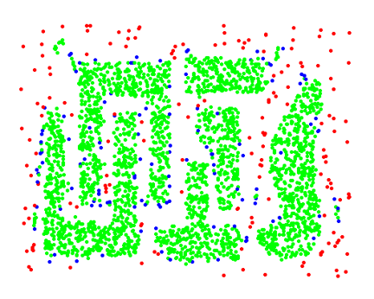
DBSCAN: Core, Border, and Noise Points
Original Points
Point types: core, border and noise
Eps = 10, MinPts = 4

Slide 30
The DBSCAN Algorithm
Label all points as core, border, or noise points.
Eliminate noise points
Perform clustering on the remaining points
Put an edge between all core points within a distance Eps of each other
Make each group of connected core points into a separate cluster
Assign each border point to one of clusters of its associated core points
Notes:
An animation on DBSCAN: https://towardsdatascience.com/the-5-clustering-algorithms-data-scientists-need-to-know-a36d136ef68

Slide 31
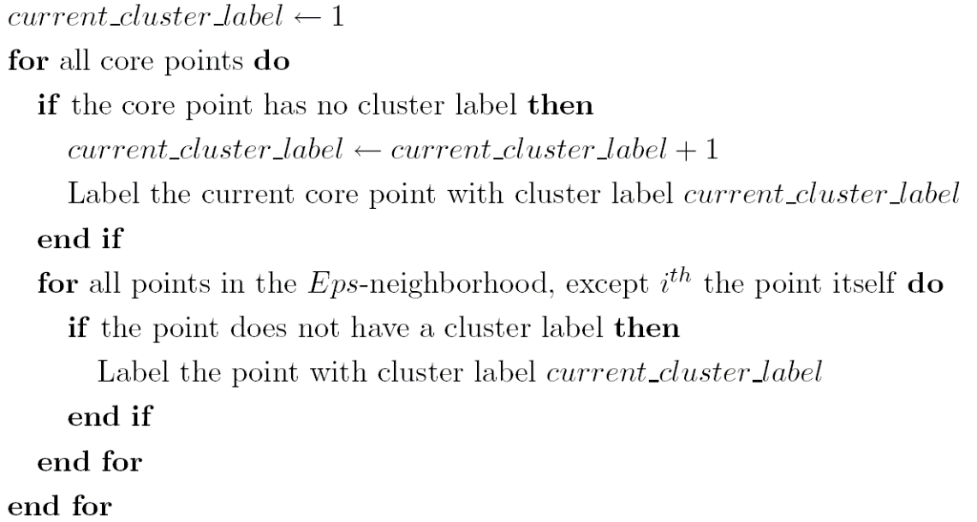
The DBSCAN Algorithm
Label all points as core, border, or noise points.
Eliminate noise points
Perform clustering on the remaining points
Notes:
An animation on DBSCAN: https://towardsdatascience.com/the-5-clustering-algorithms-data-scientists-need-to-know-a36d136ef68

Slide 32
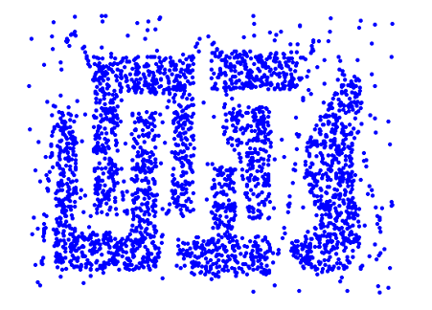
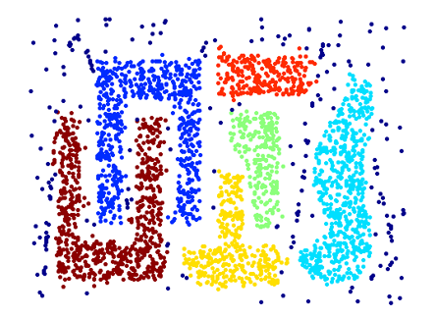
When DBSCAN Works Well
Original Points
Clusters
Resistant to Noise
Can handle clusters of different shapes and sizes

Slide 33
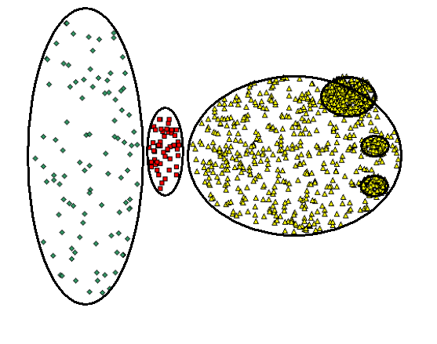
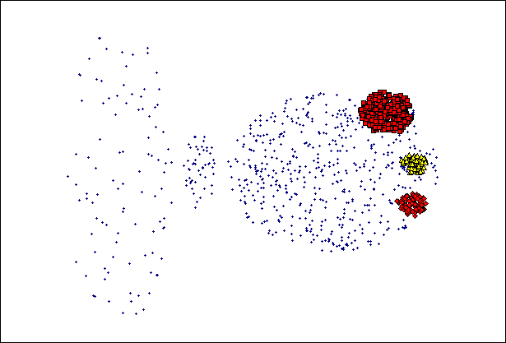
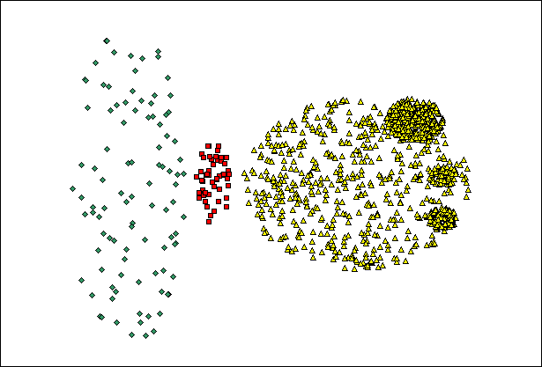
When DBSCAN Does NOT Work Well
(MinPts=4, Eps=9.75).
(MinPts=4, Eps=9.92)
Varying densities
High-dimensional data

Slide 34
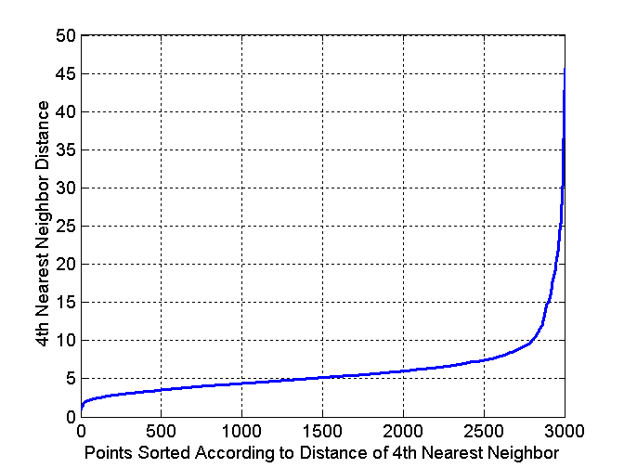
DBSCAN: Determining Eps and MinPts
For a k, the idea is that for points in a cluster, their k-th nearest neighbors are at roughly the same distance
Noise points have the k-th nearest neighbor at farther distance
So, plot sorted distance of every point to its k-th nearest neighbor
Expect to see a sharp change at the distance -- a suitable value for Eps
k is the corresponding MinPts
Selection of k:
too small, a small number of closely spaced noise/outlier can be incorrectly labelled as clusters;
too big, small clusters with less than k points are likely to be labelled as noise.
k=4 works well for most 2-dimensional data sets

Slide 35
References
Most of the slides are from or have their materials taken from the following sources (unless otherwise indicated):
https://www-users.cs.umn.edu/~kumar001/dmbook/firsted.php
https://www-users.cs.umn.edu/~kumar001/dmbook/index.php
http://web.engr.illinois.edu/~hanj/bk3/

