Slide 1
INFS 5102 Unsupervised Methods in Analytics
Module 3 – Cluster Analysis
Part 3: Validation

Slide 2
Outline
Concepts
What is cluster analysis
Types of clustering and types of clusters
Major clustering approaches
Similarity/dissimilarity measures
Methods
Partition based method – K-means
Hierarchical clustering
Density based method
Validation

Slide 3
Cluster Validity
For supervised classification we have a variety of measures to evaluate how good our model is, e.g.
accuracy, precision, recall
For cluster analysis, the analogous question is how to evaluate the “goodness” of the resulting clusters?
But “clusters are in the eye of the beholder”!
Then why do we want to evaluate them?
To avoid finding patterns in noise
To compare clustering algorithms
To compare two sets of clusters
To compare two clusters

Slide 4
Clusters Found in Random Data
Random Points
DBSCAN
K-means
Complete Link

Slide 5
Measuring Clustering Quality/Validity
Two kinds of measures: External & internal
Internal: unsupervised, criteria derived from data itself
Evaluate the goodness of a clustering by considering how well the clusters are separated, and how compact the clusters are,
Example: SSE
External: supervised, employ criteria not inherent to the dataset
Compare a clustering against prior or expert-specified knowledge (i.e., the ground truth) using certain clustering quality measure
Example: Entropy, which measures how well cluster labels match externally supplied class labels
Relative: use either supervised or unsupervised measures to directly compare different clusterings or clusters, usually those obtained via different parameter settings for the same algorithm

Slide 6
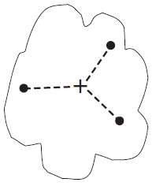
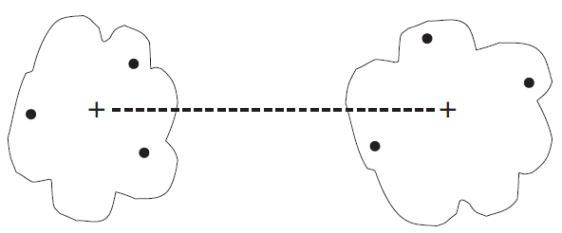
Internal Measures: Cohesion & Separation – Centroid-based view
Cluster Cohesion: Measures how closely objects are related in a cluster
Cluster Separation: Measure how distinct or well-separated a cluster is from other clusters
Example: Squared Error
Cohesion is measured by the within cluster Sum of Square Errors (SSE)
Separation is measured by the Between cluster Sum of Squares
where |C_{i}| is the size of cluster i , m is the overall mean, and m_{i} is the centroid of cluster C_{i}
It can be shown that the sum of SSE and SSB is a constant given a dataset
Note: the above evaluates the whole clustering results. Can also evaluate individual clusters obtained (without doing the outer sum)

Slide 7
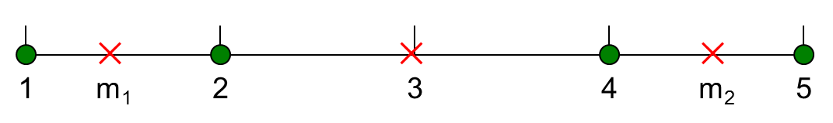
Internal Measures: Cohesion and Separation
Example: Squared error
BSS + SSE = constant
K=1 cluster:
K=2 clusters:

Slide 8
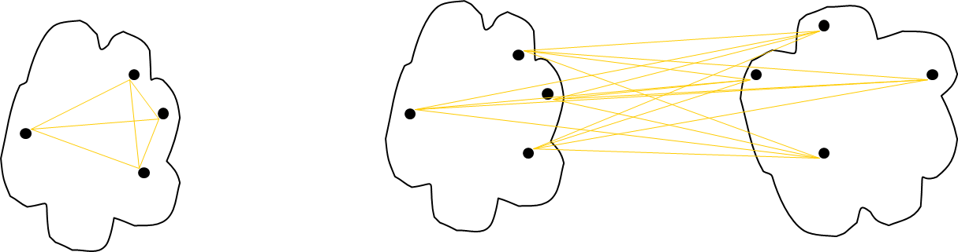
Internal Measures: Cohesion & Separation – Graph-based view
A proximity graph based approach can also be used for cohesion and separation
Cluster cohesion is the sum of the weight (indicating proximity between nodes/objects) of all links within a cluster
Cluster separation is the sum of the weights between nodes in the cluster and nodes outside the cluster
cohesion
separation

Slide 9
Internal Measures: Silhouette Coefficient
Silhouette Coefficient combine ideas of both cohesion and separation
Can be used for individual points, clusters and clusterings
For an individual point, i
Calculate a = average distance of i to the points in its cluster
Calculate b = min (the average distance of i to all points in another cluster, w.r.t. all clusters)
The silhouette coefficient for a point is then given by s = 1 – a/b if a < b; or s = b/a - 1 if a ≥ b (not the usual case)
The value of s vary between -1 and 1, but typically between 0 and 1.
The closer to 1, the better.
Can calculate the Average Silhouette for a cluster or a clustering

Slide 10
Measuring Cluster Validity via Correlation
Two matrices
Proximity Matrix
“Incidence” Matrix
One row and one column for each data point
An entry is 1 if the associated pair of points belong to the same cluster
An entry is 0 if the associated pair of points belongs to different clusters
Compute the correlation between the two matrices
Since the matrices are symmetric, only the correlation between n(n-1)/2 entries needs to be calculated
High correlation indicates that points that belong to the same cluster are close to each other
Not a good measure for some density or contiguity based clusters

Slide 11
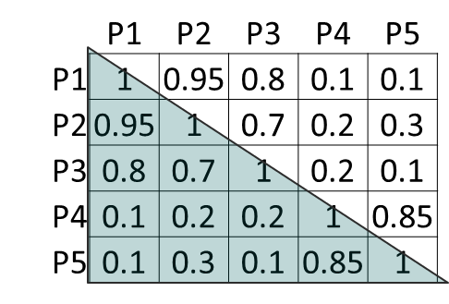
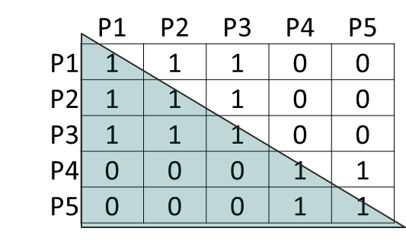
Measuring Cluster Validity Via Correlation
Clustering results: two clusters {P1, P2, P3}, {P4, P5}, represented using the incidence matrix:
Example:
Proximity matrix (similarity)
Calculate the correlation between the two matrices
As each of the matrices is symmetric, we only use the values above or below the diagonal of the matrix. i.e., the correlation between the two vectors shown below, which is 0.9698
The higher the correlation (in absolute value), the better is the clustering

Slide 12
Measuring Cluster Validity Via Correlation
Correlation of incidence and proximity (distance) matrices for the K-means clusterings of the following two data sets
Corr = -0.9235
Corr = -0.5810

Slide 13
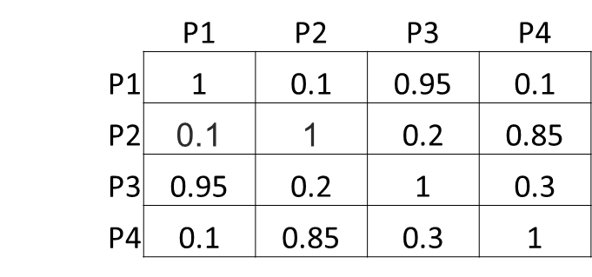
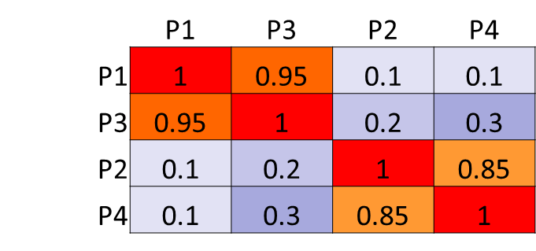
Using Similarity Matrix for Cluster Validation
Order the similarity matrix with respect to cluster labels, and different colors indicate different similarity.
For well-separated clusters, the ordered matrix should be roughly block-diagonal
Example: C1={P1, P3}, C2={P2,P4}

Slide 14
Using Similarity Matrix for Cluster Validation
Order the similarity matrix with respect to cluster labels and inspect visually

Slide 15
Using Similarity Matrix for Cluster Validation
DBSCAN

Slide 16
Using Similarity Matrix for Cluster Validation
Clusters in random data are not so crisp
DBSCAN

Slide 17
Using Similarity Matrix for Cluster Validation
Clusters in random data are not so crisp
K-means

Slide 18
Using Similarity Matrix for Cluster Validation
Clusters in random data are not so crisp
Complete Link

Slide 19
Internal Measures: SSE
SSE is good for comparing two clusterings or two clusters
Can also be used to estimate the number of clusters – look for distinct knee in the SSE plot vs. different number of K
a distinct keen at K=10

Slide 20
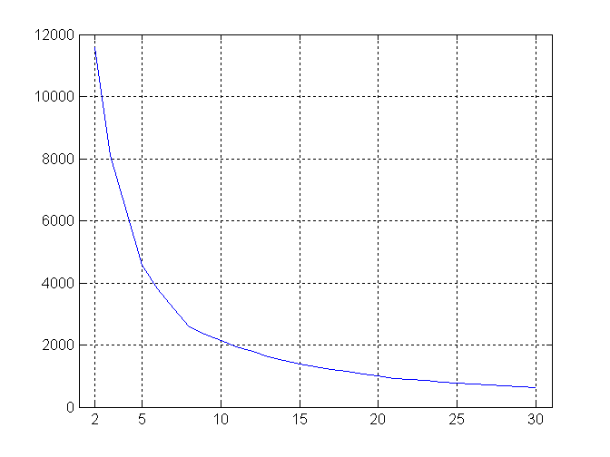
Internal Measures: SSE
SSE curve for a more complicated data set
SSE of clusters found using K-means

Slide 21
Assessing the Significance of Cluster Validity Measures
Need a framework to interpret any measure
For example, if our measure of evaluation has the value, 10, is that good, fair, or poor?
Statistics provide a framework for cluster validity
The more “atypical” a clustering result is, the more likely it represents valid structure in the data
Can compare the values of a measure that result from random data or clusterings to those of a clustering result.
If the value of the measure is unlikely (obtained from random data or clustering), then the clustering results are valid
These approaches are more complicated and harder to understand.
For comparing the results of two different sets of cluster analyses, a framework is less necessary.
However, there is the question of whether the difference between two values of a measure is significant

Slide 22
Statistical Significance of SSE
Example
Histogram shows SSE of three clusters in 500 sets of random data points of size 100 distributed over the range 0.2 – 0.8 for x and y values
Compare SSE of 0.005 of the clustering result on the right against three clusters in random data
0.005 is not in the range covered by the histogram, indicating that it is unlikely for the clustering on the right to happen by chance

Slide 23
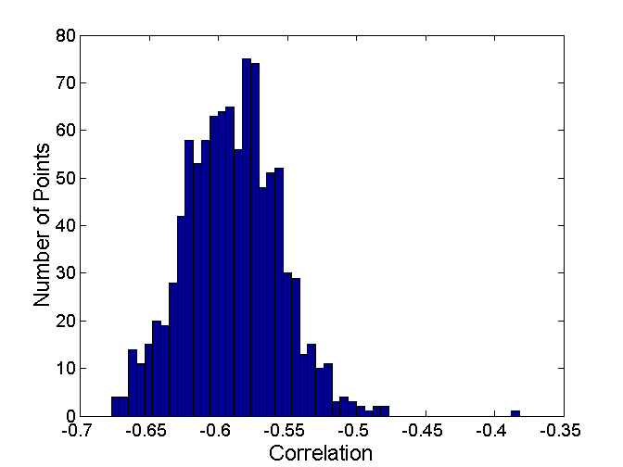
Statistical Significance of the Correlation based Method
Correlation of incidence and proximity matrices for the K-means clusterings of the following two data sets
Corr = -0.9235
Corr = -0.5810

Slide 24
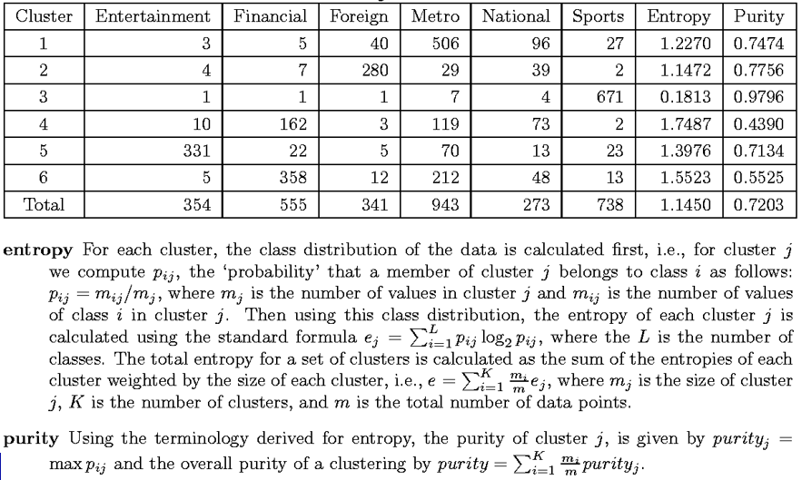
External Measures of Cluster Validity: Entropy and Purity

Slide 25
Final Comment on Cluster Validity
“The validation of clustering structures is the most difficult and frustrating part of cluster analysis.
Without a strong effort in this direction, cluster analysis will remain a black art accessible only to those true believers who have experience and great courage.”
---Algorithms for Clustering Data, Jain and Dubes

Slide 26
Basic Steps to Develop a Clustering Task
Feature selection
Select info concerning the task of interest
Minimal information redundancy
Proximity measure
Similarity of two feature vectors
Clustering criterion/objective function
Expressed via a cost function or some rules
Clustering algorithms
Choice of algorithms
Validation of the results
Choice of measures
Interpretation of the results
Integration with applications

Slide 27
References
Most of the slides are from or have their materials taken from the following sources (unless otherwise indicated):
https://www-users.cs.umn.edu/~kumar001/dmbook/firsted.php
https://www-users.cs.umn.edu/~kumar001/dmbook/index.php
http://web.engr.illinois.edu/~hanj/bk3/

