Slide 1
INFS 5102 Unsupervised Methods in Analytics
Module 6 – Association Analysis
Part 1

Slide 2
Outline
Problem formulation
Basic definitions
Association rule mining
The problem
The two-step approach
Frequent itemset generation
The Apriori principle
Frequent itemset generation in the Apriori algorithm
Rule generation
The problem
Rule generation in the Apriori algorithm
Pattern evaluation

Slide 3
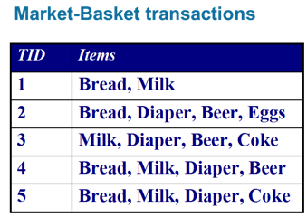
What is Association Analysis?
A methodology for discovering interesting relationships hidden in large data sets
Data sets are typically transaction or market basket data
The uncovered relationships can be represented in the form of
association rules, or
frequent itemsets
Examples of association rules:
{Diaper → {Beer}
{Milk}→{Bread}
{Coke}→{Milk, Diaper}
Note: implication (→) means co-occurrence, not necessarily causality!
Examples of frequent itemsets:
{Bread}, {Diaper}, {Milk},
{Diaper, Beer}, {Bread, Diaper}

Slide 4
What is Association Analysis?
Example applications:
You are a manager of a bookstore, which has a large collection of customer transactions. How do you use the data to serve customers better?
Customers who bought this item also bought
Data Mining: Practical Machine Learning Tools and Techniques, Second Edition (Morgan Kaufmann Series in Data Management Systems) by Ian H. Witten
Introduction to Data Mining by Pang-Ning Tan
Machine Learning by Tom M. Mitchell
Data Mining Techniques: For Marketing, Sales, and Customer Relationship Management by Michael J. A. Berry
Data Preparation for Data Mining (The Morgan Kaufmann Series in Data Management Systems) by Dorian Pyle
What products were often purchased together?
What are the subsequent purchases after buying a PC?
What kinds of DNA are sensitive to this new drug?

Slide 5
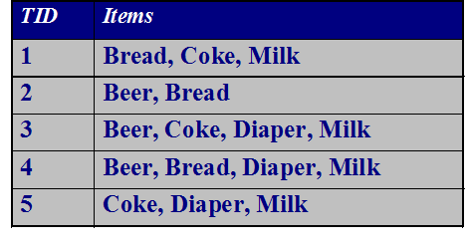
Definition: Transaction Data
A special type of record data, where
each record (transaction) involves a set of items
An item can be treated as a binary variable:
Value is 1 if the item is present in a transaction and 0 otherwise
Asymmetric binary value as an item present in a transaction is often considered more importance than its absence
A transaction data set can be represented by a data matrix of binary attributes
TID | Beer | Bread | Coke | Diaper | Milk
1 | 0 | 1 | 1 | 0 | 1
2 | 1 | 1 | 0 | 0 | 0
3 | 1 | 0 | 1 | 1 | 1
4 | 1 | 1 | 0 | 1 | 1
5 | 0 | 0 | 1 | 1 | 1

Slide 6
Definition: Frequent Itemset
Itemset
A collection of one or more items
Example: {Milk, Bread, Diaper}
k-itemset
An itemset that contains k items, e.g. a 2-itemset: {milk, bread}
Support count of an itemset (σ)
Frequency of occurrence of an itemset
Example: σ({Milk, Bread, Diaper}) = 2
Support of an itemset
Fraction of transactions that contain an itemset
Example: s({Milk, Bread, Diaper}) = 2/5
Frequent Itemset
An itemset whose support is greater than or equal to a minsup threshold
Example: if minsup=0.6, then {Milk, Bread} is a frequent itemset, but {Milk, Bread, Diaper} is not.

Slide 7
Definition: Association Rule
Association Rule
An implication expression of the form X → Y, where X and Y are itemsets
Example: {Milk, Diaper} → {Beer}
Rule Evaluation Metrics
Support of a rule (s)
Fraction of transactions that contain both X and Y
Confidence of a rule (c)
Measures how often items in Y appear in transactions that contain X, i.e., c= P(Y|X) = σ (X,Y)/ σ(X)
Example:
where |T| is the total number of transactions in the dataset.

Slide 8
Definition: Association Rule
Example of Rules: Items: bread, milk, diaper, beer eggs, coke
{Milk,Diaper} → {Beer} (s=2/5, c=2/3) {Milk,Beer} → {Diaper} (s=2/5, c=2/2)
{Diaper,Beer} → {Milk} (s=2/5, c=2/3)
{Beer} → {Milk,Diaper} (s=2/5, c=2/3) {Diaper} → {Milk,Beer} (s=2/5, c=2/4)
{Milk} → {Diaper,Beer} (s=2/5, c=2/4)
Observations:
All the above rules are binary partitions of the same itemset: {Milk, Diaper, Beer}
Rules originating from the same itemset have identical support but can have different confidence

Slide 9
Association Rule Mining
Given a set of transactions T, the goal of association rule mining is to find all rules having
support ≥ minsup threshold
confidence ≥ minconf threshold
Why use support and confidence?
High support → Rules not occurred by chance
High confidence → Reliable inference
Brute-force approach:
List all possible association rules
Compute the support and confidence for each rule
Prune rules that fail the minsup and minconf thresholds
Computationally prohibitive!

Slide 10
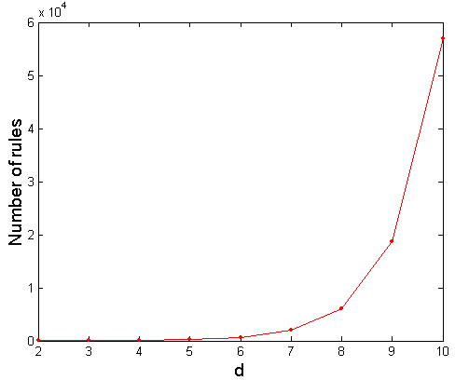
Computational Complexity
Given d unique items:
Total number of itemsets = 2^{d}
Total number of possible association rules:
If d=6, R = 602 rules
If d=10, R= 57002 rules

Slide 11
Mining Association Rules: the two-step approach
Two steps approach:
Frequent Itemset Generation
Generate all itemsets whose support ≥ minsup
Rule Generation
Generate high confidence rules from each frequent itemset, where each rule is a binary partitioning of a frequent itemset
The Apriori algorithm is a well-known algorithm for association rule mining
Use the Apriori principle and special data structure to generate frequent itemsets efficiently
Use the property of confidence for rule generation

Slide 12
Frequent Itemset Generation
A lattice structure can be used to enumerate the possible itemsets
Given d items, there are 2^{d} possible candidate itemsets!

Slide 13
Frequent Itemset Generation
Brute-force approach:
Each itemset in the lattice is a candidate frequent itemset
Count the support of each candidate by scanning the database
Match each transaction against every candidate
Complexity ~ O(NMw) => Expensive since M = 2^{d} !!!

Slide 14
Frequent Itemset Generation
Reduce the number of candidates (M)
Complete search: M=2^{d}
Use pruning techniques to reduce M
Reduce the number of comparisons (NM)
Use efficient data structures to store the candidates or transactions
No need to match every candidate against every transaction

Slide 15
Reducing Number of Candidates – the Apriori principle
The Apriori principle:
If an itemset is frequent, then all of its subsets must also be frequent
In other words, if an itemset is infrequent, none of its supersets will be frequent
The Apriori principle holds due to the following property of the support measure:
Support of an itemset never exceeds the support of its subsets
This is known as the anti-monotone property of support

Slide 16
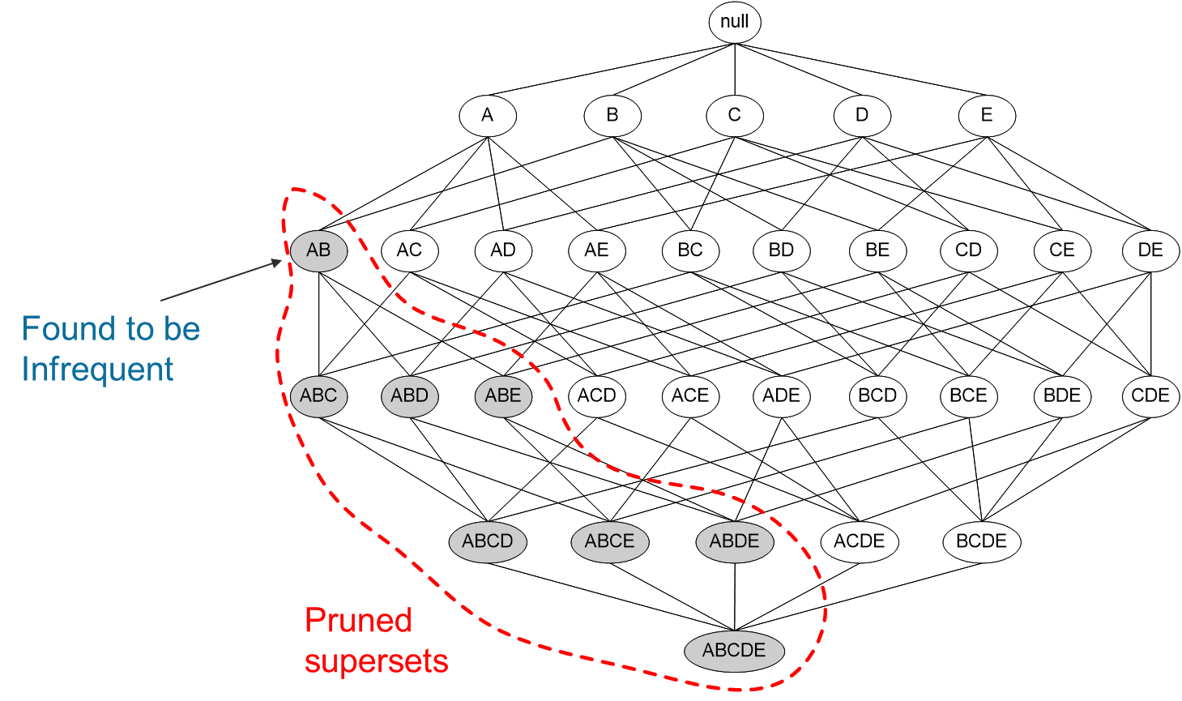
Illustrating the Apriori Principle

Slide 17
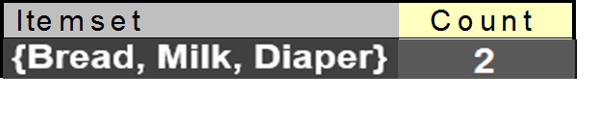
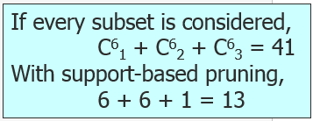
Illustrating the Apriori Principle
Questions:
Do I have to try to merge every pair of frequent 2-itemsets to get candidate 3-itemsets?
Why only 1 candidate 3-itemset is generated? For example, why not generate the 3-itemset {Milk, Diaper, Beer} as a candidate itemset?
Minimum Support Count= 3
Candidate 1-itemsets (all
items each forms a
candidate 1-itemset
Check if candidates are
infrequent: {Coke}, {Eggs}
infrequent, removed
Generate candidate 2-itemsets
(No need to generate candidates
involving Coke or Eggs)
Check if candidates are infrequent:
{Bread, Beer} and {Milk, Beer}
infrequent, removed
Generate candidate 3-itemset(s),
only one candidate generated
The candidate is infrequent, removed
Frequent itemsets obtained:
{Bread}, {Milk}, {Beer}, {diaper}, {Bread, Milk}, {Bread, Diaper}, {Milk, Diaper}, {Beer, Diaper}
Notes:
Answer to the questions:
Not necessary sometimes. For example, merging {Bread, Milk} & { Bread, Diaper} gives us {Bread, Milk, Diaper}; and merging {Bread, Diaper} & {Milk, Diaper} also gives us { Bread, Milk, Diaper}
Then the question is: Can we avoid doing the unnecessary merging?
(2) The 2-itemsets {Milk, Diaper} and {Beer, Diaper} are both frequent, so one may think that we should combine them to generate the 3-itemset {Milk, Diaper, Beer} as a candidate 3-itemset (then test if it is a frequent 3-itemset), however, note that {Milk, Beer} is in-frequent, so any of its superset will be infrequent, therefore no need to generate any 3-itemsets that contain this in-frequent 2-itemsets.
Then the further question is, how can we totally avoid generating such itemsets, i.e. without combining the two candidate 2-itemsets and then getting to know that a subset of the combined result is in-frequent, so we don’t take the result as a candidate 3-itemset?
Let’s keep these questions in mind and see how the Apriori algorithm deals with them.

Slide 18
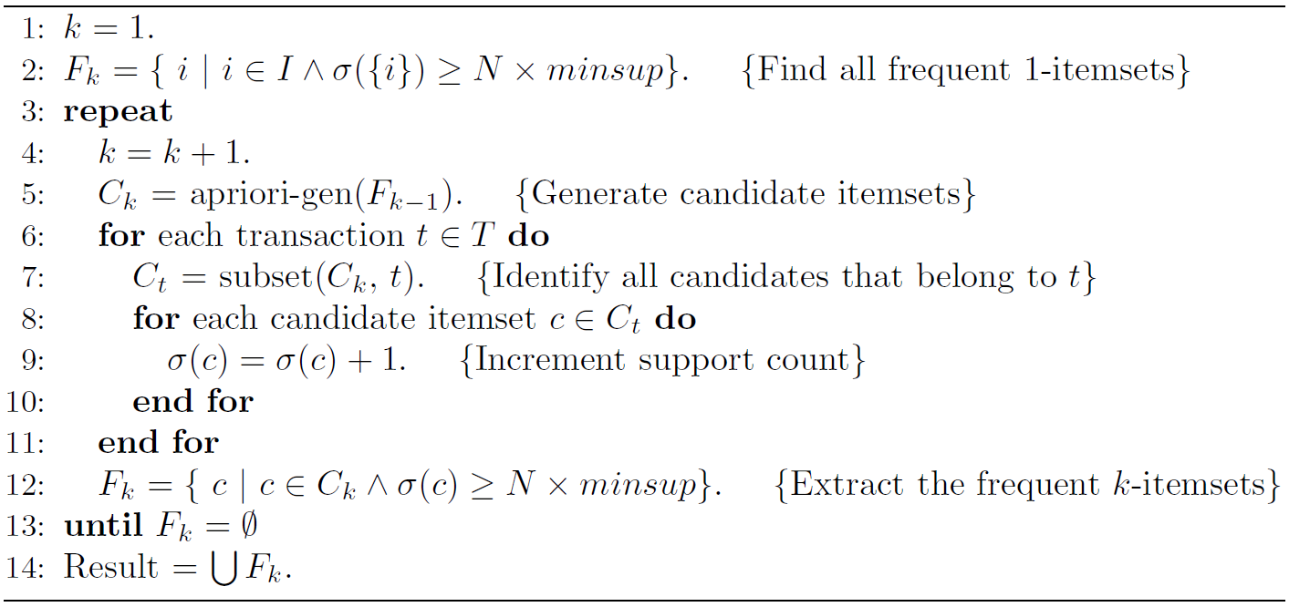
The Apriori Algorithm – the frequent itemset generation part
Candidate generation
Support counting

Slide 19
Candidate Generation
How to generate candidate K-itemsets?
Step 1: self-joining F_{k-1} (F_{k-1} : Frequent (K-1) itemsets)
Step 2: pruning
Example of candidate generation
F₃={abc, abd, acd, ace, bcd}
Self-joining: F₃*F_{3 ,} only merge the two items whose first (K-2) items are the same. In this example K=4, merge the two items in F₃ whose first two items are the same
abcd from abc and abd
acde from acd and ace
Pruning:
acde is removed because ade is not in F₃
C₄={abcd}, it is the only candidate 4-itemset.

Slide 20
Support Counting
After Candidate Generation, support counting needs to be done to determine the frequency of occurrences for every candidate itemset
Brute-force – checking each transaction/candidate directly. Can do this in two ways:
Take a candidate itemset, search through all the transactions to see which transaction contains the candidate. If a transaction contains the candidate itemset, increase the support count of the candidate by 1
Take a transaction, search through all the candidate itemsets to see if which candidates are contained in the transaction. If a candidate itemset is contained in the transaction, increase the support count of this candidate by 1.

Slide 21
Support Counting
Apriori takes the 2nd approach (take a transaction, search the candidate list for candidates that are contained in the transaction)
Questions:
How should we store the candidate itemsets (the number could be huge) to reduce the space of search? (to avoid search through all candidates)
The Apriori uses a hash tree data structure to store transactions
How should we organize the items in a transaction for comparison?
The Apriori uses a systematic way to organize subsets/itemsets in a transaction

Slide 22
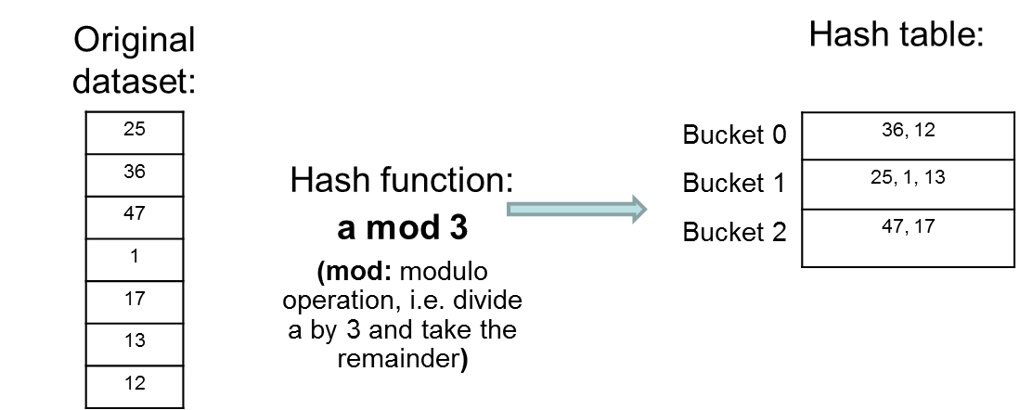
Basic idea of hashing - Illustration with a hash table
Store data using a hash table as follows:
Now if we want to check if a value is in the dataset or not, we firstly hash the value using the same hash function, to get its hash index (bucket number), then go to that bucket to look for the value. (So we don’t need to go through all the items in the original dataset)
For example, to decide if 13 is in the dataset, we do 13 mod 3, get 1. Then we go to bucket 1 of the hash table, find 13, so 13 is in the dataset.
Another example, to find if 14 is in the dataset, we hash 14 using 14 mod 3, get 2. Then we go to bucket 2, cannot find 14 there, so 14 is not in the dataset.

Slide 23
Storing Candidate Itemsets in a Hash Tree
To reduce the number of comparisons, the Apriori algorithm stores the candidates in a hash tree
Candidate itemsets are hashed (partitioned) into different buckets and stored there. The buckets of a hash tree are the tree’s leaf nodes.
Instead of matching a transaction against every candidate, match it against candidates contained in the hashed buckets

Slide 24
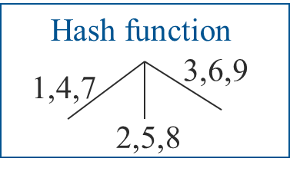
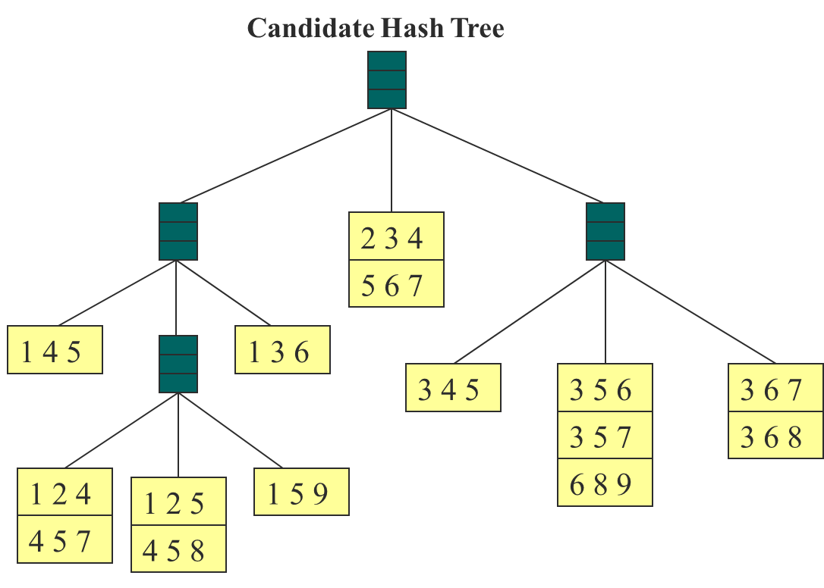
Storing Candidate Itemsets in a Hash Tree
We need:
Hash function
Max leaf size, i.e. max number of itemsets stored in a leaf node (if number of candidate itemsets exceeds max leaf size, split the node)
Example:
Suppose we have 15 candidate itemsets of length 3:
{1 4 5}, {1 2 4}, {4 5 7}, {1 2 5}, {4 5 8}, {1 5 9}, {1 3 6}, {2 3 4}, {5 6 7}, {3 4 5}, {3 5 6}, {3 5 7}, {6 8 9}, {3 6 7}, {3 6 8}
Notes:
Hash tree uses the similar idea of a hash table, and leaf nodes of the tree are the “buckets”. However, a “bucket” of a hash tree here is used to store a given number of k-itemsets, and each itemset contains k items. The above hash tree is used for store the 3-itemsets.
Since an itemset contains k values, we need to hash the individual values/items of the itemset to decide where to store/find the itemset. For example, for itemset {1, 4, 5}, we start from the root node, firstly hash the first item, which is 1, based on the hash function, we should go to left child of the root (or split the root to get and go to its left child); when we are at the left child, we hash the 2nd item, which is 4. According to the hash function, we need to split the current node and go to the left child of the current node, so we move down to the left child (at level 3) now. Then we are supposed to hash the 3rd value 5, according to hash function, we are supposed to split this level 3 node and go to its middle child, but since the current level 3 node hasn’t got any itemset stored, we don’t split it and we just store the item set {1, 4, 5} in this node.
Another example: {3,5,7}:
First standing at root, hash 3, according to hash function, go to the right child of root (at level 2 now). Then hash 5, should go to the middle child (at level 3) now. Then we are supposed to hash 7, but since this current level 3 node only has 1 itemset (3, 5, 6) stored there, not exceeding the maximum leaf size yet (let’s assuming it is 3, i.e. each leaf node can only hold up to 3 itemsets), we don’t need to split this level 3 node, we just store {3, 5, 7} there.

Slide 25
Organizing subsets/itemsets in a transaction
Given a transaction t, what are the possible subsets of size 3 (3-itemsets)?
Notes:
The diagram shows a systematic way of enumerating all the size-3 subsets of the transaction 1,2,3,5,6
Assuming that each itemset keeps its items in increasing lexicographic order, and itemset can be enumerated by specifying the smallest item first, followed by the larger items.
Then we firstly fix the possible first item in an itemset. In this example of constructing 3-itemsets, it can only be 1, 2 or 3, because there are only 1 item following 5 and no item following 6.
After fixing the first item, at level 2, we can identify the second item.

Slide 26
Support Counting using Hash Tree
1 2 3 5 6
transaction
Hash Function
1 +
2 3 5 6
2 +
3 5 6
1,4,7
3,6,9
3 +
5 6
2,5,8
2 3 4
5 6 7
1 4 5
1 3 6
3 4 5
3 5 6
3 6 7
3 5 7
3 6 8
1 2 4
1 2 5
1 5 9
6 8 9
4 5 7
4 5 8
Notes:
Now during the search, the transaction is hashed using the same hash function.
The 3-itemsets contained in the transaction must start with 1, 2, or 3 (see previous slide)
So at the root of the tree, items 1, 2 and 3 are hashed (separately), so that item 1 (together with the items following 1 in the transaction) goes to the left child of the root; item 2 (together with the items following it in the transaction) goes to the middle child; and item 3 (together with the items following it ) goes to the right child.

Slide 27
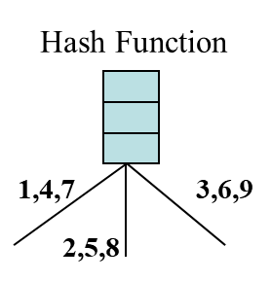
Support Counting using Hash Tree
1 2 3 5 6
transaction
1 +
2 3 5 6
2 +
3 5 6
1 2 +
3 5 6
3 +
5 6
1 3 +
5 6
2 3 4
1 5 +
6
5 6 7
1 4 5
1 3 6
3 4 5
3 5 6
3 6 7
3 5 7
3 6 8
1 2 4
1 2 5
1 5 9
6 8 9
4 5 7
4 5 8
Notes:
At level 2 of the tree, the (possibly partial) transaction is hashed on its second item. …
The process continues until the leaf nodes of the tree are reached.

Slide 28
Support Counting using Hash Tree
1 2 3 5 6
transaction
Hash Function
1 +
2 3 5 6
2 +
3 5 6
1,4,7
3,6,9
1 2 +
3 5 6
3 +
5 6
2,5,8
1 3 +
5 6
2 3 4
1 5 +
6
5 6 7
1 4 5
1 3 6
3 4 5
3 5 6
3 6 7
3 5 7
3 6 8
1 2 4
1 2 5
1 5 9
6 8 9
4 5 7
4 5 8
Match transaction against 9 out of 15 candidates
Notes:
The candidate itemsets stored at the visited leaf nodes are compared against the (possibly partial) transaction. If a candidate is a subset of the (possibly partial) transaction, the support count of the candidate is increased by 1.
As result of using hash tree to store candidate the itemsets (3-itemsets) and the systematic way of enumerating all the size-3 subsets of the transaction, instead of checking each of 15 candidate itemsets to see if the transaction contains each of them or not, we only checked 11 (out of the 15) candidate sets, i.e. those in red rectangles.

Slide 29
Factors Affecting Complexity
Choice of minimum support threshold
lowering support threshold results in more frequent itemsets
this may increase number of candidates and max length of frequent itemsets
Dimensionality (number of items) of the data set
more space is needed to store support count of each item
if number of frequent items also increases, both computation and I/O costs may also increase
Size of database
since Apriori makes multiple passes, run time of algorithm may increase with number of transactions
Average transaction width
transaction width increases with denser data sets
This may increase max length of frequent itemsets and traversals of hash tree (number of subsets in a transaction increases with its width)

Slide 30
Compact Representation of Frequent Itemsets
In practice, the number of frequent itemsets produced from a transaction data set can be very large.
It is useful to identify a small representative set of itemsets from which all other frequent itemsets can be derived
Maximal frequent itemsets and closed frequent itemsets serve for this purpose.

Slide 31
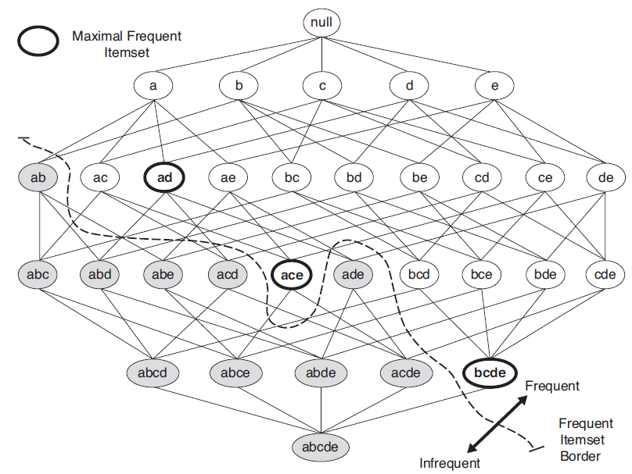
Maximal Frequent Itemset
An itemset is maximal frequent if none of its immediate supersets is frequent

Slide 32
Maximal Frequent Itemset
The maximal frequent itemsets form the smallest set of itemsets from which all frequent itemsets can be derived
However, maximal frequent itemsets do not contain the support information of their subsets

Slide 33
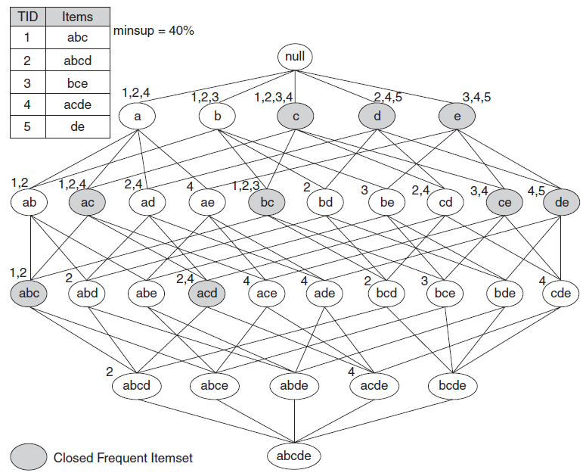
Closed Itemset
An itemset is closed if none of its immediate supersets has the same support as the itemset
Closed itemsets provide a minimal representation of itemsets without losing their support information
An itemset is a closed frequent itemset if it is closed and its support is greater than or equal to minsup

Slide 34
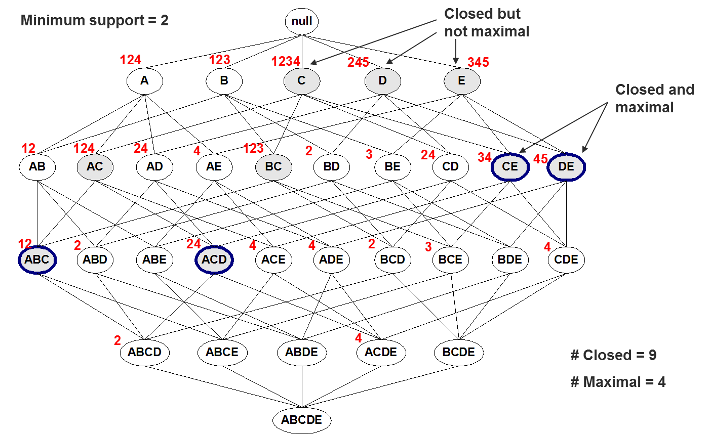
Maximal vs Closed Frequent Itemsets

Slide 35
Maximal vs Closed Frequent Itemsets

Slide 36
References
Most of the slides are from or have their materials taken from the following sources (unless otherwise indicated):
https://www-users.cs.umn.edu/~kumar001/dmbook/firsted.php
https://www-users.cs.umn.edu/~kumar001/dmbook/index.php
http://web.engr.illinois.edu/~hanj/bk3/

