Slide 1
INFS 5102 Unsupervised Methods in Analytics
Course Overview
SP2, 2023

Slide 2
Welcome

Slide 3
Introduction – Unsupervised Methods
What does “unsupervised” mean? – will find out while we go
Examples: cluster analysis; association analysis
Important tools for understanding data, reducing the amount of data for further analysis, and discovering interesting patterns in data
Outcome of unsupervised analysis can provide us insights into the data and the related problems, and serve as the starting point for further analysis
Support a wide range of applications, such as customer profiling, anomaly detection, and market basket analysis

Slide 4
Aim
To develop knowledge of the core techniques of unsupervised methods in data analytics, and to apply these techniques to large complex data sets using industry standard tool sets

Slide 5
Content
7 modules:
Introduction
Data
Cluster analysis
Customer segmentation*
Anomaly detection*
Association analysis
Advanced/other topics
*Both customer segmentation and anomaly detection are important application areas of cluster analysis, but each by itself is a separate and broader topic, so we organise them as separate modules. While customer segmentation will be briefly introduced, we will spend much more time on anomaly detection.

Slide 6
Activities
Lecture
Zoom class: Wednesday 12:10pm-2:00pm, starting from week 1
Attendance: required for internal students; external students are encouraged to attend (external students are required to listen to recorded sessions if not able to attend)
Practical
Internal students: In-person class, starting from week 2 (Attendance is required)
External students: complete weekly practical tasks in own time, with Zoom help available during the above scheduled practical class time and Lin’s consultation hours.
Outside the classes
Pre-study & Revision, including readings/reference book chapters
(unfinished) practical activities
Homework
Assignments
4.5-unit course → about (at least?) 10 hours of study per week

Slide 7
Assessments

Slide 8
Assessments – Continuous assessment
Weekly practical tasks
2% for a week’s practical
Submit online. Marks are given based on completion rate.
To be completed weekly. No extensions available, and zero marks if submit late
A small amount of marks, but important for consolidating the knowledge learnt, and for doing assignments and final exam
Details will be given on Learnonline site on a weekly basis

Slide 9
Assessments – Assignment 1
Assignment 1 (25%) - Individual assessment
Cluster analysis
Main tasks:
Pre-process a given data set for cluster analysis
Use the specified tool to conduct cluster analysis with the specified clustering methods
Analyse and compare the results obtained using different methods
Deliverable: report
Penalty (marks deduction) applies to late submissions

Slide 10
Assessments – Assignment 2
Assignment 2 (35%) - Individual assessment
Applications of unsupervised methods (data analysis and research)
Main tasks:
Literature review related to anomaly detection
Algorithm design for anomaly detection
Anomaly detection with the given data set and designed algorithm
Analyse the results
Deliverable: report
Penalty (marks deduction) applies to late submissions

Slide 11
Assessments – Tests
Tests (20%)
Online timed quiz
Two tests, 10% each
1st week in teaching break, and week 12
Multiple choice questions and short/extended answer questions

Slide 12
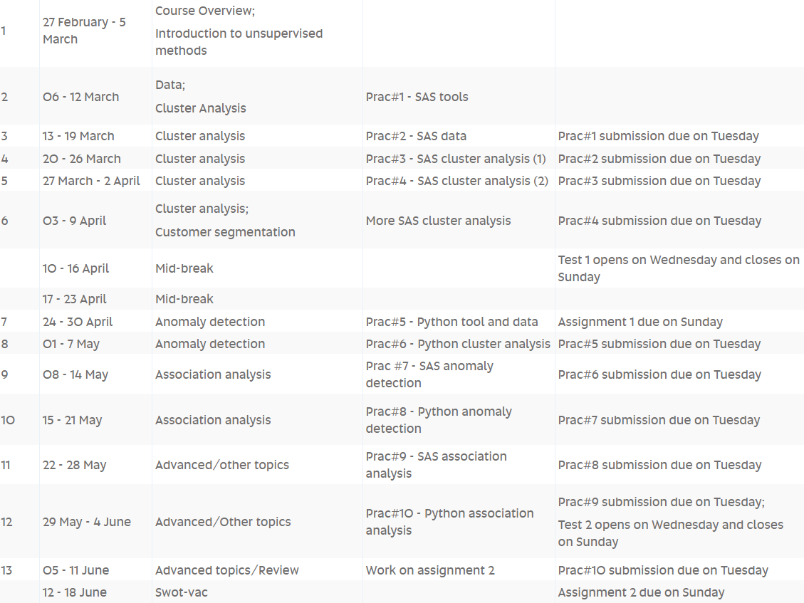
Course calendar

Slide 13
Resources
Learnonline course site
Main source of course information and materials
Updated weekly
Discussion forum
No text book. Reference books/readings, mostly available online
Main tool for practicals: SAS Enterprise Miner (plus Python)
Teaching team
Mat Ghazi, course coordinator, lecturer, and tutor
Email: Mat.Ghazi@unisa.edu.au

Slide 14
Welcome
Look forward to working with you all in the new semester!

