Slide 1
INFS 5102 Unsupervised Methods in Analytics
Module 6 – Association Analysis
Part 2

Slide 2
Outline
Problem formulation
Basic definitions
Association rule mining
The problem
The two-step approach
Frequent itemset generation
The Apriori principle
Frequent itemset generation in the Apriori algorithm
Rule generation
The problem
Rule generation in the Apriori algorithm
Pattern evaluation

Slide 3
Mining Association Rules: the two-step approach
Two steps approach:
Frequent Itemset Generation
Generate all itemsets whose support ≥ minsup
Rule Generation
Generate high confidence rules from each frequent itemset, where each rule is a binary partitioning of a frequent itemset

Slide 4
Rule Generation
Task: Given a frequent itemset F, find all non-empty subsets L ⊂ F such that L → (F – L) satisfies the minimum confidence requirement
Note: all these rules must have already met the support threshold as they are generated from a frequent itemset
Naïve approach: partition F into two non-empty subsets
Example:
If {A,B,C,D} is a frequent itemset, candidate rules:
A →BCD, B →ACD, C →ABD, D →ABC,
AB →CD, AC → BD, AD → BC, BC →AD, BD →AC, CD →AB,
ABC →D, ABD →C, ACD →B, BCD →A,
If |F| = k, then there are 2^{k} – 2 candidate association rules (ignoring F → ∅ and ∅ → F)

Slide 5
Rule Generation
How to efficiently generate rules from frequent itemsets?
In general, confidence does not have an anti-monotone property
c(ABC →D) can be larger or smaller than c(AB →D)
But confidence of rules generated from the same itemset has an anti-monotone property
e.g., F = {A,B,C,D}, then c(ABC → D) ≥ c(AB → CD) ≥ c(A → BCD)
Confidence is anti-monotone w.r.t. number of items on the RHS (right hand side) of the rule
If ABC→ D is not a high confidence rule, all the rules generated from F whose RHS contains D can be discarded (pruned) without needing to test their confidence.

Slide 6
Rule Generation
Based on the anti-monotone property stated on the previous slide, a candidate rule should be generated by only from high confidence rules
We can merge (set union) the consequences (RHS) of two high confidence rules
Example: Assume that CD→AB and BD→AC are two high confidence rules,
Merge the RHS of CD→AB and BD→AC
As the union of the RHS of the two rules is ABC, and the frequent itemset is ABCD, the LHS has to be D), we get D →ABC
If the RHS of D→ABC contains the RHS of a low confidence rule, D→ABC is pruned (without checking its confidence); otherwise, D→ABC is considered as a candidate rule

Slide 7
Rule Generation by the Apriori Algorithm
Apriori uses a level-wise approach for generating association rules, where each level corresponds to the number of items that belong to the rule consequent (RHS).
Initially, all the high confidence rules that have only one item in the rule consequent are extracted. These rules are then used to generate new candidate rules.
The generated candidate rules will be tested for confidence before the algorithm moves to the next level.
If any generated candidate at a level has low confidence, not only itself is discarded, also according to the anti-monotone property of confidence (regarding rules generated from the same itemset), the entire subgroup spanned by the node (i.e. any rules whose RHS contain the RHS of this low confidence rule) can be pruned immediately.

Slide 8
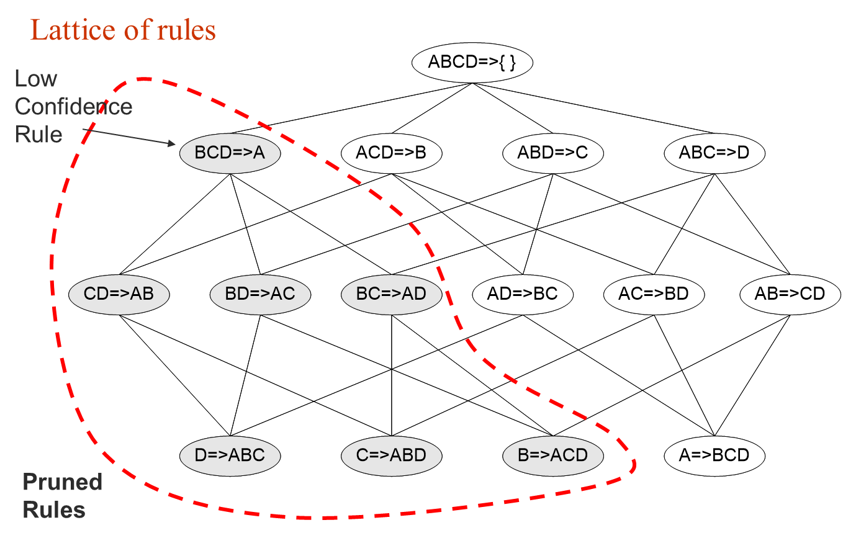
Rule Generation by the Apriori Algorithm

Slide 9
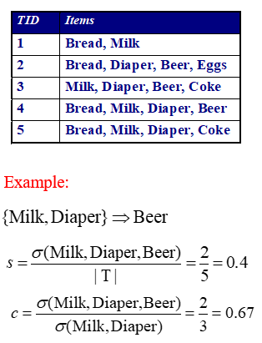
Pattern Evaluation
In the original formulation of association rules, support & confidence are the only measures used
Recall that
Support (s)
Fraction of transactions that contain both X and Y, or P(X,Y)
Confidence (c)
Measures how often items in Y appear in transactions that contain X, or P(Y|X)

Slide 10
Pattern Evaluation
However, association rule mining algorithms tend to produce too many rules
many of them are uninteresting or redundant
{A,B,C} → {D} is redundant if {A,B,C} → {D} and {A,B} → {D} have same support & confidence
Interestingness measures can be used to prune/rank the derived patterns

Slide 11
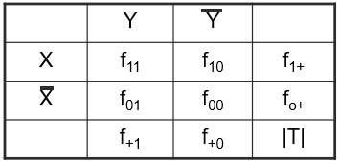
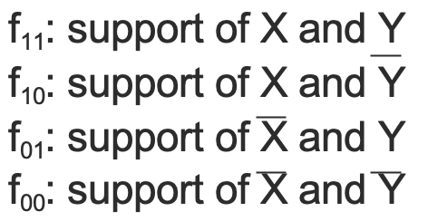
Computing Interestingness Measures
Given a rule X → Y, information needed to compute rule interestingness can be obtained from a contingency table:
Contingency table for X → Y
Used to define various measures:
support, confidence, lift, Gini, J-measure, etc.

Slide 12
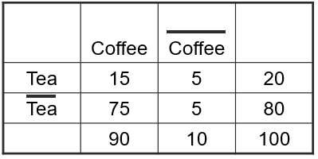
Drawback of Confidence
Association Rule: Tea → Coffee
Confidence= P(Coffee|Tea) = 0.75, meaning people who drink team are more likely to drink coffee and the rule seems reasonable,
but P(Coffee) = 0.9, meaning knowing someone drinks tea “reduces” the probability that the person drinks coffee.
Although confidence is high, the rule Tea → Coffee is misleading. Also note that P(Coffee|Tea) = 0.9375

Slide 13
Drawback of Confidence
Then what kind of rules do we really want?
Confidence(X → Y) should be sufficiently high, to ensure that people who buy X will more likely buy Y than not buy Y
Confidence(X → Y) should be greater than support(Y)
Otherwise, rule will be misleading because having item X actually reduces the chance of having item Y in the same transaction
Is there any measure that capture this constraint?
Answer: Yes. There are many of them, which make use of statistical dependence between X and Y

Slide 14
Statistical Relationship between X and Y
Note that confidence(X → Y) = support(Y) is equivalent to:
P(Y|X) = P(Y) or P(X,Y) = P(X) × P(Y), indicating X and Y are independent
If P(X,Y) > P(X) × P(Y) : X and Y are positively correlated
If P(X,Y) < P(X) × P(Y) : X and Y are negatively correlated

Slide 15
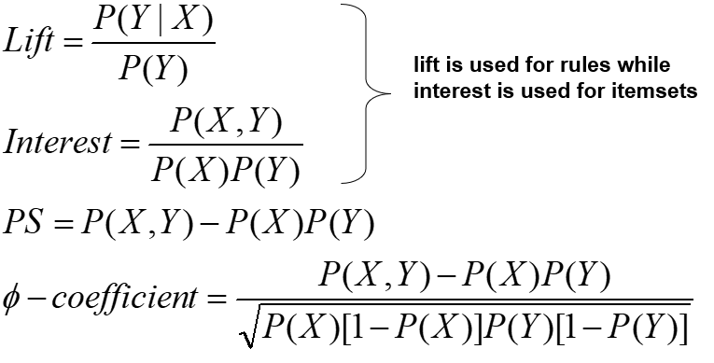
Measures taking into account statistical dependence

Slide 16
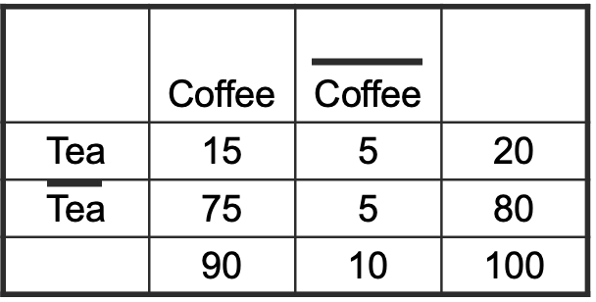
Example: Lift (a.k.a Interest Factor)
The tea-coffee example shows that high-confidence rules can sometimes be misleading because the confidence measure ignores the support of the itemset appearing in the rule consequent.
Lift computes the ratio between the rule’s confidence and the support of the itemset in the rule consequent.
If Lift = p(Y|X)/P(Y) <1, we have P(Y|X)*P(X) / P(Y) < P(X), i.e. P(X,Y) < P(X)P(Y), then X and Y negatively associated.
Similarly, if Lift >1, X and Y positively associated.
Tea → Coffee
Confidence= P(Coffee|Tea) = 0.75
but P(Coffee) = 0.9
Lift = 0.75/0.9= 0.8333 (< 1,
therefore is negatively associated)

Slide 17
Drawback of Lift
 | Y | Y
X | 10 | 0 | 10
X | 0 | 90 | 90
 | 10 | 90 | 100
 | Y | Y
X | 90 | 0 | 90
X | 0 | 10 | 10
 | 90 | 10 | 100
In both cases, X occurs if and only if Y occurs and vice versa, but two different Lift values

Slide 18
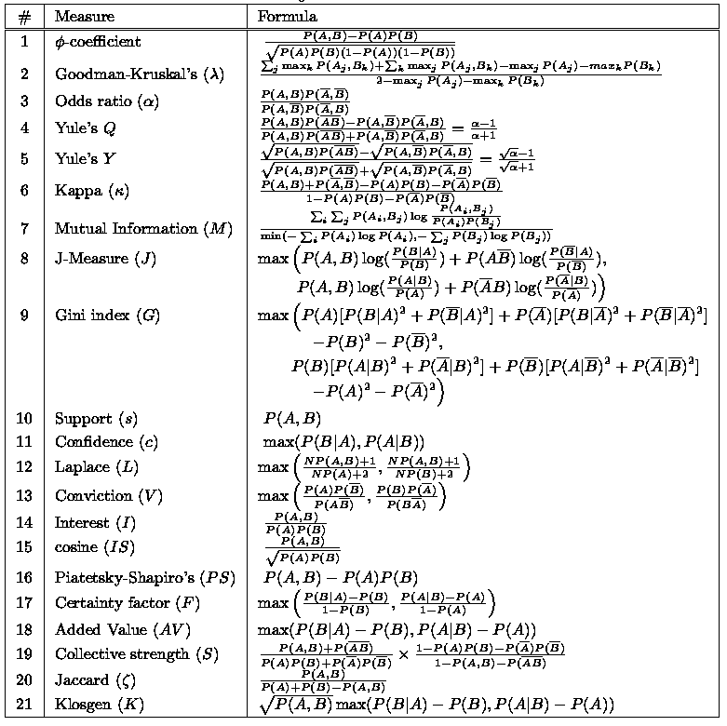
There are lots of measures proposed in the literature
Some measures are good for certain applications, but not for others

Slide 19
References
Most of the slides are from or have their materials taken from the following sources (unless otherwise indicated):
https://www-users.cs.umn.edu/~kumar001/dmbook/firsted.php
https://www-users.cs.umn.edu/~kumar001/dmbook/index.php
http://web.engr.illinois.edu/~hanj/bk3/

