Slide 1
INFS 5102 Unsupervised Methods in Analytics
Module 2 - Data

Slide 2
Outline
Data
Data sets, data objects & attributes
Types of data
Types of data sets
Data preprocessing
Why?
Main data preprocessing tasks
Cleaning
Integration
Reduction
Transformation

Slide 3
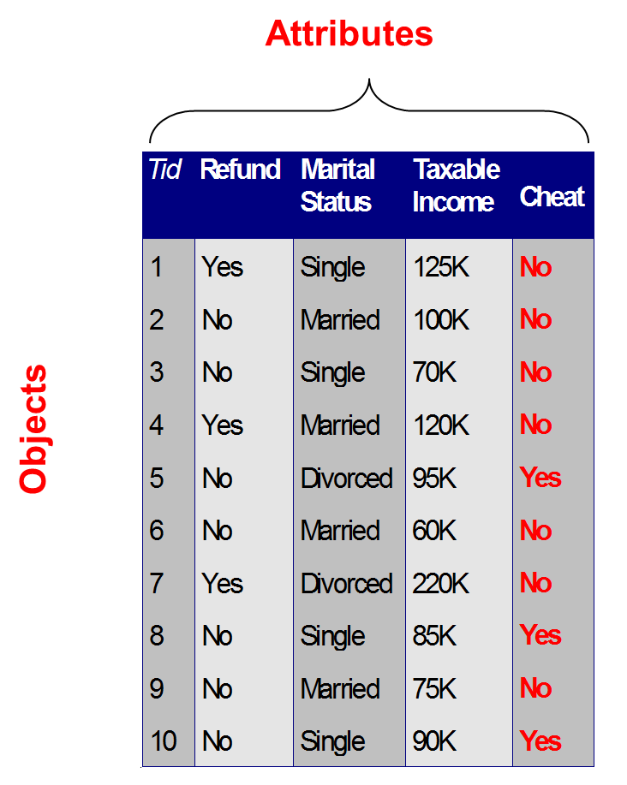
Data Sets, Data Objects & Attributes
A data set consists of data objects
A data object represents an entity
Also called record, sample, example, case, instance, points, entity
Data objects are described by attributes
An attribute is a property, feature or characteristic of an object
Aka: variable, feature, field, characteristic, dimension

Slide 4
Attribute Types
There are many ways to categorise attributes in terms of their values
A type under one way of categorisation may overlap with a type under a different way of categorisation
One common way of categorisation is to divide data into categorical/qualitative and numeric/quantitative data

Slide 5
Categorical
Categorical type is further divided into:
Nominal: categories, states, or “names of things”
Examples: Hair_color, marital status, occupation, ID numbers, zip codes
Binary
Nominal attribute with only 2 states (0 and 1)
Symmetric binary: both outcomes equally important, e.g., gender
Asymmetric binary: outcomes not equally important, e.g., medical test (positive vs. negative)
Convention: assign 1 to most important outcome (e.g., recovered from an illness)
Ordinal
Values have a meaningful order (ranking) but magnitude between successive values is unknown
Examples: Size = {small, medium, large}, grades ={HD, D, C, P1, P2, F1, F2}

Slide 6
Numeric
Numeric type is further divided into:
Interval
Measured on a scale of equal-sized units
Values have order
No true zero-point
e.g., calendar dates, temperature in Celsius or Fahrenheit scale
Ratio
Inherent zero-point
We can speak of values as being an order of magnitude larger than the unit of measurement
e.g., length, counts, monetary quantities, temperature in Kelvin scale
Notes:
https://en.wikipedia.org/wiki/Kelvin
“The Kelvin scale is an absolute thermodynamic temperature scale, meaning it uses absolute zero as its null point. ”

Slide 7
Properties of Attribute Values
The type of an attribute depends on which of the following properties/operations it possesses:
Distinctness: = ≠
Order: < >
Differences are meaningful : + -
Ratios are meaningful : * /
For the four types of attributes:
Nominal: distinctness
Ordinal : distinctness & order
Interval : distinctness, order & meaningful differences
Ratio: all 4 properties/operations

Slide 8
Categorical vs. Numeric
The types of operations chosen should be “meaningful” for the type of data we have

Slide 9
Discrete vs. Continuous
Another way of categorising attributes is to consider whether the values of an attribute are countable or not, thus having:
Discrete Attribute
Has only a finite or infinite but countable set of values
e.g., zip codes, profession, or the set of words in a collection of documents
Sometimes, represented as integer variables
Continuous Attribute
Has real numbers as attribute values
e.g., temperature, height, or weight
Practically, real values can only be measured and represented using a finite number of digits
Continuous attributes are typically represented as floating-point variables
Notes:
countably infinite: if the set of possible values is infinite but the values can be put in a one-to-one correspondence with natural numbers

Slide 10
Types of data sets
Three main types of data sets:
Record data - A data set that consists of a collection of records, and each record consists of a fixed set of attributes
e.g. data matrix, document data, transaction data
Graph – objects and their properties are captured in a graph
e.g. social network, molecular structure
Ordered – a data set involves order in time or space
e.g. spatial data, temporal data, sequential data, genetic sequence data

Slide 11
Record Data - Data Matrix
A data set with m records and n attributes can be represented by an mxn data matrix
Each data record/object/sample/point has n attributes
Each record with n attributes is interpreted as a point in a n-dimensional space, one attribute one dimension

Slide 12
Record Data - Document Data
Using the “bag of words” approach, each document (data object) can be represented as a `term’ (word) vector, and each term is a component (attribute) of the vector
Example: term-frequency vector, where the value of each component is its frequency, which can be the number of times the corresponding term occurs in the document, or other forms of frequency, e.g., number of occurrences divided by document length
Problem with term-frequency vector: frequently used, but less informative or domain specific words can have high value in the data set. One solution is to use TF-IDF (Term Frequency-Inverse Document Frequency) to rescale term frequency by inverse document frequency by how often they appear in ALL documents.

Slide 13
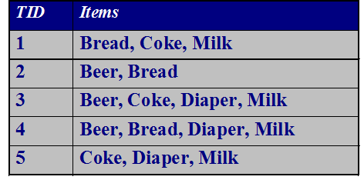
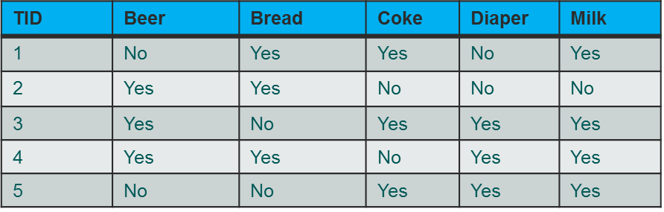
Record Data - Transaction Data
Each record (transaction) involves a set of items
For example, consider a grocery store. The set of products purchased by a customer during one shopping trip constitute a transaction, while the individual products that were purchased are the items
Can be represented by a data matrix of binary attributes

Slide 14
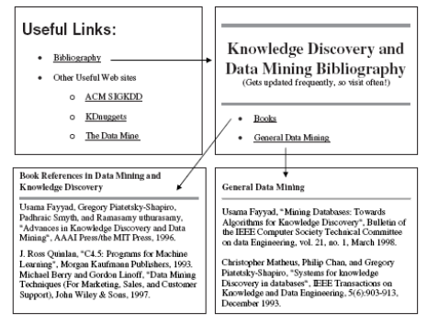
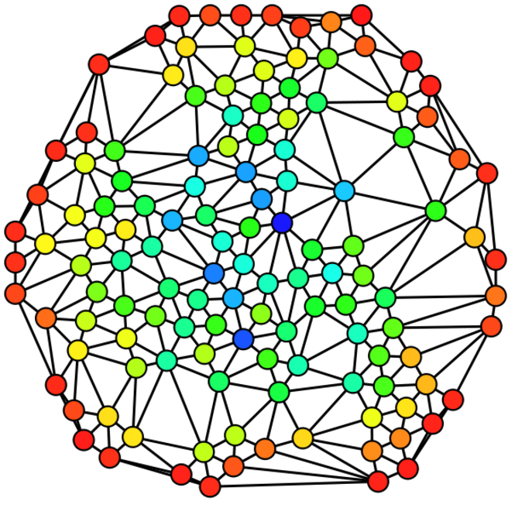
Graph Data
Nodes and edges of a graph can capture different aspects of data
Two commonly seen cases of graph data:
Nodes represent data objects and edges represent relationships between data objects, e.g., linked webpages, social networks
A data object itself is represented as graph, e.g., a molecule

Slide 15
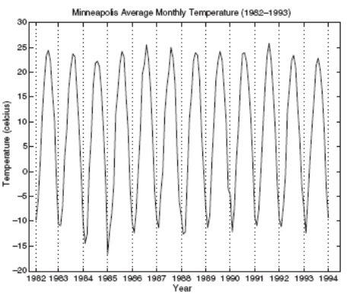
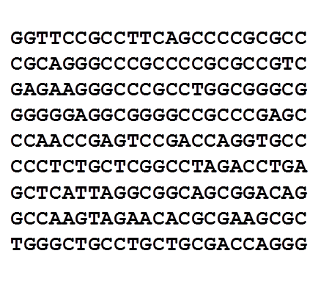
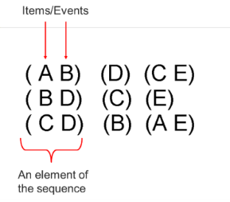
Ordered Data
Sequences of transactions, events, entities etc.
For example, person 1 visited web pages (A B), then bought (D), followed by the purchase of (C E). Each transaction or event may have a time stamp
Genomic sequence data. Order of the items/bases is significant
Time series data: each record is a time series, i.e., a series of measurements taken over time
Spatial and Spatio-Temporal Data

Slide 16
Characteristics of Data
The following characteristics of data sets have significant impact on data mining techniques used and the analysis results
Dimensionality: number of attributes in a data set
Curse of dimensionality – difficult to analyse high-dimensional data
Dimension reduction in data preprocessing is necessary
Distribution and sparsity
Skewness in class distribution
Sparse data example: Mostly zero values in a binary dataset
Resolution
Attributes may be measured at different resolutions
Patterns depend on the scale, e.g., the Earth surface is uneven at a resolution of a few meters, but relatively smooth at a resolution of tens of kilometers

Slide 17
Outline
Data
Data sets, data objects & attributes
Types of data
Types of data sets
Data preprocessing
Why?
Main data preprocessing tasks
Cleaning
Integration
Reduction
Transformation

Slide 18
Why Preprocess the Data?
Data quality: noise and outliers, missing values, duplicate data, wrong data
Data miners often don’t have the option to prevent data quality problems. What they do is to detect and correct data quality problems
Suitability of data for a data mining technique
Preprocessing helps with obtaining quality and/or suitable data for data analysis/mining, by selecting data objects and attributes or creating/changing the attributes

Slide 19
Major Tasks in Data Preprocessing
Data cleaning
Fill in missing values, smooth noisy data, identify or remove outliers and duplicates, and resolve inconsistencies
Data integration
Integration of multiple databases, data cubes, or files
Data reduction
Dimensionality reduction
Numerosity reduction
Data compression
Data transformation
Normalization
Discretization
Source:J. Han, M. Kamber, and J. Pei. Data Mining: Concepts and Techniques. 3rd edition. Morgan Kaufmann, 2012

Slide 20
Data Cleaning
Data in the Real World Is Dirty: Lots of potentially incorrect data, e.g., instrument faulty, human or computer error, transmission error
incomplete: lacking attribute values, lacking certain attributes of interest, or containing only aggregate data
e.g., Occupation = “ ” (missing data)
noisy: containing noise, errors, or outliers
e.g., Salary = “−10” (an error)
inconsistent: containing discrepancies in codes or names, e.g.,
Age = “42”, Birthday = “03/07/2010”
Was rating “1, 2, 3”, now rating “A, B, C”
discrepancy between duplicate records
Duplicated: including data objects that are duplicates, or almost duplicates of one another
Intentional (e.g., disguised missing data)
Jan. 1 as everyone’s birthday?

Slide 21
Data Cleaning - Incomplete (Missing) Data
Data is not always available
e.g., many tuples have no recorded values for several attributes, such as customer income in sales data
Missing data may be due to
equipment malfunction
inconsistent with other recorded data and thus deleted
data not entered due to misunderstanding
certain data may not be considered important at the time of entry
not register history or changes of the data
Missing data may need to be inferred

Slide 22
Data Cleaning - How to Handle Missing Data?
Ignore the record or attribute with missing values:
Simple approach, but need to be used with cautious.
Reduced number of records and/or removed important attributes → reduced reliability of analysis
Estimate missing values:
Fill in the missing value manually: tedious + infeasible?
Fill in it automatically with
a global constant : e.g., “unknown”, a new class?!
the attribute mean
Based on similar objects’ values
the most probable value: inference-based such as Bayesian formula or decision tree
Leave the job to data mining algorithms if they have been designed with strategies dealing with missing values (results of this option may depend on the specific data mining task)

Slide 23
Data Cleaning - Noisy Data & Outliers
Both noise records and outliers affect the analysis results regarding the normal patterns of a dataset, but they are different in nature
Noise: random error or variance in a measured variable
Incorrect attribute values may be due to reasons like faulty data collection instruments, data entry problems, data transmission problems, technology limitation, inconsistency in naming convention
Outliers or anomalies: unusual objects, i.e., objects having characteristics that different from most of the other objects in a data set
Considerable leeway in the definition of outliers, as they are rare occurrences that may not be fully understood/aware of
Unlike noise, outliers can be legitimate objects or adversarial objects which we are interested in detecting and known more about

Slide 24
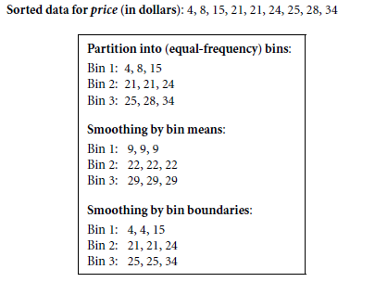
Data Cleaning - Handle Noisy Data & Outliers?
Noise: smooth data by methods like:
Binning
by consulting “neighbourhood”
first sort data and partition into bin, then one can smooth by bin means, smooth by bin median, smooth by bin boundaries, etc.
Regression
smooth by fitting the data into regression functions
Eliminating noise is difficult → Great efforts in designing robust algorithms which are resistant to noise samples
Handling outliers is difficult → Great efforts in designing outlier detection algorithms and algorithms which are robust to outliers

Slide 25
Data Integration
Data integration combines data from multiple sources into a coherent store
Schema integration: e.g., A.cust-id ≡ B.cust-#
Integrate metadata from different sources
Entity identification problem:
Identify real world entities from multiple data sources, e.g., Bill Clinton = William Clinton
Detecting and resolving data value conflicts
For the same real world entity, attribute values from different sources are different
Possible reasons: different representations, different scales, e.g., metric vs. British units

Slide 26
Data Integration - Handling Redundancy
Redundant data occur often when integration of multiple databases
Object identification: The same attribute or object may have different names in different databases
Derivable data: One attribute may be a “derived” attribute in another table, e.g., annual revenue
Redundant attributes may be able to be detected by correlation analysis and covariance analysis
Careful integration of the data from multiple sources may help reduce/avoid redundancies and inconsistencies and improve mining speed and quality

Slide 27
Data Reduction: Dimensionality Reduction
Curse of dimensionality
When dimensionality increases, data becomes increasingly sparse
Density and distance between points, which is critical to clustering, outlier analysis, becomes less meaningful
The possible combinations of subspaces will grow exponentially
Dimensionality reduction
Avoid the curse of dimensionality
Help eliminate irrelevant features and reduce noise
Reduce time and space required in data mining
Allow easier visualization
Dimensionality reduction techniques
Transform or project original data onto a smaller space
Attribute subset selection

Slide 28
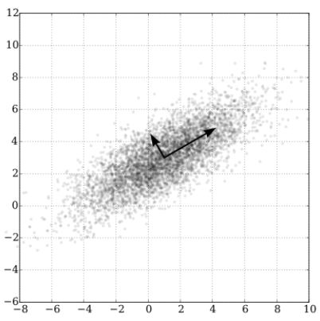
Dimensionality reduction techniques
Transform or project original data onto a smaller space
e.g. Principal Component Analysis (PCA)
Find a projection that captures the largest amount of variation in data
The original data are projected onto a much smaller space, resulting in dimensionality reduction
Notes:
Figure (from Wikipedia https://en.wikipedia.org/wiki/Principal_component_analysis):
PCA of a multivariate Gaussian distribution centered at (1,3) with a standard deviation of 3 in roughly the (0.866, 0.5) direction and of 1 in the orthogonal direction.

Slide 29
Dimensionality reduction techniques
Attribute subset selection: irrelevant, weakly relevant, or redundant attributes are detected and removed
Examples:
Redundant attributes
Duplicate much or all of the information contained in one or more other attributes
e.g., purchase price of a product and the amount of sales tax paid
Irrelevant attributes
Contain no information that is useful for the data mining task at hand
e.g., students' ID is often irrelevant to the task of predicting students' GPA

Slide 30
Data Reduction: Numerosity Reduction
Reduce data volume by choosing alternative, smaller forms of data representation
Parametric methods (e.g., regression)
Assume the data fits some model, estimate model parameters, store only the parameters, and discard the data (except possible outliers)
Non-parametric methods
Do not assume models
Major families of methods: histograms, clustering, sampling, …

Slide 31
Data Reduction: Numerosity Reduction
Histogram Analysis
Divide data into buckets and store average for each bucket
Partitioning rules:
Equal-width: equal bucket range
Equal-frequency (or equal-depth)
Clustering
Partition data set into clusters based on similarity, and store cluster representation (e.g., centroid and diameter) only
Can be very effective if data is clustered
There are many choices of clustering definitions and clustering algorithms
Cluster analysis will be studied in depth later

Slide 32
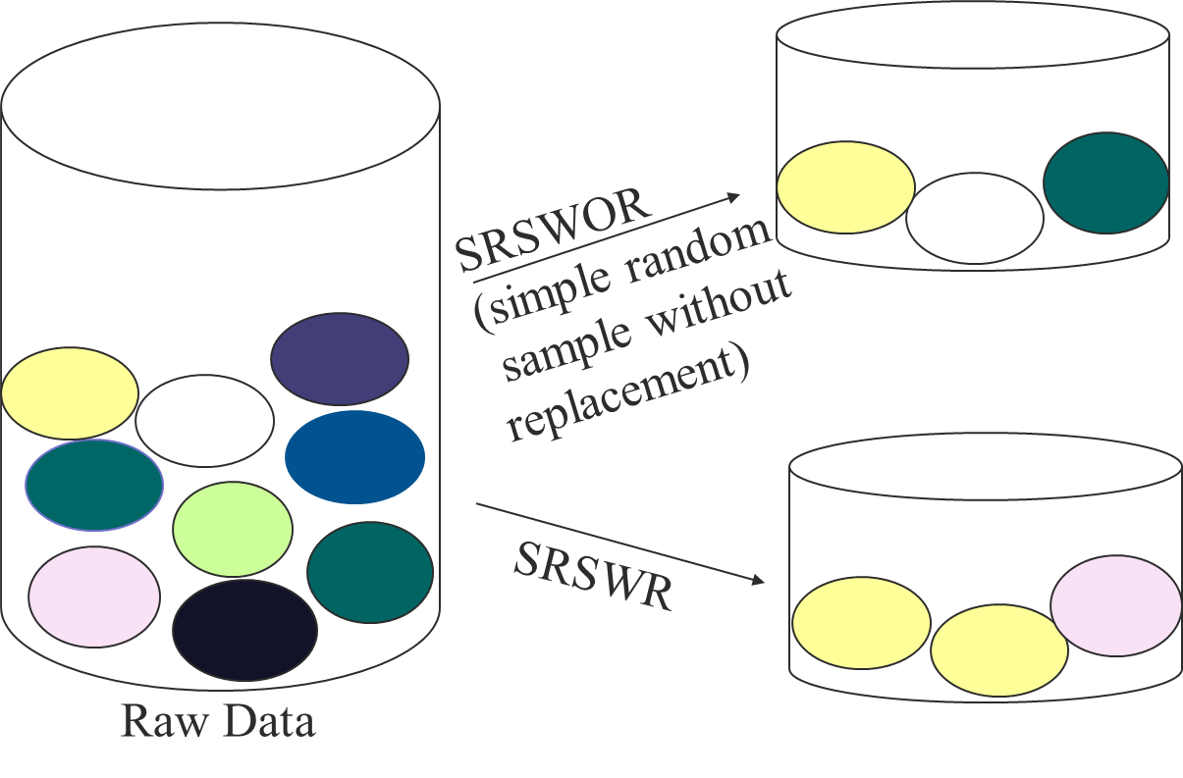
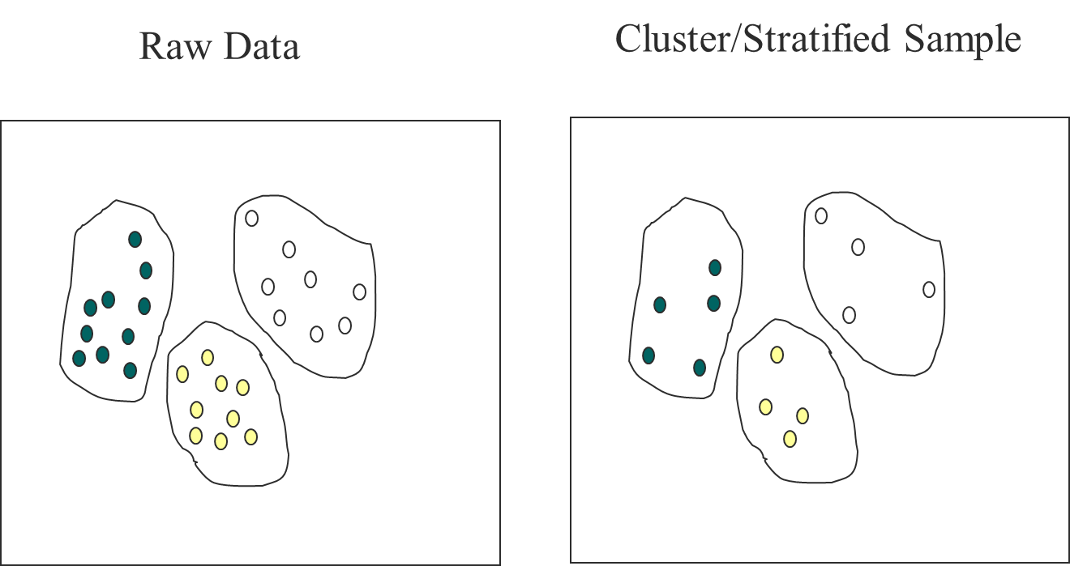
Data Reduction: Numerosity Reduction
Sampling
Sampling: obtaining a small sample s to represent the whole data set N
Key principle: Choose a representative subset of the data
Simple random sampling may have very poor performance in the presence of skew
Develop adaptive sampling methods, e.g., stratified sampling
Types of sampling
Simple random sampling
There is an equal probability of selecting any particular item
Sampling without replacement
Once an object is selected, it is removed from the population
Sampling with replacement
A selected object is not removed from the population
Stratified sampling:
Partition the data set, and draw samples from each partition (proportionally, i.e., approximately the same percentage of the data)
Used in conjunction with skewed data

Slide 33
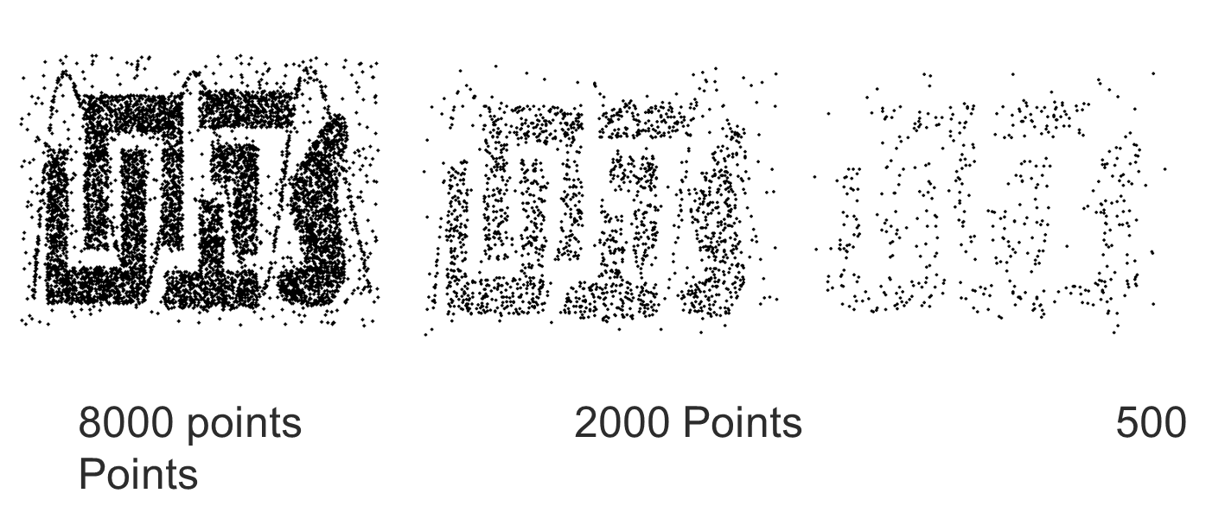
Data Reduction: Numerosity Reduction
Impact of Sample size

Slide 34
Data Reduction: Data Compression
Data compression transforms data to obtain a reduced or compressed representation of the original data
Lossless compression: the original data can be reconstructed from the compressed data without information loss
Examples:
String compression
Audio/video compression
Dimensionality and numerosity reduction may also be considered as forms of data compression

Slide 35
Data Transformation
A function that maps the entire set of values of a given attribute to a new set of replacement values such that each old value can be identified with one of the new values
Methods:
Smoothing: Remove noise from data
Attribute/feature construction
New attributes constructed from the given ones
Aggregation: Summarization, data cube construction
Normalization: Scaled to fall within a smaller, specified range
min-max normalization
z-score normalization
normalization by decimal scaling
Discretization: numeric values -> interval labels or concept labels

Slide 36
Data Transformation: Normalization
Min-max normalization: to [new_min_{A}, new_max_{A}]
Example: Let income range $12,000 to $98,000 normalized to [0.0, 1.0]. Then $73,600 is mapped to
Z-score normalization, or standardization (μ: mean, σ: standard deviation)
Example: Let μ = 54,000, σ = 16,000. Then
Normalization by decimal scaling
where j is the smallest integer such that Max(|ν’|) < 1
Notes:
Note: standardization does not change distribution to a normal distribution!

Slide 37
Data Transformation: Discretization
Discretization divides the range of a continuous attribute into intervals
Interval labels can then be used to replace actual data values
Reduce data size by discretization
Can be supervised or unsupervised
Split (top-down) vs. merge (bottom-up)
Discretization can be performed recursively on an attribute
Prepare for further analysis, e.g., classification
Typical methods: All the methods can be applied recursively
Binning: Top-down split, unsupervised
Histogram analysis: Top-down split, unsupervised
Clustering analysis: unsupervised, top-down split or bottom-up merge
Decision-tree analysis: supervised, top-down split
Correlation analysis: supervised, bottom-up merge

Slide 38
Data Transformation: Discretization
Simple discretization method: binning
Equal-width (distance) partitioning
Divides the range into N intervals of equal size: uniform grid
if A and B are the lowest and highest values of the attribute, the width of intervals will be: W = (B –A)/N.
The interval boundaries: min+W; min+2W; … min+(N-1)W
The most straightforward, but outliers may dominate presentation
Skewed data is not handled well
Equal-depth (frequency) partitioning
Divides the range into N intervals, each containing approximately same number of samples
Good data scaling
Managing categorical attributes can be tricky
Example: Sorted data for price (in dollars): 4, 8, 9, 15, 21, 21, 24, 25, 26, 28, 29, 34
* Partition into equal-width 3 bins:
- Bin 1: 4, 8, 9
- Bin 2: 15, 21, 21, 24,
- Bin 3: 25, 26, 28, 29, 34
* Partition into equal-depth (equal-frequency) 3 bins:
- Bin 1: 4, 8, 9, 15
- Bin 2: 21, 21, 24, 25
- Bin 3: 26, 28, 29, 34

Slide 39
Data Transformation: Discretization
Classification (e.g., decision tree analysis)
Supervised: Given class labels, e.g., cancerous vs. benign
Using entropy to determine split point (discretization point)
Top-down, recursive split
Correlation analysis (e.g., Chi-merge: χ²-based discretization)
Supervised: use class information
Bottom-up merge: find the best neighboring intervals (those having similar distributions of classes, i.e., low χ² values) to merge
Merge performed recursively, until a predefined stopping condition

Slide 40
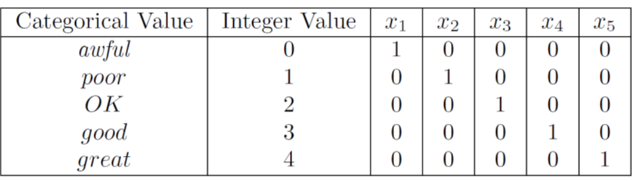
Data Transformation: Binarization
Some algorithms can only handle binary variables
Binarization maps a continuous one or more binary variables (i.e., discretization into binary variables), or a categorical attribute into one or more binary variables
Example: Binarize a categorical variable which has 5 values: awful, poor, ok, good and great

Slide 41
References
Most of the slides are from or have their materials taken from the following sources (unless otherwise indicated):
https://www-users.cs.umn.edu/~kumar001/dmbook/firsted.php
https://www-users.cs.umn.edu/~kumar001/dmbook/index.php
http://web.engr.illinois.edu/~hanj/bk3/

