Slide 1
INFS 5102 Unsupervised Methods in Analytics
Module 3 – Cluster Analysis
Part 2A: Methods (A)

Slide 2
Outline
Concepts
What is cluster analysis
Types of clustering and types of clusters
Major clustering approaches
Similarity/dissimilarity measures
Methods
Partition based method – K-means
Hierarchical clustering
Density based method
Validation of clusters

Slide 3
Partition Based Algorithms
Basic Idea:
Given a data set, D of n objects, and K, the number of clusters to form
organize the objects into K partitions (K ≤n), where each partition represents a cluster
The clusters are formed to optimize an objective partitioning criterion, such as a dissimilarity function based on distance

Slide 4
Partition Based Algorithms
Center-based partitioning approach:
Partitions a database D of n objects into a set of K clusters
Each cluster is represented by its prototype, e.g., mean or medoid (most representative point) of the objects assigned to the cluster
The difference between an object p and the prototype of a cluster C_{i} , c_{i} is measured by some distance, d(p, c_{i} )
Goal is to minimize the overall differences, e.g., the total SSE (sum of squared error) while the distance in use is Euclidean distance and the centroid of a cluster is the mean of data points assigned to the cluster:
More generally, the goal is to find an optimal solution to the objective function, e.g., “minimize the above total SSE”

Slide 5
Partition Based Algorithms
Center-based partitioning approach (continued):
Global optimal: exhaustively enumerate all partitions
Computationally prohibitive
If the number of clusters K and the dimensionality of the space d are fixed, the problem can be solved in time O(n^{dK+1}log n), where n is the number of objects.
To overcome the prohibitive computational cost for the exact solution, greedy approaches are often used in practice.
Heuristic methods: K-means and K-medoids algorithms
K-means (MacQueen’67, Lloyd’57): Each cluster is represented by the center of the cluster
K-medoids or PAM (Partition around medoids) (Kaufman & Rousseeuw’87): Each cluster is represented by one of the objects in the cluster

Slide 6
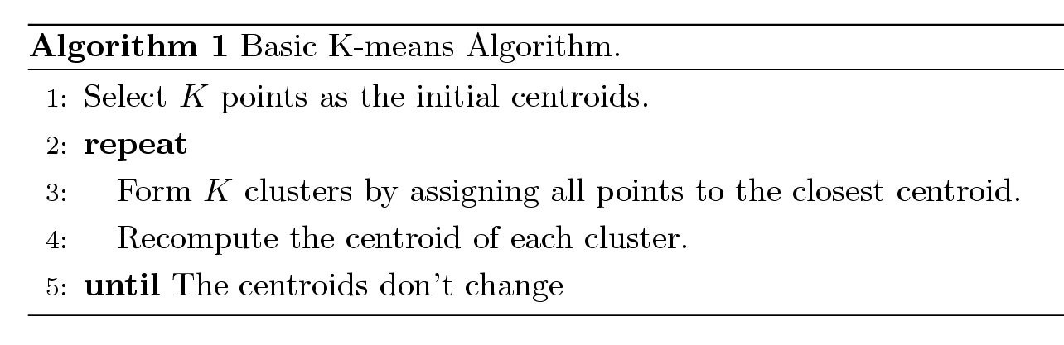
K-means Clustering
Each cluster is associated with a centroid (center point)
Each point is assigned to the cluster with the closest centroid
Number of clusters, K, must be specified
The basic K-means algorithm is very simple

Slide 7
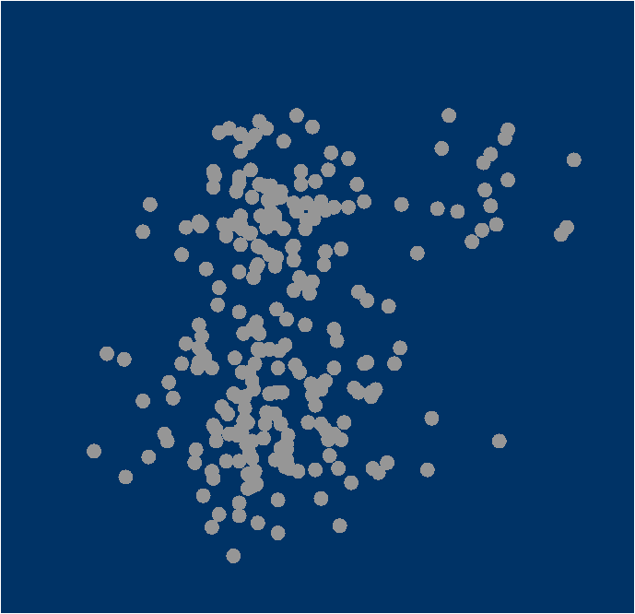
K-means Clustering - Steps
1. Select inputs.
2. Select K cluster centers.
3. Assign cases to closest center.
4. Update cluster centers.
5. Re-assign cases.
6. Repeat steps 4 and 5
until convergence.
Copyright © 2011, SAS Institute Inc. Cary, C, USA. All Rights Reserved. Reproduced with permission of SAS Institute Inc. Cary, NC, USA.
7

Slide 8
K-means Clustering - Steps
1. Select inputs.
2. Select K cluster centers.
3. Assign cases to closest center.
4. Update cluster centers.
5. Re-assign cases.
6. Repeat steps 4 and 5
until convergence.
8

Slide 9
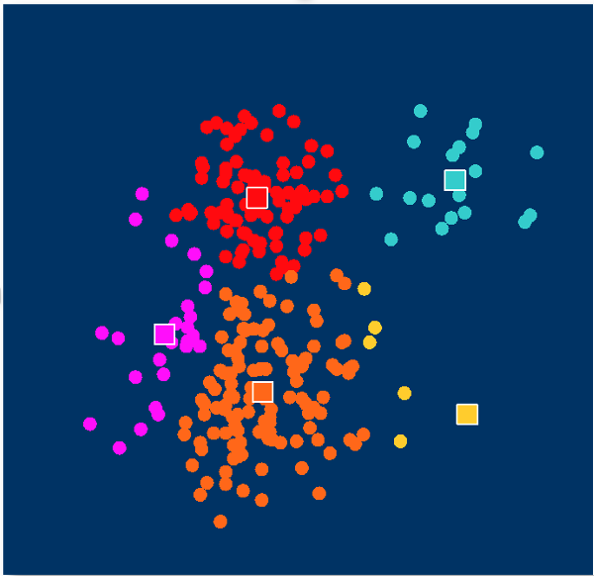
K-means Clustering - Steps
1. Select inputs.
2. Select K cluster centers.
3. Assign cases to closest center.
4. Update cluster centers.
5. Reassign cases.
6. Repeat steps 4 and 5
until convergence.
9

Slide 10
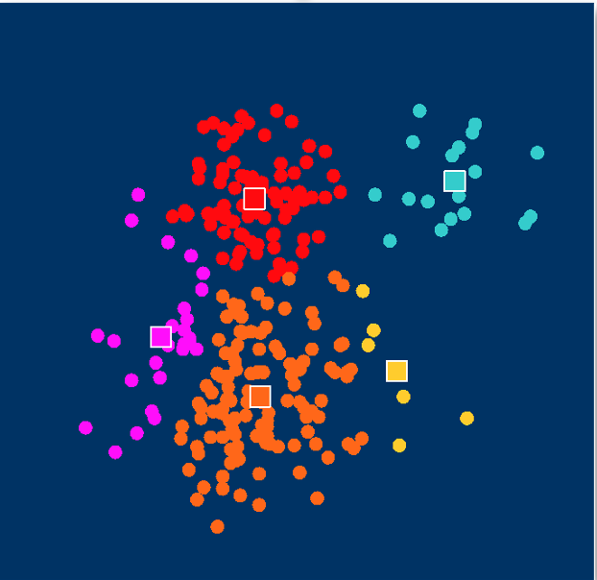
K-means Clustering - Steps
1. Select inputs.
2. Select K cluster centers.
3. Assign cases to closest center.
4. Update cluster centers.
5. Reassign cases.
6. Repeat steps 4 and 5
until convergence.
10

Slide 11
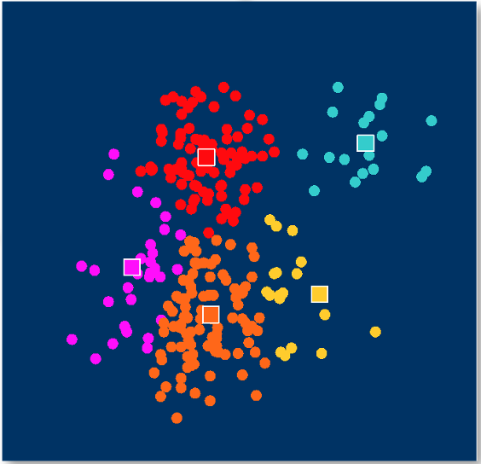
K-means Clustering - Steps
1. Select inputs.
2. Select K cluster centers.
3. Assign cases to closest center.
4. Update cluster centers.
5. Reassign cases.
6. Repeat steps 4 and 5
until convergence.
11

Slide 12
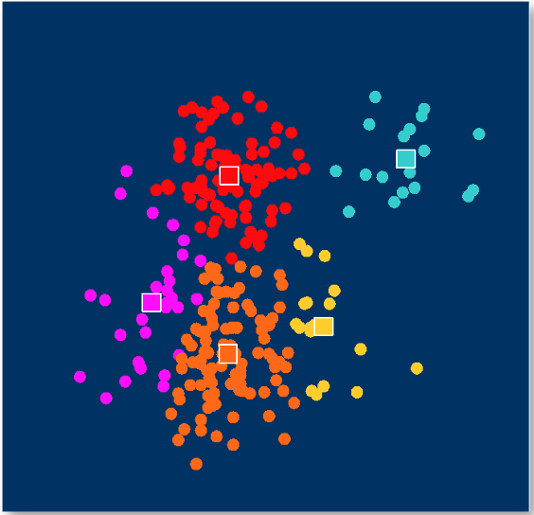
K-means Clustering - Steps
1. Select inputs.
2. Select K cluster centers.
3. Assign cases to closest center.
4. Update cluster centers.
5. Reassign cases.
6. Repeat steps 4 and 5
until convergence.
12

Slide 13
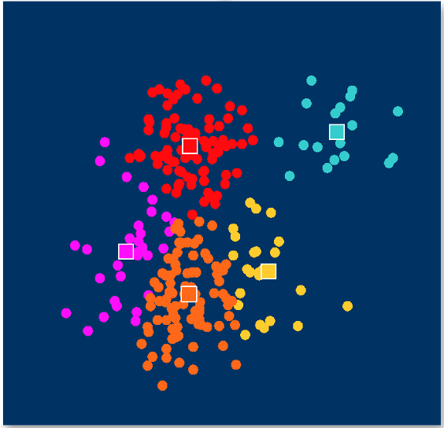
K-means Clustering - Steps
1. Select inputs.
2. Select K cluster centers.
3. Assign cases to closest center.
4. Update cluster centers.
5. Reassign cases.
6. Repeat steps 4 and 5
until convergence.
13

Slide 14
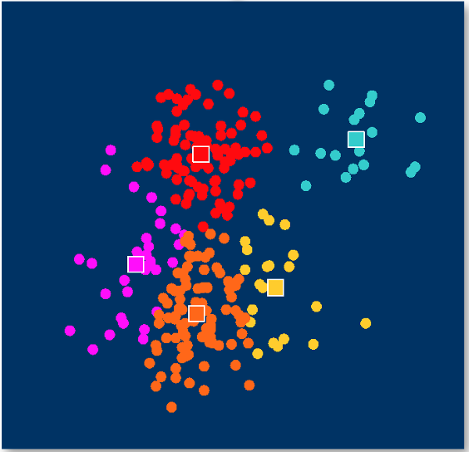
K-means Clustering - Steps
1. Select inputs.
2. Select K cluster centers.
3. Assign cases to closest center.
4. Update cluster centers.
5. Reassign cases.
6. Repeat steps 4 and 5
until convergence.
14

Slide 15
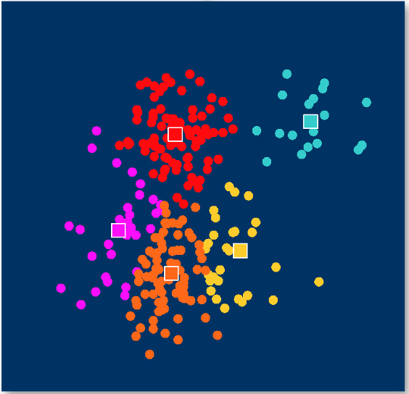
K-means Clustering - Steps
1. Select inputs.
2. Select K cluster centers.
3. Assign cases to closest center.
4. Update cluster centers.
5. Reassign cases.
6. Repeat steps 4 and 5
until convergence.
15

Slide 16
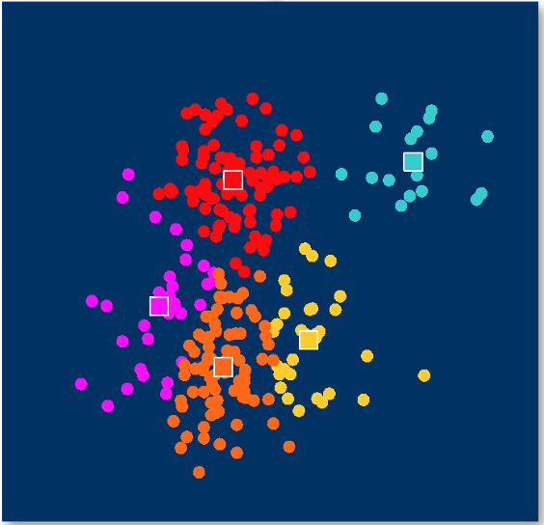
K-means Clustering - Steps
1. Select inputs.
2. Select K cluster centers.
3. Assign cases to closest center.
4. Update cluster centers.
5. Reassign cases.
6. Repeat steps 4 and 5
until convergence.
16

Slide 17
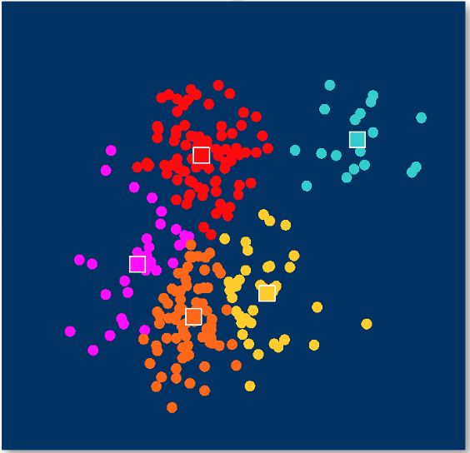
K-means Clustering - Steps
1. Select inputs.
2. Select K cluster centers.
3. Assign cases to closest center.
4. Update cluster centers.
5. Reassign cases.
6. Repeat steps 4 and 5
until convergence.
17

Slide 18
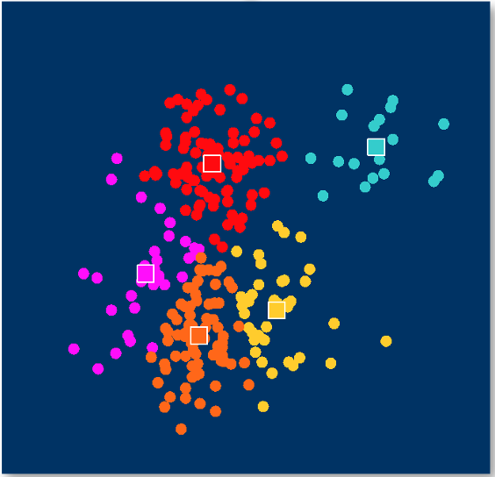
K-means Clustering - Steps
1. Select inputs.
2. Select K cluster centers.
3. Assign cases to closest center.
4. Update cluster centers.
5. Reassign cases.
6. Repeat steps 4 and 5
until convergence.
18

Slide 19

K-means Clustering - Steps
1. Select inputs.
2. Select K cluster centers.
3. Assign cases to closest center.
4. Update cluster centers.
5. Reassign cases.
6. Repeat steps 4 and 5
until convergence.
19

Slide 20
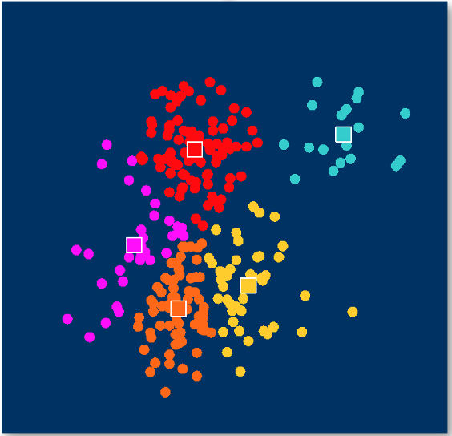
K-means Clustering - Steps
1. Select inputs.
2. Select K cluster centers.
3. Assign cases to closest center.
4. Update cluster centers.
5. Reassign cases.
6. Repeat steps 4 and 5
until convergence.
20

Slide 21
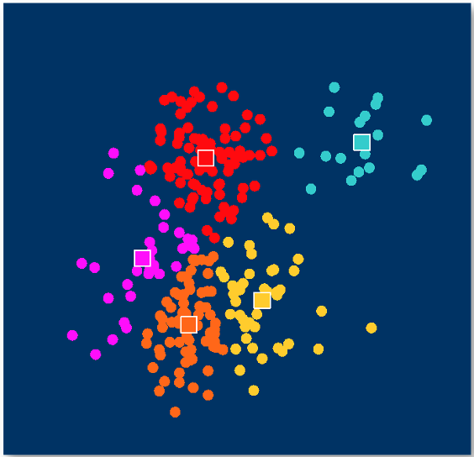
K-means Clustering - Steps
1. Select inputs.
2. Select K cluster centers.
3. Assign cases to closest center.
4. Update cluster centers.
5. Reassign cases.
6. Repeat steps 4 and 5
until convergence – no change to centroids.
21

Slide 22
K-means Clustering – More Details
Initial centroids are often chosen randomly
Clusters produced vary from one run to another
K-means will converge for common proximity measures and objective functions (see next slide)
Most of the convergence happens in the first few iterations
Often the stopping condition is changed to ‘Until relatively few points change clusters’
Complexity of K-means is O( n * K * I * d )
n = number of points, K = number of clusters, I = number of iterations, d = number of attributes
Note that although K-means aims to minimize the objective function, it does not always find the optimal solution, i.e.， given a data set, a clustering of the data set obtained using K-means may not be the one that has the minimal objective function

Slide 23
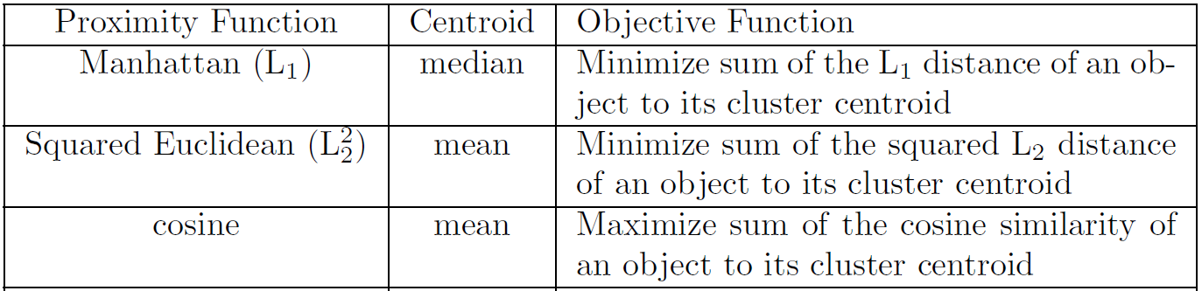
K-means Clustering – More Details
“Closeness” can be measured by different proximity measures, such as Manhattan distance, Euclidean distance, cosine similarity
The calculation of a centroid of a cluster depends on the proximity measures used and the goal of the clustering, e.g.，for Euclidean distance and minimizing SSE, it is the mean of the points in the cluster
K-means is very general clustering algorithm and can be used with a wide variety of data types

Slide 24
K-means Clustering – More Details
For Euclidean distance, Sum of Squared Error (SSE) as Objective function
For each point, the error is the distance to the nearest cluster (center)
To get SSE, we square these errors and sum them.
p is a data point in cluster C_{i} and c_{i} is the mean (center) for cluster C_{i}
Given two clustering results, we can choose the one with the smallest error
One easy way to reduce SSE is to increase K, the number of clusters
A good clustering with smaller K can have a lower SSE than a poor clustering with higher K

Slide 25
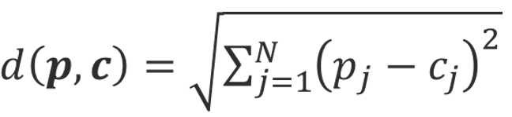

K-means Clustering – Example
Let’s use Euclidean Distance:
The centroid of cluster C, c=(c₁, …, c_{j}, …c_{N}), where

Slide 26
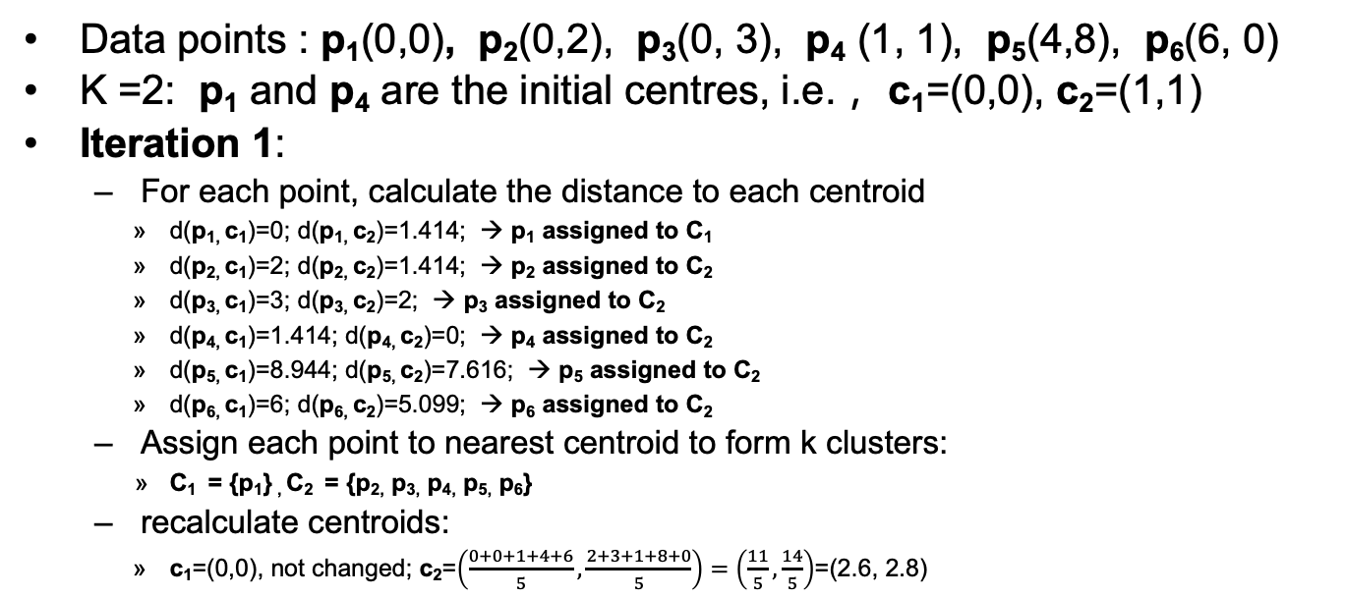
K-means Clustering – Example
Data points : p₁(0,0), p₂(0,2), p₃(0, 3), p₄ (1, 1), p₅(4,8), p₆(6, 0)
K =2: p₁ and p₄ are the initial centres, i.e.， c₁=(0,0), c₂=(1,1)
Iteration 1:
For each point, calculate the distance to each centroid
d(p_{1,} c₁)=0; d(p_{1,} c₂)=1.414; → p₁ assigned to C₁
d(p_{2,} c₁)=2; d(p_{2,} c₂)=1.414; → p₂ assigned to C₂
d(p_{3,} c₁)=3; d(p_{3,} c₂)=2; → p₃ assigned to C₂
d(p_{4,} c₁)=1.414; d(p_{4,} c₂)=0; → p₄ assigned to C₂
d(p_{5,} c₁)=8.944; d(p_{5,} c₂)=7.616; → p₅ assigned to C₂
d(p_{6,} c₁)=6; d(p_{6,} c₂)=5.099; → p₆ assigned to C₂
Assign each point to nearest centroid to form k clusters:
C₁ = {p₁} , C₂ = {p_{2,} p_{3,} p_{4,} p_{5,} p₆}
recalculate centroids:
c₁=(0,0), not changed; c₂=$\left(\frac{0+0+1+4+6}{5},\frac{2+3+1+8+0}{5}\right)=\left(\frac{11}{5},\frac{14}{5}\right)$=(2.6, 2.8)

Slide 27
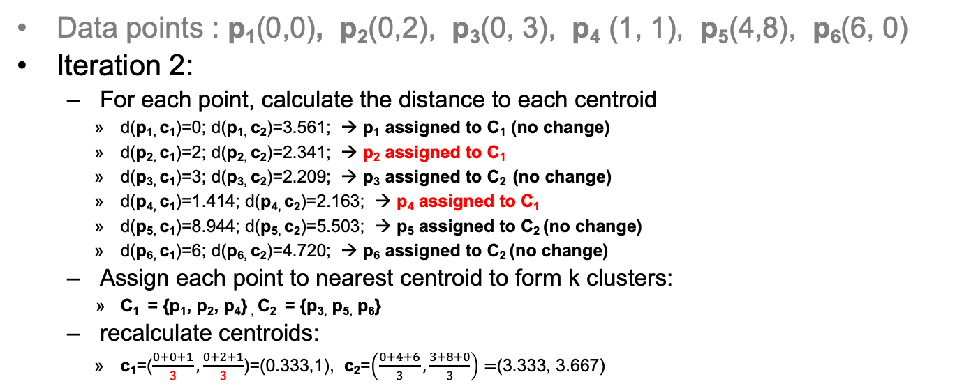
K-means Clustering – Example
Data points : p₁(0,0), p₂(0,2), p₃(0, 3), p₄ (1, 1), p₅(4,8), p₆(6, 0)
Iteration 2:
For each point, calculate the distance to each centroid
d(p_{1,} c₁)=0; d(p_{1,} c₂)=3.561; → p₁ assigned to C₁ (no change)
d(p_{2,} c₁)=2; d(p_{2,} c₂)=2.341; → p₂ assigned to C₁
d(p_{3,} c₁)=3; d(p_{3,} c₂)=2.209; → p₃ assigned to C₂ (no change)
d(p_{4,} c₁)=1.414; d(p_{4,} c₂)=2.163; → p₄ assigned to C₁
d(p_{5,} c₁)=8.944; d(p_{5,} c₂)=5.503; → p₅ assigned to C₂ (no change)
d(p_{6,} c₁)=6; d(p_{6,} c₂)=4.720; → p₆ assigned to C₂ (no change)
Assign each point to nearest centroid to form k clusters:
C₁ = {p₁, p₂, p₄} , C₂ = {p_{3,} p_{5,} p₆}
recalculate centroids:
c₁=($\frac{0+0+1}{3},\frac{0+2+1}{3}$)=(0.333,1), c₂=$\left(\frac{0+4+6}{3},\frac{3+8+0}{3}\right)=$(3.333, 3.667)

Slide 28
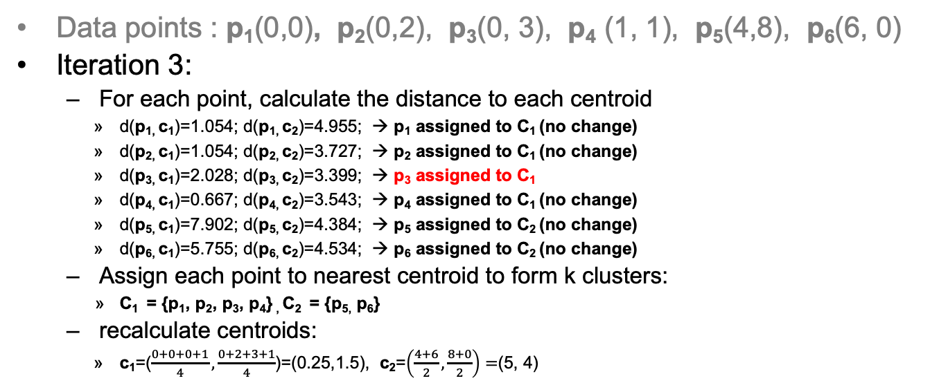
K-means Clustering – Example
Data points : p₁(0,0), p₂(0,2), p₃(0, 3), p₄ (1, 1), p₅(4,8), p₆(6, 0)
Iteration 3:
For each point, calculate the distance to each centroid
d(p_{1,} c₁)=1.054; d(p_{1,} c₂)=4.955; → p₁ assigned to C₁ (no change)
d(p_{2,} c₁)=1.054; d(p_{2,} c₂)=3.727; → p₂ assigned to C₁ (no change)
d(p_{3,} c₁)=2.028; d(p_{3,} c₂)=3.399; → p₃ assigned to C₁
d(p_{4,} c₁)=0.667; d(p_{4,} c₂)=3.543; → p₄ assigned to C₁ (no change)
d(p_{5,} c₁)=7.902; d(p_{5,} c₂)=4.384; → p₅ assigned to C₂ (no change)
d(p_{6,} c₁)=5.755; d(p_{6,} c₂)=4.534; → p₆ assigned to C₂ (no change)
Assign each point to nearest centroid to form k clusters:
C₁ = {p₁, p₂, p₃, p₄} , C₂ = {p_{5,} p₆}
recalculate centroids:
c₁=($\frac{0+0+0+1}{4},\frac{0+2+3+1}{4}$)=(0.25,1.5), c₂=$\left(\frac{4+6}{2},\frac{8+0}{2}\right)=$(5, 4)

Slide 29
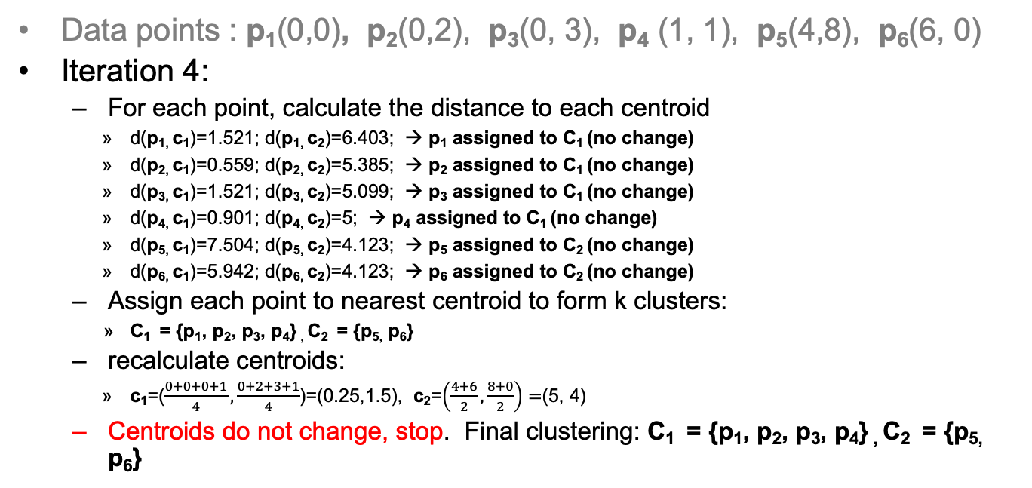
K-means Clustering – Example
Data points : p₁(0,0), p₂(0,2), p₃(0, 3), p₄ (1, 1), p₅(4,8), p₆(6, 0)
Iteration 4:
For each point, calculate the distance to each centroid
d(p_{1,} c₁)=1.521; d(p_{1,} c₂)=6.403; → p₁ assigned to C₁ (no change)
d(p_{2,} c₁)=0.559; d(p_{2,} c₂)=5.385; → p₂ assigned to C₁ (no change)
d(p_{3,} c₁)=1.521; d(p_{3,} c₂)=5.099; → p₃ assigned to C₁ (no change)
d(p_{4,} c₁)=0.901; d(p_{4,} c₂)=5; → p₄ assigned to C₁ (no change)
d(p_{5,} c₁)=7.504; d(p_{5,} c₂)=4.123; → p₅ assigned to C₂ (no change)
d(p_{6,} c₁)=5.942; d(p_{6,} c₂)=4.123; → p₆ assigned to C₂ (no change)
Assign each point to nearest centroid to form k clusters:
C₁ = {p₁, p₂, p₃, p₄} , C₂ = {p_{5,} p₆}
recalculate centroids:
c₁=($\frac{0+0+0+1}{4},\frac{0+2+3+1}{4}$)=(0.25,1.5), c₂=$\left(\frac{4+6}{2},\frac{8+0}{2}\right)=$(5, 4)
Centroids do not change, stop. Final clustering: C₁ = {p₁, p₂, p₃, p₄} , C₂ = {p_{5,} p₆}

Slide 30
Issues with K-means Clustering
Initial centroids
Empty clusters
Outliers

Slide 31
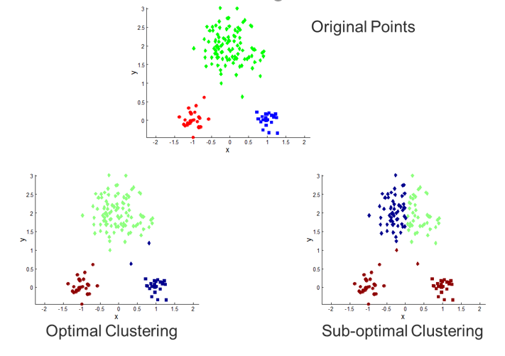
Choosing Initial Centroids
A common approach is to choose initial centroids randomly, but the resulting clusters are often of poor quality
When random initialisation of centroids is used, different runs of K-means typically produce different SSEs
Reason for local minimum:
K-means are only guaranteed to find a local minimum with respect to the SSE since they are based on optimizing the SSE for specific choices of the centroids and clusters, rather for all possible choices

Slide 32
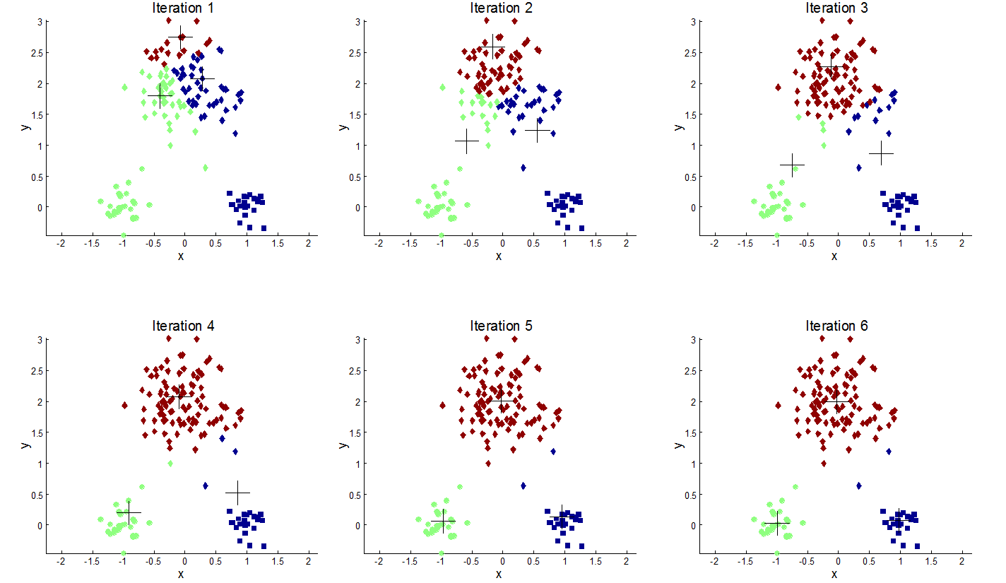
Importance of Choosing Initial Centroids

Slide 33
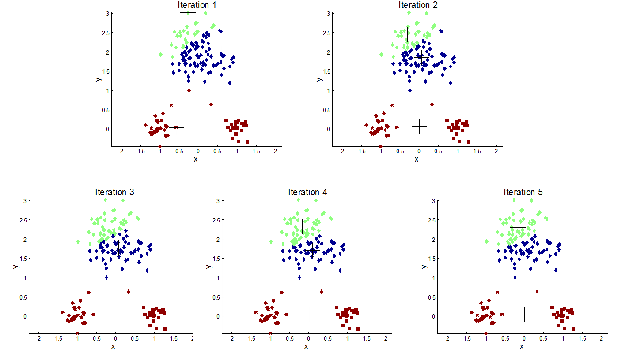
Importance of Choosing Initial Centroids

Slide 34
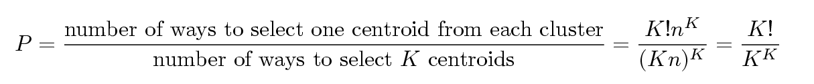
Problems with Selecting Initial Points
If there are K ‘real’ clusters, then the chance of selecting one centroid from each (real) cluster is small
Chance is relatively small when K is large
If clusters are of the same size, n, then
For example, if K = 10, then probability = 10!/10¹⁰ = 0.00036
Sometimes the initial centroids will re-adjust themselves in ‘right’ way, and sometimes they don’t, as the examples shown on the previous two slides
Consider another example of five pairs of clusters (see following slides)

Slide 35
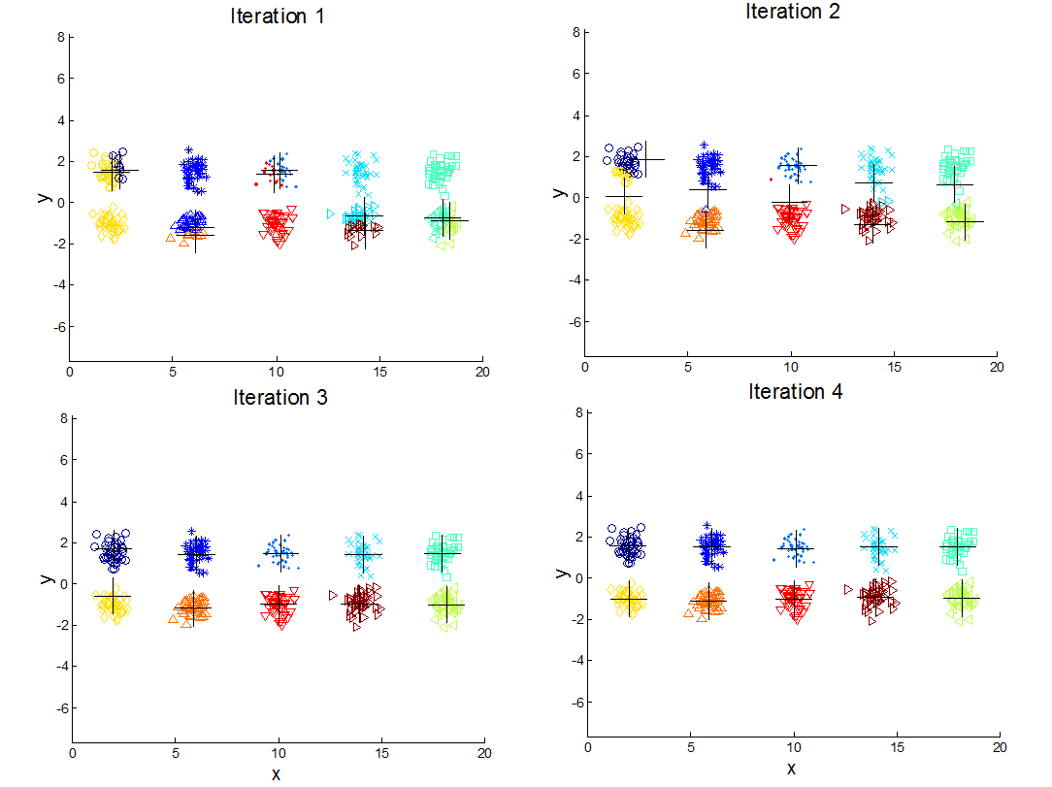
A 10 Cluster Example
Starting with two initial centroids in one cluster of each pair of clusters, where the clusters in each (top-down) pair are closer to each other than to the clusters in the other pairs
The centroids will re-distribute themselves so that the “true” clusters are found

Slide 36
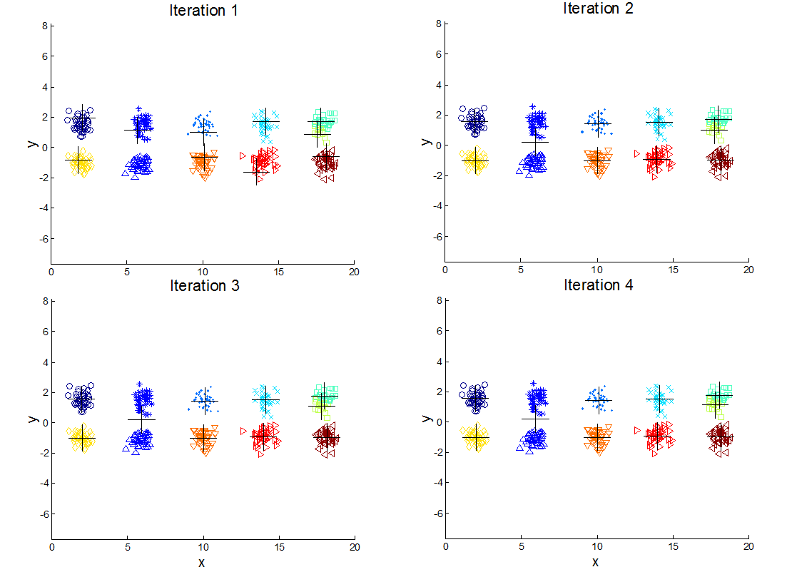
A 10 Cluster Example
However …
Starting with some pairs of clusters having three initial centroids, while other have only one.
A true cluster can be split and two true clusters are combined.

Slide 37
Solutions to Initial Centroids Problem
Multiple runs and select the set of clusters with minimum SSE
Helps, but probability is not on your side (as illustrated by the previous examples)
Sample the original data set and use hierarchical clustering (HC) to determine initial centroids
After getting the hierarchical clusters, extract K clusters, and the centroids of those clusters are used as the initial centroids
Works in practice only if
the sample size is relatively small (HC has high time complexity)
K is relatively small compared to the sample size
Select more than K initial centroids and then select among these initial centroids
Select most widely separated
Bisecting K-means
Not as susceptible to initialization issues

Slide 38
Handling Empty Clusters
Basic K-means algorithm can yield empty clusters
In this case, a strategy is needed to choose a replacement centroid
Several strategies
Choose the point that contributes most to SSE
Choose a point from the cluster with the highest SSE
Choose the point that is farthest away from any current centroid
If there are several empty clusters, the above can be repeated several times

Slide 39
Handling Outliers
When outliers are present, the resulting cluster centroids may not be as representative as they otherwise would be
Often it is useful to detect outliers and remove them beforehand
However, there are applications for which outliers should not be removed, e.g., clustering used for data compression, fraud detection
How to detect outliers? – will learn methods for this later
Alternatively, outliers may be identified in a postprocessing step, e.g., remove small clusters, remove points with unusually high contributions to SSE

Slide 40
The K-Medoids Algorithm
The K-means algorithm is sensitive to outliers !
Since an object with an extremely large value may substantially distort the distribution of the data
K-Medoids: Instead of taking the mean value of the object in a cluster as a reference point, medoids can be used, which is the most centrally located (most representative) object in a cluster
10
10
9
9
8
8
7
7
6
6
5
5
4
4
3
3
2
2
1
1
0
0
1
2
3
4
5
6
7
8
9
10
0
0
1
2
3
4
5
6
7
8
9
10

Slide 41
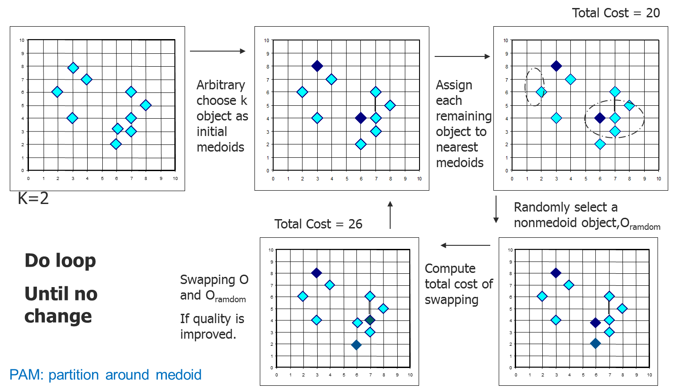
PAM: A Typical K-Medoids Algorithm

Slide 42
Variations/Extensions to K-means
Updating centroids incrementally
Postprocessing
Bisecting K-means

Slide 43
Updating Centers Incrementally
In the basic K-means algorithm, centroids are updated after all points are assigned to a centroid
An alternative is to update the centroids after each assignment (incremental approach)
Each assignment updates zero or two centroids
More expensive
Introduces an order dependency
Never get an empty cluster – if a cluster ever has only one point, then that point will always be reassigned to the same cluster
Can work with objective functions other than “minimizing SSE” – compute the value of objective function for each cluster assignment and choose the cluster that optimizes the objective function to assign the point

Slide 44
Post-processing
Post-processing to reduce SSE
Eliminate small clusters that may represent outliers
Split ‘loose’ clusters, i.e., clusters with relatively high SSE
Merge clusters that are ‘close’ and that have relatively low SSE

Slide 45
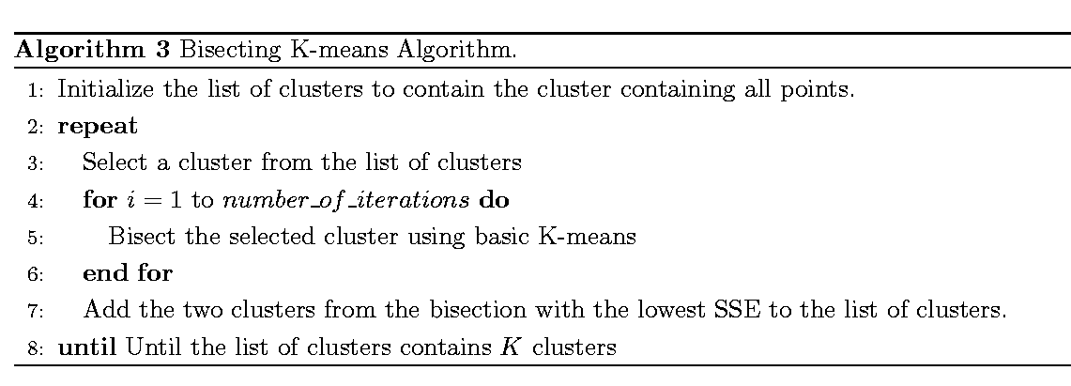
Bisecting K-means
Variant of K-means that can produce a partitioning or a hierarchical clustering
Idea: Split all points into two clusters, select one of these clusters to split and so on, until K clusters have been produced
Less susceptible to initialization problem

Slide 46
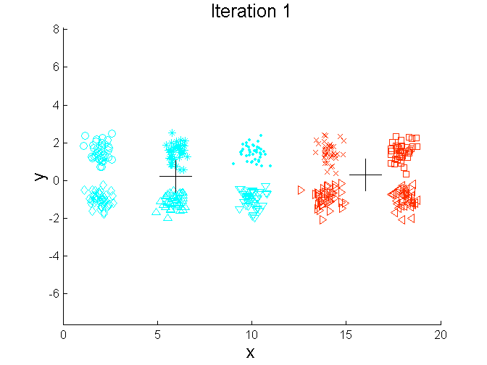
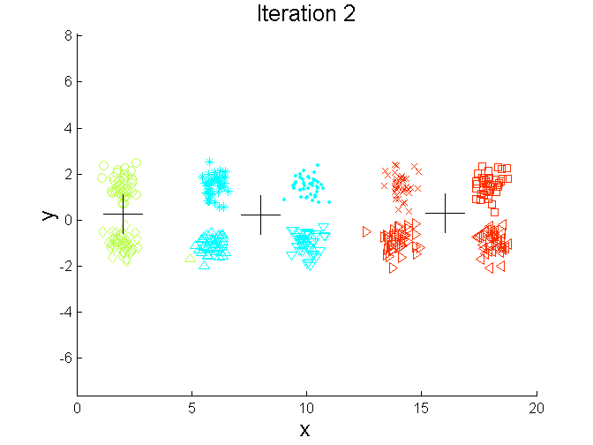
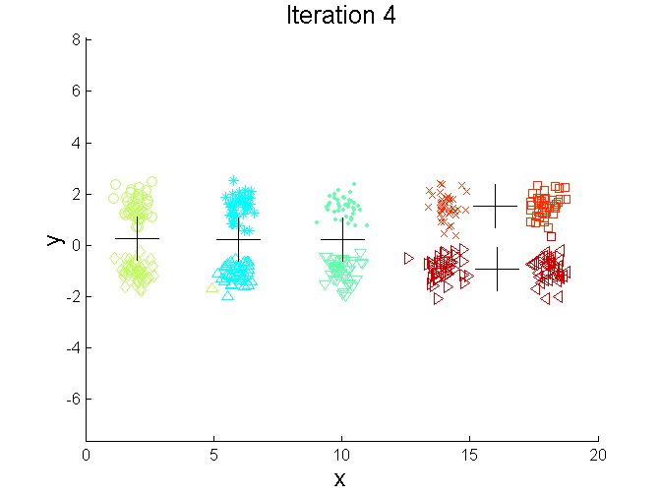
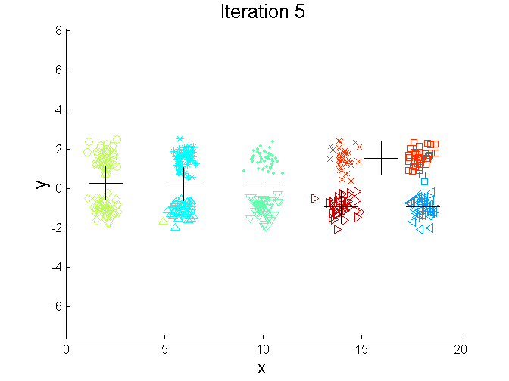
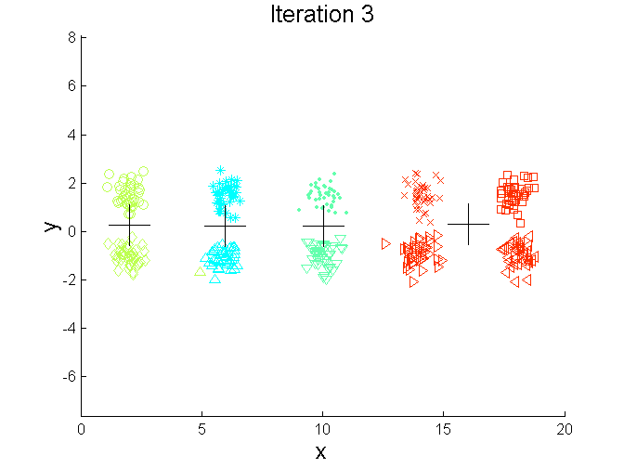
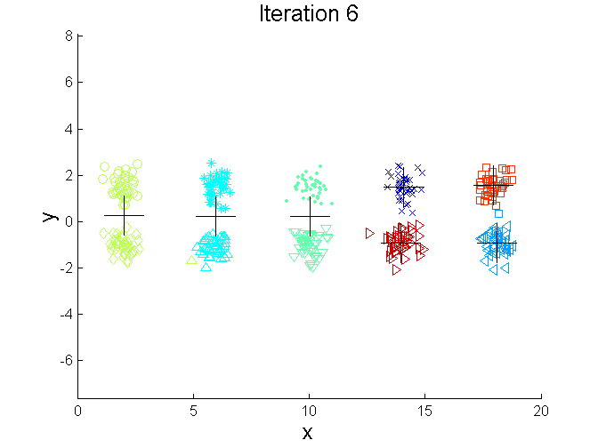
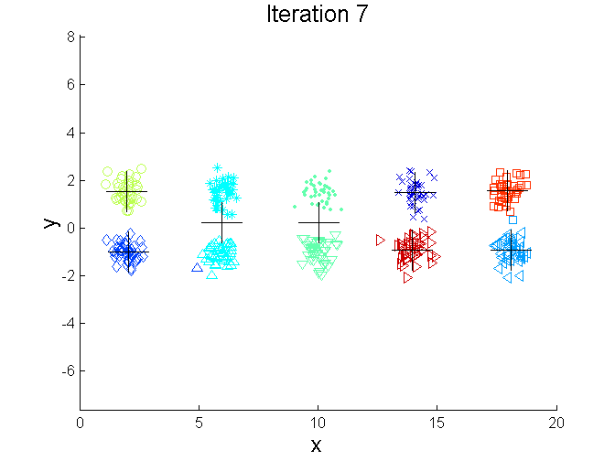
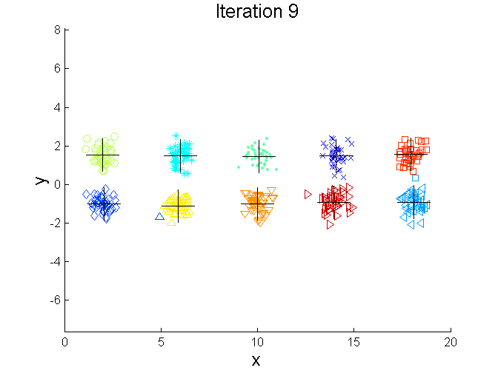
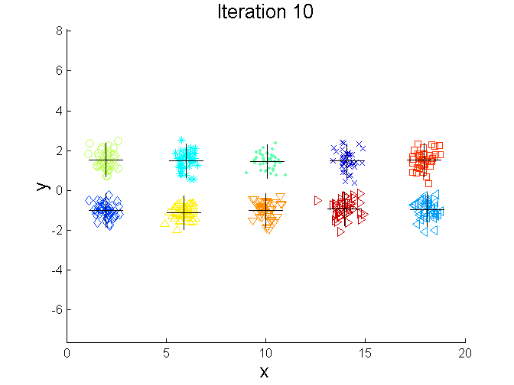
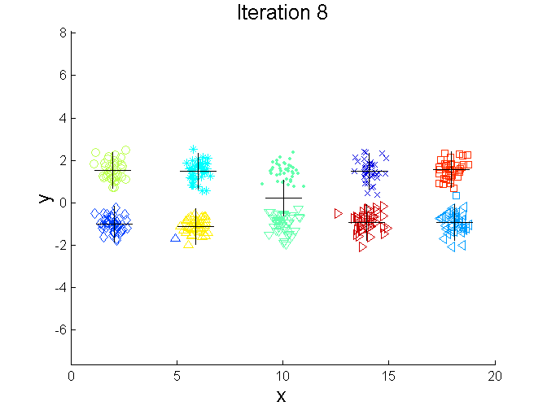
Bisecting K-means - Example

Slide 47
Limitations of K-means
K-means has problems when clusters are of differing sizes, densities, or non-globular shapes
Reason: the K-means objective function is minimized by globular clusters of equal size and density or by clusters that are well separated
K-means cannot handle nominal data →K-modes
The k-modes method is a variant of k-means, which extends the k-means paradigm to cluster nominal data by replacing the means of clusters with modes. (the mode of a set of values is the most frequent occurring value)
It uses new dissimilarity measures to deal with nominal objects and a frequency-based method to update modes of clusters
K has to be given by users

Slide 48
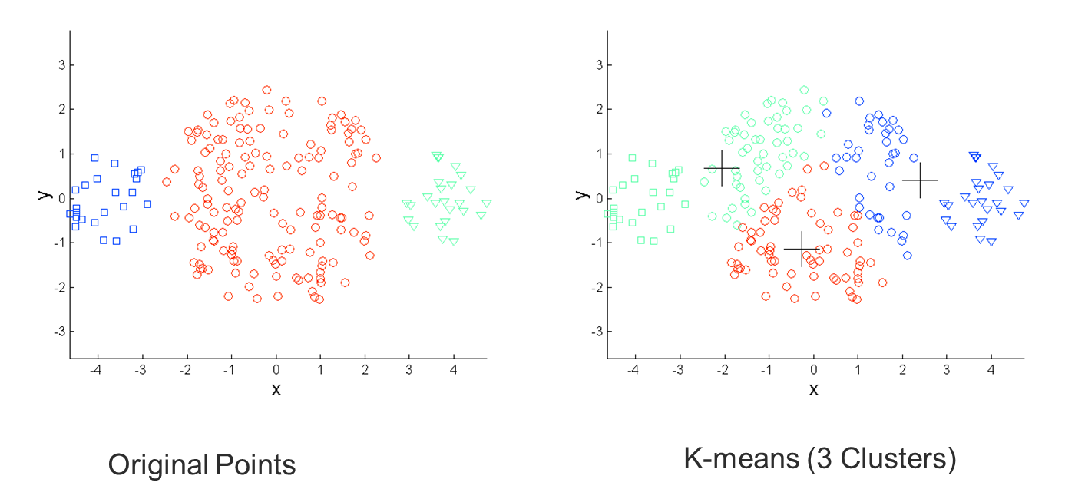
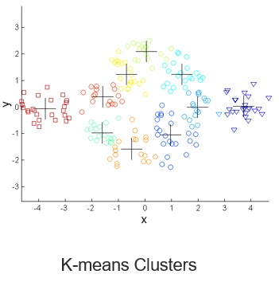
Limitations of K-means: Differing Sizes
One solution is to use many clusters. Find parts of clusters, but need to put together.

Slide 49
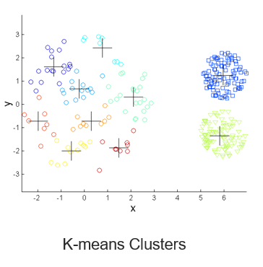
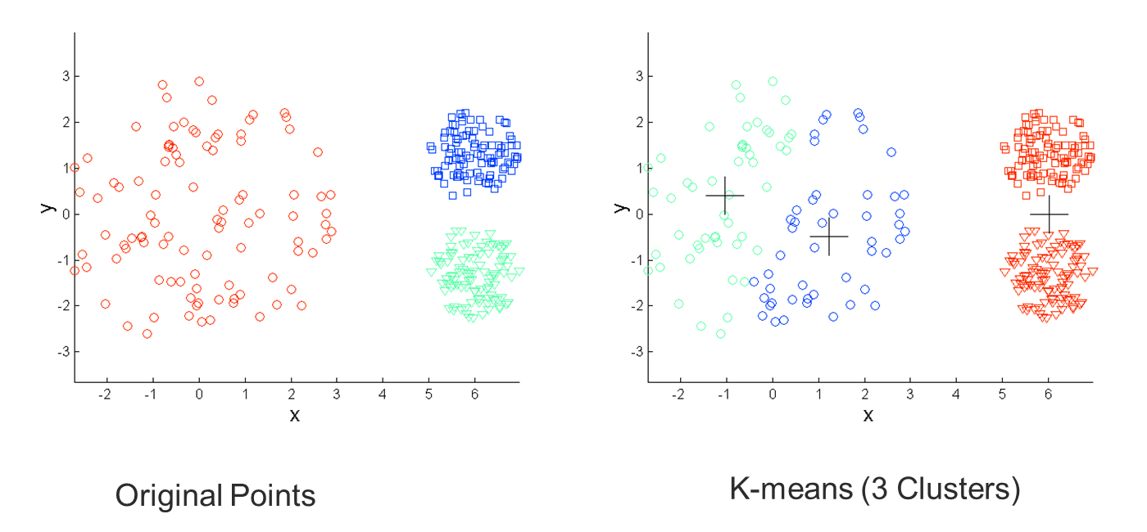
Limitations of K-means: Differing Density
One solution is to use many clusters. Find parts of clusters, but need to put together.

Slide 50
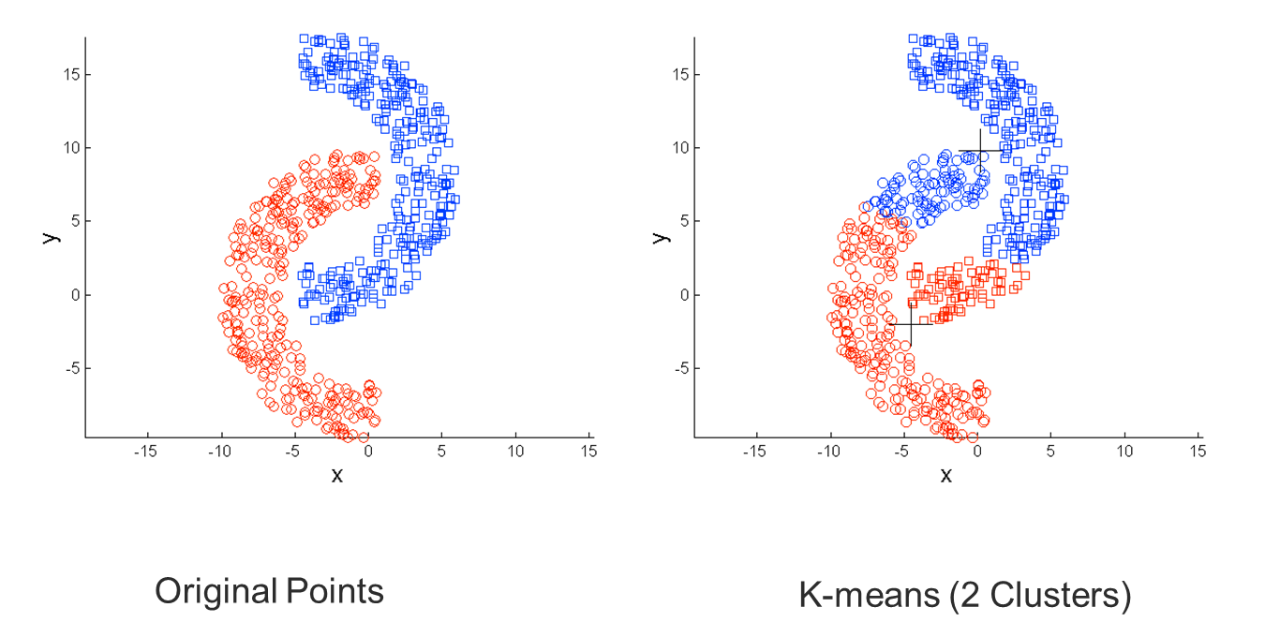
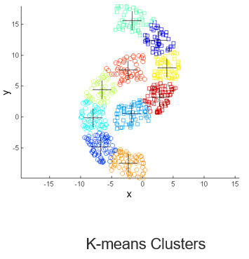
Limitations of K-means: Non-globular Shapes
One solution is to use many clusters. Find parts of clusters, but need to put together.

Slide 51
References
Most of the slides are from or have their materials taken from the following sources (unless otherwise indicated):
https://www-users.cs.umn.edu/~kumar001/dmbook/firsted.php
https://www-users.cs.umn.edu/~kumar001/dmbook/index.php
http://web.engr.illinois.edu/~hanj/bk3/

