Slide 1
INFS 5102 Unsupervised Methods in Analytics
Module 4 – Customer Segmentation

Slide 2
Outline
Introduction
What is customer segmentation
Why segment?
Types of customer segmentation
Main methods for customer segmentation

Slide 3
What is customer segmentation?
In the context of CRM (customer relationship management), customer segmentation is used to classify customers according to some similarity.
-- R. Colica. Customer Segmentation and Clustering using SAS Enterprise miner. 3rd edition, 2017
A more specific definition:
Customer segmentation “is the process of dividing customers (or, prospects) whose needs or wants vary greatly into groups or segments of customers whose needs or wants vary little within the group but vary greatly among groups ”
--Goutam Chakraborty, the notes of SAS course Customer Segmentation with Numeric and Textual Data using SAS®

Slide 4
What is customer segmentation?
Customer segmentation vs. clustering:
Segmentation: partition the data in a way that is convenient and useful, e.g., for marketing
Clustering: to find out if a data set is composed of natural groups
Segmentation can be very simple, e.g., divide customers based on their post codes
Clustering normally uses sophisticated algorithms/tools
Clustering is an important technique for customer segmentation

Slide 5
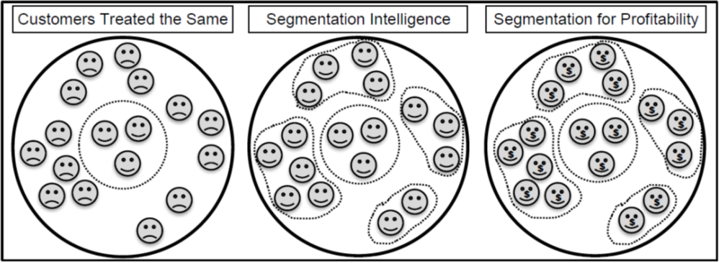
Why segment?
To better meet customer needs and wants
A result of balancing between mass marketing (one marketing scheme for all customers) & one-to-one marketing
Source: D. Baer. CSI: Customer Segmentation Intelligence for Increasing Profits. SAS Global Forum 2012

Slide 6
Why segment?
STP (Segmentation, Targeting, and Positioning) is a core business process used to identify and select groups of potential customers
whose needs within groups are the same and whose needs between groups are different (S)
who can be reached profitably (T)
with a focused marketing program (P)
Segmentation concepts have evolved over time
Firms have moved from mass production to mass customization, making segmentation more important
Firms have moved from using just demographics to segment markets to a combination of demographics, psychographics, attitudinal, and behavioral data to fine-tune market segments

Slide 7
Types of segmentation
Customer profiling
To gain insight or understanding about customers
Example: to answer field sales force’s question: “I need to understand customer base in the xyz area in order to deploy field sales force accordingly.”, a customer profile by geographic region will help.
A simple query of the database (#customers & purchases by region) may do the work
When number of attributes desired is large, clustering method may be needed.
Source: R. Colica. Customer Segmentation and Clustering using SAS Enterprise miner. 2nd edition, 2011

Slide 8
Types of segmentation
Customer likeness clustering
To know how customers are similar
Example: a chain store studies whether its outlets are similar in terms of social neighbourhood, size, staff numbers, vicinity to other shops…, to see if they have similar turnovers and profit.
A clustering on the outlets in terms of the above mentioned attributes, and examine turnovers within each cluster
Or a clustering on turnovers, then profile other variables that are of interest and feature the outlets.

Slide 9
Types of segmentation
RFM cell classification grouping
RFM: Recency, Frequency, and Monetary value.
Recency: a measure of the time lag since last communication or purchase by a customer
Frequency: quantity or volume of items or services purchased
Monetary value: numeric money figure of the value of the frequency
RFM cells:
Each customer is classified into only one of the cells/segments
Use RFM: for example, All customers in group 3C1, could be good candidates to increase revenue as they are very recent and they have purchased often
Source: R. Colica. Customer Segmentation and Clustering using SAS Enterprise miner. 2nd edition, 2011

Slide 10
Types of segmentation
Purchase affinity clustering
Interested in customers’ affinity for certain groups of product they have purchased within a certain time frame
Can cluster customers based on attributes of interests, e.g., revenue, demographics etc., then computes product affinity score for the clusters to see product tendencies for the groups, or
compute affinity score for the products of interests, then cluster those scores to find out similar groups

Slide 11
Methods for segmentation
Business rules – this does not include the use of clustering
Creating segments based on quantile membership.
Although this does not use clustering, grouping is performed by assessing the univariate statistics of customer attributes.
Classification – decision trees and so on
Clustering

Slide 12
Methods for segmentation
Business rule
Assign each customer to a group according to predetermined classes
Examples:
Grouping based on demographics of age, gender, income, education attained, and so on
Grouping based on the RFM rule, e.g. customers having shopped within the past 2 months and shopped 20 times over the past year and spent an average of $50 or more per week are in a “Gold” Segment, i.e. highest in recency, frequency and monetary value
Business Rules Advantages:
Consistent with business goals
Easy to apply
Business Rules Disadvantages:
Might not reflect the reality of customer behavior
Some segments might not be significantly different from one another

Slide 13
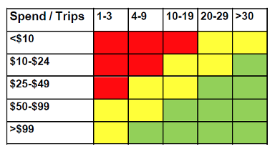
Methods for segmentation
Quantile membership
Uses attribute frequencies to determine segment membership
Univariate data analysis determines the groupings
Can further group segments created using quantiles:
Most Valuable – green
Average Value – yellow
Least Valuable – red
Advantages:
Clearly reflects segments based on chosen metrics
Easy to apply
Disadvantages:
Does not provide a mechanism to forecast behaviour as a predictive model might
Metrics for segmentation pre-chosen. Better segments might be obtained with a different set of attributes
Source: D. Baer. CSI: Customer Segmentation Intelligence for Increasing Profits. SAS Global Forum 2012

Slide 14
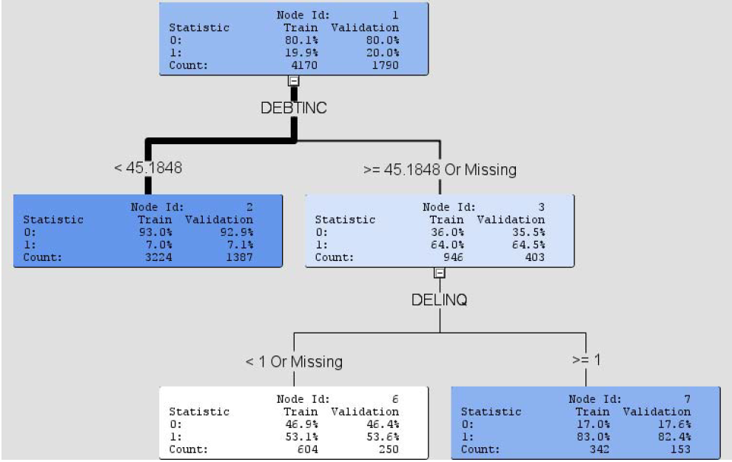
Methods for segmentation
Classification
Advantages:
Consistent with a specific business goal
Can correlate the target with other customer attributes
Disadvantages:
Only reflects one aspect of customer behaviour
Assumes that the drivers of the target will remain the same in the future
Source: D. Baer. CSI: Customer Segmentation Intelligence for Increasing Profits. SAS Global Forum 2012

Slide 15
Methods for segmentation
Clustering
Advantages:
Enables the greatest view of the customers
Provides a general set of segments that can be used for marketing
Provides a general set of segments that can be used as input to predictive models
Disadvantages:
May be difficult to decide what actions to take with each segment
Requires a good understanding of clustering methodologies

Slide 16
References/Sources of Slides
Most of the slides have their materials taken from the following sources:
R. Colica. Customer Segmentation and Clustering using SAS Enterprise miner. 3rd edition, 2017
D. Baer. CSI: Customer Segmentation Intelligence for Increasing Profits. SAS Global Forum 2012
Goutam Chakraborty, the notes of SAS course Customer Segmentation with Numeric and Textual Data using SAS®

