Slide 1
INFS 5102 Unsupervised Methods in Analytics
Module 5 – Anomaly Detection
Part 1: Introduction

Slide 2
Outline
Introduction
What are anomalies
Types of anomalies
Anomaly detection: problem definition, general scheme, methods, and evaluation
Methods
Statistical methods
Proximity based methods
Clustering based methods
Other topics
Contextual outlier and collective anomaly detection
anomaly detection in high-dimensional data

Slide 3
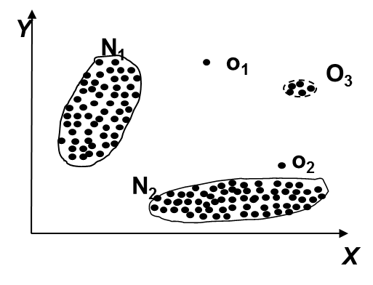
What are Anomalies?
An anomaly is an observation that doesn't fit the distribution of the data for normal instances, i.e., is unlikely under the distribution of the majority of instances.
a.k.a. outliers, exceptions, peculiarities, surprise, etc. In this course, we will use the term anomaly and outlier interchangeably
Examples:
Unusual credit card purchase
Sports: Michael Jordon, Roger Federer, ...
Most objectives follow a roughly Gaussian distribution,
but objects in Region R are significantly different.
N₁ and N₂ are regions of normal behaviour,
Points o₁ and o₂ are anomalies
Points in region O₃ are anomalies
Notes:
*clustering: sometimes also refers to the entire collection of clusters obtained

Slide 4
What are Anomalies?
Causes of anomalies
Data from different classes (e.g., outbreak of diseases)
Natural variation (unlikely variations), e.g., Spiderman?
Data measurement and collection errors (unexpected esp.)
Anomalies which are erroneous data objects recoded due to device/human errors or noise (random error) are not interesting, and normally are not the focus of anomaly detection algorithms
Relation to novelty detection:
Novel objects may appear as anomalies at early stage, so novelty detection and anomaly detection have similarity in methods.
but novel objects later merged into the model as normal ones

Slide 5
Types of Anomalies
Three kinds:
Global anomalies (a.k.a point anomalies) – focus of this course
contextual anomalies (a.k.a conditional anomalies)
collective anomalies
A data set may have multiple types of anomalies
One object may belong to more than one type

Slide 6
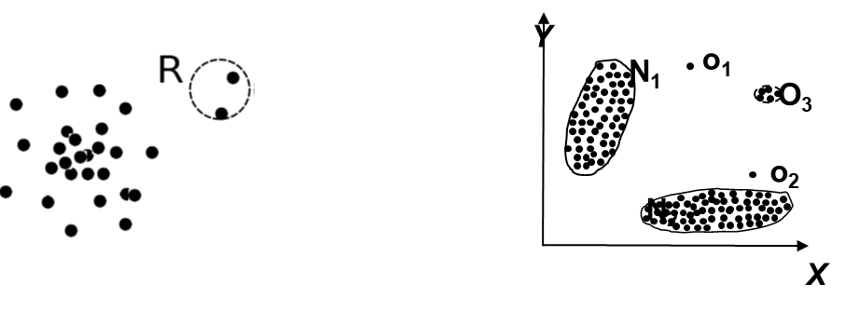
Types of Anomalies – Global/Point
An individual data object that is anomalous w.r.t. the rest of the data
Most outlier detections methods are developed for finding global anomalies
Examples: points in region R; and objects O₁ and O₂
Challenge: how to find an appropriate measurement of deviation
different measurements lead to different categories of anomaly detection methods.

Slide 7
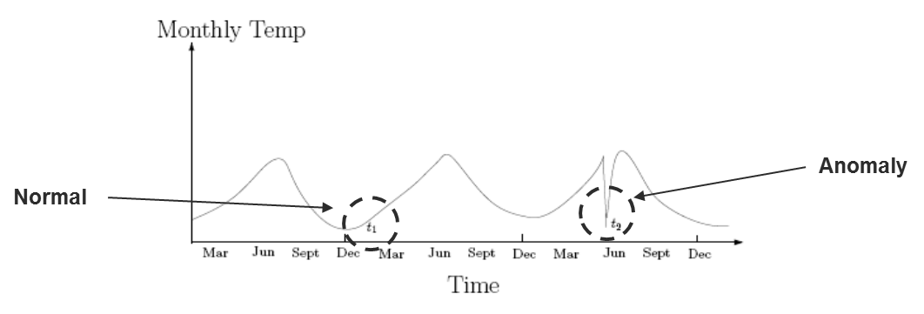
Types of Anomalies – Contextual
Object that deviates significantly based on a selected context
Examples:
42º C in Adelaide: anomaly? (depending on the season)
Using more than 90% of credit limit each months (depending on whether the customer is in the low credit limit group or in the high-income group)
Attributes of data objects should be divided into two groups
Contextual attributes: defines the context, e.g., time & location
Behavioral attributes: characteristics of the object, e.g., temperature
Challenge: How to define or formulate meaningful context?

Slide 8

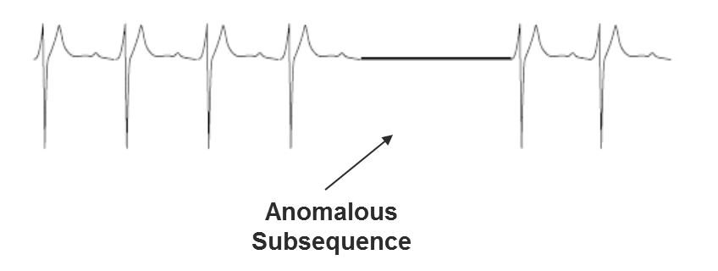
Types of Anomalies – Collective
A subset of data objects collectively deviate significantly from the whole data set, even if the individual data objects may not be anomalies
Applications:
intrusion detection: When a number of computers keep sending packets to a server → denial of service (Dos) attack
Detection of collective anomalies
Consider not only behavior of individual objects, but also that of groups of objects
Need to have the background knowledge on the relationship among data objects, such as a distance or similarity measure on objects.

Slide 9
Challenges of Anomaly Detection
Modeling normal objects and anomalies properly
Hard to enumerate all possible normal behaviors in an application
The border between normal objects and anomalies is often a gray area
Application-specific anomaly detection
Choice of distance measure among objects and the model of relationship among objects are often application-dependent
E.g., clinical data: a small deviation could be an anomaly; while in marketing analysis, larger fluctuations
Handling noise in anomaly detection
Noise may distort the normal objects and blur the distinction between normal objects and anomalies. It may help hide anomalies and reduce the effectiveness of anomaly detection
Understandability
Understand why these are anomalies: Justification of the detection
Specify the degree of an anomaly: the unlikelihood of the object being generated by a normal mechanism

Slide 10
Anomaly Detection – Problem Definitions
Given a dataset D, anomaly detection can be formalized as one of the two tasks/problems:
Each object in D is assigned an anomaly score, to measure how abnormal a data point is. Several variations of the problem:
Find all the data points x ∈ D with anomaly scores greater than some threshold t
Find all the data points x ∈ D having the top-n largest anomaly scores f(x)
Alternatively, assign each data object in D a normal or anomaly label
Some anomaly detection methods are able to use the given dataset D to provide a score or label for a new test instance (which is not in D).

Slide 11
Anomaly Detection Schemes
General steps
Build a profile of the “normal” behavior
Profile can be patterns or summary statistics for the overall population
Use the “normal” profile to detect anomalies
Anomalies are observations whose characteristics differ significantly from the normal profile
Working assumption:
There are considerably more “normal” observations than “abnormal” observations (anomalies) in the data

Slide 12
Anomaly Detection Methods
Two (orthogonal) ways to categorise anomaly detection methods:
Based on whether user-labeled examples of anomalies can be obtained:
Supervised, semi-supervised vs. unsupervised methods
Based on assumptions about normal data and anomalies:
e.g., statistical, proximity-based, and clustering-based methods

Slide 13
Supervised Methods
Labels of training data are known
Samples labelled by domain experts as normal or abnormal, and the labelled samples are used for training & testing
Consider anomaly detection as a classification problem
Challenges/issues
Imbalanced classes, i.e., anomalies are rare.
A possible solution: Boost the anomaly class and make up some artificial anomalies
For anomaly detection, recall (catching the anomalies) is more important than accuracy (not misclassifying normal objects as anomalies). So need interpret classification result properly.

Slide 14
Unsupervised Methods
Assume the normal objects are somewhat ``clustered'‘ into multiple groups, each having some distinct features
An anomaly is expected to be far away from any groups of normal objects
Challenge: hard to distinguish collective anomalies from normal objects.
Normal objects may not share any strong patterns, but the collective anomalies may share high similarity in a small area
Example: In some intrusion or virus detection, normal activities are diverse
Unsupervised methods may have a high false positive rate but still miss many real outliers.
Supervised methods can be more effective, e.g., identify attacking some key resources

Slide 15
Unsupervised Methods
Many clustering methods can be adapted for unsupervised methods
Find clusters, then identify an anomaly as: an object not belonging to any cluster; having a large distance between from its closest cluster, or belonging to a small or sparse cluster
Problem 1: Hard to distinguish noise from anomalies
Problem 2: Costly to do clustering, but far less anomalies than normal objects

Slide 16
Semi-Supervised Methods
Situation: In many applications, the number of labeled data is often small
Semi-supervised anomaly detection: Regarded as applications of semi-supervised learning
If some labeled normal objects are available
Use the labeled examples and the proximate unlabeled objects to train a model for normal objects
Those not fitting the model of normal objects are detected as anomalies
If only some labeled anomalies are available, a small number of labeled anomalies many not cover the possible anomalies well
To improve the quality of anomaly detection, one can get help from models for normal objects learned from unsupervised methods

Slide 17
Statistical Methods
Statistical methods assume that the normal data follow some statistical model, and the objects not following the model are anomalies.
Example: First use Gaussian distribution to model the normal data
For each object y in region R, estimate g_{D}(y), the probability of y fits the Gaussian distribution
If g_{D}(y) is very low, y is unlikely generated by the Gaussian model, thus an outlier
Effectiveness highly depends on whether the assumption of statistical model holds in the real data
There are rich alternatives to use various statistical models
E.g., parametric vs. non-parametric

Slide 18
Proximity-Based Methods
Intuition/Assumption: Objects that are far away from the others are outliers
An object is an anomaly if the nearest neighbors of the object are far away, i.e., the proximity of the object significantly deviates from the proximity of most of the other objects in the same data set
Example: model the proximity of an object using its 3 nearest neighbors
Objects in region R are substantially
different from other objects in the data
set, thus the objects in R are anomalies

Slide 19
Proximity-Based Methods
The effectiveness of proximity-based methods highly relies on the proximity measure.
In some applications, proximity or distance measures cannot be obtained easily.
Often have a difficulty in finding a group of anomalies which stay close to each other
Two major types of proximity-based outlier detection
Distance-based vs. density-based

Slide 20
Clustering-Based Methods
Normal data belong to large and dense clusters, whereas anomalies belong to small or sparse clusters, or do not belong to any clusters
Example: two clusters
All points not in R form a large cluster
The two points in R form a tiny cluster, thus are anomalies
Since there are many clustering methods, there are many clustering-based anomaly detection methods as well
Clustering is expensive: straightforward adaption of a clustering method for outlier detection can be costly and does not scale up well for large data sets

Slide 21
Evaluation
Evaluation of the effectiveness of anomaly detection methods is a difficult task, because anomalies are rare, which means the ground-truth about which data points are anomalies is often not available.
This is especially true for unsupervised algorithms.
Therefore, case studies are often used to provide an intuitive and qualitative evaluation of the underlying outliers in unsupervised scenarios.
When ground-truth is available, a part of which can be used in order to perform the supervision, and the remaining can be used for evaluation.

Slide 22
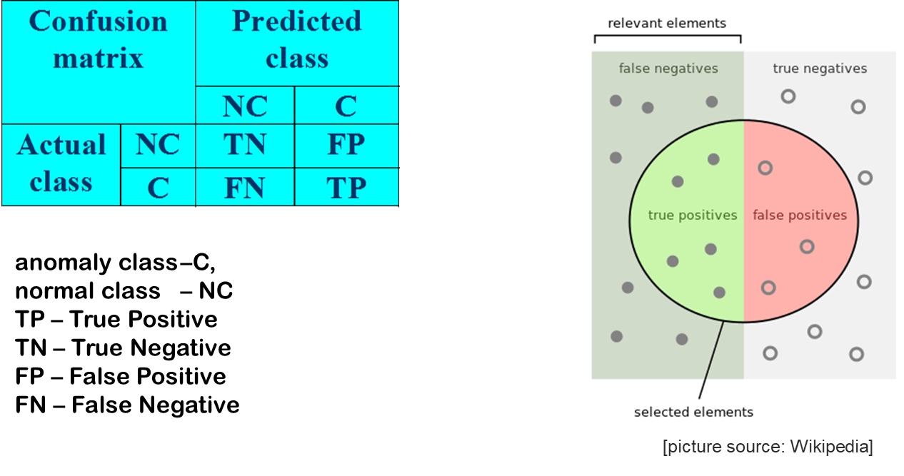
Evaluation

Slide 23
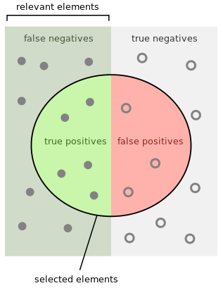
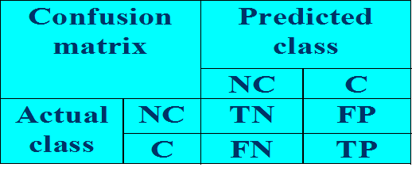
Evaluation
Accuracy = (TN+TP)/ (TP+FP+TN+FN)
Accuracy is commonly used for evaluating the performance of a classifier, but accuracy is not a sufficient metric for evaluating the performance of an anomaly detection method!
Example: network traffic data set with 99.9% of normal data and 0.1% of intrusions. Trivial classifier that labels everything with the normal class can achieve 99.9% accuracy.

Slide 24
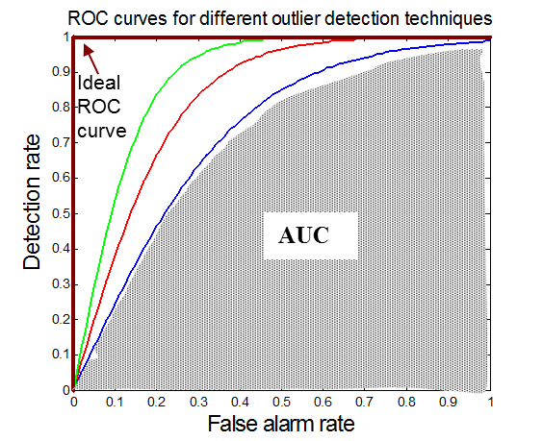
Evaluation
Standard measures for evaluating anomaly detection problems:
Recall (Detection rate) - ratio between the number of correctly detected anomalies and the total number of anomalies, R=TP/(TP + FN)‏
False alarm (false positive) rate – ratio between the number of data records from normal class that are misclassified as anomalies and the total number of data records from normal class, FA=FP/(FP+TN)‏
Area under the ROC curve (AUC)
ROC Curve is a trade-off between detection rate and false alarm rate

Slide 25
References
J. Han, M. Kamber, and J. Pei. Data Mining: Concepts and Techniques. 3rd edition. Morgan Kaufmann, 2012 (eBook available at UniSA library)
P.-N. Tan, M. Steinbach, and V. Kuma. Introduction to Data Mining. Addison-Wesley. 2019.
C. C. Aggarwal. Outlier Analysis. Springer. 2013
Most of the slides are from or have their materials taken from the following sources:
http://www-users.cs.umn.edu/~kumar/dmbook/index.php
http://web.engr.illinois.edu/~hanj/bk3/
Some of the slides on Evaluation are from or have their materials taken from the following source:
https://www.siam.org/meetings/sdm08/TS2.ppt

