Slide 1
INFS 5102 Unsupervised Methods in Analytics
Module 5 – Anomaly Detection
Part 2: Methods

Slide 2
Outline
Introduction
What are anomalies
Types of anomalies
Anomaly detection: problem definition, general scheme, methods, and evaluation
Methods
Statistical methods
Proximity based methods
Clustering based methods
Other topics
Contextual outlier and collective anomaly detection
anomaly detection in high-dimensional data

Slide 3
Statistical Methods
Assume that the normal data follow some statistical model
(a stochastic model), and the data points not following the
model are anomalies
Basic idea:
Estimate a model fitting given data set
Identify objects in low probability regions as outliers
Anomaly score scores ~ probability
Effectiveness highly depends on whether the assumption of statistical model holds in the real data
Statistical methods are divided into two categories:
parametric
non-parametric

Slide 4
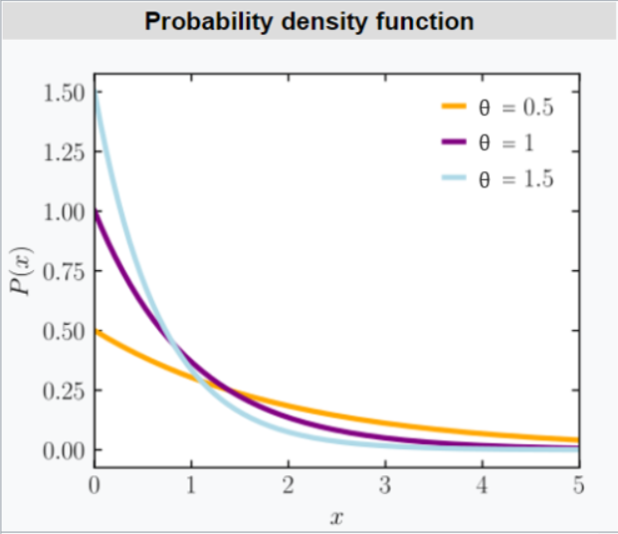
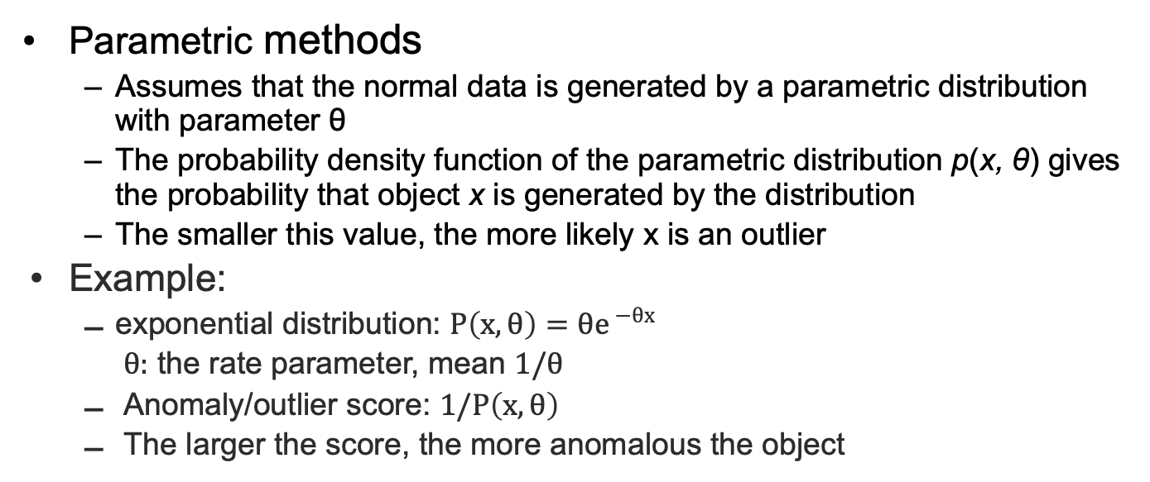
Statistical Methods – Parametric Methods
Parametric methods
Assumes that the normal data is generated by a parametric distribution with parameter θ
The probability density function of the parametric distribution p(x, θ) gives the probability that object x is generated by the distribution
The smaller this value, the more likely x is an outlier
Example:
exponential distribution: $P\left(x,θ\right)={θe}^{ −θx}$
$θ:$ the rate parameter, mean $1/θ$
Anomaly/outlier score: $1/P\left(x,θ\right)$
The larger the score, the more anomalous the object

Slide 5
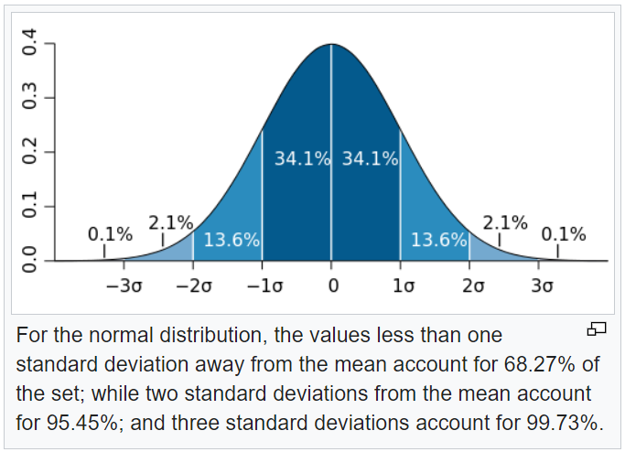
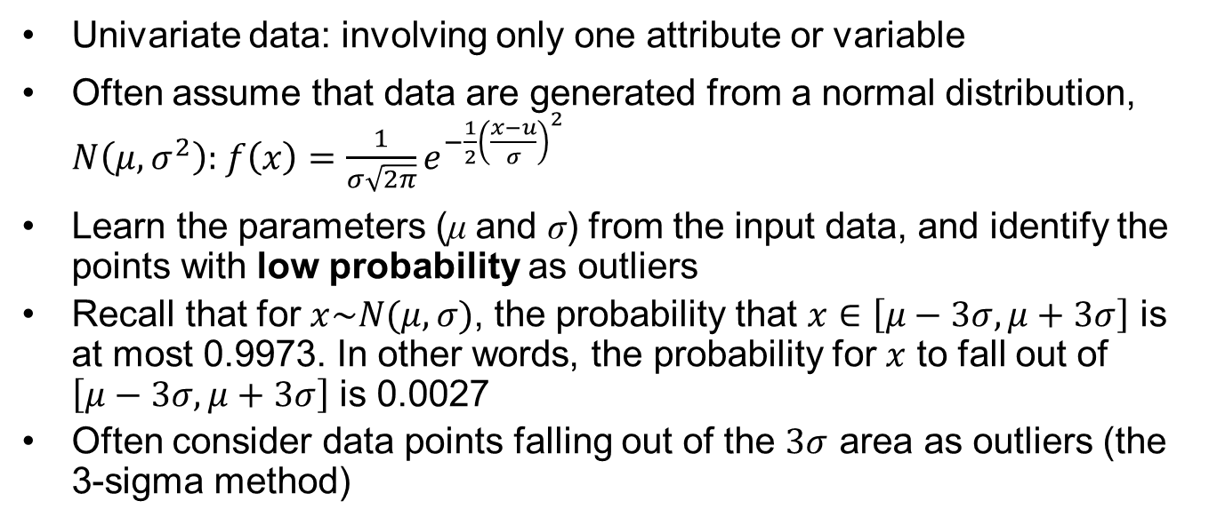
Parametric Methods – Detecting Univariate Outliers based on
Normal Distribution
Univariate data: involving only one attribute or variable
Often assume that data are generated from a normal distribution, $N\left(μ, σ^{2}\right):$ $f\left(x\right)=\frac{1}{σ\sqrt{2π}}e^{−\frac{1}{2}{\left(\frac{x−u}{σ}\right)}^{2}}$
Learn the parameters (μ and σ) from the input data, and identify the points with low probability as outliers
Recall that for $x\sim N(μ,σ)$, the probability that $x∈\left[μ−3σ,μ+3σ\right]$ is at most 0.9973. In other words, the probability for $x$ to fall out of $\left[μ−3σ,μ+3σ\right]$ is 0.0027
Often consider data points falling out of the $3σ$ area as outliers (the 3-sigma method)
from Wikipedia

Slide 6


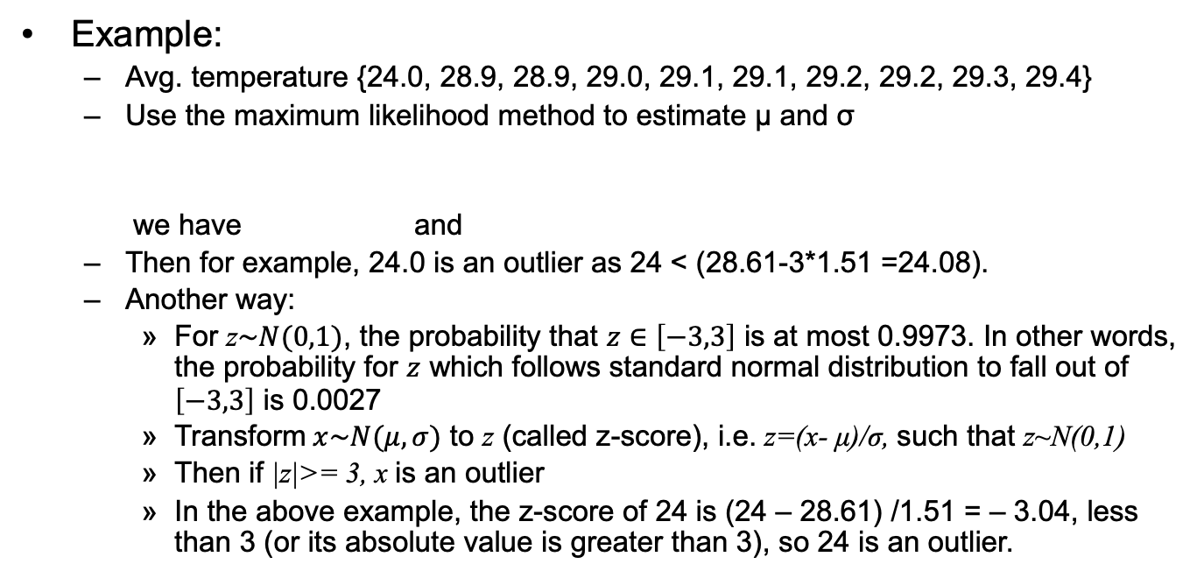
Parametric Methods – Detecting Univariate Outliers based on
Normal Distribution
Example:
Avg. temperature {24.0, 28.9, 28.9, 29.0, 29.1, 29.1, 29.2, 29.2, 29.3, 29.4}
Use the maximum likelihood method to estimate μ and σ
we have and
Then for example, 24.0 is an outlier as 24 < (28.61-3*1.51 =24.08).
Another way:
For z$\sim N(0,1)$, the probability that $z∈\left[−3,3\right]$ is at most 0.9973. In other words, the probability for $z$ which follows standard normal distribution to fall out of $\left[−3,3\right]$ is 0.0027
Transform$x\sim N(μ,σ)$ to z (called z-score), i.e. z=(x- μ)/σ, such that z~N(0,1)
Then if |z|>= 3, x is an outlier
In the above example, the z-score of 24 is (24 – 28.61) /1.51 = – 3.04, less than 3 (or its absolute value is greater than 3), so 24 is an outlier.

Slide 7
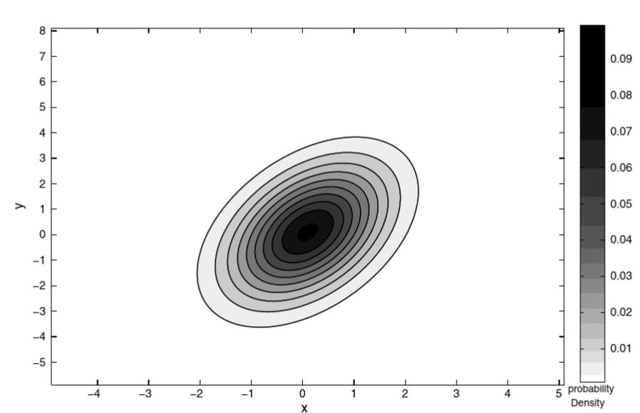
Parametric Methods - Detecting Multivariate Outliers
Multivariate data: A data set involving two or more attributes or variables
Correlation between different attributes makes the detection difficult as a multivariate normal distribution is not symmetrical w.r.t. its center

Slide 8

Parametric Methods - Detecting Multivariate Outliers
Basic idea:
transform the multivariate outlier detection task into a univariate outlier detection problem
For example, can use χ² –statistic:
where E_{i} is the mean of the i-th dimension among all objects, o_{i} is value of o in the i-th dimension, and n is the dimensionality
If χ² –statistic is large, then object o is an outlier

Slide 9
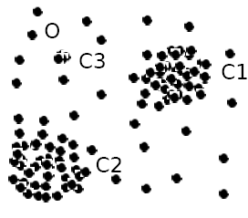
Parametric Methods - Using Mixture of Parametric Distributions
Assuming data generated by a single normal distribution could be sometimes overly simplified
Example:
The objects between the two clusters cannot be captured as outliers since they are close to the estimated mean

Slide 10
Parametric Methods - Using Mixture of Parametric Distributions
To overcome this problem, assume the normal data is generated by two normal distributions. For any object o in the data set, the probability that o is generated by the mixture of the two distributions is given by
where f_{θ1} and f_{θ2} are the probability density functions of θ₁ and θ₂
Then learn the parameters μ₁, σ₁, μ₂, σ₂ from data
An object o is an outlier if the probability is very low for it to be generated by the mixture of the distributions

Slide 11
Non-parametric Methods
Non-parametric (statistical) methods
Determine the model from input data without assuming an a-priori statistical model
Not completely parameter free but consider the number and nature of the parameters are flexible and not fixed in advance
Examples: histogram and kernel density estimation

Slide 12
Non-parametric Methods - Detection Using Histogram
a.k.a. frequency-based, counting based method
Figure shows the histogram of purchase amounts in
transactions
A transaction in the amount of $7,500 is an outlier,
since only 0.2% transactions have an amount higher
than $5,000
Problem: Hard to choose an appropriate bin size (the number of bins) for histogram
Too small bin size → normal objects in empty/rare bins, false positive
Too big bin size → outliers in some frequent bins, false negative
Solution: Adopt kernel density estimation (KDE) to estimate the probability density distribution of the data. If the estimated density function is high, the object is likely normal. Otherwise, it is likely an outlier.
For multivariate data, use attribute-wise histogram or KDE

Slide 13
Limitations of Statistical Approaches
In many cases, data distribution may not be known, thus, the assumption of the data distribution often does not hold true
For high dimensional data, it may be difficult to estimate the true distribution
Transforming multivariate anomaly detection into univariate task is unable to capture the interactions between attributes

Slide 14
Proximity-Based Methods
Intuition/Assumption: Objects that are far away from the others are outliers
An object is an outlier if the nearest neighbors of the object are far away, i.e., the proximity of the object significantly deviates from the proximity of most of the other objects in the same data set
Example: model the proximity of an object using its 3 nearest neighbors
Objects in region R are substantially
different from other objects in the data
set, thus the objects in R are outliers

Slide 15
Proximity-Based Methods
Generally using a two-step approach:
Compute neighbourhood for each data record
Analyse the neighbourhood to determine whether data record is anomaly or not
Two types of proximity-based outlier detection methods
Distance-based outlier detection: An object o is an outlier if its neighborhood does not have enough other points
Density-based outlier detection: An object o is an outlier if its density is relatively much lower than that of its neighbours

Slide 16
Distance-Based Outlier Detection
For each object o, examine the number of other objects in the r-neighborhood of o, where r is a user-specified distance threshold
An object o is an outlier if most of the objects in D are far away from o, i.e., not in the r-neighborhood of o
Specifically, an object o is a DB(r, π) outlier if
Equivalently, one can check the distance between o and its k-th nearest neighbor o_{k}, where . Then o is an outlier if dist(o, o_{k}) > r

Slide 17
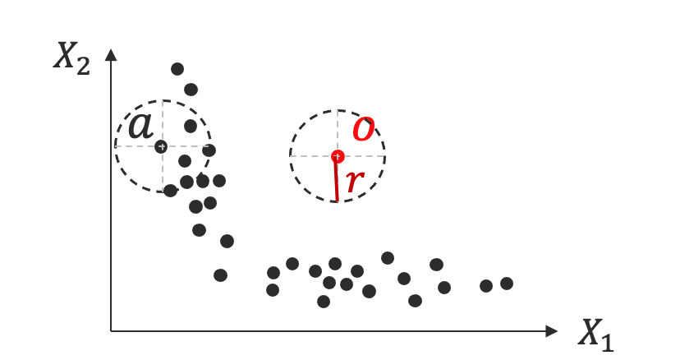
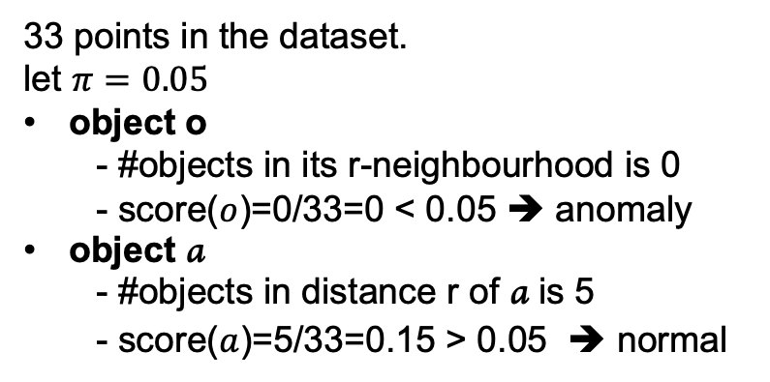
Distance-Based Outlier Detection
Example:
An object o is a DB(r, π) outlier if
33 points in the dataset.
let $π=0.05$
object o
- #objects in its r-neighbourhood is 0
- score($o$)=0/33=0 < 0.05 ➔ anomaly
object a
- #objects in distance r of a is 5
- score($a$)=5/33=0.15 > 0.05 ➔ normal

Slide 18
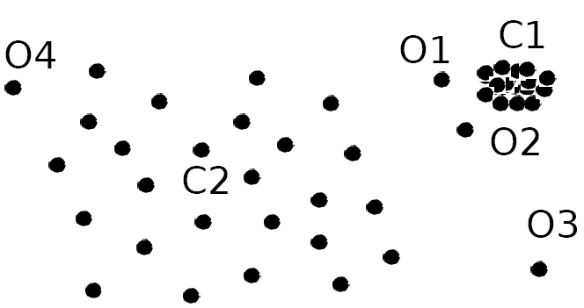
Density-Based Outlier Detection - Motivation
Local outliers: Outliers comparing to their local neighborhoods, instead of the global data distribution
In the Fig., if we look at o₁ and o₂ locally w.r.t. cluster C1, o₁ and o₂ should be considered as outliers
But using distance-based method, o₁ and o₂ will not be detected as outliers as they are close enough to their neighbours. (If use distance-based method, o₃ is a global outlier)
Density based method can detect o₁ and o₂ as outliers.

Slide 19
Density-Based Outlier Detection
Assumption (density-based outlier detection): The density around an outlier object is significantly different from the density around its neighbours;
Basic idea: Use the relative density of an object against its neighbors as the indicator of the degree of the object being outliers

Slide 20
Density-Based Outlier Detection
Now the question is: how to measure relative density?
We could use the average distance from o to objects in its neighbourhood to measure the local density of o. Then use the ratio of the local densities of two objects to define their relative density
However, such a straightforward measure has a problem:
If o has very close neighbours o’ such that dist(o, o’) is very small, the ratio of the local densities could fluctuate undesirably
The LOF (local outlier factor) algorithm overcomes this problem using the “reachability distance measure” by adding a smoothing effect

Slide 21
Density-Based Outlier Detection
k-distance of an object o, dist_{k}(o): distance between o and its k-th NN
k-distance neighborhood of o, N_{k}(o) = {p| p in D, dist(o, p) ≤ dist_{k}(o)}
Number of objects in the k-distance neighbourhood could be bigger than k since multiple objects may have identical distance to o
Reachability distance from o to p:
reachdist_{k} (p ← o) = max {dist_{k}(p), dist(p,o)}

Slide 22
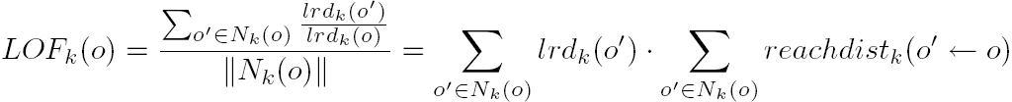
Density-Based Outlier Detection - LOF
Local reachability density of o:
LOF (Local outlier factor) of an object o is the average of the ratio of local reachability of o and those of o’s k-nearest neighbours
The lower the local reachability density of o, and the higher the local reachability density of the kNN of o, the higher LOF
This captures a local outlier whose local density is relatively low comparing to the local densities of its kNN

Slide 23
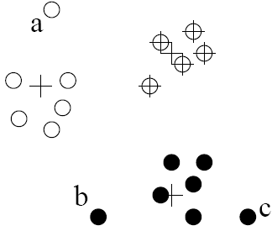
Clustering-Based Outlier Detection
An object is an outlier if
Case 1: it does not belong to any cluster,
Case 2: there is a large distance between the object and its closest cluster, or
Case 3: it belongs to a small or sparse cluster
Case 1: Not belong to any cluster
Example: Using a density-based clustering method such as DBSCAN
Case 2: Far from its closest cluster
Partition data points into clusters
For each object o, assign an outlier score based on its distance from its closest center
E.g. : If dist(o, c_{o})/avg_dist(c_{o}) is large, likely an outlier

Slide 24
Clustering-Based Outlier Detection
Case 3: small cluster
An example algorithm: FindCBLOF
Find clusters, and sort them in decreasing size, and using some user given parameters to divide the clusters into small and large clusters
To each data point, assign a cluster-based local outlier factor (CBLOF):
If obj p belongs to a large cluster Cp, CBLOF = cluster_size of Cp X distance between p and the centroid of Cp
If p belongs to a small cluster Cp, CBLOF = cluster size of Cp X distance between p and the closest large cluster
FindCBLOF can identify points in C₃ as outliers. For any point in C₃, its closest large cluster is C_{2,} and its distance from C₂ is large, although the size of C_{3,} i.e., |C₃| = 3 is small

Slide 25
Clustering-Based Methods - Strength and Weakness
Strength
Detect outliers without requiring any labeled data
Work for many types of data
Clusters can be regarded as summaries of the data
Once the cluster are obtained, need only compare any object against the clusters to determine whether it is an outlier (fast)
Weakness
Effectiveness depends highly on the clustering method used - they may not be optimized for outlier detection
High computational cost: Need to first find clusters

Slide 26
Mining Contextual Outliers
- Transform into Conventional Outlier Detection
If the contexts can be clearly identified, transform it to conventional outlier detection
Identify the context of the object using the contextual attributes
Calculate the outlier score for the object in the context using a conventional outlier detection method
Example: Detect outlier customers in the context of customer groups
Contextual attributes: age group, postal code
Behavioral attributes: # of trans/yr, annual total trans. amount
Steps: (1) locate c’s context, (2) compare c with the other customers in the same group, and (3) use a conventional outlier detection method
If the (exact) context contains very few customers, results using the above approach are unreliable. Can generalize contexts

Slide 27
Mining Contextual Outliers
- Modeling Normal Behavior with Respect to Contexts
In some applications, one cannot clearly partition the data into contexts
Model the “normal” behavior with respect to contexts
Using a training data set, train a model that predicts the expected behavior attribute values with respect to the contextual attribute values
An object is a contextual outlier if its behavior attribute values significantly deviate from the values predicted by the model
Using a prediction model that links the contexts and behavior, these methods avoid the explicit identification of specific contexts
Methods: A number of classification and prediction techniques can be used to build such models, such as regression, Markov Models, and Finite State Automaton

Slide 28
Mining Collective Outliers - On the Set of “Structured Objects”
Collective outlier if objects as a group deviate significantly from the entire data
Need to examine the structure of the data set, i.e, the relationships between multiple data objects
Each of these structures is inherent to its respective type of data
For temporal data (such as time series and sequences), we explore the structures formed by time, which occur in segments of the time series or subsequences
For spatial data, explore local areas
For graph and network data, we explore subgraphs
Difference from the contextual outlier detection: the structures are often not explicitly defined, and have to be discovered as part of the outlier detection process.

Slide 29
Mining Collective Outliers - On the Set of “Structured Objects”
Collective outlier detection methods: two categories
Reduce the problem to conventional outlier detection
Identify structure units, treat each structure unit (e.g., subsequence, time series segment, local area, or subgraph) as a data object, and extract features
Then outlier detection on the set of “structured objects” constructed as such using the extracted features
Model the expected behavior of structure units directly
Example 1. Detect collective outliers in online social network of customers
Treat each possible subgraph of the network as a structure unit
Collective outlier: An outlier subgraph in the social network
Small subgraphs that are of very low frequency
Large subgraphs that are surprisingly frequent

Slide 30
Mining Collective Outliers - On the Set of “Structured Objects”
Example 2. Detect collective outliers in temporal sequences
Learn a Markov model from the sequences
A subsequence can then be declared as a collective outlier if it significantly deviates from the model
Collective outlier detection is subtle due to the challenge of exploring the structures in data
The exploration typically uses heuristics, and thus may be application dependent
The computational cost is often high due to the sophisticated mining process

Slide 31
Challenges for Outlier Detection in High-Dimensional Data
Interpretation of outliers
Detecting outliers without saying why they are outliers is not very useful in high-D due to many features (or dimensions) are involved in a high-dimensional data set
E.g., which subspaces that manifest the outliers or an assessment regarding the “outlier-ness” of the objects
Data sparsity
Data in high-D spaces are often sparse
The distance between objects becomes heavily dominated by noise as the dimensionality increases
Data subspaces
Adaptive to the subspaces signifying the outliers
Capturing the local behavior of data
Scalable with respect to dimensionality
# of subspaces increases exponentially

Slide 32
References
J. Han, M. Kamber, and J. Pei. Data Mining: Concepts and Techniques. 3rd edition. Morgan Kaufmann, 2012 (eBook available at UniSA library)
P.-N. Tan, M. Steinbach, and V. Kuma. Introduction to Data Mining. Addison-Wesley. 2nd edition, 2018
C. C. Aggarwal. Outlier Analysis. Springer. 2013
Most of the slides are from or have their materials taken from the following sources:
http://www-users.cs.umn.edu/~kumar/dmbook/index.php
http://web.engr.illinois.edu/~hanj/bk3/

