Slide 1
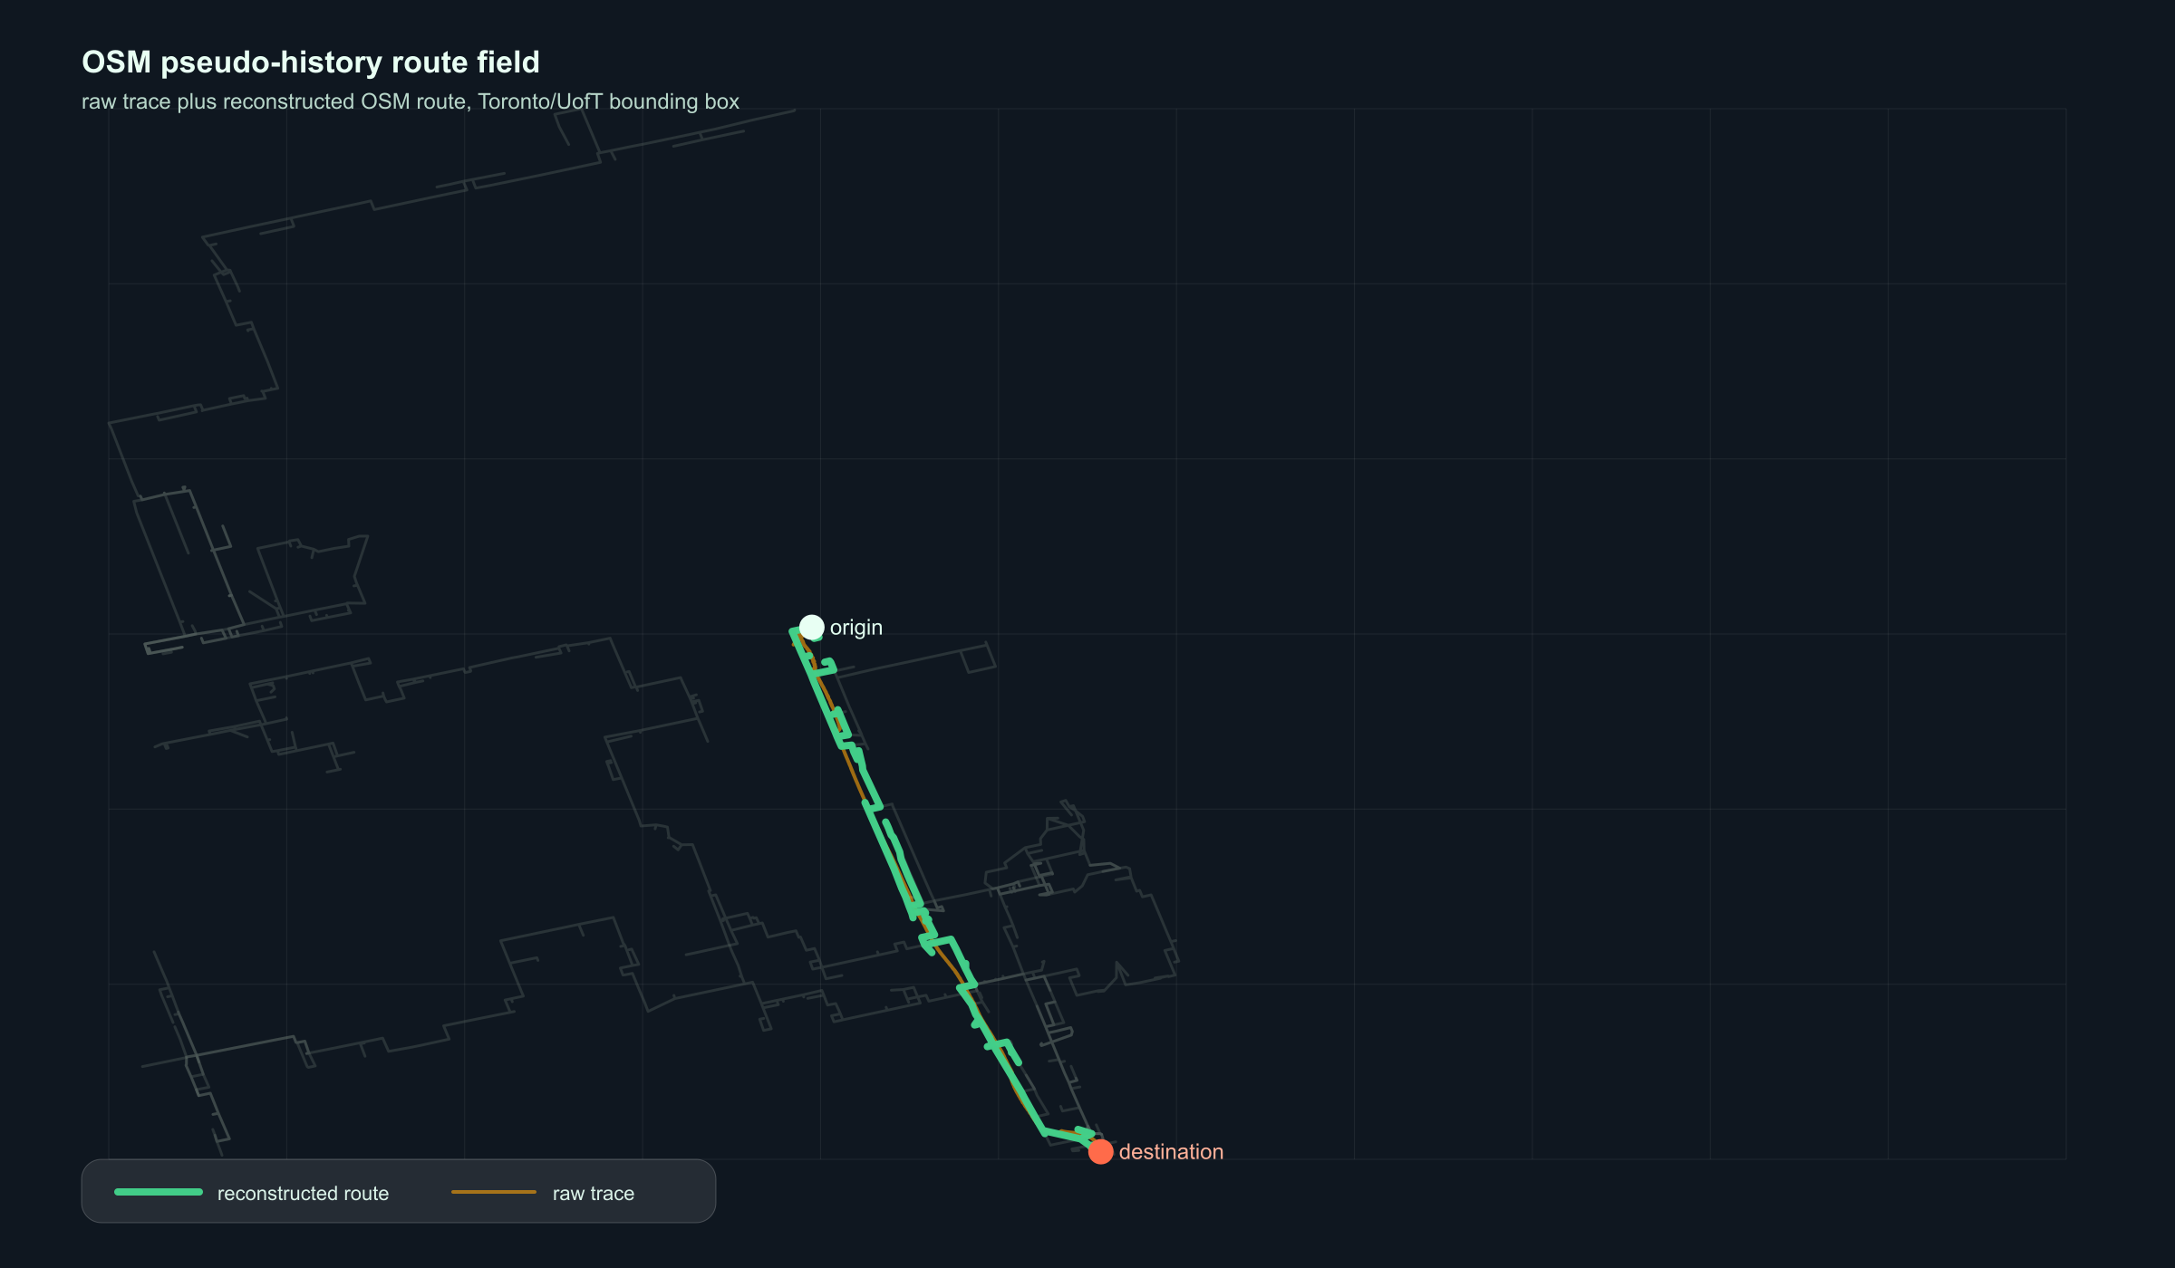
Route
GraphRAG
Preference-aware route ranking from noisy geospatial signals
Technical deep dive for Aker AI Platform Engineering
Built around FastAPI, OSMnx, dynamic profiles, SBERT ranking, and explicit reconstruction diagnostics.

Slide 2
Aker's platform thesis is exactly this problem class
Turn messy operational data into internal tools, knowledge, and agents that drive real decisions.
Source: Aker AI Platform public site and LinkedIn hiring post, accessed May 2026.
The product pitch
INVEST
OPERATE
RouteGraphRAG is a pattern for Aker's internal AI platform: ingest imperfect operational traces, build an explainable representation, rank options, and show the uncertainty before anyone trusts the output.
Site context, trade areas, walkability, asset diligence
Field movement patterns, service routing, inspection planning
SERVE
KNOW
Resident-facing route guidance and neighborhood intelligence
A knowledge layer that explains why a route was ranked
Aker framing: agents, tools, workflows, knowledge, and production AI systems for real estate operations.

Slide 3
The product ranks routes the way a person actually asks
A natural-language preference, a dynamic profile, and OSM features combine into explainable route candidates.
Example request
>
>
INPUT
RANK
EXPLAIN
Preference text plus route context
Profile score + prompt/SBERT score
Feature summary, scores, coordinates
Prefer quieter walking routes near parks and away from major roads.
origin + destination + timestamp + user_id + ranking_mode=hybrid
5
3
ranked candidates
ranking modes
Backend endpoint: /rank-routes. Modes: prompt, profile, hybrid.

Slide 4
The hard part is not drawing a route. It is deciding which route deserves rank 1.
This field view uses actual OSM pseudo-history records: raw public GPS samples are reconstructed onto OSM walking geometry, then converted into route features.
Important wording: OSM-derived historical movement signals, not clean per-user history.

Slide 5
System architecture: one shared route representation
Every stage produces or consumes the same route feature object, which keeps ranking explainable and testable.
>
>
>
1. PROBE
2. SEGMENT
3. MATCH
4. FEATURES
OSM public GPS trackpoints in target bounding box
Split by time gaps, spatial jumps, useful movement filters
Nearest OSM nodes plus shortest-path stitching
Distance, road mix, parks, turns, lighting, crossings
>
>
5. PROFILE
6. CANDIDATES
7. RANK
Contextual weights from prior pseudo-history records
Diverse OSM routes under length, scenic, safe, simple costs
Random, shortest, profile, prompt/SBERT, hybrid
Key design choice: keep model-facing text and numerical feature scoring traceable to the same OSM-derived representation.

Slide 6
The GraphRAG idea is a routing memory, not a chatbot wrapper
Route facts become inspectable nodes, weights, summaries, and retrieval context.
Representation
ROUTE
CONTEXT
Route candidates are ranked by a structured feature graph: road-type mix, park proximity, lighting, crossings, tunnels, turns, temporal context, and profile weights.
candidate geometry + coordinates
weekday, time bucket, season, rush hour
The LLM/SBERT layer only sees route summaries derived from the same features, so natural language preferences remain auditable.
FEATURES
PROFILE
interpretable OSM-derived attributes
dynamic weights from historical signals
TEXT
EVIDENCE
summary used for semantic ranking
diagnostics attached to each claim
Production implication: retrieval can cite route features and data quality, not just emit a plausible answer.

Slide 7
Evaluation says profile ranking is useful, but not yet a victory lap
The profile baseline improves the strongest graded/path signal over shortest distance on a small, noisy OSM pseudo-history run.
0.727
Profile NDCG@3
0.630
Profile path F1
8
successful route-candidate queries
Interpretation: promising system behavior, not a claim that it beats prior personalized-routing research.
Source: data/route_candidate_baseline_comparison.json. Prompt and hybrid use synthetic preference text as ablation only.

Slide 8
The strongest engineering signal is the caveat handling
The system separates reconstruction quality from ranking quality instead of hiding data uncertainty.
Passes exploratory gate
25,000
11
timestamped OSM trackpoints probed
useful pseudo-segments found
Fails strict gate because median route-distance ratio is 2.37, above the strict target range. That means the route may stay close to points while still overbuilding path length.
Production move: promote confidence and reconstruction diagnostics into the API response, evaluation dashboards, and human review loop.
100%
6.99 m
map-match success rate
median GPS-to-route distance
Source: data/threshold_sensitivity.json and docs/THRESHOLD_SENSITIVITY_STUDY.md.

Slide 9
What I would productionize first
The existing backend is enough to show the product; the next layer is reliability, observability, and evaluation discipline.
API CONTRACT
OBSERVABILITY
Keep route features, component scores, summary, coordinates, and profile summary in every response.
Log ranking inputs, top-k deltas, feature weights, and diagnostics for replay.
CACHE + COST
DATA GOVERNANCE
Cache OSM graph builds by bounding box and precompute common property-area graphs.
Label pseudo-history, synthetic preference text, and clean user-labeled data separately.
EVAL HARNESS
HUMAN LOOP
Run random, shortest, profile, prompt, hybrid on the same candidate pool after every ranking change.
Capture route accept/reject feedback before introducing learned rankers.
Tradeoff posture: ship the demo, but do not let model confidence outrun data provenance.

Slide 10
Why this fits Aker
I can build end-to-end
FastAPI service, data pipeline, model/ranker, evaluation artifacts, and demo surface.
It is an AI platform pattern: connect data, encode domain judgment, rank operational options, expose uncertainty, and make the system better every sprint.
I know where the risk is
Data quality, map matching, synthetic labels, overclaiming, and deployment cost.
I can translate to Aker
Property operations, investment diligence, resident experience, and internal knowledge workflows.
Round 1 discussion path: product problem -> architecture -> scoring tradeoffs -> evaluation -> production roadmap.

