Slide 1
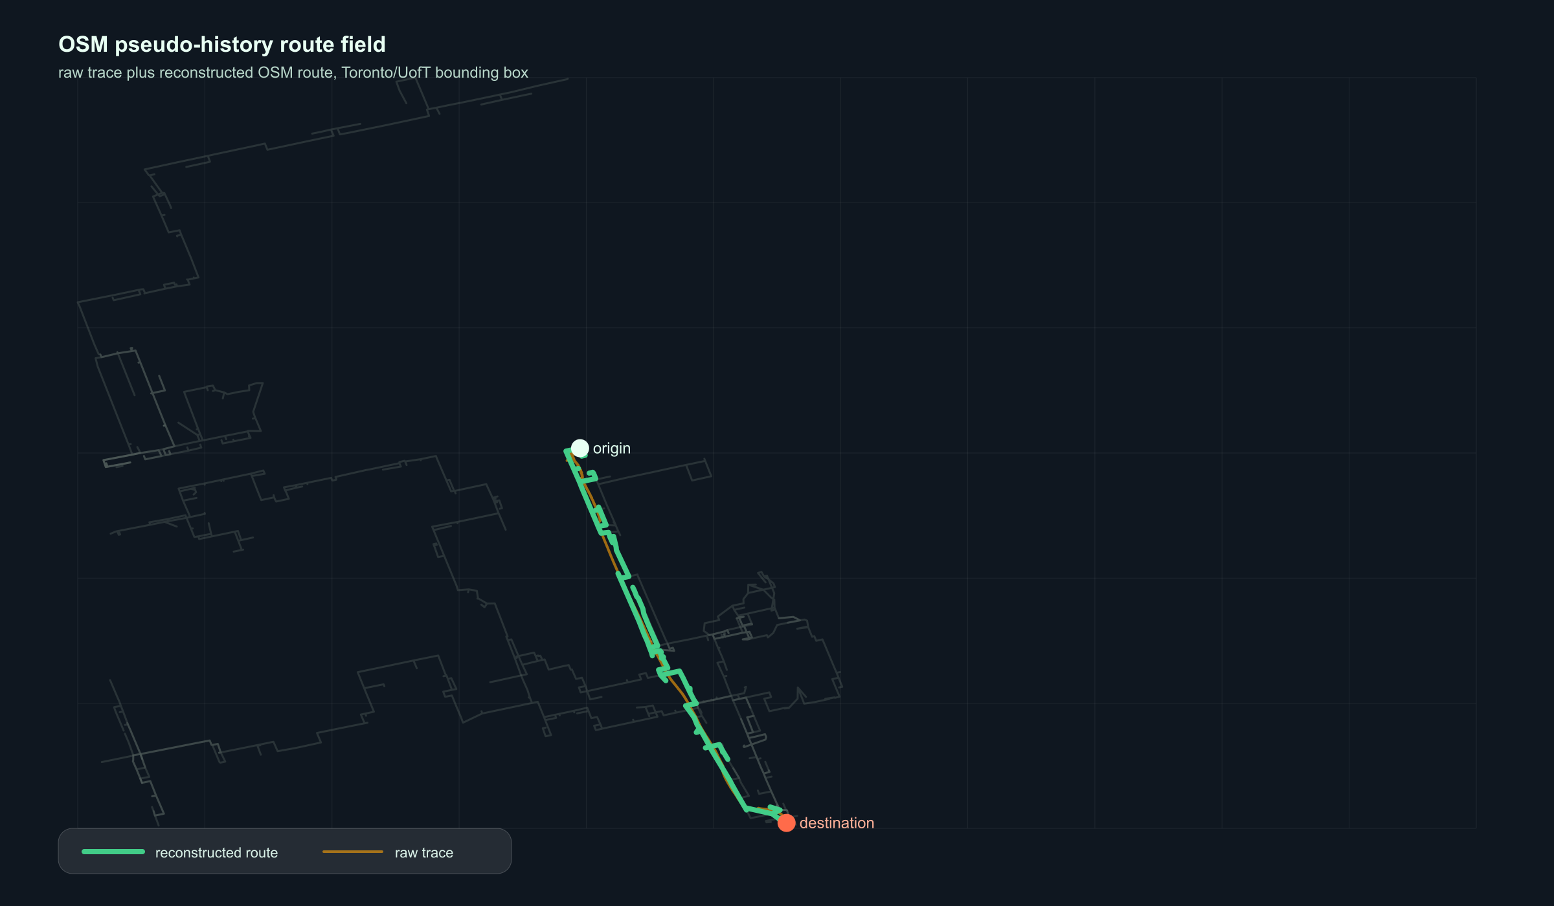
AKER AI PLATFORM ENGINEERING
RouteGraph
RAG
A product pitch for preference-aware route ranking from noisy geospatial signals.
SYSTEM SHAPE
FastAPI service, OSMnx graph pipeline, dynamic profiles, SBERT ranking
INTERVIEW ANGLE
End-to-end AI system design with real caveats, not demo theater
Built from the current repository artifacts and Aker AI Platform public role context.

Slide 2
PRODUCT THESIS
A route is an operational decision, not a polyline.
messy data
The product turns messy movement traces and OSM context into ranked, explainable choices: the same platform pattern Aker needs for investment, operations, resident experience, and internal knowledge tools.
public OSM traces, temporal context, incomplete labels
structured memory
features, profile weights, route summaries
ranked action
candidate routes with scores and diagnostics
Aker fit: internal AI platform work is about turning operational data into decisions with provenance.

Slide 3
PRODUCT SURFACE
Ask like a human. Rank like a system.
The backend combines natural-language preference, temporal context, user history, and candidate route features.
Prefer quieter walking routes near parks and away from major roads.
INPUT
origin, destination, preference, timestamp, user_id
CANDIDATE GENERATION
prompt
profile
k diverse walking routes under length, scenic, safe, and simple costs
semantic route-summary match
dynamic feature weights
RANKING
hybrid
explain
same candidate pool scored by random, shortest, profile, prompt/SBERT, hybrid
0.75 profile + 0.25 SBERT
features, scores, coordinates
RESPONSE
ranked route list with component scores, features, summary, profile explanation
Current backend endpoint: /rank-routes.

Slide 4
DATA REALITY
The model only earns trust if the reconstruction does.
This route field is generated from actual pseudo-history records in the repo: raw public GPS samples reconstructed onto OSM walking geometry.
Use the precise wording: OSM-derived historical movement signals, not clean per-user histories.

Slide 5
SYSTEM MAP
One route representation flows through the whole system.
That is the important design choice: the model-facing text and the numerical scorer are derived from the same OSM feature object.
01 PROBE
02 SEGMENT
03 MATCH
04 EXTRACT
OSM public GPS trackpoints
time gaps, jumps, useful movement filters
nearest nodes plus shortest-path stitching
road mix, parks, turns, lighting, crossings
05 PROFILE
06 GENERATE
07 RANK
08 EVALUATE
contextual weights from prior signals
diverse OSM route candidates
profile, prompt, hybrid baselines
reconstruction + ranking metrics
Files: app/routing.py, app/profile.py, app/ranking.py, app/main.py, scripts/evaluate_route_candidate_baselines.py.

Slide 6
GRAPHRAG ANGLE
The graph is the memory. The language layer is the interface.
Road type, park proximity, turns, crossings, tunnels, lighting, temporal context, and profile weights become retrievable evidence. The route summary is not magic; it is a readable projection of the feature graph.
ROUTE NODES
candidate geometry + coordinates
FEATURE EDGES
OSM-derived attributes and tradeoffs
PROFILE STATE
dynamic preferences inferred from past signals
EVIDENCE TRAIL
diagnostics attached to every confident answer
Production implication: an agent can cite why a route was ranked, not merely generate a plausible route explanation.

Slide 7
EVALUATION
Profile ranking gives the best graded signal, but the sample is still small.
0.727
Profile NDCG@3
0.630
Profile path F1
8
successful route-candidate queries
Useful signal, modest claim: profile-aware ranking improves several metrics over shortest distance, but this is not an external benchmark victory.
Source: data/route_candidate_baseline_comparison.json. Prompt text is synthetic and treated as an ablation.

Slide 8
PRODUCTION PLAN
Ship the decision engine, then earn the right to learn.
Before adding learned rankers, harden graph caching, replayable evaluation, route-diagnostic logging, and clean feedback collection.
CACHE
precompute OSM graphs for property areas and common bounding boxes
OBSERVE
log ranking inputs, top-k deltas, feature weights, and diagnostics
GOVERN
separate pseudo-history, synthetic preferences, and clean labels
LEARN
introduce supervised rankers only after enough feedback exists
Tradeoff posture for interview: product-minded shipping with research-grade caveat discipline.

Slide 9
CLOSING MESSAGE
I can build the AI platform layer between messy data and operational action.
END-TO-END
That is the pitch: not just a model, not just a map, but a governed decision system with an evidence trail.
data pipeline, API, ranker, evaluation, demo
SYSTEMS JUDGMENT
latency, caching, observability, deployment cost
PRODUCT TRANSLATION
investment, operations, resident experience, knowledge workflows
Suggested walkthrough: problem -> product surface -> architecture -> GraphRAG memory -> evaluation -> production roadmap.

