Slide 1
Sunflower
Joey, Alex, Andy, and Albert

Slide 2
Smart bike locks
Where it all started

Slide 3
Product Market fit
Customer Segment
Value Proposition
Commuters who live in big cities
Gains: Easy Commutes
Pains: Bikes are being stolen
Smart Bike Lock
Add smart technology to increase bike security and protection
Need to determine if this will solve the problems our customers are having
Notes:
Customer Segment
Commuters who live in cities
Cons: Bikes are being stolen
Value Proposition
We need a more protective bike lock
Add smart technology for increased security

Slide 4
Interviews
Interviewed people in our customer segment to gauge perception of our product idea

Slide 7
Interviews
Affirm our proposal that bike theft is a problem
Affirm that people don’t feel protected
Conclude that people are NOT interested in adding smart technology to personal bike locks
So what next?

Slide 8
Public Bike locks
The next saga

Slide 9
Product market fit
Customer segment is the same
Trying to solve the same problem
Value Proposition
Public pay-to-use bike locks that will
Will public bike locks have more success?

Slide 11
Interviews
Very underwhelming support for public bike locks
People thought the idea was good in theory, but doubted they’d use it themselves
Another issue would be getting local government approval
In the end, we decided to scrap public bike locks and move back to square one

Slide 12
Sunflower
The beginning of the end

Slide 13
Brainstorming
Bike locks and smart technology did not mesh as well as we thought
Went back to the drawing board
Stumbled upon solar panels in a residential setting
Why are they not very efficient?

Slide 14
Product Market Fit
Customer Segment
Value Proposition
Middle class homeowners who are interested in pursuing solar energy
Gains: Good for environment, saves money in the long run
Pains: Large initial cost, hassle to get installed
A device that directs a solar panel towards the direction of maximum sunlight in order to increase efficiency
Increases energy collection and therefore decreases the number of years until the return on investment point

Slide 15
Interviews
Interviews were conducted on homeowners who already owned solar panels and homeowners who were interested in solar panels.

Slide 17
Interviews
Very positive feedback on our idea
People said they would be interested if it decreased return on investment time
Happy that it increases efficiency

Slide 18
Parts List
Current Solar Panel Installation:
Brushless Electrical Motor:
Crankshaft System:
Aluminum Platform:
2x Steel Poles:
3x Light Intensity Sensor:
Printed Circuit Board:
Misc. (screws, nuts, bolts, etc.):
Total (w/o solar panel):
Total with 5x markup:
$20,000
$200
$130
$100
$50
$160
$45 (approx.)
$20
$705
$3525

Slide 19
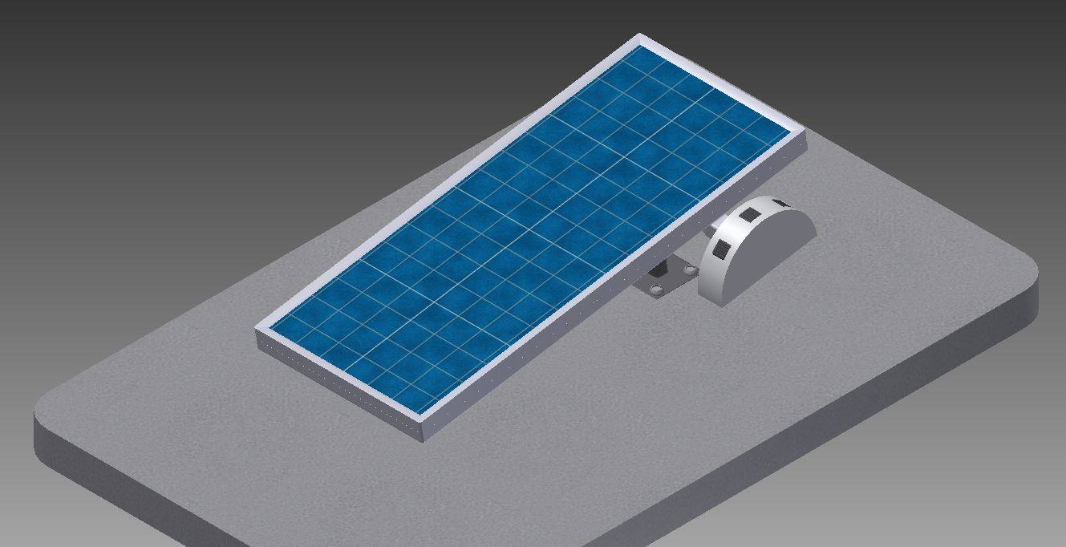
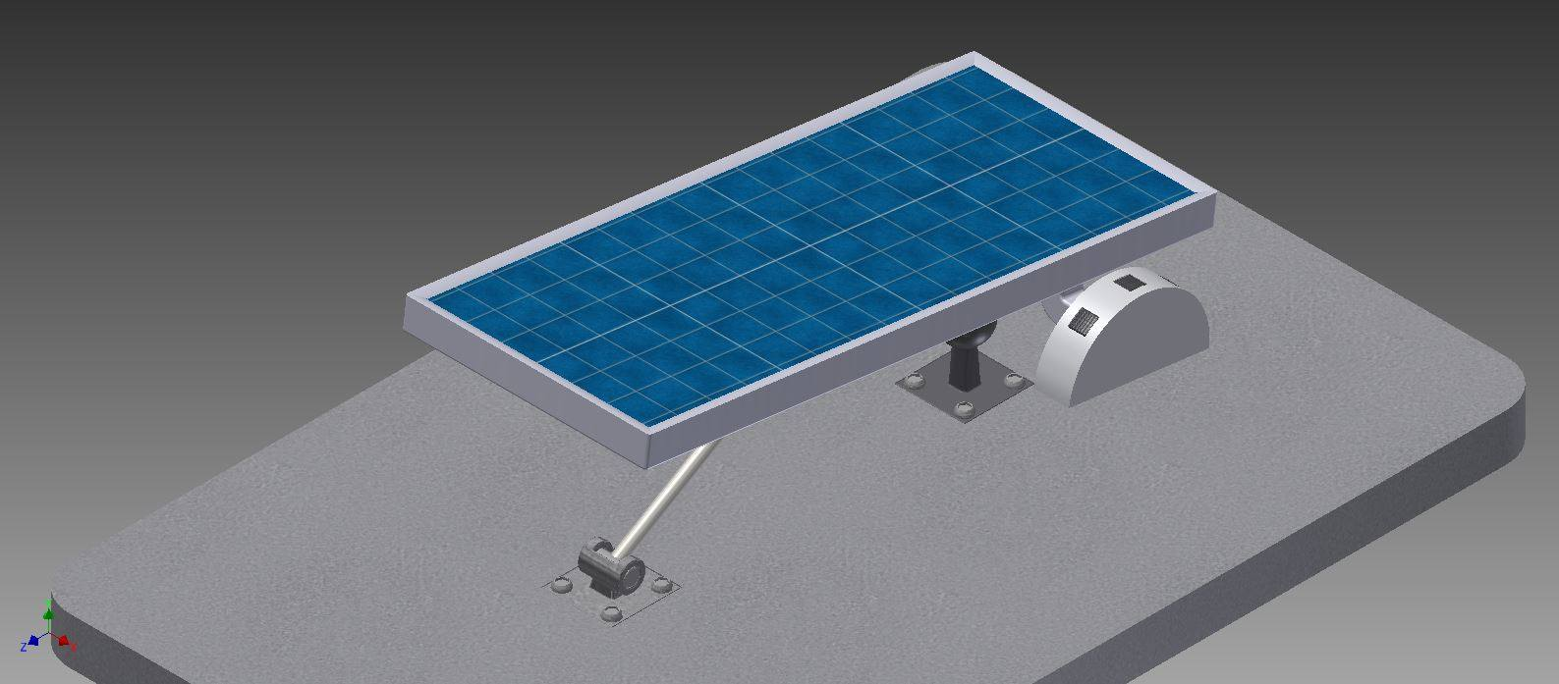
CAD Drawing #1&2
These drawings show a completed rendering of the product prototype in both the up and down positions

Slide 20
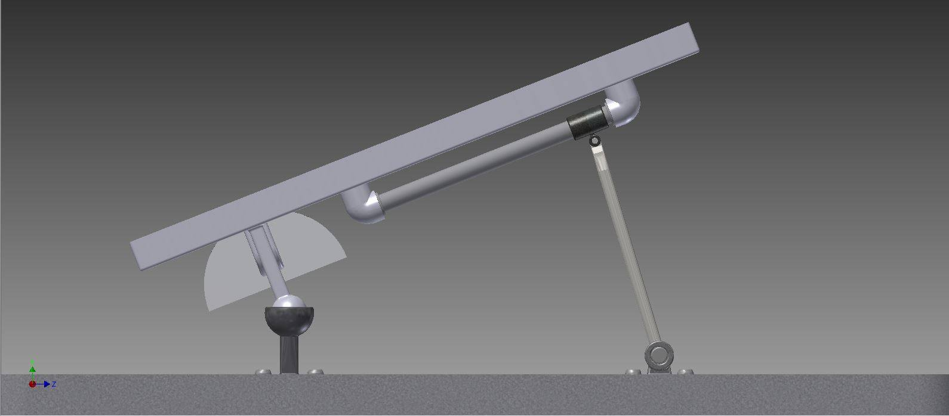
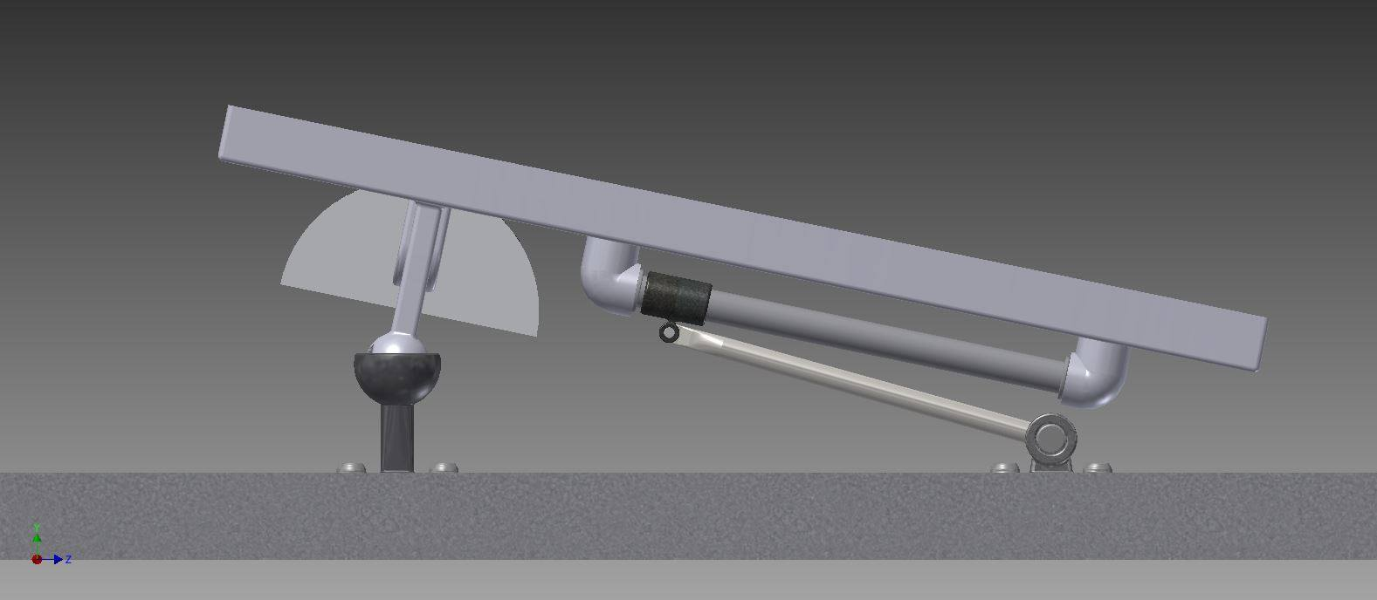
CAD Drawing #3&4
These drawings show the underbelly of the panel and all of the mechanisms used to change the angle of the panel

Slide 21
Website
In addition to our physical prototypes and digital models, we created a website to market directly to our customers
http://enigmamemory.github.io/Sunflower/
Join our mailing list!
Also, check out our Kickstarter:
https://www.kickstarter.com/projects/930445097/1354541747?token=ab1a9e40

Slide 22
Public Reception
Used new data to re-assess our product
Hard to find people with solar panels in the city → went to suburbs and online connections
Conclusions:
People were VERY interest in the product
They would be keen on buying it if they could see a working prototype and be assured that it would decrease return on investment
Concerns included:
Very high price
Safety and maintence

Slide 23
Future plans
Once we have a completely functional product, we must continue the design process
Build a successful prototype
Run tests and determine efficiency
Address safety concerns

Slide 24
Thank You

