Slide 1
Multi agent ai assistance for software engineering solutions
23CSE399 Project Phase 1 – Approval Presentation
Team ID: 23UG082 Panel No.: 9
S.No | Reg.No | Name of the Student | Branch
1 | BL.EN.U4AID23058 | Bhavya Charitha | AID
2 | BL.EN.U4AID23061 | Enikepalli Geetha Sree | AID
3 | BL.EN.U4AID23064 | Reddyvari Akhil Reddy | AID
4 | BL.EN.U4AID23066 | Gowtham | AID
Project Guide: Ms. Shalini Tiwari
Designation : Assistant Professor

Slide 2
Screenshot of your guides’ approval mail (to go ahead with the presentation)

Slide 3
Problem Definition
To develop an intelligent software engineering assistant that can automatically analyze software repositories and support multiple software engineering tasks - code review, bug detection, security analysis, test generation, and documentation - using specialized LLM-based agents and project-aware Retrieval-Augmented Generation (RAG), while evaluating both individual agent capabilities and end-to-end system performance.

Slide 4
Literature Survey
S.No. | Authors name(s) & Published In | Full title of the paper with year | Inference from the paper | Open Problem (For proposed work)
1 | Zhiyu Li et al. ESEC/FSE Conference | Automating Code Review Activities by Large-Scale Pre-training (2022) | Introduces CodeReviewer, a pre-trained model for automated code-review activities such as code-change quality estimation and review-comment generation using large-scale real-world code changes. | Focuses mainly on individual code-review activities. It does not provide a multi-agent workflow where code review collaborates with coding, testing, debugging, documentation, and other agents.
2 | Yu Zhou et al. Journal — Elsevier | Automatic Source Code Summarization with Graph Attention Networks (2022) | Proposes a graph-attention-based approach for automatic source-code summarization by combining structural and semantic information from source code. | Generates code summaries but does not provide project-level context-aware documentation or collaboration with other software engineering agents.
3 | Max Schäfer et al. IEEE Transactions | An Empirical Evaluation of Using Large Language Models for Automated Unit Test Generation (2023) | Evaluates TestPilot, an LLM-based approach for automated unit-test generation using implementation details, documentation, examples, and feedback from failing tests. | Concentrates on automated test generation rather than an integrated system where the testing agent collaborates with coding, debugging, review, and validation agents.

Slide 5
Literature Survey
S.No. | Authors name(s) & Published In | Full title of the paper with year | Inference from the paper | Open Problem (For proposed work)
4 | Yaqin Zhou et al. NeurIPS Conference | Devign: Effective Vulnerability Identification by Learning Comprehensive Program Semantics via Graph Neural Networks (2019) | Uses Graph Neural Networks to learn comprehensive program semantics and identify vulnerable functions. | Primarily performs vulnerability identification. It does not autonomously explain, fix, test, and validate vulnerabilities through collaboration with other software engineering agents.
5 | Misbah Ali et al. IEEE Journal | Software Defect Prediction Using an Intelligent Ensemble-Based Model (2024) | Uses an ensemble of machine-learning models for predicting defective software modules using software metrics and multiple datasets. | Predicts defects but does not automatically investigate the cause, generate a fix, execute tests, or validate the correction using a multi-agent software engineering workflow.
6 | Chen Qian et al. ACL Volume 1: Long Papers Conference | ChatDev: Communicative Agents for Software Development (2024) | Presents a multi-agent framework where specialized LLM agents communicate through structured conversations to perform software design, coding, and testing. | Provides general multi-agent software development but has limited specialization for code review, vulnerability detection, defect prediction, documentation, and comprehensive validation.
7 | Carlos E. Jimenez et al. ICLR Conference | SWE-bench: Can Language Models Resolve Real-World GitHub Issues? (2024) | Introduces a benchmark containing real-world GitHub issues and repositories to evaluate whether language models can understand issues and modify existing code to resolve them. | Acts mainly as an evaluation benchmark rather than a complete collaborative multi-agent system. It does not itself provide specialized agents working together throughout the software engineering lifecycle.

Slide 6
Literature Survey
S.No. | Authors name(s) & Published In | Full title of the paper with year | Inference from the paper | Open Problem (For proposed work)
8 | Patrick Lewis et al. NeurIPS Conference | Retrieval-Augmented Generation for Knowledge-Intensive NLP Tasks (2020) | Introduces RAG, combining language models with external knowledge retrieval to provide relevant information and improve knowledge-intensive generation. | Traditional RAG does not inherently provide agent planning, role-based collaboration, or software-engineering-specific reasoning. It can be extended as a shared knowledge layer for specialized agents.
9 | Yiwen Zhu et al. Journal — MDPI | LLM-Based Multi-Agent Orchestration: A Survey of Frameworks, Communication Protocols, and Emerging Patterns (2026) | Surveys LLM-based multi-agent orchestration, including agent coordination, communication protocols, planning, state management, error handling, scalability, and security. | Challenges remain in reliable coordination, context sharing, error recovery, scalability, and evaluation. A software-engineering-specific orchestration system integrating specialized agents remains an open area.
10 | Sunghyeon Woo et al. ICLR Conference | ICaRus: Identical Cache Reuse for Efficient Multi-Model Inference (2026) | Addresses computational and memory overhead in multi-model inference by enabling multiple models to share identical KV caches, improving efficiency in multi-model/multi-agent settings. | Focuses mainly on inference efficiency rather than software engineering intelligence. It does not address how specialized agents should reason, collaborate, verify results, or recover from failures..

Slide 7
Literature Survey – Summary
AI/LLM techniques are widely used for code review, testing, documentation, vulnerability detection, and defect prediction.
Multi-agent frameworks demonstrate collaboration between AI agents for software development.
RAG-based approaches improve access to relevant software/project knowledge.
Existing research shows the potential of LLMs and specialized agents in automating software engineering tasks.

Slide 8
Limitations
Most approaches focus on individual software engineering tasks.
Existing multi-agent systems provide limited specialization for different SE activities.
Limited context sharing and communication between specialized agents.
Lack of reliable output validation and error recovery.
Limited support for a complete end-to-end software development lifecycle.
Research Gap
Lack of a unified multi-agent AI system for software engineering.
Need for effective coordination between specialized SE agents.
Need for shared project context and knowledge across agents.
Need for automated verification, feedback, and correction.
Limited research on combining multiple SE tasks into a single collaborative workflow.

Slide 9
Justification for the Proposed Problem
Existing AI tools mainly focus on individual software engineering tasks.
Different tasks require specialized reasoning and expertise.
LLMs may lack project-specific context.
RAG enables access to relevant project and domain knowledge.
Multi-agent collaboration enables comprehensive software analysis.
Existing approaches lack unified agent-level and system-level evaluation.
The proposed system integrates 5 specialized agents + RAG for repository-level analysis.

Slide 10
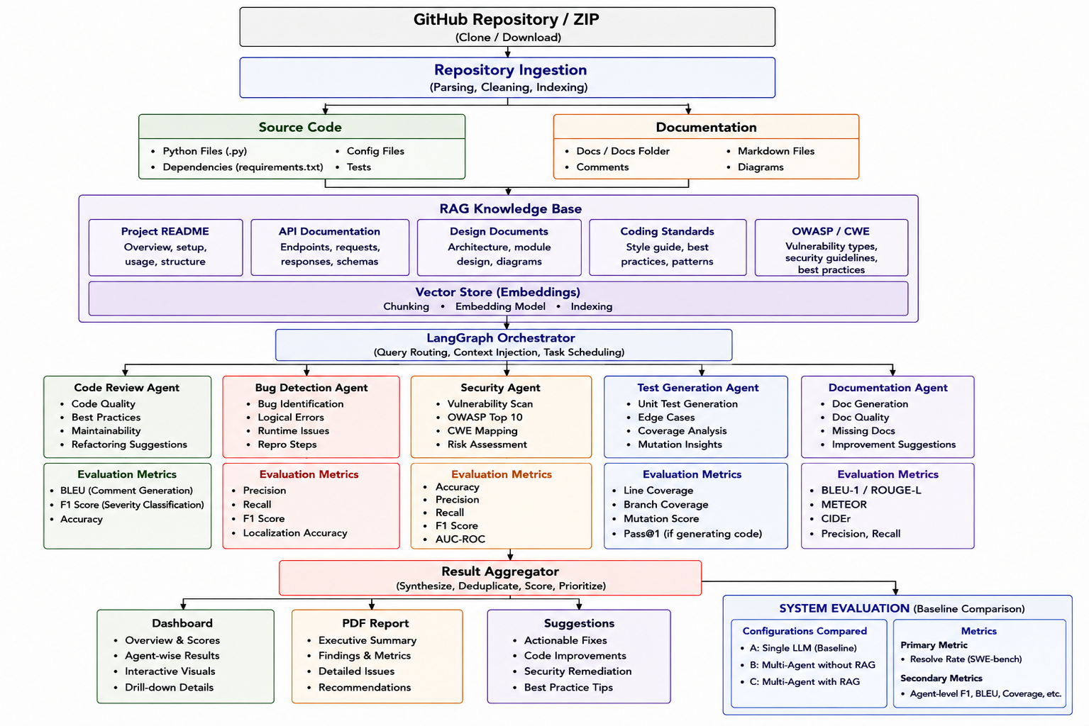
Architecture of the Proposed System
Fig.1 Architecture of proposed system

Slide 11
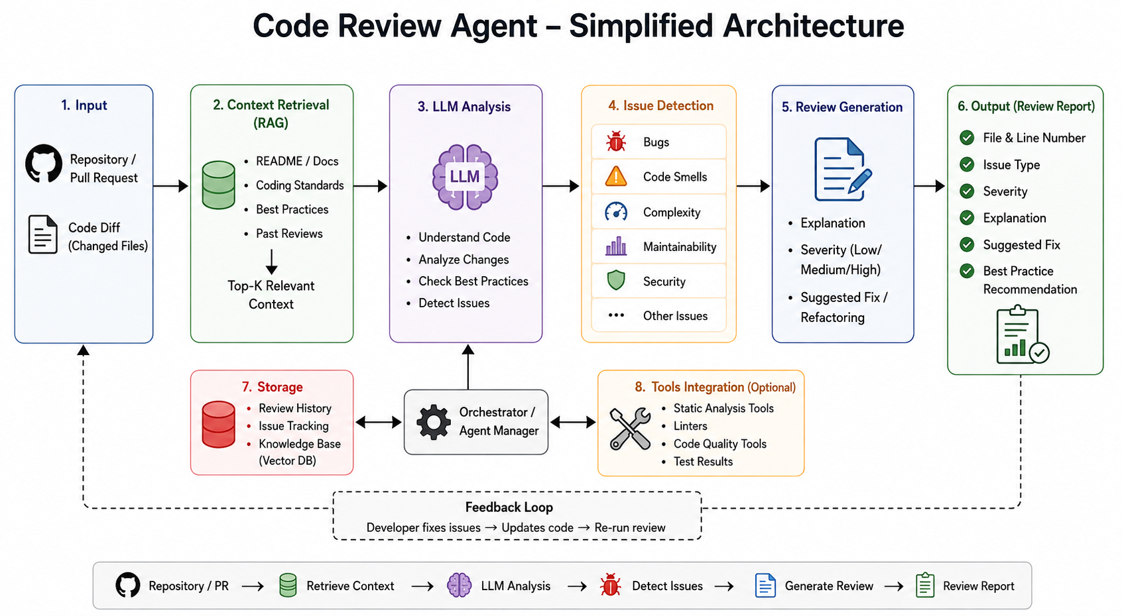
Fig.2 Code review agent architecture

Slide 12
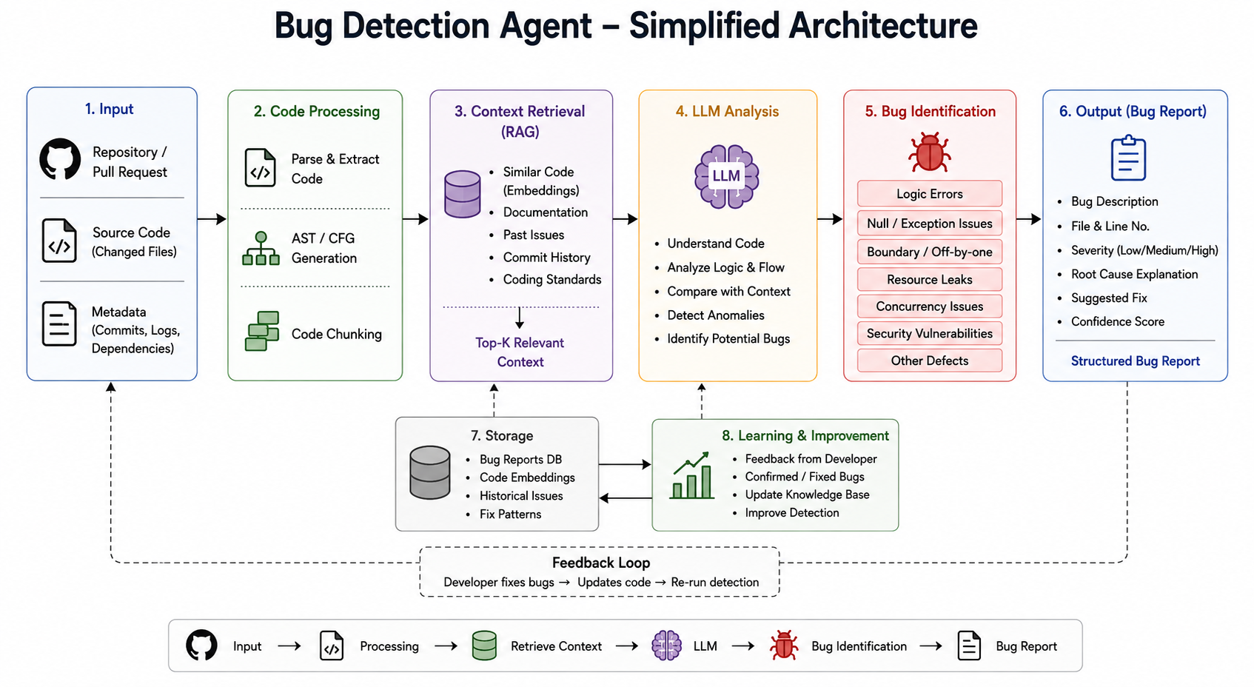
Fig.3 Bug Detection agent architecture

Slide 13
Functionalities of the Proposed System
GitHub Repository Analysis – Upload and analyze source-code repositories.
Automated Code Review – Detect code smells, analyze complexity, and suggest refactoring.
Bug Detection – Identify faulty logic, localize potential bugs, and suggest fixes.
Security Analysis – Detect vulnerabilities, identify insecure practices, and recommend remediation.
Test Generation – Generate unit tests, cover edge cases, and evaluate test effectiveness.
Documentation Generation – Detect missing/outdated documentation and generate docstrings and API documentation.
RAG-based Assistance – Retrieve relevant project, API, coding-standard, and security knowledge.
Multi-Agent Collaboration – Coordinate specialized agents to produce comprehensive analysis.
Consolidated Reporting – Combine findings into a unified software-quality report.
Actionable Recommendations – Provide refactoring, testing, security, and documentation suggestions.

Slide 14
Software/Tools Requirements
Backend
Python
FastAPI
LangGraph
LangChain
Frontend
React
TypeScript
Tailwind CSS
Testing & Evaluation
pytest
Coverage.py
Mutation Testing Tools
Benchmark Datasets
AI / LLM
GPT / Llama / Qwen
Hugging Face Transformers
Sentence Transformers
Repository & Integration
GitHub API
Git / GitHub
Docker
Development
VS Code
Jupyter Notebook
Git
RAG
ChromaDB / FAISS
Embedding Models
Database
PostgreSQL

Slide 15
Data Set
Dataset | Purpose | Source
CodeReviewer | Code Review Agent | Zenodo – CodeReviewer Dataset
BugsInPy | Bug Detection Agent | GitHub – BugsInPy
Devign | Security Agent | GitHub – Devign
HumanEval | Test Generation Agent | GitHub – HumanEval
CodeSearchNet | Documentation Agent | GitHub – CodeSearchNet
SWE-bench Lite | System-Level Evaluation | Hugging Face – SWE-bench Lite
Task-specific benchmark datasets are used for independent agent-level evaluation, while SWE-bench Lite is used for end-to-end system-level evaluation.
Key Statistics
Devign: 27,318 functions
HumanEval: 164 problems
SWE-bench Lite: 23 development + 300 test instances
CodeSearchNet: ~2M code–comment pairs in the original corpus
BugsInPy: Real bugs from Python open-source projects
CodeReviewer: Real code-review datasets for quality estimation and comment generation

Slide 16
Timeline
Literature Survey
Design [Front End, Back End]
Implementation
Testing
Document Submission
September (end)
October
October (end)
November (first week)
Abstract Submission
July (ending) 2026
August (first week) 2026

Slide 17
Conclusion
The proposed system provides a unified AI-based solution for repository-level software engineering analysis.
Five specialized agents - Code Review, Bug Detection, Security, Test Generation, and Documentation -address different software engineering tasks.
RAG provides project-specific and domain-specific context to improve agent analysis.
LangGraph orchestration enables coordinated task execution and aggregation of agent results.
Agent-level and system-level evaluation using established benchmarks enables objective performance comparison.
The comparison of Single LLM, Multi-Agent without RAG, and Multi-Agent with RAG helps measure the contribution of agent specialization and retrieval.
The system aims to provide actionable software quality insights, suggested fixes, security findings, generated tests, and documentation recommendation

Slide 18
References
[1] Tufano R, Bavota G. Automating code review: A systematic literature review. arXiv preprint arXiv:2503.09510. 2025 Mar 12.
[2] Jimenez CE, Yang J, Wettig A, Yao S, Pei K, Press O, Narasimhan K. Swe-bench: Can language models resolve real-world github issues?. InInternational Conference on Learning Representations 2024 May 31 (Vol. 2024, pp. 54107-54157).
[3] Zhou, Yaqin, Shangqing Liu, Jingkai Siow, Xiaoning Du, and Yang Liu. "Devign: Effective vulnerability identification by learning comprehensive program semantics via graph neural networks." Advances in neural information processing systems 32 (2019).
[4] Tang, Yutian, Zhijie Liu, Zhichao Zhou, and Xiapu Luo. "Chatgpt vs sbst: A comparative assessment of unit test suite generation." IEEE Transactions on Software Engineering 50, no. 6 (2024): 1340-1359.
[5] Sun, Weisong, Yun Miao, Yuekang Li, Hongyu Zhang, Chunrong Fang, Yi Liu, Gelei Deng, Yang Liu, and Zhenyu Chen. "Source code summarization in the era of large language models." In 2025 IEEE/ACM 47th International Conference on Software Engineering (ICSE), pp. 1882-1894. IEEE, 2025.
[6] Qian, Chen, Wei Liu, Hongzhang Liu, Nuo Chen, Yufan Dang, Jiahao Li, Cheng Yang et al. "Chatdev: Communicative agents for software development." In Proceedings of the 62nd annual meeting of the association for computational linguistics (volume 1: Long papers), pp. 15174-15186. 2024.
[7] Hong, Sirui, Mingchen Zhuge, Jonathan Chen, Xiawu Zheng, Yuheng Cheng, Jinlin Wang, Ceyao Zhang et al. "MetaGPT: Meta programming for a multi-agent collaborative framework." In International Conference on Learning Representations, vol. 2024, pp. 23247-23275. 2024.

Slide 19
THANK YOU

