Slide 1
Multi-Agent AI Assistant for Software Engineering Solutions
23CSE399 Project Phase 1 (Review-2)
Team ID: 23UG082 Panel No.: 9
S.No | Reg.No | Name of the Student | Branch
1 | BL.EN.U4AID23058 | Bhavya Charitha | AID
2 | BL.EN.U4AID23061 | Enikepalli Geetha Sree | AID
3 | BL.EN.U4AID23064 | Reddyvari Akhil Reddy | AID
4 | BL.EN.U4AID23066 | Gowtham | AID
Project Guide: Ms. Shalini Tiwari
Designation : Assistant Professor

Slide 2
Screenshot of your guides’ approval mail (to go ahead with the presentation)

Slide 3
Problem Definition
To develop an intelligent software engineering assistant that can automatically analyze software repositories and support multiple software engineering tasks - code review, bug detection, security analysis, test generation, and documentation - using specialized LLM-based agents and project-aware Retrieval-Augmented Generation (RAG), while evaluating both individual agent capabilities and end-to-end system performance.

Slide 4
Project Objectives
Build five specialised LLM agents (Code Review, Bug Detection, Security, Test Generation, Documentation) that analyse a software repository.
Give every agent project-specific context through a repository-level RAG layer (code chunks, call graph, coding and security guidance).
Orchestrate the agents with LangGraph and merge their output in a Result Aggregator (dedupe, score, prioritise).
Never trust LLM output blindly: validate every finding against the real code before it reaches a report.
Deliver results as a web dashboard, PDF / Markdown / JSON / SARIF reports and actionable fix suggestions.
Evaluate each agent on its benchmark and the full system on SWE-bench Lite (single LLM vs multi-agent vs multi-agent + RAG).
Notes:
What the project set out to build; the Code Review Agent objectives are complete.

Slide 5
Architecture of the Proposed System
Input: GitHub repo / ZIP / git change
Ingestion
safe extraction, filtering
Parsing
AST, call graph
RAG knowledge base
ChromaDB + guidelines
LangGraph Orchestrator (shared state)
Code Review
Agent
Bug Detection
Agent
Security
Agent
Test Generation
Agent
Documentation
Agent
Result Aggregator (dedupe, score, prioritise)
Web dashboard
Reports: PDF / MD / JSON / SARIF
Suggestions & verified fixes
Evaluation: agent-level benchmarks + system-level SWE-bench Lite (A / B / C)
Fig.1 Architecture of the proposed system
Notes:
Overall system. The Code Review Agent (highlighted) is implemented; the other four agents are the next phase.

Slide 6
Code Review Agent – Implemented Architecture
1. Ingestion
dir / ZIP / file / snippet
zip-slip & size limits
2. Parsing
Python AST, symbols,
call graph
3. Static analysis
Ruff, Radon, AST checks,
secrets, test gaps, mypy
4. Review units
function / class
sized chunks
8. Validation
evidence must match
the real file & lines
7. LLM review
Groq (gpt-oss-120b),
JSON schema output
6. Prompt
code + static hints
+ context
5. Context
call graph + ChromaDB
+ OWASP / style guides
9. Actionability
drop vague findings
10. Dedup
merge sources
11. Severity rubric
rules, not the LLM
12. Confidence
rank & filter
13. Verified fix suggestions
Ruff autofix + LLM patch, re-analysed; never applied
14. Outputs
JSON / Markdown / PDF / SARIF, dashboard, CLI exit code
Fig.2 Code Review Agent pipeline (implemented)
Notes:
Every stage is a separate package with a small interface; the LLM is reached only through LLMProvider (Groq, or a mock for offline tests).

Slide 7
Timeline
Literature Survey
Design [Front End, Back End]
Implementation
Testing
Document Submission
September (end)
October
October (end)
November (first week)
Abstract Submission
July (ending) 2026
August (first week) 2026

Slide 8
Implemented System Architecture & Data Flow
Clients
Backend (Python 3.11)
Services & data
React + TypeScript
web dashboard
FastAPI REST API
/api/reviews, /api/changes
Groq LLM API
via LLMProvider
CLI
review / review-change / eval
Job manager
background jobs, history
ChromaDB vector store
code chunks + guidelines
Git pre-commit hook
blocks high findings
Code Review Agent
(Fig.2 pipeline)
Static tools (subprocess)
Ruff, Radon, mypy
CI (GitHub Actions)
SARIF -> PR annotations
Report renderers
JSON / MD / PDF / SARIF
Evaluation results
experiments/results
Analysed code is parsed, never executed. Local git repositories are read only from this machine. Quota-aware LLM calls.
Fig.3 Implemented system architecture and data flow
Notes:
Same agent behind every entry point: dashboard, CLI, pre-commit hook, CI.

Slide 9
Phase 1 – Technical Progress
Code Review Agent complete: repository review and change (pull-request) review, end to end.
Shared building blocks for all five agents: safe ingestion, AST parsing and call graph, RAG (ChromaDB), findings pipeline, reports, evaluation harness.
Static analysis + LLM: Ruff, Radon, custom AST checks, secret detection, test gaps and mypy, combined with Groq LLM reasoning.
Working product: FastAPI backend, React + TypeScript dashboard, CLI, pre-commit hook and CI example with SARIF.
Evaluated on real benchmarks: CodeReviewer (4,196 + 1,403 Python samples), planted-issue suite, RAG retrieval benchmark.
Tested: 289 backend + 39 frontend automated tests, all offline (mock LLM, no API key needed).
Notes:
Phase 1 focus was the Code Review Agent end to end, plus the shared building blocks every agent will reuse.

Slide 10
Static Analysis & Project Context (RAG)
Static analysers normalised into one Finding schema: Ruff (lint + security rules), Radon (complexity), AST checks (swallowed exceptions, resource leaks), secrets, test gaps, mypy type checks.
Review units: the code is split into function/class sized units so the LLM sees focused, complete code.
Structural context: callers, callees and tests of the unit, taken from the AST call graph.
Retrieved context: similar code from ChromaDB plus OWASP / CWE and Python-standards guidance.
Prompt-injection defence: code is delimited as data; instructions inside code or comments are ignored.

Slide 11
LLM Review, Validation & Severity
Structured output: the LLM must return JSON matching a Pydantic schema (retry once on invalid JSON).
Evidence validation: each finding's quoted code must exist at the reported lines; otherwise it is repaired or rejected and counted.
Actionability filter: vague findings ('consider improving this') are dropped or downgraded.
Dedup and merge: the same issue from Ruff and the LLM becomes one finding with both sources.
Severity rubric: critical / high / medium / low / info set by rules, not by the LLM.
Confidence: a 0-1 ranking signal (not a probability) used to order and filter findings.

Slide 12
Change Review – Pull-Request Workflow
Input: git base..head / uncommitted / staged / two ZIPs
ChangeSet
raw git blobs (no checkout, no hooks), diff, renames
Impact analysis
signature binding, removed functions,
LLM behaviour check, mypy
Scoped review of changed lines
(Code Review pipeline, Fig.2)
Merge, dedup, severity rubric
Hunk risk ranking
'review these first'
Change summary (LLM)
PR-style narrative
Verified fix
suggestions
Outputs: CLI exit code (CI / pre-commit gate) | SARIF -> PR annotations | dashboard diff view
Fig.4 Change (pull-request) review data flow
Notes:
Reviews only what changed, plus the unchanged code that depends on it.

Slide 13
Impact Analysis & Hunk Risk Ranking
Breaks outside the diff: finds callers the change did not touch that no longer fit it: removed functions still called, calls that no longer match a new signature (checked like Python's argument binding), behaviour changes such as a new None return (LLM, validated).
Hunk risk ranking: every changed hunk gets an estimated chance that a reviewer comments on it (security-sensitive code, error handling, signature changes, size, broken callers).
Calibrated, not guessed: four weights fitted on the CodeReviewer validation split, tested once on the test split; critical/high findings are never ranked low.
PR summary: short LLM narrative of what changed and what deserves attention.

Slide 14
Verified Fixes, Safety & Reliability
Verified fix suggestions: a patch is shown only if it parses and re-analysis finds no new issue; 'verified' only when the tool confirms the issue is gone. Never applied automatically.
Untrusted code: analysed code is never executed or imported; safe ZIP extraction; mypy runs without repository plugins.
Local git safety: only requests from this machine can read a local repository (loopback, Host check, custom header).
Free-tier LLM quotas: follows the provider's rate-limit headers, fails fast on daily limits with a clear message, retries oversized requests without context.
Partial results are flagged: if the LLM could not review part of the code, the dashboard and reports say so.

Slide 15
Evaluation Methodology
Question | Benchmark / data | Metrics
Does it find planted defects? | 17 hand-labelled issues + clean control file | Recall, precision, line error
Does this change need a comment? | CodeReviewer cls, 4,196 Python test hunks | Accuracy, precision, F1, ROC-AUC
Are its comments like a reviewer's? | CodeReviewer msg, Python test split | Coverage, BLEU-4, ROUGE-L, chrF
Does 'review first' rank well? | CodeReviewer cls (valid: fit, test: once) | ROC-AUC, precision at top 10%
Are its comments useful? | Blind LLM judge + human rating kit | Relevance, informativeness (1-5), kappa
Does RAG find related code? | Call-graph relevance on the project's own code | Recall@10, MRR, nDCG
Rules: benchmark ground truth is never put in the RAG index; test splits are not used for tuning; failures are counted, not hidden.
Notes:
Every number comes from a saved run (config, model, prompt versions, sample IDs, raw predictions).

Slide 16
System Implementation & Demonstration
Working web dashboard: upload a repository ZIP or file, paste code, or review a change from a local git repository or two ZIPs.
Live progress, quality index, charts, filterable findings with evidence, suggested-fix diffs and downloadable reports.
Change review shows the PR summary, breaks outside the diff, changed functions and risk-ranked hunks with diffs.
Same agent from the command line, as a git pre-commit gate and in CI with SARIF annotations on pull requests.
Evaluation page lists every saved benchmark run with its headline metrics.

Slide 17
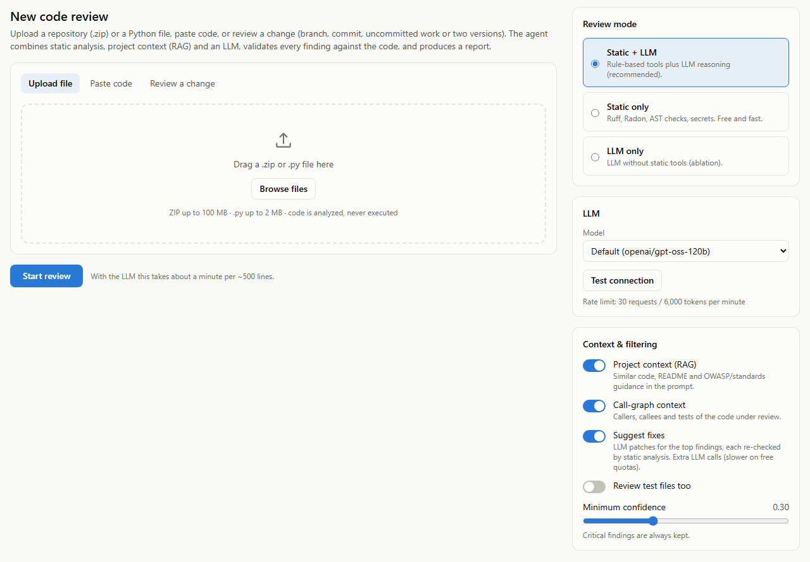
Results
Fig.5 New review page: input, review mode, model and context options

Slide 18
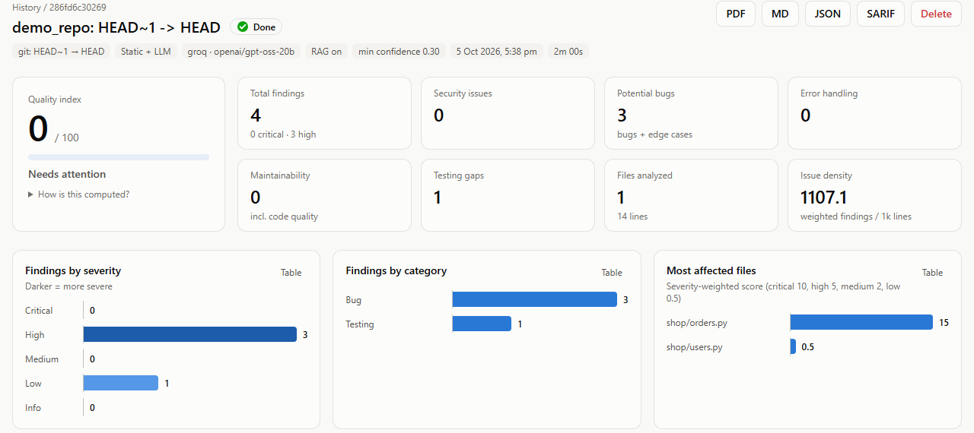
Results
Fig.6 Review dashboard for a code change (static + LLM)

Slide 19
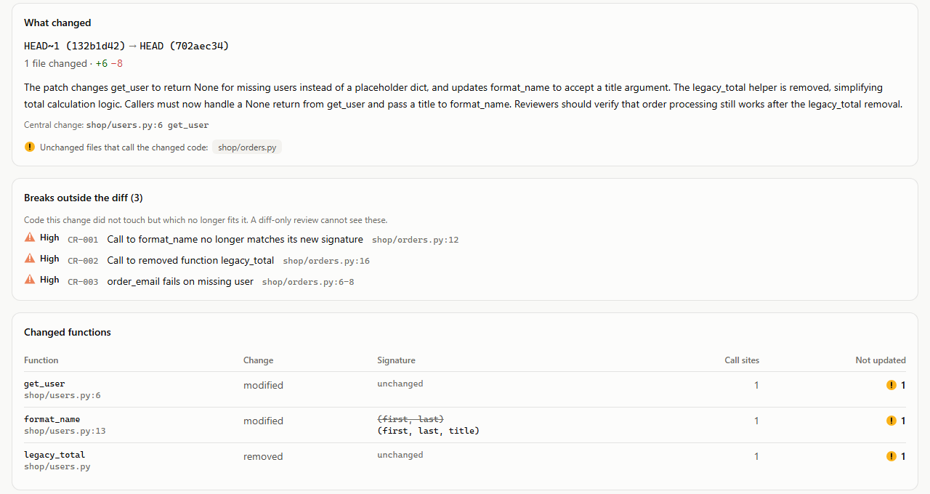
Results
Fig.7 Change summary, breaks outside the diff and changed functions

Slide 20
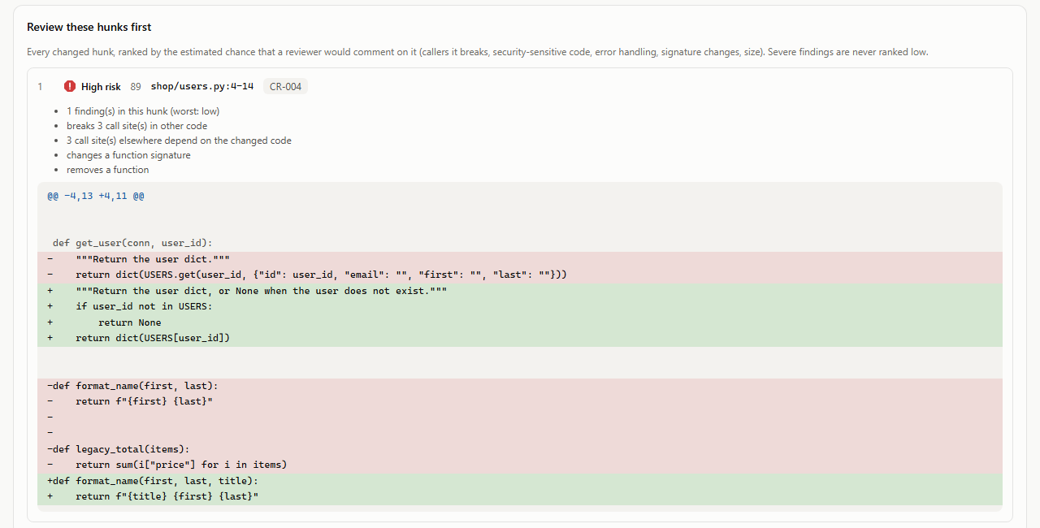
Results
Fig.8 Risk-ranked hunks with the diff ('review these first')

Slide 21
Results – Detection Benchmarks
Benchmark | Configuration | Result
Planted issues (17) | Static only | Recall 0.941, precision 1.00
Planted issues (17) | Static + LLM (gpt-oss-120b) | Recall 1.00, precision 1.00
CodeReviewer cls (4,195) | Static, cross-hunk rules excluded | Precision 0.592, AUC 0.539
CodeReviewer msg (36, same samples) | Static only | Coverage 0.47, chrF 8.7
CodeReviewer msg (36, same samples) | Static + LLM (qwen3.8-27b) | Coverage 0.78, chrF 13.6
RAG retrieval (277 queries) | Hashing embedder vs random | Recall@10 0.438 vs 0.030
The LLM finds the semantic bug static analysis cannot (division by zero) and writes a comment for 78% of diffs vs 47%. BLEU-4 change is within noise at n=36.
Notes:
Static-only runs cover the full Python test sets; LLM rows are from Groq runs.

Slide 22
Results – 'Review These Hunks First'
v1 ranked worse than random (AUC 0.434): static findings did not predict human comments.
v2: 4 weights fitted on the validation split, test split used once (AUC 0.624).
Hunks v2 marks high: 67.8% commented vs 48.5% base rate.
Notes:
Precision at top 10%: share of the hunks ranked first that a human reviewer commented on.

Slide 23
Results – Comment Usefulness (LLM Judge)
Comment author | n | Relevance (1-5) | Informativeness (1-5)
Agent (qwen3.8-27b reviewer) | 28 | 4.71 | 4.64
Human reviewer (CodeReviewer) | 36 | 3.67 | 3.00
Judge: openai/gpt-oss-20b, a different model family from the reviewer; blind and reference-free.
Paired difference (agent - human): relevance +0.96, informativeness +1.57 (95% CIs exclude 0).
Caveats: agent comments are ~7x longer; half the human comments are questions; one judge; small n.
Validation in progress: 56-row blinded human rating kit; judge-human agreement measured with weighted kappa.
Notes:
Judge never knows who wrote a comment and sees only the diff. Human ratings are the next validation step.

Slide 24
Objective Achievement & Current Project Status
Component | Status
Code Review Agent (repository + change review) | Complete
Shared ingestion, parsing, RAG, findings pipeline, reports | Complete
Dashboard, CLI, pre-commit hook, CI / SARIF | Complete
Code Review evaluation (CodeReviewer, planted, retrieval) | Complete; human ratings pending
Security, Test Generation, Documentation agents | Next phase
LangGraph orchestration + Result Aggregator | Next phase
System evaluation on SWE-bench Lite (A / B / C) | Next phase

Slide 25
Conclusion
The Code Review Agent is complete: it reviews whole repositories and code changes, combining static analysis, project context (RAG) and an LLM.
Every LLM finding is validated against the real code; fixes are verified before they are shown and never applied automatically.
Change review catches breaks outside the diff and ranks hunks so reviewers look at the riskiest code first.
Results are measured on real benchmarks with honest baselines, including where the first approach failed and how it was fixed.
The shared building blocks are ready for the remaining four agents, LangGraph orchestration and SWE-bench Lite evaluation.

Slide 26
References
[1] Tufano R, Bavota G. Automating code review: A systematic literature review. arXiv preprint arXiv:2503.09510. 2025 Mar 12.
[2] Jimenez CE, Yang J, Wettig A, Yao S, Pei K, Press O, Narasimhan K. Swe-bench: Can language models resolve real-world github issues?. InInternational Conference on Learning Representations 2024 May 31 (Vol. 2024, pp. 54107-54157).
[3] Zhou, Yaqin, Shangqing Liu, Jingkai Siow, Xiaoning Du, and Yang Liu. "Devign: Effective vulnerability identification by learning comprehensive program semantics via graph neural networks." Advances in neural information processing systems 32 (2019).
[4] Tang, Yutian, Zhijie Liu, Zhichao Zhou, and Xiapu Luo. "Chatgpt vs sbst: A comparative assessment of unit test suite generation." IEEE Transactions on Software Engineering 50, no. 6 (2024): 1340-1359.
[5] Sun, Weisong, Yun Miao, Yuekang Li, Hongyu Zhang, Chunrong Fang, Yi Liu, Gelei Deng, Yang Liu, and Zhenyu Chen. "Source code summarization in the era of large language models." In 2025 IEEE/ACM 47th International Conference on Software Engineering (ICSE), pp. 1882-1894. IEEE, 2025.
[6] Qian, Chen, Wei Liu, Hongzhang Liu, Nuo Chen, Yufan Dang, Jiahao Li, Cheng Yang et al. "Chatdev: Communicative agents for software development." In Proceedings of the 62nd annual meeting of the association for computational linguistics (volume 1: Long papers), pp. 15174-15186. 2024.
[7] Hong, Sirui, Mingchen Zhuge, Jonathan Chen, Xiawu Zheng, Yuheng Cheng, Jinlin Wang, Ceyao Zhang et al. "MetaGPT: Meta programming for a multi-agent collaborative framework." In International Conference on Learning Representations, vol. 2024, pp. 23247-23275. 2024.

Slide 27
References
[8] Li Z, Lu S, Guo D, Duan N, Jannu S, Jenks G, Majumder D, Green J, Svyatkovskiy A, Fu S, Sundaresan N. "Automating code review activities by large-scale pre-training." In Proceedings of the 30th ACM ESEC/FSE, pp. 1035-1047. 2022.
[9] Lewis P, Perez E, Piktus A, et al. "Retrieval-augmented generation for knowledge-intensive NLP tasks." Advances in Neural Information Processing Systems 33 (2020): 9459-9474.
[10] Zheng L, Chiang W-L, Sheng Y, et al. "Judging LLM-as-a-judge with MT-Bench and Chatbot Arena." Advances in Neural Information Processing Systems 36 (2023).
[11] Landis JR, Koch GG. "The measurement of observer agreement for categorical data." Biometrics 33, no. 1 (1977): 159-174.
[12] OASIS. "Static Analysis Results Interchange Format (SARIF) Version 2.1.0." OASIS Standard, 2020.

Slide 28
THANK YOU

