Slide 1
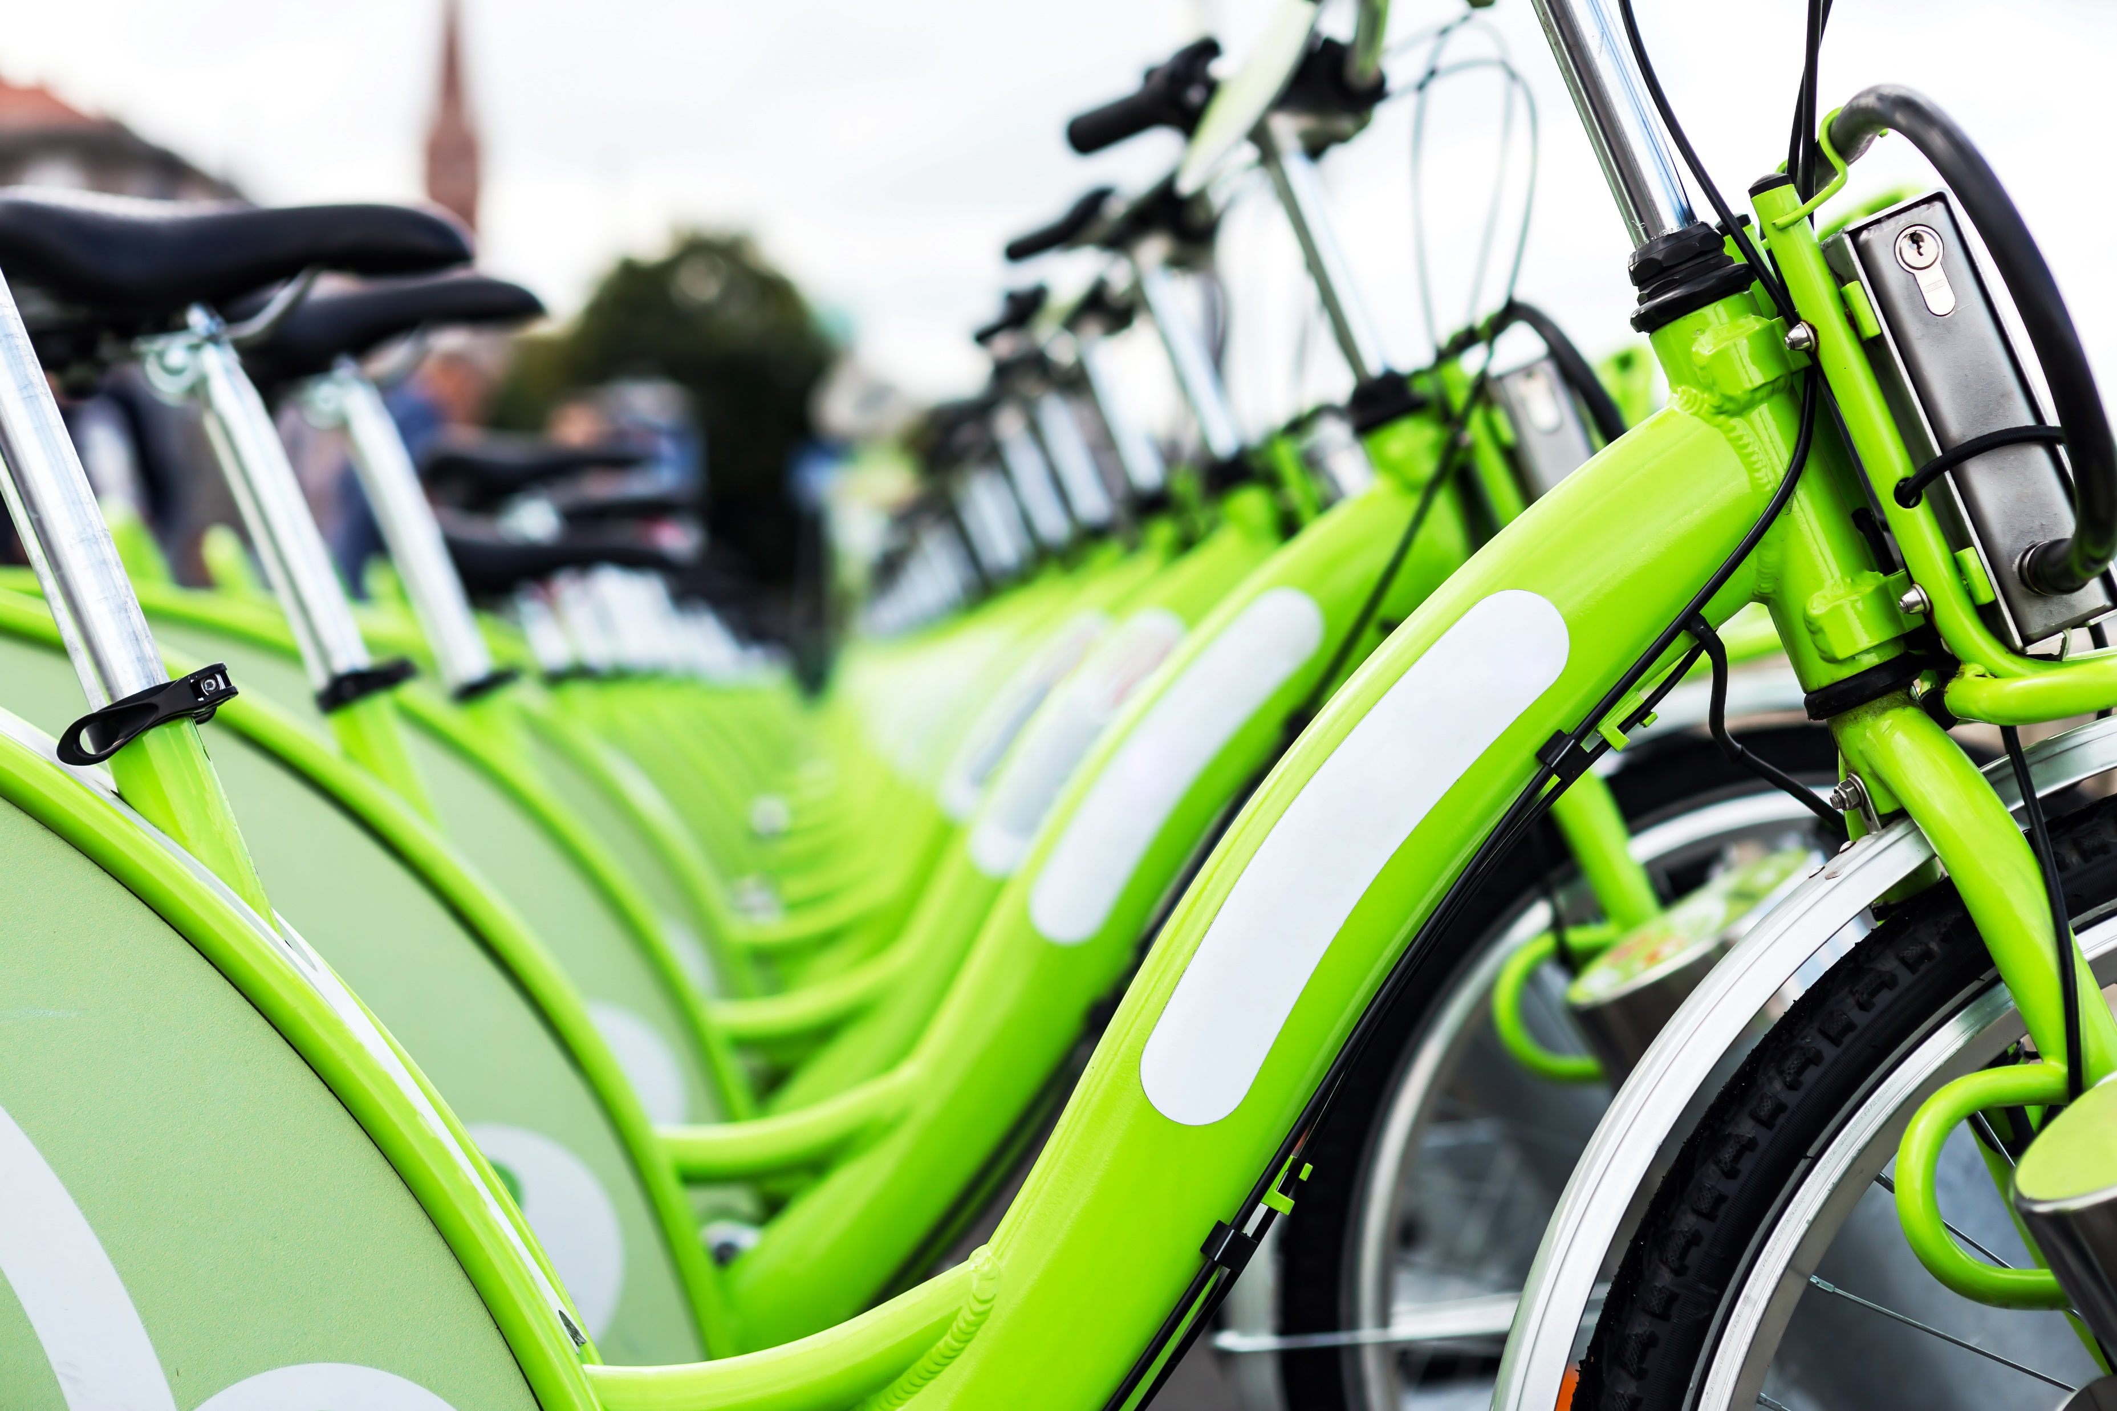
How to improve bike sharing to increase annual members
By Ezzdeen Nimer

Slide 2
Background
Cyclistic is a Bike sharing company located in Chicago, they have more than 5,800 bicycles and 600 docking stations.
They offer different types of bikes such as Reclining, hand, and cargo bikes.
Cyclistic offers to casual riders and offers a membership program. Most users ride for leisure but about 30% use to commute to work everyday.

Slide 3
Scenario
Lily Moreno the Director of Marketing is interested in finding ways to convert casual riders into annual members, she has preprepared 3 questions:
How do annual members and casual riders use Cyclistic bikes differently?
Why would casual riders buy Cyclistic annual memberships?
How can Cyclistic use digital media to influence casual riders to become members?
We will be focusing on the first question today.

Slide 4
How long are they riding?
On average Casual riders use the bikes for more than twice the length that members do (29 minutes and 50 seconds minutes compared to 12 minutes and 57 seconds )

Slide 5
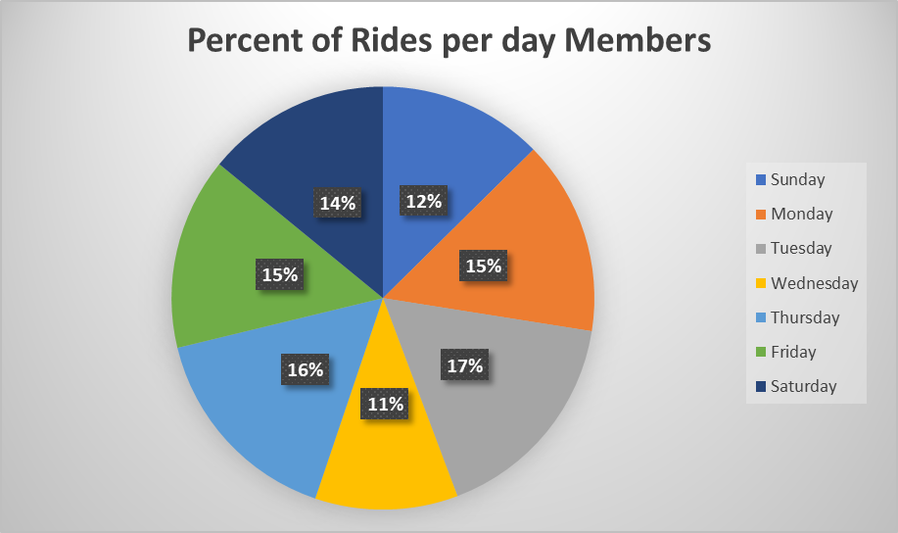
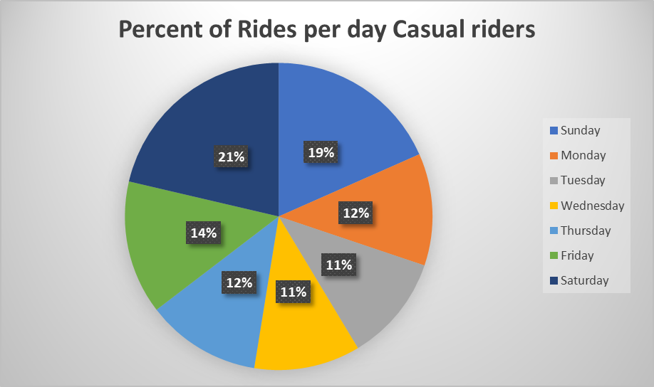
Busiest days?
For members weekend rides only make up 26% of rides compared to 40% for casual riders
Members use Cyclistic most on Tuesday and Thursday
Casual riders use it more on weekends and Friday more.

Slide 6
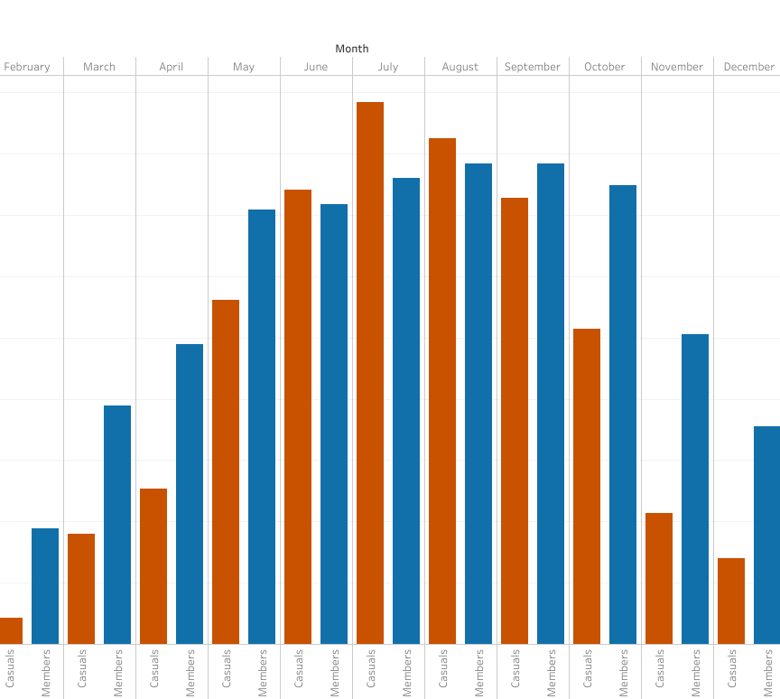
Rides Per Month
Busiest months: Members: Sep.
Casuals: July
Least busy: January for both
Summer months tend to be busier times compared to the winter seasons.

Slide 7
Key findings
1) Casual riders tend to have longer ride times than members do.
2)Members busiest days were during the week but casual riders 40% of rides were done on the weekends.
3) Warmer weather months do better compared to cold weather months. The reason probably being that more people would rather stay inside in the cold.

Slide 8
Suggestions
I believe there are a couple things Cyclistic can do to help convert these casual riders into annual members.
1) They should incorporate a weekend pass something like an annual membership, having them pay a monthly subscription but have it much cheaper. This pass will include Friday, Saturday, and Sunday. I believe this will motivate people who use the bikes often but don’t want to commit to a full out membership.
2) They can add more summer/early fall deals and promotions. These months are the busiest times so if users are using our bikes the most during these times, they will be more likely to want to sign up since at the time they will be using it more. Having sign up promotions or reduced membership fee if you sign up during certain times in the summer could help.

