Slide 1

Temperature converter
Worked by:Enio Bica SWE-B

Slide 2
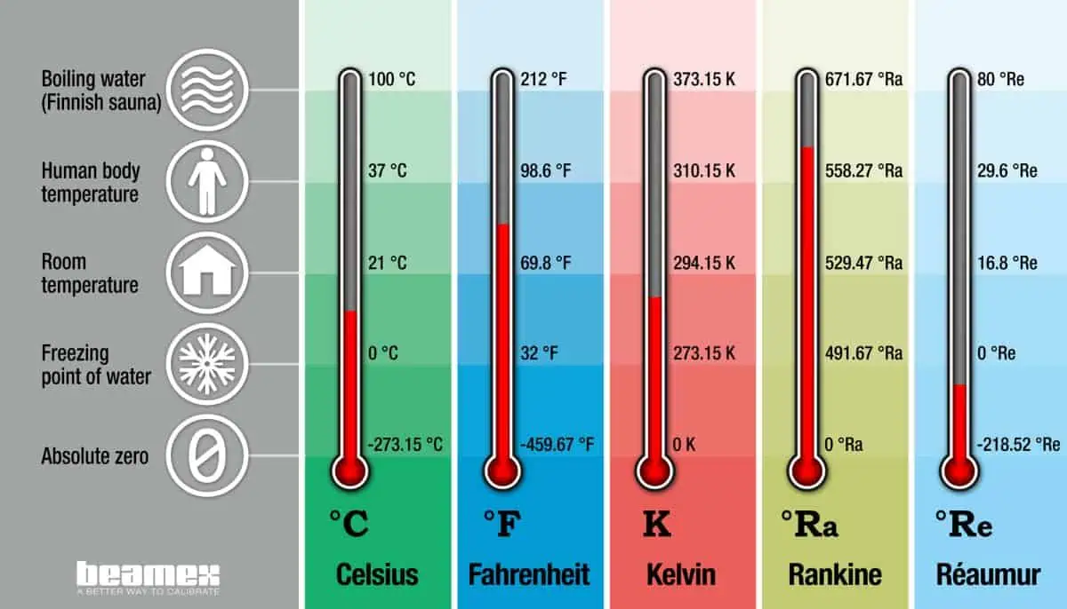
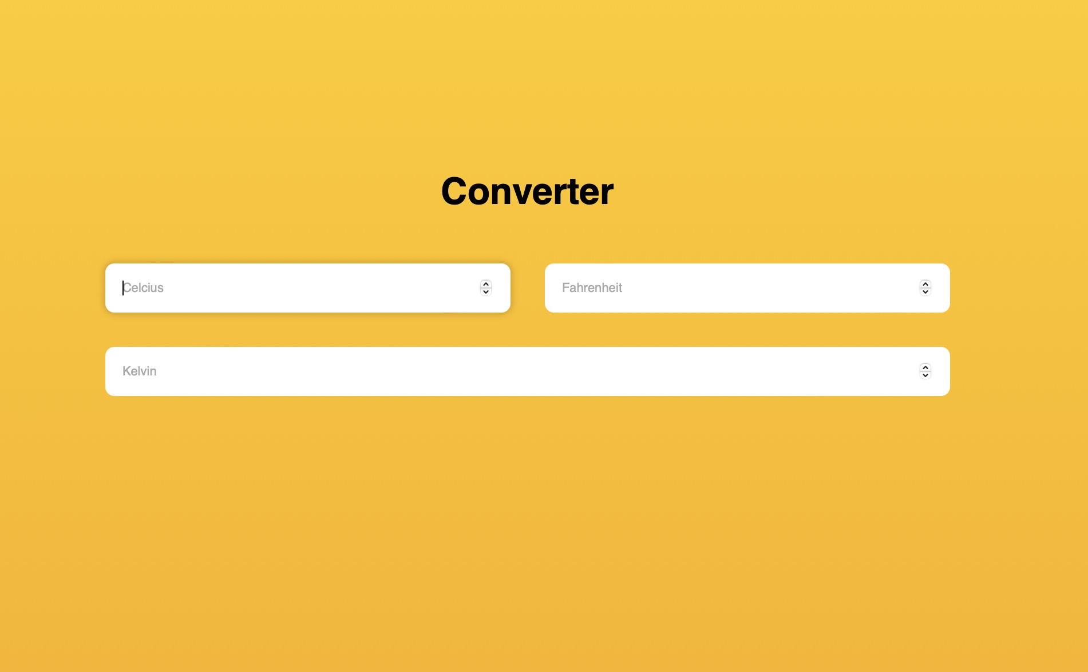
INTRODUCTION
The purpouse of this project is to create a friendly user interface that is able to convert temperatures between Celsius , Fahrenheit and Kelvin scales.

Slide 3
Project Features
As we can see, in all boxes there is determined the scales of temperature(Celsius,Fahrenheit,Kelvin).The user can input in it any number and it will be converted imediately to the two other temperature scales.

Slide 4
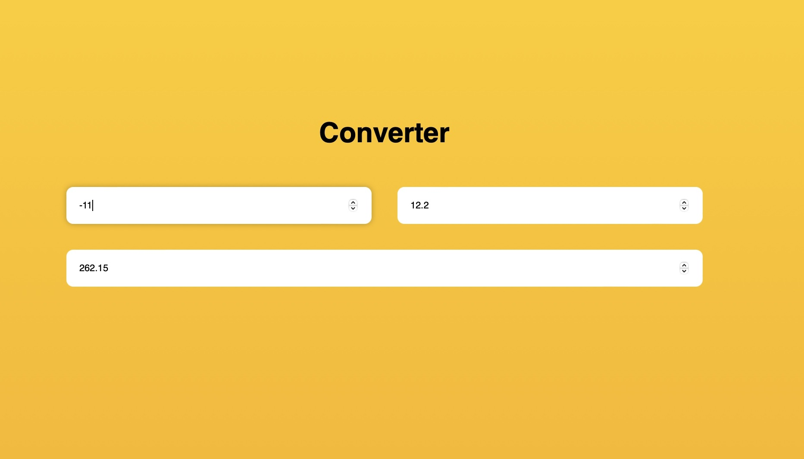
Project Features
The Temperature has been calculated with the formulas T(C) +273.15 =T(K)
,T(C)*9/5-32=T(F) and
T(F)-32 *5/9 +273.15. And it can be calculated for all Natural Numbers.

Slide 5

Error Input by User
Make Sure to put only numbers because if any letter is inputed or a non numerical variable no calculation would be shown at all as we see in the picture.

Slide 6
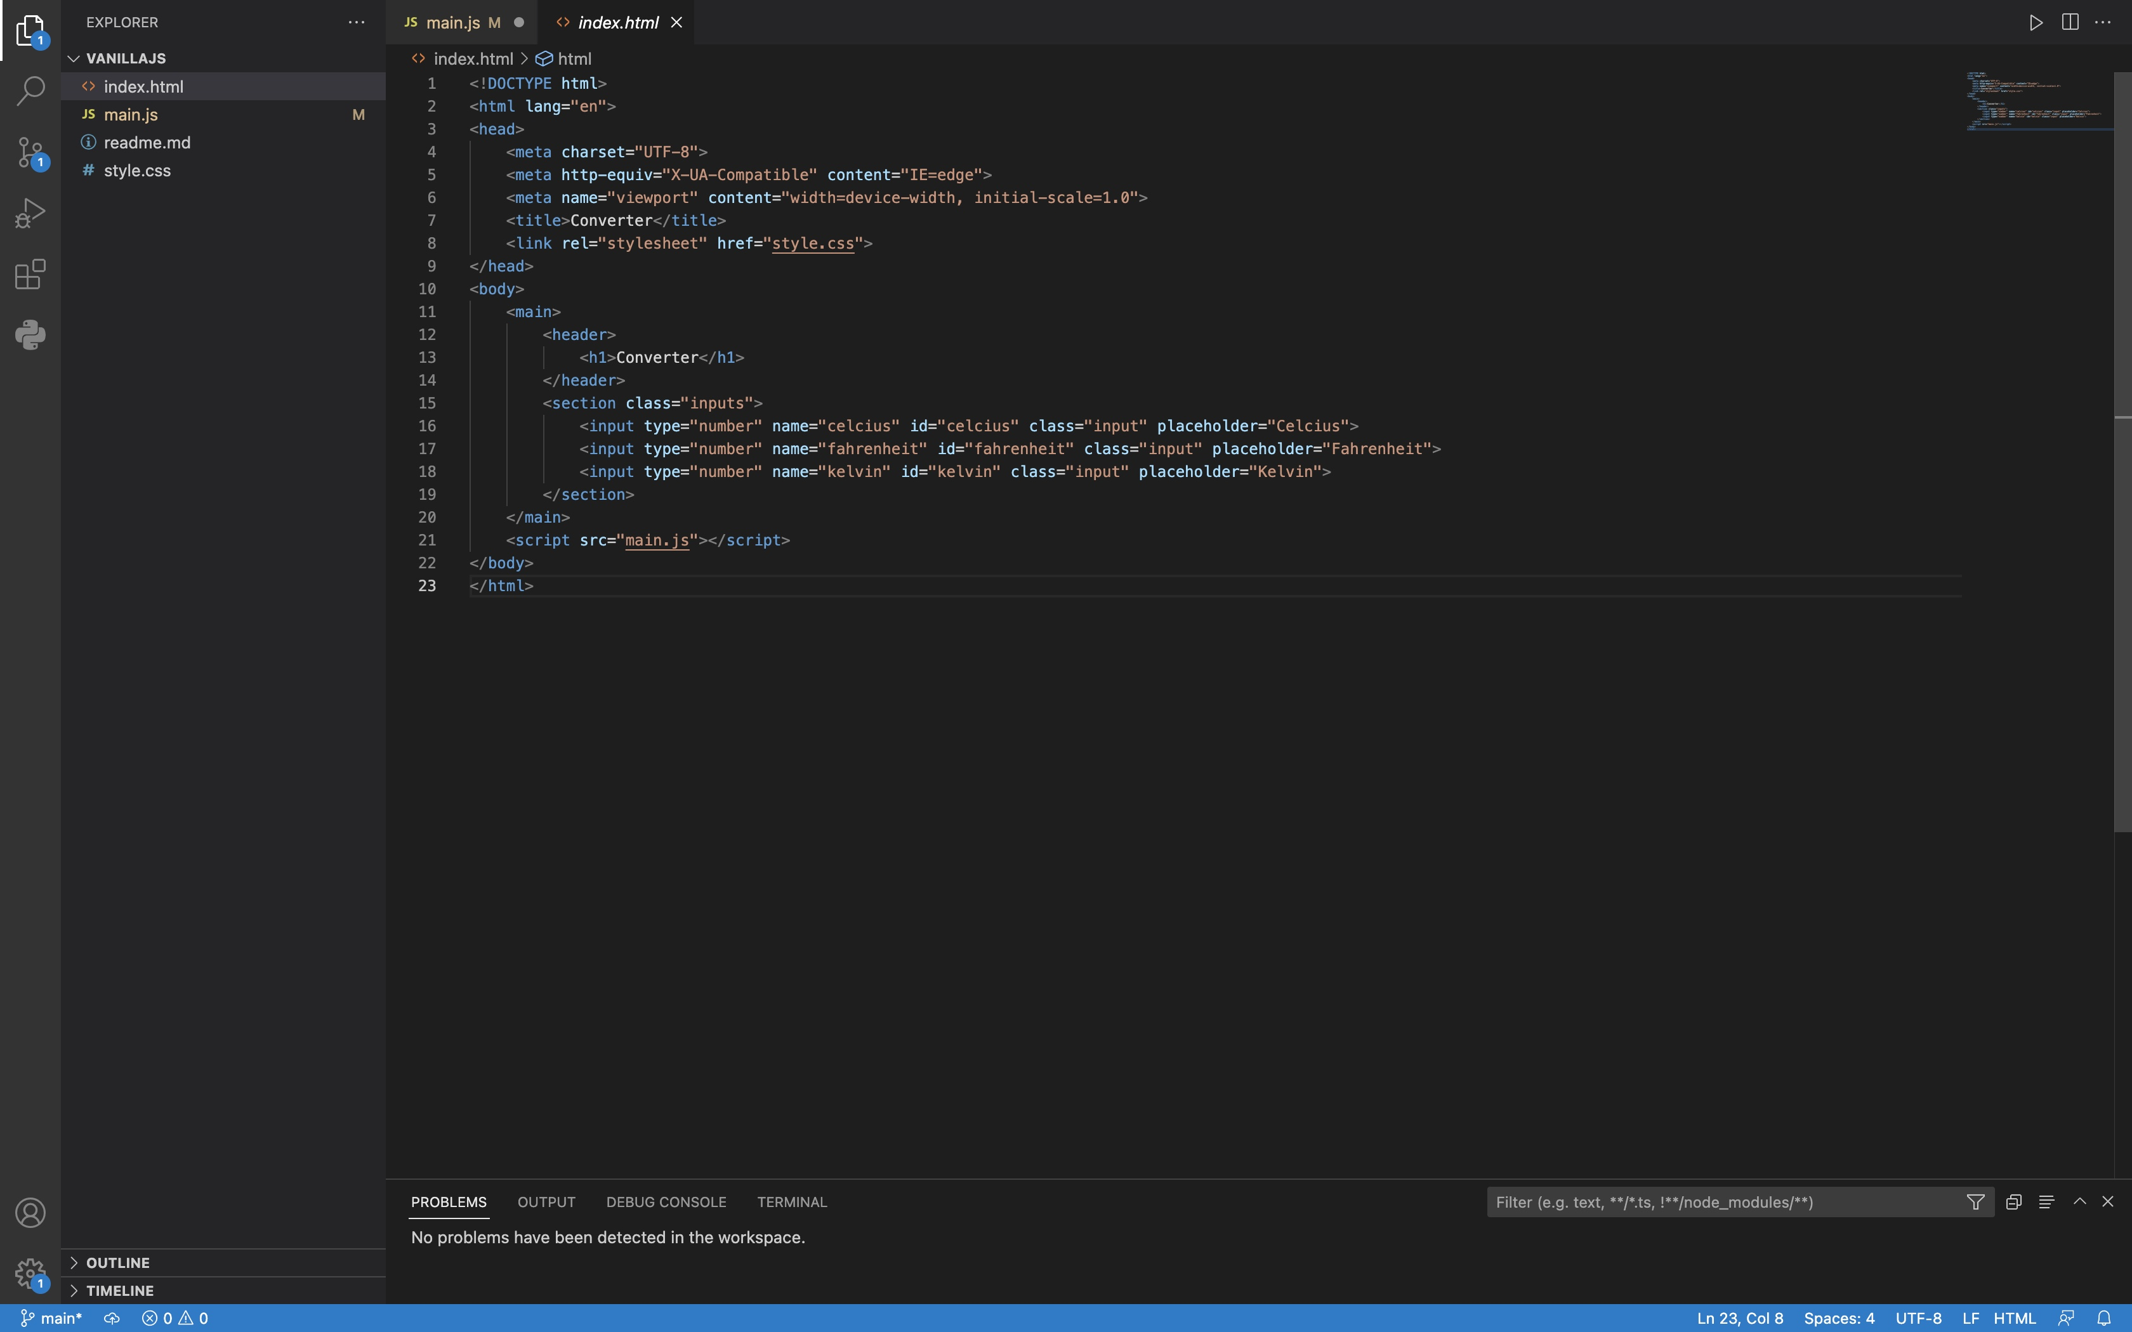
The HTML code represents the converter web page. Here is a short description of the code.
The code starts with the usual HTML document structure, including the DOCTYPE declaration and the opening <html> tag.
The lang attribute in the <html> tag specifies the language of the document as English.
The <head> section contains meta tags that define the character encoding, compatibility settings for Internet Explorer, and the viewport settings for responsive design.
The <title> element sets the title of the web page as "Converter."
The <link> tag references an external CSS file called "style.css" to apply styling to the HTML elements.
The <body> section is where the content of the web page is defined.
Inside the <body>, there is a <main> element that represents the main content of the web page.
The <header> element contains a <h1> heading with the text "Converter" as the title of the page.
The <section> element with the class "inputs" represents a section of the page where input fields for temperature conversion are located.
Inside the <section>, there are three <input> elements of type "number" with different name, id, and placeholder attributes. These input fields allow users to enter temperature values in Celsius, Fahrenheit, and Kelvin.
Finally, just before the closing </body> tag, there is a <script> tag that references an external JavaScript file called "main.js," which is used for adding functionality to the web page.

Slide 7
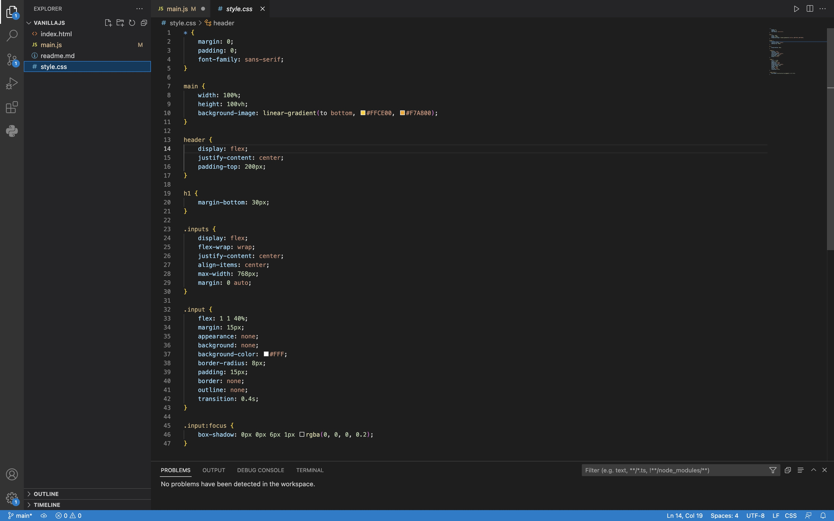
The CSS code contains styles for the converter web page. Here is a short description of the code:
The * selector applies the following styles to all elements in the document: setting the margin and padding to 0, and setting the font-family to sans-serif.
The main selector styles the main content container element. It sets the width to 100% and the height to 100vh (viewport height). It also applies a linear gradient background from #FFCE00 to #F7A800.
The header selector styles the header element. It uses flexbox to horizontally center the content and applies a padding-top of 200px.
The h1 selector styles the heading element within the header. It adds a margin-bottom of 30px.
The .inputs selector styles the section element with the class "inputs." It uses flexbox to center the content both horizontally and vertically, wraps the content to multiple lines if necessary, sets a maximum width of 768px, and centers the section horizontally using margin: 0 auto.
The .input selector styles the input elements within the section. It uses flexbox to distribute the available space evenly among the input elements. It adds margin around the inputs, sets the appearance to none (to remove the default styling), sets the background color to white, adds a border-radius of 8px, and sets padding to 15px. It also removes the default border and outline styles.
The .input:focus selector styles the input elements when they receive focus. It adds a box-shadow effect to provide a visual indication of focus.

Slide 8
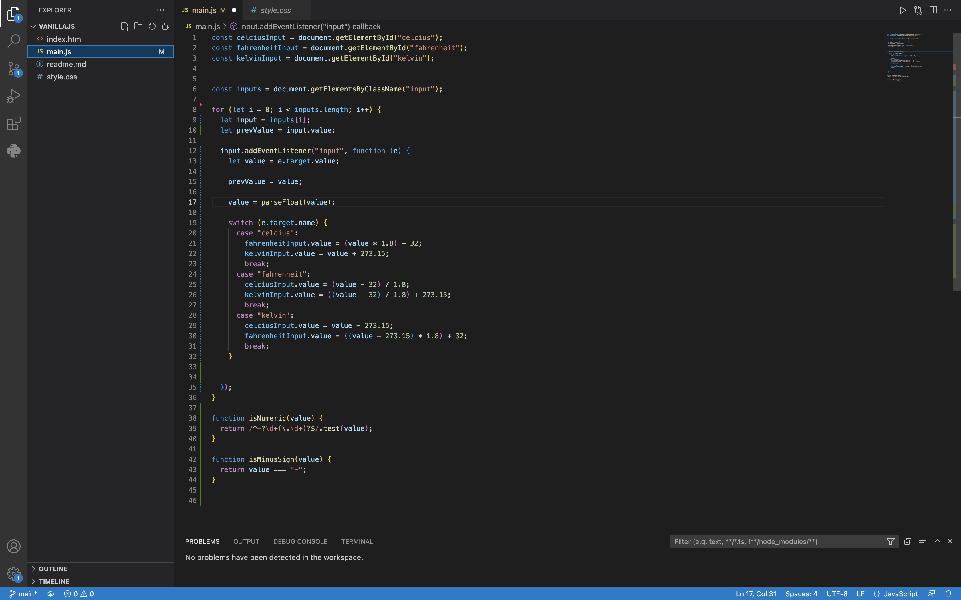
The JavaScript code provides functionality for the converter web page. Here's a short description of the code:
The code first retrieves references to the input elements with the IDs "celcius," "fahrenheit," and "kelvin" using getElementById.
It also retrieves references to all elements with the class "input" using getElementsByClassName.
Next, it loops through each input element and adds an event listener to listen for input changes.
When an input event occurs, the event listener function is triggered.
Within the event listener function, it retrieves the current value of the input and stores it in the value variable. It also stores the previous value of the input in the prevValue variable.
The code then converts the value to a floating-point number using parseFloat.
Based on the name of the input element (celcius, fahrenheit, or kelvin), it performs the appropriate temperature conversions and updates the values in the other input fields accordingly.
The isNumeric function checks if a given value is numeric by using a regular expression to match a valid number format.
The isMinusSign function checks if a given value is a minus sign (-).

Slide 9

This PowerPoint presentation provided an overview of the temperature converter programming project, including its features, programming language and tools, conversion formulas, user interface, testing.

