Slide 1

Computer Organization: Instruction Set Architecture
Debapriya Basu Roy
Department of Computer Science & Engineering
Indian Institute of Technology Kanpur
dbroy@cse.iitk.ac.in
dbroy24@gmail.com

Slide 2
Instruction and Instruction Set
The words of a computer’s language are called instructions, and its vocabulary is called an instruction set
We will focus on the MIPS instruction set, an example of the instruction sets designed during the 1980s.
Other Instruction Sets:
ARMv7 is similar to MIPS.
Intel x86,
ARMv8:which extends the address size of the ARMv7 from 32 bits to 64 bits. This instruction set is closer to MIPS than it is to ARMv7
The similarity of instruction sets occurs because all computers are constructed from hardware technologies based on similar underlying principles and because there are a few basic operations that all computers must provide
stored-program concept: The idea that instructions and data of many types can be stored in memory as numbers, leading to the stored program computer.

Slide 3
Operations in Computer
Every computer must be able to do arithmetic operations:
Add, subtract, multiply, divide
The variables operated on and the result variables are called operands
The operands used in an operation are called source operands or read operands
The operands used for storing the result of an operation are called destination operands or write operands
a = b + c: c and b are source or read operands, a is the destination or write operand
MIPS Instruction to add: add a, b, c instructs a computer to add the two variables b and c and to put their sum in a
MIPS Instruction to add four numbers:
add a, b, c # The sum of b and c is placed in a
add a, a, d # The sum of b, c, and d is now in a
add a, a, e # The sum of b, c, d, and e is now in a
Rigid: Each MIPS arithmetic instruction performs only one operation and must always have exactly three operands.

Slide 4
Compiling C code into MIPS
Example 1:
a = b + c; d = a – e;
In MIPS:
add a, b, c
sub d, a, e
Example 2:
f = (g + h) – (i + j);
In MIPS:
add t0,g,h # temporary variable t0 contains g + h
add t1,i,j # temporary variable t1 contains i + j
sub f,t0,t1 # f gets t0 – t1, which is (g + h) – (i + j)
Example 3:
d=(b+c)-e
In MIPS:
add d, b, c
sub d, d, e

Slide 5
Computer Operations
Computer operations come in many types
Each distinct operation has a corresponding instruction that the computer understands
Each operation has a few operands
Usually three in most computers
Two are source operands and one is destination operand
Accordingly, each instruction has a corresponding number of operands
In a computer, all instructions may have the same number of operands or may have a variable number of operands
Simple designs favor uniformity and regularity in instructions
A compiler (e.g., gcc) generates a sequence of instructions from a HLL (e.g., C) program
Each instruction specifies one operation
The program containing this sequence of MIPS instructions is called a MIPS assembly language program
Notice that we have implicitly assumed that the MIPS instruction operands have the same name as the C statement variables (Not usually the case)

Slide 6
Operands
Each hardware operation reads its source operands from some storage and writes its destination operand to some storage
This storage can be either a register from the register file inside the processor or a memory location (DRAM)
Recall that anything that is accessed from DRAM is also copied into SRAM cache inside the processor replacing something if the SRAM cache is already full
So, at any point in time, the SRAM cache stores a subset of the DRAM contents
The data in a memory location can be found in SRAM cache or in DRAM (DRAM is accessed only if SRAM cache does not have the data)
Translating an HLL program to an assembly language program involves two basic steps
Mapping HLL operators to computer instructions
Mapping HLL operands (or variables) to computer instruction operands
Requires deciding which variable is stored where and when
Every variable gets a fixed memory location
However, this forces every computer instruction to operate on memory operands only and obviates the need for a register file
But accessing a register is faster than accessing memory (faster than even SRAM cache)

Slide 7
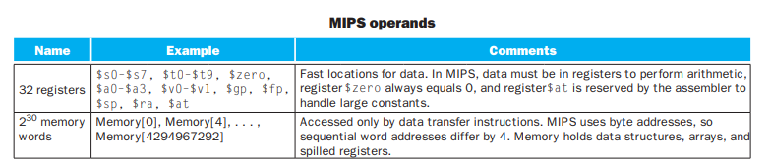
Operands
The operands of arithmetic instructions are restricted; they must be from a limited number of special locations built directly in hardware called registers. (for MIPS). In x86, both register and memory operands are allowed.
Consistent latency of these operations if registers are used
Registers are primitives used in hardware design that are also visible to the programmer when the computer is completed,
The size of a register in the MIPS architecture is 32 bits; groups of 32 bits occur so frequently that they are given the name word in the MIPS architecture.
One major difference between the variables of a programming language and registers is the limited number of registers, typically 32 on MIPS
The three operands of MIPS arithmetic instructions must each be chosen from one of the 32, 32-bit registers. (Smaller is faster).
A very large number of registers may increase the clock cycle time and the area overhead

Slide 8
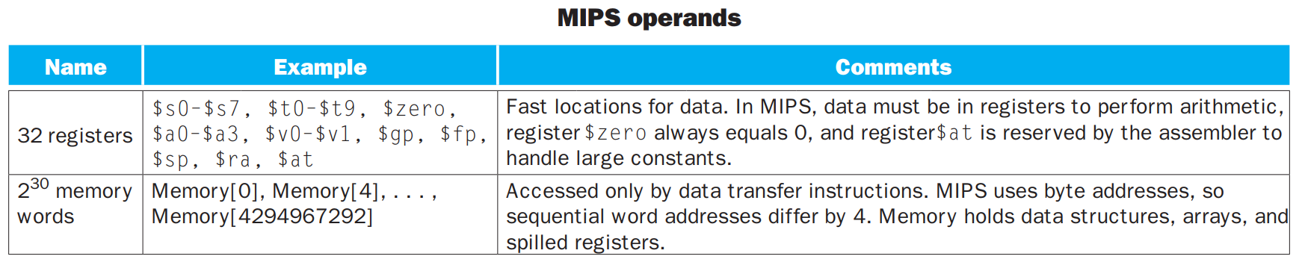
Operands
Another reason for not using more than 32 is the number of bits it would take in the instruction format,
The MIPS convention is to use two-character names following a dollar sign to represent a register.,$s0, $s1, . . . for registers that correspond to variables and $t0, $t1, . . . for temporary registers
Example:
f = (g + h) – (i + j);
In MIPS:
add $t0,$s1,$s2 # register $t0 contains g + h
add $t1,$s3,$s4 # register $t1 contains i + j
sub $s0,$t0,$t1 # f gets $t0 – $t1, which is (g + h)–(i + j)

Slide 9
Register Width
Width of register file dictates width of datapath used in computation
Register width is typically decided based on the primitive variable types used in HLL programs
Makes it easy to map variables to registers
In C language, these are char, short, int, long long, float, double
Notice that 64-bit registers are large enough to hold a variable of any of these types
Since wider register file is slower, it is important to find out how often a 64-bit operand is used
If that is not too common, a 32-bit wide register file would suffice
A 64-bit operand will have to be mapped on a pair of registers and may require double the 32-bit access time
Important design principle: make the common case fast

Slide 10
Register Design
Since each variable is given a unique memory location to store its value, it must be copied to a register if an instruction wants to use it as a register operand
Not all variables of a program can be allocated in registers at the same time due to restricted number of registers
Variables are allocated in and de-allocated from registers as the program progresses (filled from and spilled into memory)
Large number of registers not only increase the access time of register operands, but also can increase the clock cycle time
Cycle time is decided by the setup time analysis
Register read, computation of the operation, and register write can be split into three consecutive cycles
The cycle time will decrease compared to the previous one, but will remain limited by max(read latency, op latency, write latency)

Slide 11
Register File Design
For instructions that have two register sources and one register destination, the best performance is achieved if the register file has two read ports and one write port
If the register file had a single read port, this would have required two sequential accesses doubling the overall time to read the source operands
If we assume that one instruction executes at a time, the write port can share the decoder, wordline and the bitline with one of the read ports
Register allocation of variables is the compiler’s responsibility
Goal is to minimize the number of fills and spills because memory access is inefficient
Example: assume four registers r1, r2, r3, r4
Consider the C statements:
a=b + c; // Allocate a, b, c to r1, r2, r3
d=e + f; // Allocate d to r4, how to allocate e and f?
a=a + d;
b=a + e;

Slide 12
Operands
Mapping variables to operands
Consider the C statements:
a=b + c; // Allocate a, b, c to r1, r2, r3
d=e + f; // Allocate d to r4, how to allocate e and f?
a=a + d;
b=a + e;
Assembly language translation (not exactly MIPS)
load r2, addr_b #fill b
load r3, addr_c #fill c
add r1, r2, r3 #a = b + c
load r2, addr_e #fill e
load r3, addr_f #fill f
add r4, r2, r3 #d = e + f
add r1, r1, r4 #a= a + d
add r3, r1, r2 #b=a + e
store r1, addr_a #spill a (note changed syntax)
store r3, addr_b #spill b
store r4, addr_d #spill d

Slide 13
Memory Operands
Programming have usage of complex data structures like arrays and structures. These complex data structures can contain many more data elements than there are registers in a computer. These are kept in the memory
Arithmetic operations occur only on registers in MIPS instructions; thus, MIPS must include instructions that transfer data between memory and registers. Such instructions are called data transfer instructions.
To access a word in memory, the instruction must supply the memory address. Memory is just a large, single-dimensional array, with the address acting as the index to that array, starting at 0
The data transfer instruction that copies data from memory to a register is traditionally called load.

Slide 14
Memory Operands
The format of the load instruction is the name of the operation followed by the register to be loaded, then a constant and register used to access memory. The sum of the constant portion of the instruction and the contents of the second register forms the memory address. The actual MIPS name for this instruction is lw, standing for load word.
Let’s assume that A is an array of 100 words and that the compiler has associated the variables g and h with the registers $s1 and $s2 as before. Let’s also assume that the starting address, or base address, of the array is in $s3
g = h + A[8];
In MIPS:
lw $t0,8($s3) # Temporary reg $t0 gets A[8]
add $s1,$s2,$t0 # g = h + A[8]
The constant in a data transfer instruction (8) is called the off set, and the register added to form the address ($s3) is called the base register.

Slide 15
Store Instruction
The instruction complementary to load is traditionally called store; it copies data from a register to memory. The format is: the name of the operation, followed by the register to be stored, then off set to select the array element, and finally the base register.
Assume variable h is associated with register $s2 and the base address of the array A is in $s3. What is the MIPS assembly code for the C assignment statement A[12] = h + A[8]?
lw $t0,32($s3) # Temporary reg $t0 gets A[8] add $t0,$s2,$t0 # Temporary reg $t0 gets h + A[8] sw $t0,48($s3) # Stores h + A[8] back into A[12]
Note the usage of proper offset

Slide 16
Memory Operands: Addressing
Virtually all architectures today address individual bytes. Therefore, the address of a word matches the address of one of the 4 bytes within the word, and addresses of sequential words differ by 4
In MIPS, words must start at addresses that are multiples of 4. This requirement is called an alignment restriction, and many architectures have it.
Big-endian (BE): Stores the most significant byte (the “big end”) first->use the address of the left most or “big end” byte as the word address. MIPS follows this
Little-endian (LE): Stores the least significant byte (the “little end”) first->use the address of the right most or “little end” byte as the word address. x86 follows little endian ordering
Byte addressing also affects the array index. To get the proper byte address in the code shown in the previous slides, the offset to be added to the base register $s3 must be 4*8, or 32, so that the load address will select A[8] and not A[8/4]

Slide 17
Alignment
MIPS requires that a memory operand of size n bytes must start at an address that is divisible by n
The least significant log(n) bits of the memory operand address must be zero
Observe that byte operands (n==1) can start at any address. This is a property of byte-addressable memory. Each memory address corresponds to a distinct byte
Observe that n can take only a few values: 1, 2, 4, 8
x86 ISA allows unaligned memory operands

Slide 18
Memory Operands: Why we need offset
Since instructions need to be stored in memory, it is important to be economical in specifying operands
Having 4 GB memory would require 32 bits of address to specify a memory operand-> direct memory addressing mode
Recall that instructions are generated by the compiler and the compiler does not always know the addresses of all variables of a program
Example: return pointer of a malloc call (resolved only when the program runs)
Memory operands are represented by a memory address which refers to a byte and a register is typically bigger than a byte
Four- or eight-byte registers in most ISAs
Need to disambiguate this size mismatch
To resolve this, data transfer instructions also specify the number of bytes to be transferred between register and memory

Slide 19
MIPS LOAD and STORE
MIPS has four different load and four different store instructions corresponding to four different size
Load byte: lb
Load half word: lh (loads two bytes)
Load word: lw (loads four bytes)
Load double word: ld (supported in 64-bit MIPS)
Store byte: sb
Store half word: sh
Store word: sw
Store double word: sd (supported in 64-bit MIPS)
In x86 ISA, an instruction may have multiple memory operands
Not possible to encode memory operand size in instruction name because different memory operands may have different sizes
Load a byte from address A, load a word from address B, add them, and store the result in a register
Each memory operand needs to specify its size separately within the instruction
Requires more bits in the instruction (e.g., could be two bits per memory operand)

Slide 20
Sub-Word Memory Location
Consider the load byte or load half word instruction
These instructions load a byte or two bytes into the least significant side of the destination register
Remaining bits can be either zero filled (for unsigned) or sign extended (for signed)
Sign-extension fills the remaining bits with the sign bit of the loaded byte or the loaded half word. In two’s complement representation, extending a number’s sign bit by arbitrary number of bits does not change the equivalent decimal value
More variations: Load byte unsigned (lbu) and load byte (lb); load half unsigned (lhu) and load half (lh);
Unsigned variant fills the remaining bits of the destination register with zeros; the other one sign-extends

Slide 21
Example:
long long x[10]; long long y = x[2];
For 64 bit MIPS: Assuming y is allocated to $1 and the starting address of x is in $29, MIPS code is ld $1, 16($29)
For 32 bits MIPS: Assume y is split between $1 and $2
lw $1, 16($29) lw $2, 20($29)
int x[10]; int y = x[2];
y is allocated to $1 and the starting address of x is in $29-> lw $1, 8($29)
short x[10]; short y = x[2];
MIPS code->lh $1,4($29)
unsigned short x[10]; unsigned short y = x[2];
MIPS code->lhu $1,4($29)
char x[10]; char y = x[2];
MIPS code->lb $1,2($29)

Slide 22
Example
unsigned char x[10];unsigned char y = x[2];
MIPS Code-> lbu $1, 2($29)
Store byte instruction takes the least significant byte from the source register (left operand) and stores the byte at the address of the memory operand -> sb $2, 0($1)
Store half word instruction takes the least significant two bytes from the source register (left operand) and stores the bytes starting at the address of the memory operand
sh $2, 0($1)
There is no scope of zero-fill or sign-extension
unsigned char x[10];unsigned char y; x[2] = y;
MIPS Code-> Assuming y is allocated to $1 and the starting address of x is in $29, sb $1, 2($29)
Changing type to “char” does not change the instruction
Bit no. 7 of y already encodes the sign (LSB is bit no. 0)

Slide 23
Example:
unsigned short x[10]; unsigned short y; x[2] = y;
MIPS Code-> sh $1, 4($29) (Bit no. 15 of y encodes the sign (LSB is bit no. 0)
unsigned int x[10]; unsigned int y; x[2] = y;
MIPS Code-> sw $1, 8($29) (Bit no. 31 of y encodes the sign (LSB is bit no. 0)
unsigned long long x[10];unsigned long long y; x[2] = y;
64 bit MIPS code-> sd $1,16($29)
32 bit MIPS code -> sw $1, 16($29); sw $2, 20($29)

Slide 24
Byte ordering within a memory word: Big Endian and Little Endian
Suppose we are loading a half word from address zero
We need to load two bytes from addresses 0 and 1
Which of these is the least significant byte?
Decided by how the bytes are ordered within a word i.e., how you assign addresses to bytes within a word
The word containing the half word to be loaded starts at address zero and ends at address 3; need to assign these four addresses (0, 1, 2, 3) to the bytes in a word
It is possible to do this assignment in 4! ways
Out of these 24 different orders, only two are sequential in nature; in one case, the most significant byte has address 0 and the address increases linearly till the least significant byte gets address 3 (big endian ordering); in the other case, the least significant byte gets address 0 and the address increases linearly till the most significant byte gets address 3 (called little endian ordering)
Word ordering within a double word
Two words in a double word
Let the addresses of the words be zero and one
Big endian machines have word#0 as the most significant word and word#1 as the least significant word
Little endian machines have word#0 as the least significant word and word#1 as the most significant word

Slide 25
Operands
Example C code to distinguish between big endian and little endian ISAs
unsigned int x = 0x12345678;
unsigned char y = *(char*)&x; // byte at start address
printf(“%#x\n”, y);
A big endian machine would print 0x12
A little endian machine would print 0x78
Address
&x
&x + 1
&x + 2
&x + 3
&x + 3
&x + 2
&x + 1
&x
Value
12
34
56
78
12
34
56
78
Big endian
Little endian

Slide 26
How to do unaligned memory operand accesses in MIPS?
Suppose I would like to extract four consecutive characters starting from any arbitrary location of a string, say, “abcdefghij”
For example, I may want to extract “defg”, which starts at an unaligned word address
One option is to do four load byte operations and then somehow put them together properly in a 32-bit register
A lot of instructions needed
Slightly better option is to do two load bytes (for ‘d’ and ‘g’) and one load half word (for “ef”)
Still a lot of instructions needed
Supporting unaligned access is important for reducing the number of instructions in a program
MIPS supports two unaligned load word instructions and two unaligned store word instructions
lwl (load word left)
lwr (load word right)
swl (store word left)
swr (store word right)

Slide 27
Operands
Understanding lwl and lwr
Example: lwl $4, 0($10); let $10 contain 0x57
Let the word containing this byte address be w
Extract the bytes contained by w that start from this address (remember this is big endian)
Put these bytes (in this case one byte) in the upper portion of $4 and leave the remaining bytes (in this case 3 lower bytes) unchanged
Example: lwr $4, 0($10); let $10 contain 0x5a
Extract the bytes contained by w that end at this address
Put these bytes (in this case three bytes) in the lower portion of $4 and leave the remaining bytes (in this case the upper byte) unchanged
LWL will load 4 - A % 4 bytes to the left of the register and LWR will load the remaining A % 4 bytes to the right of it
Suppose the char pointer x points to “abcdefghij” i.e., char x[10] = “abcdefghij”
If we want to extract “defg”, the compiler will generate a lwl from address x+3 and a lwr from address x+6

Slide 28
Constant and Immediate Operands
We want to compute a=b+4
lw $t0, AddrConstant4($s1) # $t0 = constant 4 add $s3,$s3,$t0 # $s3 = $s3 + $t0 ($t0 == 4)
Alternative: Use of constant operands
addi $s3,$s3,4 # $s3 = $s3 + 4
The constant zero has another role, which is to simplify the instruction set.
For example, the move operation is just an add instruction where one operand is zero. Hence, MIPS dedicates a register $zero to be hard-wired to the value zero.
Immediate operands can be negative also-> no need to have a subi instruction
Usage of $zero-> a=3-b
Suppose a is allocated to $11, b is allocated to $12
Suppose the address of a is 0($1), address of b is 0($2)
lw $12, 0($2) sub $12, $0, $12 addi $11, $12, 3 sw $11, 0($1)
lw $12, 0($2)
addi $13, $0, 3
sub $11, $13, $12
sw $11, 0($1)

Slide 29
Summary on Operands
Three types of operands: register operands, memory operands, immediate operands
Register operands are represented by register names and register names have one-to-one mapping to register numbers
MIPS ISA has 32 distinct registers
Out of these, one register is hardwired to store zero
Memory operands use displacement addressing mode in MIPS
A memory operand address is represented as the sum of a base register content and a displacement
Displacement can be positive or negative
Immediate operands represent constants

Slide 30
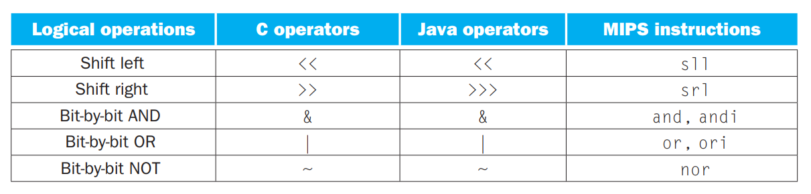
Logical Operations and Operators in MIPS
Suppose register $s0 contains the value 9
What will be value of $s0 afters sll $t2,$s0,4
Op: Opcode, rs=source register 1, rt=source register 2, rd=destination register, shamt=shift amount, func= will be explained later
The encoding of sll is 0 in both the op and funct fields, rd contains 10 (register $t2), rt contains 16 (register $s0), and shamt contains 4. The rs field is unused and thus is set to 0.
srl is shift right and work similarly as sll

Slide 31
AND operation
Register $t2 contains 0000 0000 0000 0000 0000 1101 1100 0000_{two}
Register $t1 contains 0000 0000 0000 0000 0011 1100 0000 0000_{two}
and $t0,$t1,$t2 # reg $t0 = reg $t1 & reg $t2
What is the value of $t0?
AND can apply a bit pattern to a set of bits to force 0s where there is a 0 in the bit pattern. Such a bit pattern in conjunction with AND is traditionally called a mask, since the mask “conceals” some bits.
OR -> dual of AND
or $t0,$t1,$t2 # reg $t0 = reg $t1 | reg $t2
What is the value of $t0?
nor $t0,$t1,$t2 # reg $t0 = ~(reg $t1 | reg $t2)
What is the value of $t0?
MIPS allows constant and immediate operands through andi or ori operations
More logical instructions: xor, xori, sra (shift right arithmetic), sllv (shift left logical variable), srlv, srav

Slide 32
Logical Operations
For right shift, If the shift amount is a constant and at most 31, the srl instruction is generated
If the shift amount is larger or a variable, the srlv instruction is generated where the shift amount is specified in a register
In both cases, shifting right by one bit position is equivalent to dividing by two (integer division)
If the operand being shifted is of signed type, the sra or srav instruction is generated
For signed shift, sign bit is shifted into the most significant side so that the shifted result retains appropriate sign of the operand
If the shift amount is a constant and at most 31, the sra instruction is generated.
If the shift amount is larger or a variable, the srav instruction is generated where the shift amount is specified in a register.

Slide 33
Logical Operations: Examples
Suppose a, b, c are allocated to registers $11, $12, $13 and their memory addresses are in $1, $2, $3
int a, b, c; lw $12, 0($2)
lw $13, 0($3)
a = b ^ c; xor $11, $12, $13
b = a & c; and $12, $11, $13
a = c | a; or $11, $13, $11
b = ~a; nor $12, $11, $0
b = b ^ 0x20; xori $12, $12, 0x20
a = b & 0x7; andi $11, $12, 0x7
sw $11, 0($1)
sw $12, 0($2)
sw $13, 0($3)

Slide 34
Logical Operations: Examples
Suppose a, b, c are allocated to registers $11, $12, $13 and their memory addresses are in $1, $2, $3
int a, b; lw $12, 0($2)
unsigned int c; lw $13, 0($3)
a = b >> 12; sra $11, $12, 12
c = c >> 4; srl $13, $13, 4
b = b >> c; srav $12, $12, $13
c = c >> b; srlv $13, $13, $12
c = c*8; sll $13, $13, 3
b = a << c; sllv $12, $11, $13
sw $11, 0($1)
sw $12, 0($2)
sw $13, 0($3)

Slide 35
Decision Making in MIPS
Decision making is commonly represented in programming languages using the if statement, sometimes combined with go to statements and labels. MIPS assembly language includes two decision-making instructions, similar to an if statement with a go to.
beq register1, register2, L1 (branch if equal)
Th is instruction means go to the statement labeled L1 if the value in register1 equals the value in register2
bne register1, register2, L1 (branch if not equal)
It means go to the statement labeled L1 if the value in register1 does not equal the value in register2.
Both these instruction helps us to execute conditional branches (if else statements)

Slide 36
Example:
if (i == j) f = g + h; else f = g – h;
f, g, h, i, and j are variables. If the five variables f through j correspond to the five registers $s0 through $s4,
bne $s3,$s4,Else # go to Else if i ≠ j add $s0,$s1,$s2 # f = g + h (skipped if i ≠ j) j Exit # go to Exit Else:sub $s0,$s1,$s2 # f = g – h (skipped if i = j) Exit:
j- unconditional branch. This instruction says that the processor always follows the branch. To distinguish between conditional and unconditional branches, the MIPS name for this type of instruction is jump, abbreviated as j
Some other branching instructions:
bgez (Branch if >= 0) compares a register operand against zero
bgtz (Branch if > 0)
blez (Branch if <= 0)
bltz (Branch if < 0)

Slide 37
Some more example
Suppose x, y, z are allocated to registers $11, $12, $13 and their addresses are in $1, $2, $3
int x, y, z;
if (x == y) z++;
else z--;
MIPS assembly language program:
lw $11, 0($1)
lw $12, 0($2)
lw $13, 0($3)
bne $11, $12, Label1
addi $13, $13, 1
j Label2
Label1: addi $13, $13, -1
Label2: sw $13, 0($3)

Slide 38
Some more example
Suppose x, y, z are allocated to registers $11, $12, $13 and their addresses are in $1, $2, $3
int x, y, z;
if (x != y) z++;
else z--;
MIPS assembly language program:
lw $11, 0($1)
lw $12, 0($2)
lw $13, 0($3)
beq $11, $12, Label1
addi $13, $13, 1
j Label2
Label1: addi $13, $13, -1
Label2: sw $13, 0($3)

Slide 39
Some more example
Suppose x, z are allocated to registers $11, $13 and their addresses are in $1, $3
int x, z;
if (x <= 0) z++;
else z--;
MIPS assembly language program:
lw $11, 0($1)
lw $13, 0($3)
bgtz $11, Label1
addi $13, $13, 1
j Label2
Label1: addi $13, $13, -1
Label2: sw $13, 0($3)

Slide 40
Some more example:
Suppose x, z are allocated to registers $11, $13 and their addresses are in $1, $3
int x, z;
if (x < 0) z++;
else z--;
MIPS assembly language program:
lw $11, 0($1)
lw $13, 0($3)
bgez $11, Label1
addi $13, $13, 1
j Label2
Label1: addi $13, $13, -1
Label2: sw $13, 0($3)

Slide 41
Some more example
Suppose x, z are allocated to registers $11, $13 and their addresses are in $1, $3
int x, z;
if (x > 0) z++;
else z--;
MIPS assembly language program:
lw $11, 0($1)
lw $13, 0($3)
blez $11, Label1
addi $13, $13, 1
j Label2
Label1: addi $13, $13, -1
Label2: sw $13, 0($3)

Slide 42
Some more example
Suppose x, y, z are allocated to registers $11, $12, $13 and their addresses are in $1, $2, $3
int x, y, z;
if (x > y) z++;
else z--;
MIPS assembly language program:
lw $11, 0($1)
lw $12, 0($2)
lw $13, 0($3)
sub $14, $11, $12
blez $14, Label1
addi $13, $13, 1
j Label2
Label1: addi $13, $13, -1
Label2: sw $13, 0($3)

Slide 43
Some more example
Suppose x, y, z are allocated to registers $11, $12, $13 and their addresses are in $1, $2, $3
int x, y, z;
if (x > y) z++;
else z--;
Instead of a subtraction, a comparison operation can be invoked to save energy and possibly time
The instructions slt and slti achieve this
slt compares two source register operands and sets the destination register contents to one if the first operand is less than the second
slti compares a source register against an immediate operand and sets the destination register contents to one if the source register operand is less than the immediate

Slide 44
Some more example
Suppose x, y, z are allocated to registers $11, $12, $13 and their addresses are in $1, $2, $3
int x, y, z;
if (x > y) z++;
else z--;
MIPS assembly language program:
lw $11, 0($1)
lw $12, 0($2)
lw $13, 0($3)
slt $14, $12, $11
beq $14, $0, Label1
addi $13, $13, 1
j Label2
Label1: addi $13, $13, -1
Label2: sw $13, 0($3)

Slide 45
Some more example
Suppose x, y, z are allocated to registers $11, $12, $13 and their addresses are in $1, $2, $3
int x, y, z;
if (x >= y) z++;
else z--;
MIPS assembly language program:
lw $11, 0($1)
lw $12, 0($2)
lw $13, 0($3)
slt $14, $11, $12
bne $14, $0, Label1
addi $13, $13, 1
j Label2
Label1: addi $13, $13, -1
Label2: sw $13, 0($3)

Slide 46
Some more example
Suppose x, z are allocated to registers $11, $13 and their addresses are in $1, $3
int x, z;
if (x < 3) z++;
else z--;
MIPS assembly language program:
lw $11, 0($1)
lw $13, 0($3)
slti $14, $11, 3
beq $14, $0, Label1
addi $13, $13, 1
j Label2
Label1: addi $13, $13, -1
Label2: sw $13, 0($3)

Slide 47
Some more example
Suppose x, z are allocated to registers $11, $13 and their addresses are in $1, $3
int x, z;
if (x <= 3) z++;
else z--;
MIPS assembly language program:
lw $11, 0($1)
lw $13, 0($3)
slti $14, $11, 4
beq $14, $0, Label1
addi $13, $13, 1
j Label2
Label1: addi $13, $13, -1
Label2: sw $13, 0($3)

Slide 48
Some more example
Suppose x, z are allocated to registers $11, $13 and their addresses are in $1, $3
int x, z;
if (x > 3) z++;
else z--;
MIPS assembly language program:
lw $11, 0($1)
lw $13, 0($3)
slti $14, $11, 4
bne $14, $0, Label1
addi $13, $13, 1
j Label2
Label1: addi $13, $13, -1
Label2: sw $13, 0($3)

Slide 49
Signed and unsigned comparisons
Comparison between two 32-bit signed values and between two 32-bit unsigned values must be done differently
The interpretation of the most significant bit is different
For signed types, the entire 32-bit value must be treated as a two’s complement value
The most significant bit will be multiplied by -2³¹
For unsigned types, the entire 32-bit value must be treated as an unsigned binary value
The most significant bit will be multiplied by 2³¹
unsigned int a = 0xFFFFFFF0;
int b = (int)a; // What is the decimal value of b?

Slide 50
Conditional branch instructions
Signed and unsigned comparisons
Consider the following C code
unsigned int a = 0xFFFFFFF0;
unsigned int b = 0xF;
int x = 0xFFFFFFF0;
int y = 0xF;
int c = 0;
if (a < b) c++;
else c--;
if (x < y) c++;
else c--;
Final value of c is zero; the two comparisons must be done differently
In one case, the comparison operands must be treated unsigned and in the other case, they are treated signed

Slide 51
Conditional branch instructions
Signed and unsigned comparisons
Comparison between two 32-bit signed values and between two 32-bit unsigned values must be done differently
MIPS ISA offers two flavors of slt and slti to convey to the hardware how the operands of the comparison must be treated
sltu and sltiu instructions treat the comparison operands as unsigned values
slt and slti instructions treat the comparison operands as signed values
In the example of the last slide, the first comparison would generate the sltu instruction and the second would generate the slt instruction

Slide 52
Some more example
Compiling array bound check
Consider the following C code
int i, N;
if ((i < N) && (i >= 0)) a[i]++;
else go to EXIT
Suppose i is in $1, N is in $2, a is an integer array and its starting address is in $3, and a[i] is allocated in $13
sltu $4, $1, $2
beq $4, $0, EXIT
sll $4, $1, 2
add $4, $4, $3
lw $13, 0($4)
addi $13, $13, 1

Slide 53
Some more example
Compiling complex conditions
Suppose x, y, z are allocated to registers $11, $12, $13 and their addresses are in $1, $2, $3
int x, y, z;
if ((x == y) && (x >= 0)) z++;
else z--;
MIPS assembly language program:
lw $11, 0($1)
lw $12, 0($2)
lw $13, 0($3)
bne $11, $12, Label1
bltz $11, Label1
addi $13, $13, 1
j Label2
Label1: addi $13, $13, -1
Label2: sw $13, 0($3)
Short circuit

Slide 54
Some more example
Compiling complex conditions
Suppose x, y, z are allocated to registers $11, $12, $13 and their addresses are in $1, $2, $3
int x, y, z;
if ((x == y) || (x >= 0)) z++;
else z--;
MIPS assembly language program:
lw $11, 0($1)
lw $12, 0($2)
lw $13, 0($3)
beq $11, $12, Label1
bgez $11, Label1
addi $13, $13, -1
j Label2
Label1: addi $13, $13, 1
Label2: sw $13, 0($3)
Short circuit

Slide 55
Conditional branch instructions
Compiling complex conditions
Each clause is compiled from left to right
If conjunction of clauses is used, the compiled code looks for the first false clause so that no further evaluation of clauses is necessary
If disjunction of clauses is used, the compiled code looks for the first true clause so that no further evaluation of clauses is necessary
Converts the if block into the jump path
Fall through and jump paths cannot be correctly identified until the C code is compiled
This compilation procedure is known as short-circuiting and saves time on average

Slide 56
Loops in MIPS
while (save[i] == k) i += 1;
Assume that i and k correspond to registers $s3 and $s5 and the base address of the array save is in $s6.
Loop: sll $t1,$s3,2 # Temp reg $t1 = i * 4 add $t1,$t1,$s6 # $t1 = address of save[i] lw $t0,0($t1) # Temp reg $t0 = save[i] bne $t0,$s5, Exit # go to Exit if save[i] ≠ k addi $s3,$s3,1 # i = i + 1 j Loop # go to Loop Exit:
Another alternative (More optimized):
sll $t1, $s3, 2 add $t1, $s1, $s6 Loop: lw $t0, 0($t1) bne $11, $3, Exit addi $s3, $s3, 1 addi $t1, $t1, 4 j Loop Exit:

Slide 57
For Loops
Consider the following “for” loop where a is an integer array (each element is four bytes)
for (i=0; i<N; i++) a[i]++;
Suppose i is in $1, N is in $2, the starting address of array a is in $3, and a[i] is allocated in $13
xor $1, $1, $1
blez $2, EXIT # (Forward branch)
Loop: lw $13, 0($3)
addi $13, $13, 1
sw $13, 0($3)
addi $3, $3, 4
addi $1, $1, 1
slt $4, $1, $2
bne $4, $0, Loop # (Backward branch)
EXIT: …

Slide 58
Conditional Branch: Some Pointers
Conditional branches do not have any destination operand
At most two source operands for comparison
Two source register operands in beq and bne
One source register operand in blez, bltz, bgez, bgtz
Branch target is a constant and is represented as an immediate operand
Branch target or the label used in a branch instruction is the memory address where the target instruction is stored
Compiler usually does not know instruction addresses because these get fixed at a later stage
The branch target in a conditional branch instruction is encoded as how many instructions away the target is from the branch instruction.

Slide 59
Target in Branching
Representing targets in conditional branches
xor $1, $1, $1
blez $2, EXIT // EXIT is encoded as 7
START: lw $13, 0($3)
addi $13, $13, 1
addi $3, $3, 4
addi $1, $1, 1
slt $4, $1, $2
bne $4, $0, START // START is encoded as -5
EXIT: …
Target for a conditional branch instruction is computed by adding the offset multiplied by instruction size to the branch instruction’s address
Works only if all instructions have the same size
All MIPS instructions have the same size (four bytes)
Address A
Address A+4
Target = A+4+4*7
Target =
A+28+4*(-5)
Address A+28

Slide 60
Switch/Case in MIPS
The simplest way to implement switch is via a sequence of conditional tests, turning the switch statement into a chain of if-then-else statements.
The number of comparisons depends on the position of the successful case in the chain.
There can be a lot of wasted comparisons
Sometimes the alternatives may be more efficiently encoded as a table of addresses of alternative instruction sequences, called a jump address table or jump table.

Slide 61
Jump Table for Case
The program needs only to index into the table and then jump to the appropriate sequence.
The jump table is then just an array of words containing addresses that correspond to labels in the code.
The program loads the appropriate entry from the jump table into a register. It then needs to jump using the address in the register.
To support such situations, computers like MIPS include a jump register instruction (jr), meaning an unconditional jump to the address specified in a register.
Then it jumps to the proper address using this instruction.

Slide 62
Jump Table for Case Statements
The code will be transformed by the compiler
for (i=0; i<N; i++) {
switch (x[i]) {
label0: case 0: …
label1: case 1: …
…
labelD: default: …
}
}
Transformed code:
for (k=0; k<JTSize; k++) T[k] = labelD
T[0] = label0; T[1] = label1; …
for (i=0; i<N; i++) goto T[x[i]];
The compiler must generate an instruction to jump to the correct label (for goto T[x[i]])
This is an unconditional jump with a variable target
The j instruction is allowed to use a constant target

Slide 63
jr Instruction
MIPS ISA provides an instruction to make unconditional jumps to variable targets
This instruction is jr (jump register)
Has one register operand holding the jump target
Compiler is responsible to generate code for loading the correct target in the register before the jr instruction
jr $20
Takes the contents of $20 and treats it as a jump target
This target is NOT an offset relative to the address where the jr instruction is stored
This target is the absolute final target

Slide 64
Consider the following C code
switch (x[i]) {
case 0: …
case 1: …
…
default: …
}
Suppose jump table starting address is in $1, starting address of x is in $2, i is in $3, x is an integer array, and x[i] is allocated in $12
sll $4, $3, 2
add $4, $4, $2
lw $12, 0($4)
sll $12, $12, 2
add $4, $12, $1
lw $4, 0($4) // Each jump table entry is 32 bits
jr $4

Slide 65
Compiling switch/case
MIPS translation shown in the last slide is not particularly efficient
This translation works if we know the range of values x[i] can take
Wastes a lot of memory by preparing a jump table for the entire range of x[i]
Jump table size can be optimized by doing a simple range check on x[i] before using the jump table entry indexed by x[i]
All values of x[i] outside the range of case labels can be mapped to one jump table entry representing the default target

Slide 66
Compiling switch/case
If case labels are not consecutive, a lot of jump table space is wasted
A simple range check on x[i] is not enough
Compiling switch/case is fundamentally a search problem in general
Need to search for x[i] in the jump table and pick the corresponding case target
Any efficient search technique can be used
Hash tables are particularly attractive due to low average search time

Slide 67
Procedure and Function Call in MIPS
Put parameters in a place where the procedure can access them.
Transfer control to the procedure.
Acquire the storage resources needed for the procedure.
Perform the desired task.
Put the result value in a place where the calling program can access it.
Return control to the point of origin, since a procedure can be called from several points in a program.
Registers important for procedure call:
$a0–$a3: four argument registers in which to pass parameters
$v0–$v1: two value registers in which to return values
$ra: one return address register to return to the point of origin

Slide 68
Instructions useful for procedure
jump-and-link instruction: An instruction that jumps to an address and simultaneously saves the address of the following instruction in a register ($ra in MIPS).
return address A link to the calling site that allows a procedure to return to the proper address; in MIPS it is stored in register $ra.
Syntax: jal ProcedureAddress, jr $ra
Caller: The program that instigates a procedure and provides the necessary parameter values.
Callee: A procedure that executes a series of stored instructions based on parameters provided by the caller and then returns control to the caller
Program counter (PC): The register containing the address of the instruction in the program being executed.

Slide 69
Procedure
The caller, puts the parameter values in $a0–$a3 and uses jal X to jump to procedure X (the callee).
The callee then performs the calculations, places the results in $v0 and $v1, and returns control to the caller using jr $ra.
In the stored-program idea is the need to have a register to hold the address of the current instruction being executed. (Program Counter)
The jal instruction saves PC +4 in register $ra to link to the following instruction to set up the procedure return.
Accessing registers between procedure and main function
Suppose the procedure needs more registers for a procedure than the four argument and two return value registers.
Any registers needed by the caller must be restored to the values that they contained before the procedure was invoked.
This situation is an example in which we need to spill registers to memory.

Slide 70
Procedure and Stack
Stack: A data structure for spilling registers organized as a last-in first-out queue.
Stack pointer: A value denoting the most recently allocated address in a stack that shows where registers should be spilled or where old register values can be found. In MIPS, it is register $sp.
Push: Add element to stack.
Pop: Remove element from stack.
stacks “grow” from higher addresses to lower addresses. This convention means that you push values onto the stack by subtracting from the stack pointer. Adding to the stack pointer shrinks the stack, thereby popping values off the stack.

Slide 71
Example:
int leaf_example (int g, int h, int i, int j) { int f; f = (g + h) – (i + j); return f; }
The parameter variables g, h, i, and j correspond to the argument registers $a0, $a1, $a2, and $a3, and f corresponds to $s0.
First part -> label of the procedure-> leaf_example
The next step is to save the registers used by the procedure. We will use $t0, $t1 and $s0 (for f). We “push” the old values onto the stack by creating space for three words (12 bytes) on the stack and then store them

Slide 72
Example
Leaf example: addi $sp, $sp, –12 # adjust stack to make room for 3 items sw $t1, 8($sp) # save register $t1 for use afterwards sw $t0, 4($sp) # save register $t0 for use afterwards sw $s0, 0($sp) # save register $s0 for use afterwards add $t0,$a0,$a1 # register $t0 contains g + h add $t1,$a2,$a3 # register $t1 contains i + j sub $s0,$t0,$t1 # f = $t0 – $t1, which is (g + h)–(i + j) add $v0,$s0,$zero # returns f ($v0 = $s0 + 0) lw $s0, 0($sp) # restore register $s0 for caller lw $t0, 4($sp) # restore register $t0 for caller lw $t1, 8($sp) # restore register $t1 for caller addi $sp,$sp,12 # adjust stack to delete 3 items jr $ra # jump back to calling routine

Slide 73
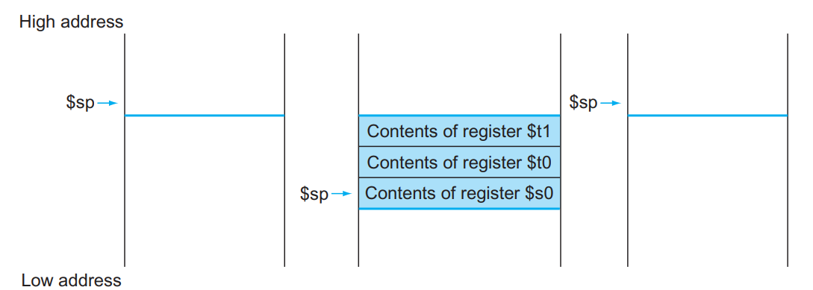
Stack during the procedure call
To avoid saving and restoring a register whose value is never used, which might happen with a temporary register, MIPS soft ware separates 18 of the registers into two groups:
■ $t0–$t9: temporary registers that are not preserved by the callee (called procedure) on a procedure call
■ $s0–$s7: saved registers that must be preserved on a procedure call (if used, the callee saves and restores them)

Slide 74
Nested Procedure
Procedure calling other procedures, or itself again (recursion)
Conflict->main program calls procedure A with an argument of 3, placed in register $a0 and then using jal A.
procedure A calls procedure B via jal B with an argument of 7, also placed in $a0. Since A hasn’t finished its task yet, there is a conflict over the use of register $a0.
Similarly, there is a conflict over the return address in register $ra, since it now has the return address for B.
Solution: Push all the other registers that must be preserved onto the stack.
The caller pushes any argument registers ($a0–$a3) or temporary registers ($t0–$t9) that are needed after the call. The callee pushes the return address register $ra and any saved registers ($s0–$s7) used by the callee. The stack pointer $sp is adjusted to account for the number of registers placed on the stack.

Slide 75
Example:
int fact (int n) { if (n < 1) return (1); else return (n * fact(n – 1)); }
fact: addi $sp, $sp, –8 # adjust stack for 2 items sw $ra, 4($sp) # save the return address sw $a0, 0($sp) # save the argument n slti $t0,$a0,1 # test for n < 1 beq $t0,$zero,L1 # if n >= 1, go to L1 addi $v0,$zero,1 # return 1 addi $sp,$sp,8 # pop 2 items off stack jr $ra # return to caller (we could have loaded $a0 and $ra, but they don’t change.) L1: addi $a0,$a0,–1 # n >= 1: argument gets (n – 1) jal fact # call fact with (n –1) lw $a0, 0($sp) # return from jal: restore argument n lw $ra, 4($sp) # restore the return address addi $sp, $sp, 8 # adjust stack pointer to pop 2 items mul $v0,$a0,$v0 # return n * fact (n – 1) jr $ra

Slide 76
Allocating Space for New Data on the Stack
Stack is also used to store variables that are local to the procedure but do not fit in registers, such as local arrays or structures.
The segment of the stack containing a procedure’s saved registers and local variables is called a procedure frame or activation record
Some MIPS software uses a frame pointer ($fp) to point to the first word of the frame of a procedure.
A stack pointer might change during the procedure, and so references to a local variable in memory might have different off sets depending on where they are in the procedure, making the procedure harder to understand.
Alternatively, a frame pointer offers a stable base register within a procedure for local memory-references.
We’ve been avoiding using $fp by avoiding changes to $sp within a procedure: in our examples, the stack is adjusted only on entry and exit of the procedure.

Slide 77
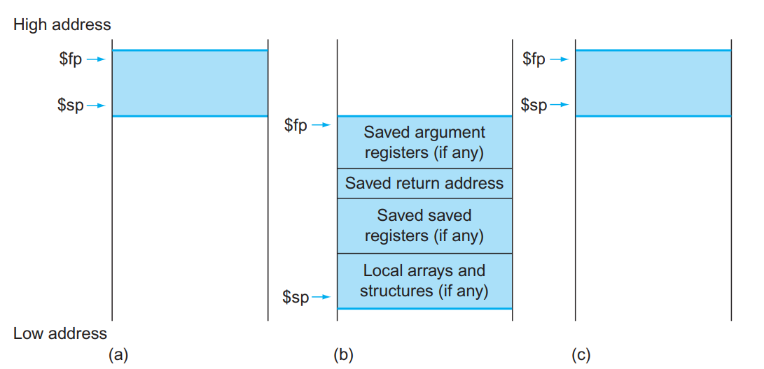
Stack Pointer and Frame Pointer
The frame pointer ($fp) points to the first word of the frame, often a saved argument register, and the stack pointer ($sp) points to the top of the stack.
The stack is adjusted to make room for all the saved registers and any memory-resident local variables
If there are no local variables on the stack within a procedure, the compiler will save time by not setting and restoring the frame pointer.
When a frame pointer is used, it is initialized using the address in $sp on a call, and $sp is restored using $fp.

Slide 78
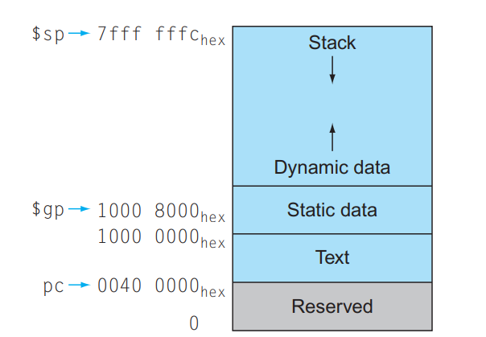
Allocating Space for New Data on the Heap
C programmers need space in memory for static variables and for dynamic data structures.
The stack starts in the high end of memory and grows down. The first part of the low end of memory is reserved, followed by the home of the MIPS machine code, traditionally called the text segment
Above the code is the static data segment, which is the place for constants and other static variables
Data structures like linked lists tend to grow and shrink during their lifetimes. The segment for such data structures is traditionally called the heap, and it is placed next in memory.

Slide 79
Procedure: Summary
The same function can be called from different places in the program
Each call will be translated to a corresponding jal instruction
Each jal instruction will store a different return address in $31
a: f() → jal x ($ra is filled with a+4)
…
b: f() → jal x ($ra is filled with b+4)
…
…
c: f() → jal x ($ra is filled with c+4)
x: f() {
…
…
}

Slide 80
Procedure: Summary
Before the function returns, the return values are stored in $v0 and $v1 (same as $2 and $3)
Usually, $v0 would be used only since only one value can be returned from a function
In 32-bit MIPS, if a function returns a 64-bit value, the return value is split into two 32-bit values and placed in $v0 and $v1. $v0 contains the most significant word for 64-bit value.
A function receives its first four parameters in four registers
The remaining parameters are spilled into memory
Additionally, the function may require some memory space for spilling registers.
The memory region usable by a function for spilling registers or function parameters belongs to a larger memory region known as the stack

Slide 81
Procedure: Summary
Stack PUSH and POP
sw $4, -4($sp) // Spills $4 to stack addi $sp, $sp, -4 // Adjusts $sp sb $5, -1($sp) // Spills only the least significant byte of $5 addi $sp, $sp, -1 // Adjusts $sp
lb $5, 0($sp) // Restores $5 lw $4, 1($sp) // Restores $4
addi $sp, $sp, positive_constant // to restore the stack

Slide 82
Procedure: Passing five parameters to function
Suppose in a function, we want to pass five parameters, there values are 12,1 34,42 and 9
addi $sp, $sp, -8 // Just one instruction to adjust $sp addi $a0, $0, 12 addi $a1, $0, 1 addi $a2, $0, 34 addi $a3, $0, 42 addi $v0, $0, 9 // Fifth parameter value is 9 sw $ra, 4($sp) sw $v0, 0($sp) jal example add $v0, $0, $0 lw $ra, 4($sp) addi $sp, $sp, 8 jr $ra

Slide 83
Procedure: Summary
MIPS register saving convention clearly specifies which registers are saved by the caller and which are saved by the callee
Helps minimize the number of spills and fills
If the caller wants the contents of any of the caller saved registers to be preserved, it must spill them to stack before calling a function
$t0 to $t9, $a0 to $a3, $v0, $v1
The callee does not worry about saving any of these registers; it can directly use them
If the callee wants to use any of the callee saved registers, it must save them to stack before using them and restore them from stack after using them
$s0 to $s7, $sp, $ra
The caller does not worry about saving any of these before calling a function

Slide 84
Procedure:Summary
Functions in C access two types of variables
Automatic: local to function and discarded when the function returns
Static: global variables and anything declared as static; persist across calls and returns
All automatic variables are allocated on stack
Accessed using appropriate offsets relative to $sp
When a function returns, $sp is incremented so that all automatic variables of that function are popped
All static variables are allocated to the static/global memory
Accessed using appropriate offsets relative to $gp (same as $28)
$gp is a callee saved register
Stack portion created for a function’s automatic variables is called a procedure frame or activation record
MIPS ISA defines a register known as frame pointer ($fp or $30) which can be used to record the bottom of the procedure frame

Slide 85
Procedure:Summary
All automatic variables can already be accessed using displacements relative to $sp
$fp offers another alternative where all automatic variables can be accessed using displacements relative to $fp
Advantage is that $fp does not change during the function, but $sp can be adjusted from time to time during the function to push or pop variables
Assembly language functions written using $sp can be hard to understand due to the changing values in $sp
The same variable pushed on the stack at the beginning of a function can be referred to as d($sp) at one point in the function and as d’($sp) at another point in the function
This variable referred to relative to $fp will have the same displacement throughout the function because $fp always points to the bottom of the procedure frame

Slide 86
Procedure/Function call
Structure of procedure stack frame
Before $sp is decremented by frame size, $fp is saved at -4($sp) and then $fp is set to $sp-4
$fp
Saved $fp
Spilled arguments (if any)
Callee saved registers (if any)
$sp
Local arrays and structures
Decreasing address

Slide 87
Procedure:Summary
So far we have assumed that a function call has a constant target known to the compiler
These are known as direct calls
C programming language allows function pointers
A function pointer can point to any legitimate function
The value of a function pointer is the PC of the first instruction of the function it points to
During the execution of a program, a function pointer can be assigned different values
Just like any other pointer variable

Slide 88
Procedure/Function call
Example use of function pointer
int f (int x, int y) {
return x+y;
}
int g (int x, int y) {
return x-y;
}
int main (void) {
int (*fptr)(int, int);
int a, b, c;
scanf(“%d %d”, &a, &b);
if (a > b) fptr = g;
else fptr = f;
c = fptr(a, b);
printf(“%d\n”, c);
return 0;
}
Target unknown at compile time

Slide 89
Procedure/Function call
Calls made using function pointers are known as indirect calls
Compiling indirect calls requires something like jr instruction with the linking facility so that the return address can be saved
MIPS ISA offers the jump and link register (jalr) instruction for compiling indirect calls
Takes a register operand and uses the content of the register as the call target: jalr $20

Slide 90
Procedure/Function call
Translating indirect calls
Consider the following code snippet
if (a > b) fptr = g;
else fptr = f;
c = fptr(a, b);
Suppose f starts at PC x and g starts at PC y (these constants are known at compile time)
Suppose fptr is in $11, a is in $12, and b is in $13
MIPS translation
slt $t0, $13, $12
beq $t0, $0, label
la $11, y # pseudo-instruction (load label address)
j label1
label: la $11, x # pseudo-instruction (load label address)
label1: add $a0, $0, $12
add $a1, $0, $13
addi $sp, $sp, -4
sw $ra, 0($sp)
jalr $11
…

Slide 91
Procedure/Function call
Data allocated dynamically within a function resides in a portion of memory known as the heap
Any pointer to heap data would still be allocated in registers if the pointer is local to the function
Local pointers are treated as automatic variables and can be spilled to stack if the compiler is short of registers
Local pointers cannot be used outside the function because the registers allocated to them may get overwritten by the caller after the function returns

Slide 92
MIPS Instruction Encoding
Instructions are kept in the computer as a series of high and low electronic signals and may be represented as numbers.
Each piece of an instruction can be considered as an individual number, and placing these numbers side by side forms the instruction.
In MIPS assembly language, registers $s0 to $s7 map onto registers 16 to 23, and registers $t0 to $t7 map onto registers 8 to 15. Hence, $s0 means register 16, $s1 means register 17, $s2 means register 18, . . . , $t0 means register 8, $t1 means register 9.
Let us consider the instruction: add $t0,$s1, $s2

Slide 93
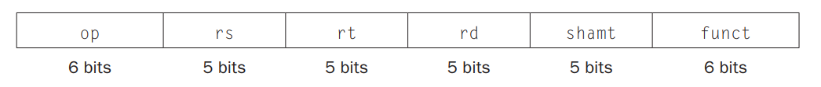
MIPS Instruction Encoding
Instruction Format: A form of representation of an instruction composed of fields of binary numbers.
Machine language: Binary representation used for communication within a computer system
MIPS Instruction Format:
op: Basic operation of the instruction, traditionally called the opcode.
rs: The first register source operand.
rt: The second register source operand.
rd: The register destination operand. It gets the result of the operation.
shamt: Shift amount.
funct: Function. This field, often called the function code, selects the specific variant of the operation in the op field

Slide 94
Instruction Fields
Not all fields are used by all instructions
Non-shift instructions and variable shift instructions do not use sh amt
sll, srl, and sra do not use rs
jr does not use rt, rd
jalr does not use rt (rd is always set to 31)
mfhi and mflo do not use rs, rt
mthi and mtlo do not use rt, rd
mult, multu, div, divu do not use rd
Unused fields are encoded as zero
Length of these instructions could be shortened, but MIPS designers wanted all instructions to have a fixed four-byte size
Simple design, even though wastes memory

Slide 95
MIPS Instruction: Single Format vs Constant Instruction Width
The load word instruction must specify two registers and a constant.
If the address were to use one of the 5-bit fields in the format, the constant within the load word instruction would be limited to only 32.
This constant is used to select elements from arrays or data structures, and it often needs to be much larger than 32. Th is 5-bit field is too small to be useful.
Solution: Constant instruction width with multiple instruction format
R-Type Instruction:
Example: add,sub

Slide 96
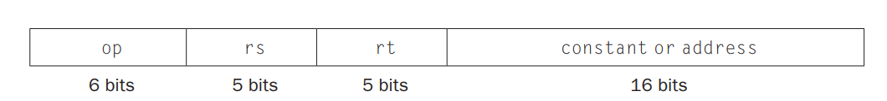
Immediate Instruction
A second type of instruction format is called I-type (for immediate) or I-format and is used by the immediate and data transfer instructions.
The 16-bit address means a load word instruction can load any word within a region of ±2¹⁵ or 32,768 bytes (2¹³ or 8192 words) of the address in the base register rs. Similarly, add immediate is limited to constants no larger than ± 2¹⁵.
Consider lw $t0,32($s3)
19 (for $s3) is placed in the rs field, 8 (for $t0) is placed in the rt field, and 32 is placed in the address field.
Note that the meaning of the rt field has changed for this instruction: in a load word instruction, the rt fi eld specifies the destination register, which receives the result of the load.

Slide 97
Immediate Instruction
Observation: these instructions require at most two register operands
Both register operands could be source operands: beq, bne, all store instructions
One register operand could be source and the other could be destination: addi, addiu, andi, ori, slti, sltiu, xori, all load instructions, lui
Some I-format instructions use only one register operand as a source: blez, bgtz, bltz, bgez
The immediate operand is treated differently for different types of I-format instructions
Arithmetic instructions: signed immediate operand (addi, addiu, slti) or unsigned immediate operand (sltiu)
Logical instructions: unsigned immediate operand (andi, ori, xori, lui)
Branch instructions: PC-relative signed jump offset (beq, bne, blez, bltz, bgtz, bgez)
Load and store instructions: signed displacement from the base register
The immediate operand is sign-extended to 32 bits for addi, addiu, slti, sltiu (treats the sign-extended value as unsigned), all branches, all loads and stores
The immediate operand is zero-extended to 32 bits for all logical instructions

Slide 98
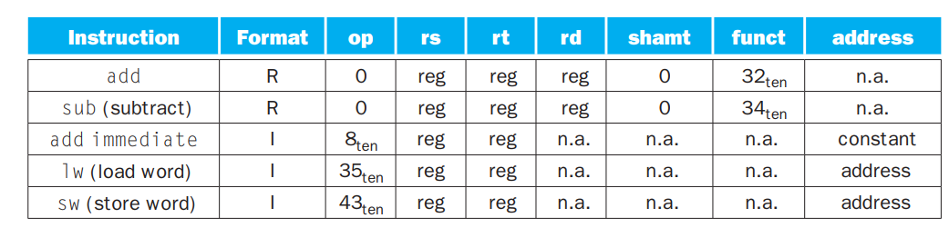
Immediate vs Register
Although multiple formats complicate the hardware, we can reduce the complexity by keeping the formats similar. For example, the first three fields of the R-type and I-type formats are the same size and have the same names;
The length of the fourth field in I-type is equal to the sum of the lengths of the last three fields of R-type.
The formats are distinguished by the values in the first field: each format is assigned a distinct set of values in the first field (op) so that the hardware knows whether to treat the last half of the instruction as three fields (R-type) or as a single field (I-type).

Slide 99
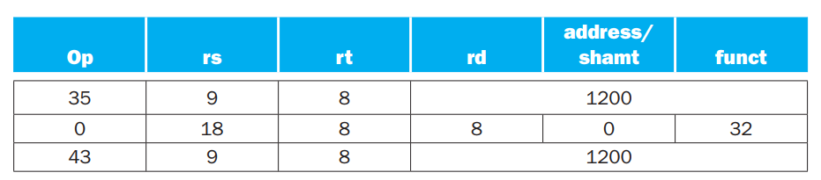
Example:
A[300] = h + A[300]; is compiled into
lw $t0,1200($t1) # Temporary reg $t0 gets A[300] add $t0,$s2,$t0 # Temporary reg $t0 gets h + A[300] sw $t0,1200($t1) # Stores h + A[300] back into A[300]
The lw instruction is identified by 35 in the first field (op). The base register 9 ($t1) is specified in the second field (rs), and the destination register 8 ($t0) is specified in the third field (rt). The offset to select A[300] (1200=300x4) is found in the final field (address).
The add instruction that follows is specified with 0 in the first field (op) and 32 in the last field (funct). The three register operands (18, 8, and 8) are found in the second, third, and fourth fields and correspond to $s2, $t0, and $t0.
The sw instruction is identified with 43 in the first field.

Slide 100
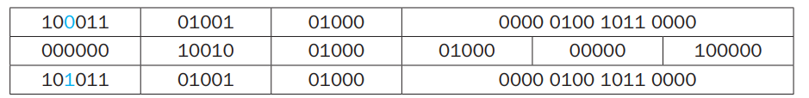
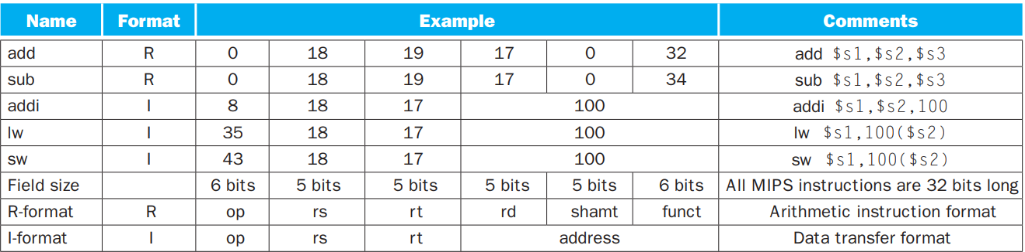
The actual machine code
Summarizing R-type and I-type Instruction

Slide 101
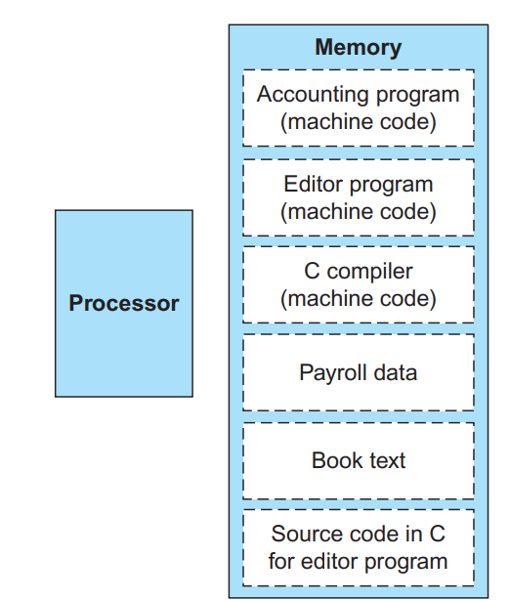
Stored Program Concept
Instructions are represented as numbers.
Programs are stored in memory to be read or written, just like data.
Specifically, memory can contain the source code for an editor program, the corresponding compiled machine code, the text that the compiled program is using, and even the compiler that generated the machine code.
Computers can inherit ready-made software provided they are compatible with an existing instruction set. Such “binary compatibility” often leads industry to align around a small number of instruction set architectures.
Treating instructions in the same way as data greatly simplifies both the memory hardware and the software of computer systems.
The switch happens simply by loading memory with programs and data and then telling the computer to begin executing at a given location in memory

Slide 102
Arithmetic and Logic Instructions
6 bits preserved for opcode: 64 different instructions
6 bits for func: 64 different subtypes for each instruction
ArrA subset of instructions that have opcode zero (the function value is shown in parentheses)
sll (0x0), srl (0x2), sra (0x3), sllv (0x4), srlv (0x6), srav (0x7), jr (0x8), jalr (0x9), mfhi (0x10), mthi (0x11), mflo (0x12), mtlo (0x13), mult (0x18), multu (0x19), div (0x1a), divu(0x1b), add (0x20), addu (0x21), sub (0x22), subu (0x23), and (0x24), xor (0x26), nor (0x27), or (0x25), slt (0x2a), sltu (0x2b)
These are ALU instructions that do not have any immediate operands (R-type)
Difference between add and addu instructions: addu instruction does not catch any overflow, but add does

Slide 103
Arithmetic and Logical Instruction
Multiplications are done through mult and multu instructions
Difference between mult and multu is that multu treats operands as unsigned; none detects overflow
These instructions do not have any explicit destination register and accepts only two source register operands
Two special registers called Hi and Lo store the most significant and the least significant words of the 64-bit result in 32-bit MIPS
mult $10, $20 // Multiplies $10 by $20 and sends result to Hi and Lo registers
The Hi and Lo registers cannot be used as operands of any ALU instructions
To further process the results of multiplication (division), the Hi and Lo register contents must be moved to general purpose registers
MIPS ISA offers two instructions to achieve this:
mfhi moves the contents of Hi to a specified register: mfhi $t0
mflo moves the contents of Lo to a specified register: mflo $t6
There are matching instructions to move to Hi and Lo also: mthi $X and mtlo $Y (rarely used)

Slide 104
Arithmetic and Logical Instruction
Integer divisions are done through div and divu instructions
Difference between div and divu is that divu treats the operands as unsigned; no overflow in division
These instructions do not have any explicit destination register and accepts only two source register operands
Two special registers called Hi and Lo store remainder and quotient respectively
div $10, $20 // Divides $10 by $20 and stores remainder in Hi quotient in Lo
C language disables overflow detection: MIPS C compiler always generates addu, subu-> results are same as add, sub except that nothing additional happens on overflow
For multiplication involving signed operand types, mult is generated; otherwise multu is generated (same for division)
MIPS doesn’t have any hardware support for detecting multiplication overflow

Slide 105
Some Example: Loading a constant bigger than 16 bits
Suppose we would like to load the value 0x123456 into $10
Make use of the lui instruction (load upper immediate)
lui $10, 0x12 ori $10, $10, 0x3456
Another use of lui: synthesizing addresses
Suppose the compiler wants to generate instructions to load the word starting at address 0x789abc into register $10
lui $1, 0x78 // $1 is also referred to as $at ori $1, $1, 0x9abc // $at is a register used by assembler lw $10, 0($1)
Note that the last two instructions cannot be replaced by lw $10, 0x9abc($1)
If the address was 0x345678, the following would work lui $1, 0x34 lw $10, 0x5678($1)

Slide 106
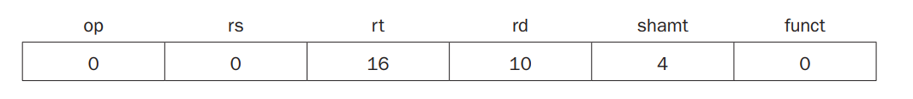
Logical Instruction
sll $t2,$s0,4 # reg $t2 = reg $s0 << 4 bits
The encoding of sll is 0 in both the op and funct fields, rd contains 10 (register $t2), rt contains 16 (register $s0), and shamt contains 4. The rs field is unused and thus is set to 0.

Slide 107
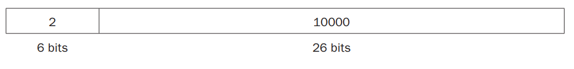
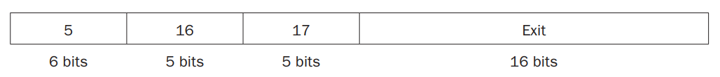
Jump Instruction: J-Type
The MIPS jump instructions have the simplest addressing.
It uses J-Type instruction format, which consists of 6 bits for the operation field and the rest of the bits for the address field.
Thus, j 10000 # go to location 10000
Unlike the jump instruction, the conditional branch instruction must specify two operands in addition to the branch address (I-type)
bne $s0,$s1,Exit # go to Exit if $s0 ≠ $s1

Slide 108
Addressing in Branching Instruction
If addresses of the program had to fit in this 16-bit field, it would mean that no program could be bigger than 2¹⁶ (not realistic)
An alternative would be to specify a register that would always be added to the branch address, so that a branch instruction would calculate the following:
Program counter=Register + Branch address
This sum allows the program to be as large as 2³² and still be able to use conditional branches, solving the branch address size problem.
Since the program counter (PC) contains the address of the current instruction, we can branch within ±2¹⁵ words of the current instruction if we use the PC as the register to be added to the address. Almost all loops and if statements are much smaller than 2¹⁶ words, so the PC is the ideal choice.
PC-relative addressing: An addressing regime in which the address is the sum of the program counter (PC) and a constant in the instruction.

Slide 109
Addressing in Branching Instruction
jump-and-link instructions invoke procedures that have no reason to be near the call, so they normally use other forms of addressing.
Hence, the MIPS architecture offers long addresses for procedure calls by using the J-type format for both jump and jump-and-link instructions
Since all MIPS instructions are 4 bytes long, MIPS’s PC-relative addressing refer to the number of words to the next instruction instead of the number of bytes.
Thus, the 16-bit field can branch four times as far by interpreting the field as a relative word address rather than as a relative byte address.
Similarly, the 26-bit field in jump instructions is also a word address, meaning that it represents a 28-bit byte address.

Slide 110
Example
Loop:sll $t1,$s3,2 # Temp reg $t1 = 4 * i add $t1,$t1,$s6 # $t1 = address of save[i] lw $t0,0($t1) # Temp reg $t0 = save[i] bne $t0,$s5, Exit # go to Exit if save[i] ≠ k addi $s3,$s3,1 # i = i + 1 j Loop # go to Loop Exit: we assume that we place the loop starting at location 80000 in memory, what is the MIPS machine code for this loop?

Slide 111
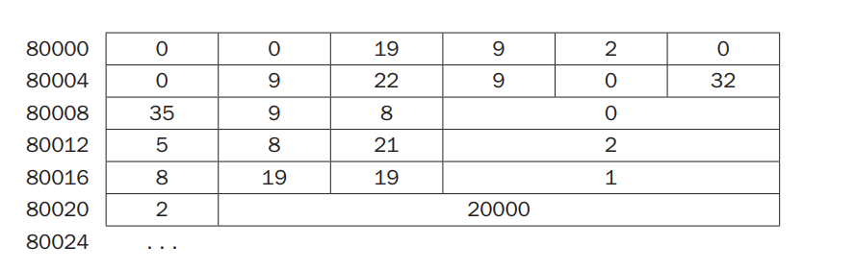
Answer
The bne instruction on the fourth line adds 2 words or 8 bytes to the address of the following instruction (80016), specifying the branch destination relative to that following instruction (8+80016) instead of relative to the branch instruction (12 +80012) or using the full destination address (80024).
The jump instruction on the last line does use the full address (20000x4= 80000), corresponding to the label Loop.

Slide 112
Example
Given a branch on register $s0 being equal to register $s1,
beq $s0, $s1, L1
replace it by a pair of instructions that off ers a much greater branching distance.
Solution:
bne $s0, $s1, L2 j L1 L2:

Slide 113
MIPS Addressing Modes
Multiple forms of addressing are generically called addressing modes. The MIPS addressing modes are the following:
Immediate addressing: where the operand is a constant within the instruction itself
Register addressing: where the operand is a register
Base or displacement addressing: where the operand is at the memory location whose address is the sum of a register and a constant in the instruction
PC-relative addressing, where the branch address is the sum of the PC and a constant in the instruction
Pseudodirect addressing, where the jump address is the 26 bits of the instruction concatenated with the upper bits of the PC

Slide 114
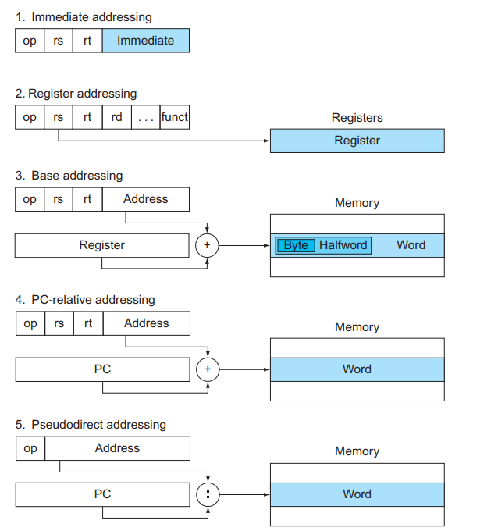
MIPS Addressing Modes

Slide 115
Acknowledgement
Dr. Mainak Chauduri
Dr. Urbi Chatterjee

