Slide 1

WANDERLUST APP
A PERSONALIZED TRAVEL PLANNING AND TRACKING APP
TEAM MEMBERS :-
Ganga v
Janakiraman.s
Iswarya A
Eniyaraj.K

Slide 2
DESCRIPTION
Wanderlust is a comprehensive travel planning and tracking app tailored to meet the unique needs of every traveler. It offers a user-friendly interface that allows you to plan, customize, and record your trips with ease. The app features itinerary management, expense tracking, location suggestions, and real-time updates to help make your journey seamless and memorable. Whether you're an adventurer or a casual traveler, Wanderlust ensures you stay organized, informed, and inspired throughout your trip.
Plan Your Trip: Create detailed itineraries with personalized recommendations for destinations, activities, and accommodations.
Track Your Journey: Keep a real-time log of your travel experiences, from expenses to memorable moments.
Stay Organized: Access all your travel information in one place for a seamless, stress-free journey.
Get Inspired: Discover new places and experiences tailored to your unique travel preferences.

Slide 3
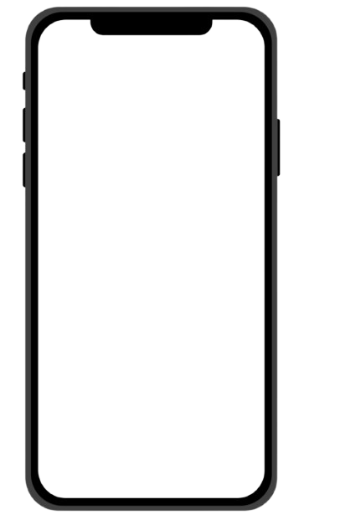
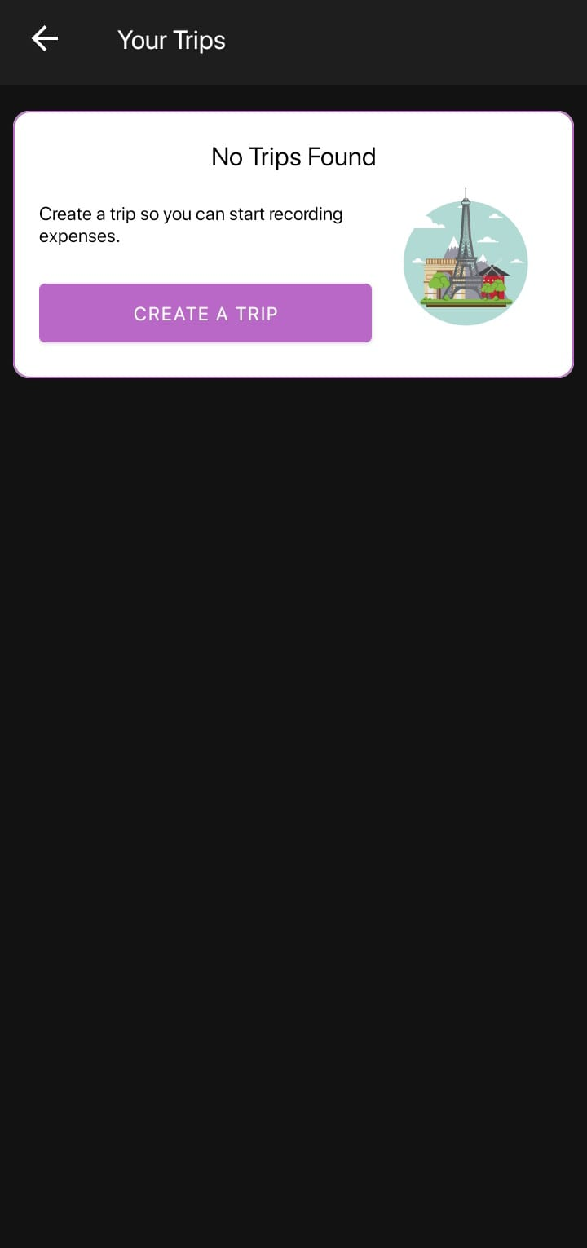
Easy Trip Planning
Create detailed travel itineraries effortlessly.
Get personalized recommendations for destinations,
activities, and accommodations.
Add stops, manage schedules, and set reminders for
important travel events.

Slide 4
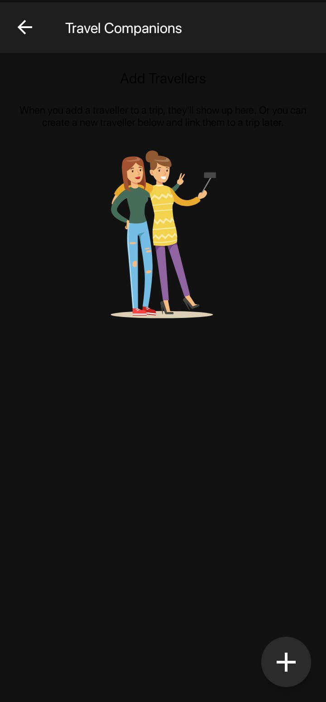
TRAVEL COMPANIONS
TRAVEL COMPANIONS Create meaningful memories
by exploring destinations together.
Enjoy the comfort of having someone familiar
on your journey.
Build deeper relationships through shared
adventures and challenges.

Slide 5
HOME.ACTIVITY.JAVA
package com.robdich.wanderlust.activities;
import android.os.Bundle;
import android.support.v4.app.Fragment;
import android.support.v4.app.FragmentManager;
import android.support.v4.app.FragmentPagerAdapter;
import android.support.v4.view.ViewPager;
import android.view.Menu;
import android.view.MenuItem;
import android.view.View;
import com.robdich.wanderlust.R;
import com.robdich.wanderlust.fragments.FeedFragment;
import com.robdich.wanderlust.fragments.NotificationsFragment;
import com.robdich.wanderlust.view.SlidingTabLayout;
public class HomeActivity extends BaseNavDrawerActivity{
private SlidingTabLayout mSlidingTabLayout;
private ViewPager mViewPager;
private FeedFragment mFeedFragment;
private NotificationsFragment mNotificationsFragment;
private static final int FRAGMENTS_COUNT = 2;
private static final String PAGE_FEED = "FEED";
private static final String PAGE_NOTIFICATIONS = "NOTIFICATIONS";
private static final String TAG_FEED = "fragment_feed";
private static final String TAG_NOTIFICATIONS = "fragment_notifications";

Slide 6
@Override
protected void onCreate(Bundle savedInstanceState) {
super.onCreate(savedInstanceState);
setContentView(R.layout.activity_home);
mViewPager = (ViewPager) findViewById(R.id.view_pager);
ViewPagerAdapter pagerAdapter = new ViewPagerAdapter(getSupportFragmentManager());
mViewPager.setAdapter(pagerAdapter);
mSlidingTabLayout = (SlidingTabLayout) findViewById(R.id.sliding_tabs);
mSlidingTabLayout.setCustomTabView(R.layout.tab_indicator, android.R.id.text1);
mSlidingTabLayout.setSelectedIndicatorColors(getResources().getColor(R.color.tab_selected_strip));
mSlidingTabLayout.setDistributeEvenly(true);
mSlidingTabLayout.setViewPager(mViewPager);
mSlidingTabLayout.setOnPageChangeListener(new ViewPager.OnPageChangeListener() {
@Override
public void onPageScrolled(int position, float positionOffset, int positionOffsetPixels) {
showOrHideActionBar(true);
}
@Override
public void onPageSelected(int position) {
}
@Override
public void onPageScrollStateChanged(int state) {
}
});
}

Slide 7
@Override
protected CharSequence getActivityTitle() {
return getResources().getString(R.string.activity_home);
}
@Override
protected View getHideableView() {
return (findViewById(R.id.header_bar));
}
@Override
protected int getDrawerItemValue() {
return DRAWER_ITEM_ACTIVITY;
}
@Override
public boolean onCreateOptionsMenu(Menu menu) {
// Inflate the menu; this adds items to the action bar if it is present.
getMenuInflater().inflate(R.menu.home, menu);
return true;
}
@Override
public boolean onOptionsItemSelected(MenuItem item) {
int id = item.getItemId();
if (id == R.id.action_settings) {
return true;
}
return super.onOptionsItemSelected(item);
}

Slide 8
@Override
protected void onSaveInstanceState(Bundle outState) {
super.onSaveInstanceState(outState);
// orientation changes.
if (mFeedFragment != null) {
getSupportFragmentManager().putFragment(outState, TAG_FEED,
mFeedFragment);
}
if (mNotificationsFragment != null) {
getSupportFragmentManager().putFragment(outState, TAG_NOTIFICATIONS,
mNotificationsFragment);
}
}
@Override
protected void onRestoreInstanceState(Bundle savedInstanceState) {
super.onRestoreInstanceState(savedInstanceState);
if (mFeedFragment == null) {
mFeedFragment = (FeedFragment) getSupportFragmentManager()
.getFragment(savedInstanceState, TAG_FEED);
}
if (mNotificationsFragment == null) {
mNotificationsFragment = (NotificationsFragment) getSupportFragmentManager()
.getFragment(savedInstanceState, TAG_NOTIFICATIONS);
}
}

Slide 9
private class ViewPagerAdapter extends FragmentPagerAdapter {
public ViewPagerAdapter(FragmentManager fm) {
super(fm);
}
@Override
public Fragment getItem(int position) {
switch (position) {
case 0:
return (mFeedFragment = new FeedFragment());
case 1:
return (mNotificationsFragment = new NotificationsFragment());
}
return null;
}
@Override
public int getCount() {
return FRAGMENTS_COUNT;
}
@Override
public CharSequence getPageTitle(int position) {
switch (position){
case 0: return PAGE_FEED;
case 1: return PAGE_NOTIFICATIONS;
}
return null;
}
}
}

Slide 10
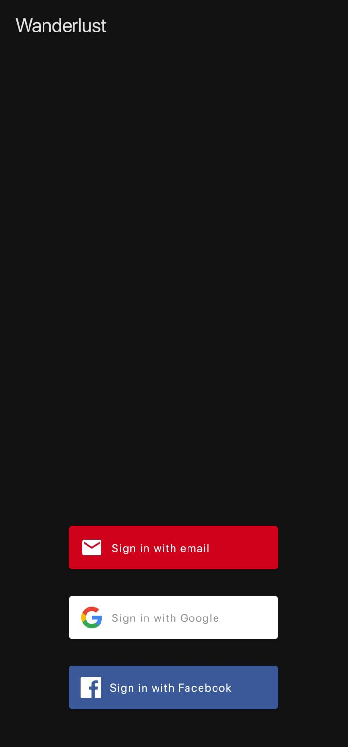
SCREENSHOTS

Slide 11
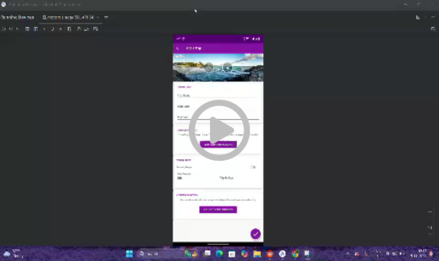
VIDEO

Slide 12

Thank you

