Slide 1
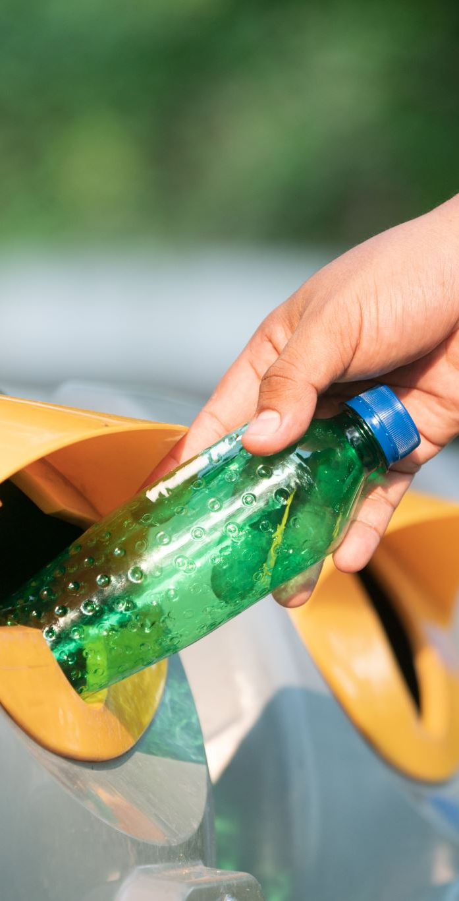
Smart Waste Reward System
(Trash-to-Cash Bin + Mobile App)
Innovative solution for cleaner cities and incentivized recycling

Slide 2
🧩 Project Concept
• Measures weight of waste deposited by users.
• Identifies waste type and credits money or points via mobile app.
• Encourages recycling and cleanliness in public areas.
• Rewards responsible waste disposal with real incentives.

Slide 3
📱 App Function & User Flow
1. User Registration
- Register with name, phone, UPI/bank details.
- Receive QR code or RFID card.
2. At the Smart Bin
- Scan QR code to open bin.
- Waste type & weight detected via sensors.
3. Data Processing
- Data sent to cloud via IoT.
- Rewards calculated automatically.
4. Money Transfer / Rewards
- Rewards credited to app wallet.
- Redeem via UPI, vouchers, or discounts.

Slide 4
💰 Money Calculation Idea
Reward rates based on waste type:
• Plastic – ₹5 / kg
• Paper – ₹7 / kg
• Metal – ₹20 / kg
• Glass – ₹3 / kg
• E-waste – ₹30 / kg
💡 Points system alternative: 1 point = ₹1 for easier management.

Slide 5
⚙️ Hardware Components
• Weight Sensor (Load Cell)
• Microcontroller (Arduino / NodeMCU / Raspberry Pi)
• AI Camera or Waste-type Sensor
• QR Code / RFID Scanner
• IoT Module (Wi-Fi)
• LCD Display
• Solar Panel (optional)
• Segregated Waste Bins

Slide 6
🧠 Software Components
• Mobile App (Flutter / React Native)
• Backend Server (Firebase / Node.js)
• Cloud Database
• Admin Dashboard for authorities
• Payment API Integration (UPI, Paytm, etc.)

Slide 7
🔋 Improvements & Future Expansion
• Collaborate with municipalities & recycling centers.
• Introduce app leaderboards for top recyclers.
• Use AI to analyze waste generation patterns.
• Integrate with carbon credit systems.
• Expand to smart city projects.

Slide 8
🌟 Expected Impact
• Cleaner and greener public areas 🌆
• Reduced littering 🧹
• Encourages recycling ♻️
• Engages citizens in waste management 💚
• Provides valuable data for city planning 📊

