Slide 1

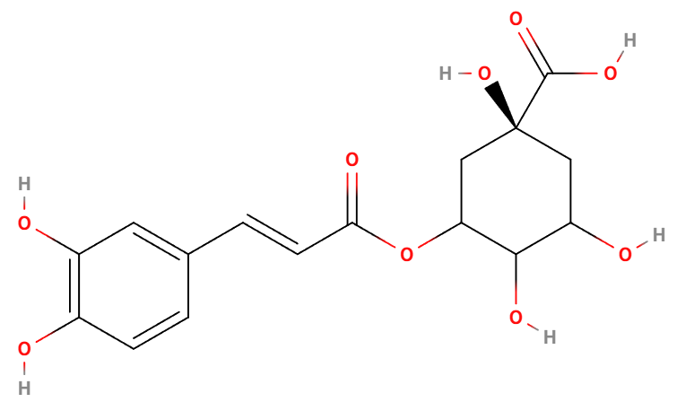
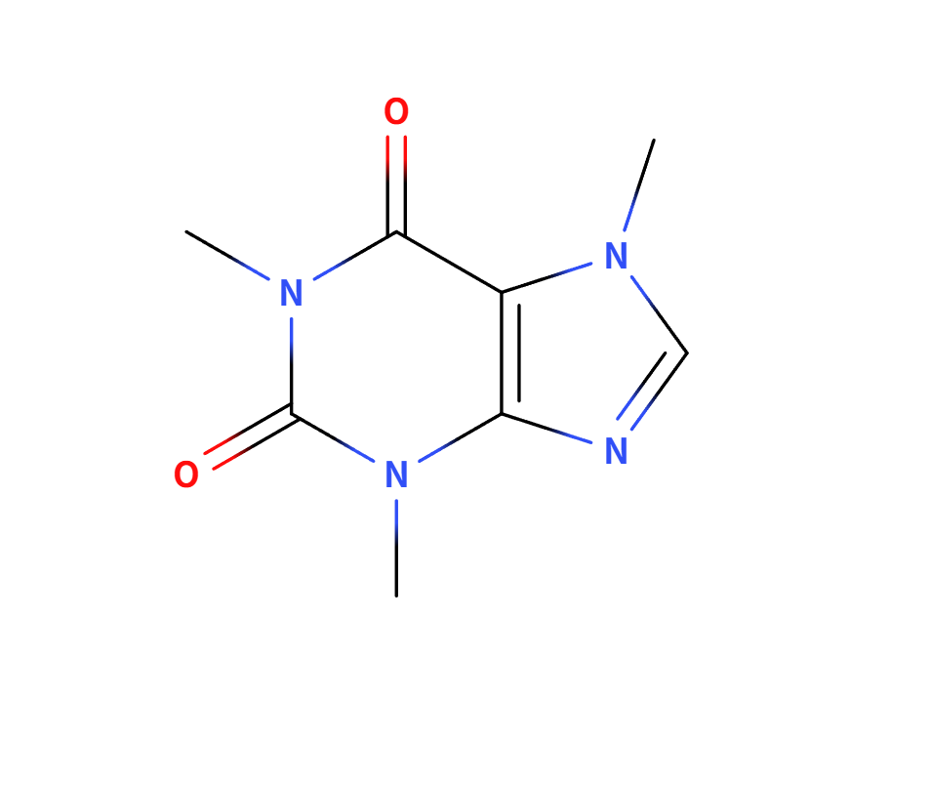
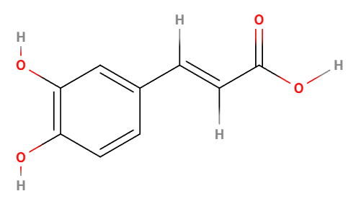
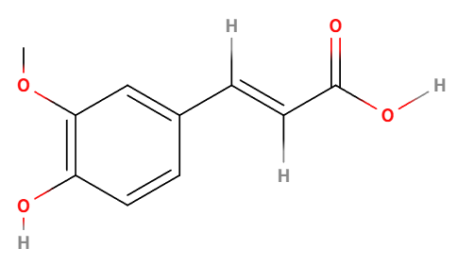
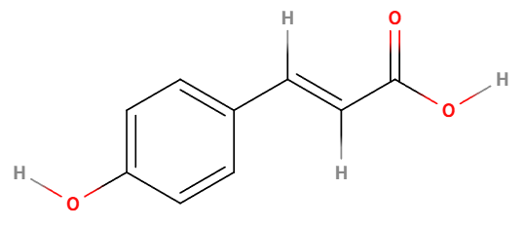


Type 2 Diabetes
Cardiovascular Disease
Colorectal cancer
Hepatocellular Carcinoma
Coffee
Chlorogenic Acid
Caffeine
Caffeic acid
Ferulic acid
p-Coumaric Acid
Other Polyphenols
AMPK
NF-κB
$$A_{2A}Rs$$
UCP1
SCFAs
Energy Metabolism
Anti-inflammatory and antioxidant
Intestinal Flora Intervention
Regulation of lipid metabolism
Appetite suppression

