Slide 1

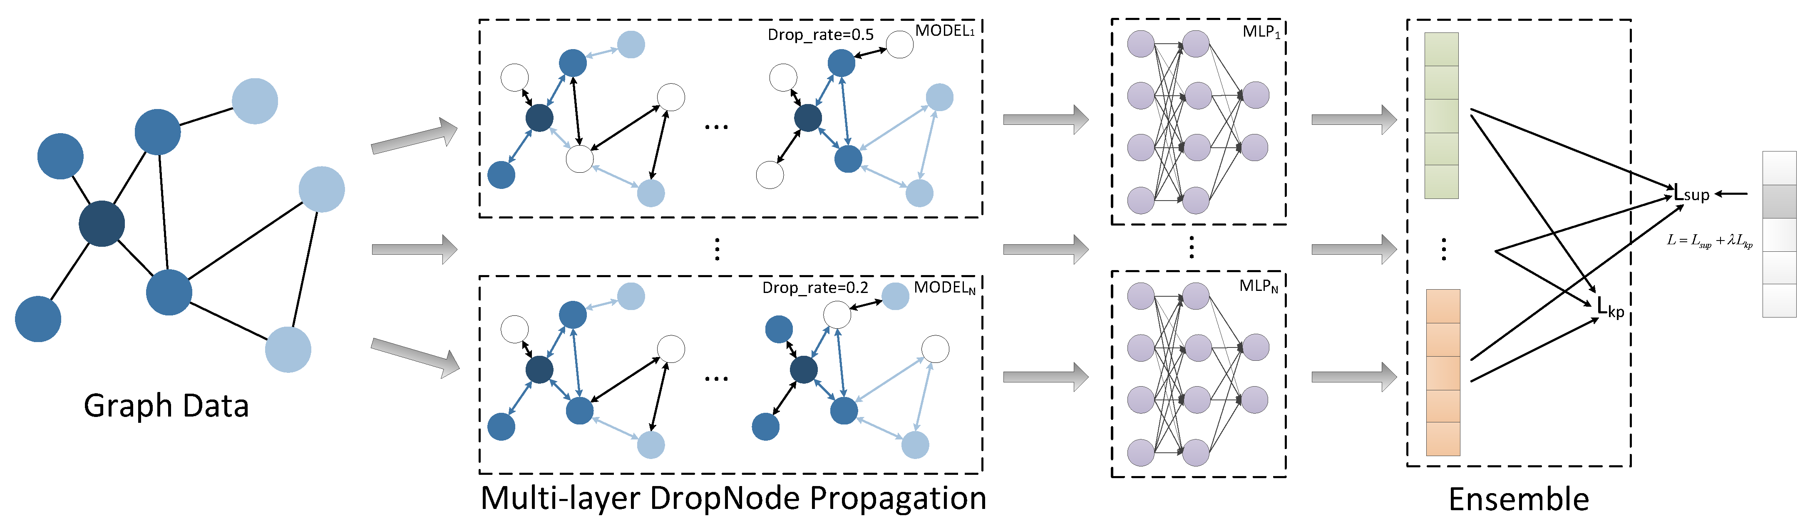

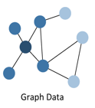

Evaluation Agent
  Quality Assessment
Feedback Generation
Quality Feedback
(
Generate embeddings of nodes:x_0
Pass
h=(w x_0 +w _x1 +w_x_2)......
Fail
x_0
Manager Agent
Task
Assignment
&
Coordination
Feedback Integration
Task Assignment
Graph Perception Agent
  Quality Assessment
Feedback Generation
Graph Enhancement Agent
Input Data
Text Generation
Structure Enhancement
prompt
Genetate New Nodes
LLM

Slide 2






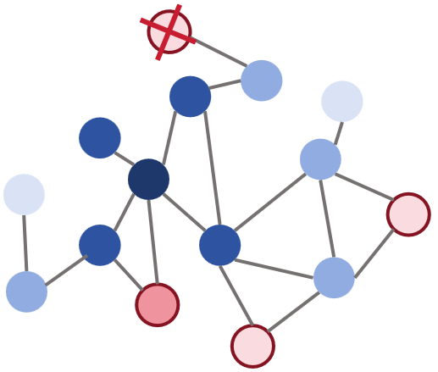




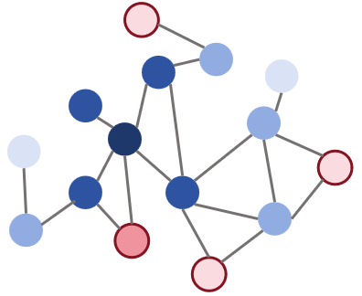
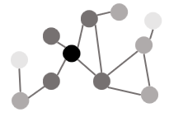
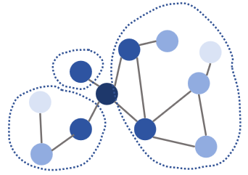






Manager Agent
Evaluation Agent
Previous
Environmental report
Agent initialization
Dataset
synthesis data update
Current Environmental report
Enhanced data preservation
Quality
evaluation
Knowledge
Corpus
Iterative
loop
Convergence?
Determine task progress
synthetic data
Perception Agent
Graph construction
Enhancement Agent
Environment detection
Label detection
Dataset
Knowledge
Corpus
Ingest sampled data
Node sampling strategy
Semantic Enhancement
Louvain community clustering
Topology Enhancement
few-shot label
Update synthetic data
PPR starting area selection
PPR score
Prompt
New Nodes
Environmental
report
Synthesis Task
LLM
Top 10%

