Slide 1





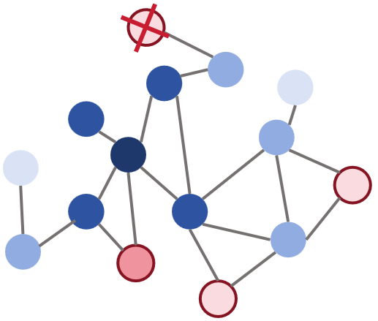

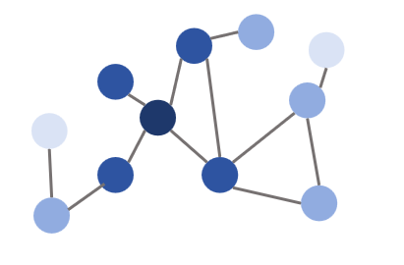





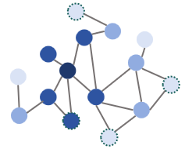
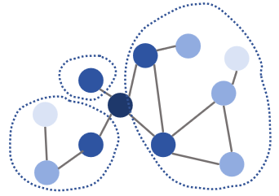
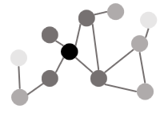








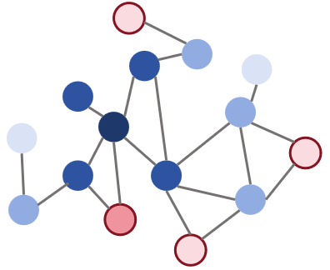


Current Environmental report
Previous
Environmental report
Manager Agent
Dataset
Evaluation Agent
Agent initialization
Augmented data update
Enhanced data preservation
Quality
evaluation
Sampled
data
Iterative
loop
Convergence?
Augmented
data
Determine task progress
Environment detection
Label detection
Graph construction
Dataset
Enhancement Agent
Output
augmented
data
Node sampling strategy
Sampled nodes
Ingest
sampled
data
Semantic Enhancement
Louvain community clustering
Topology Enhancement
sampled base knowledge
few-shot label
Environmental
report
Synthesis Task
PPR starting area selection
PPR score
Prmpt
New Nodes
sampled base knowledge
Top K%
LLM
Perception Agent

