Slide 1
The invisibles
Truck Platooning
Brian-Kelein-Ngwoh Visas
Enkeledi Mema
Aluko Tunde Oluwayemi
Hermann Anguiga

Slide 2
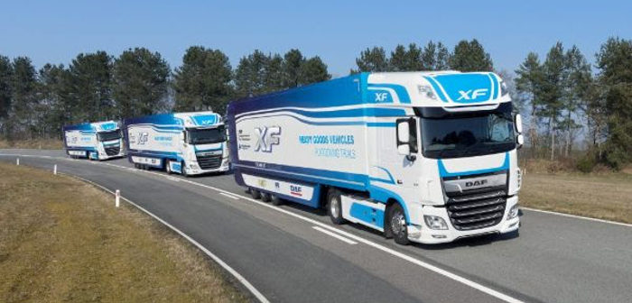
Motivation
https://www.traffictechnologytoday.com/news/connected-vehicles-infrastructure/fusion-processing-deploys-cavstar-system-in-uks-real-world-truck-platooning-trial.html

Slide 3
Description of the overall system
Communications
Processes

Slide 4
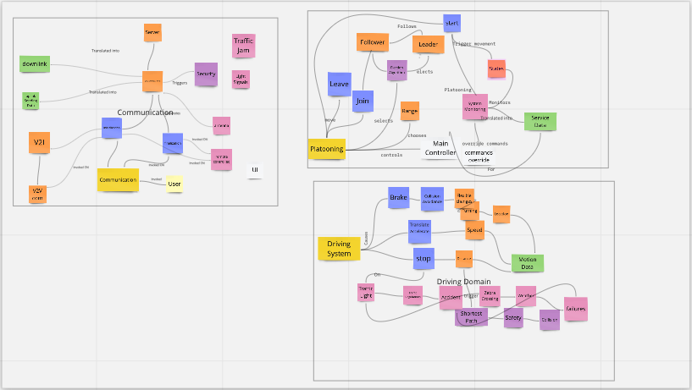
Architecture
Architecture Patterns
Miro

Slide 5
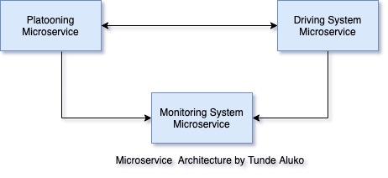
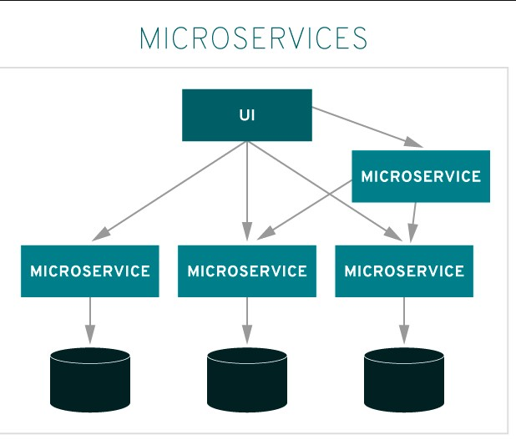
Microservices

Slide 6
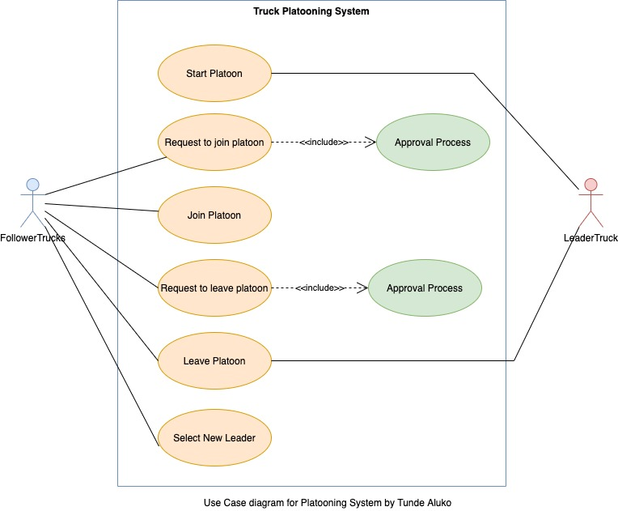
Approach to solution

Slide 7
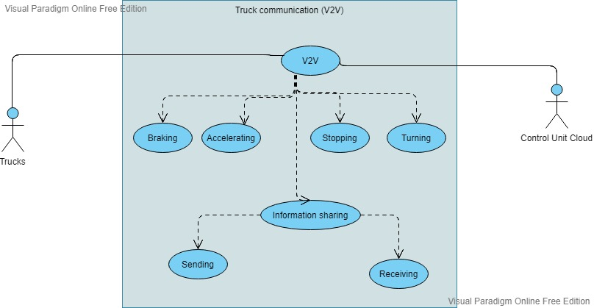
Communication use-case

Slide 8
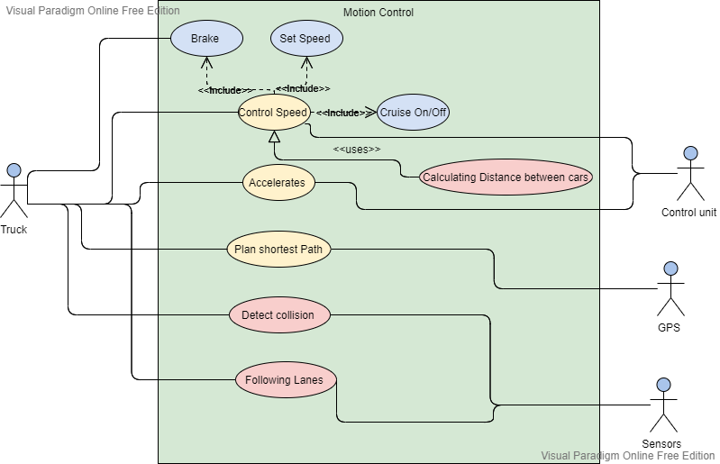
Motion use-case

Slide 9
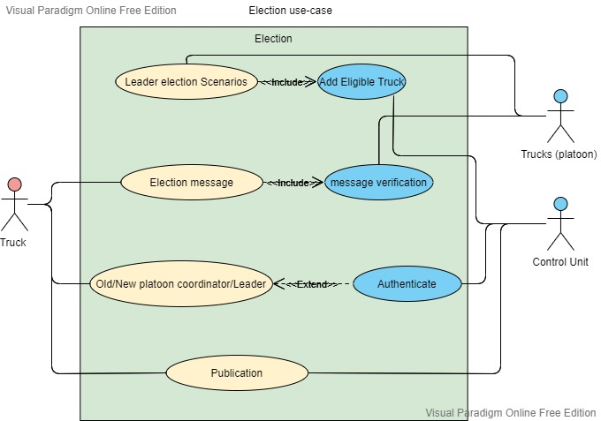
Bully algorithm use-case

Slide 10
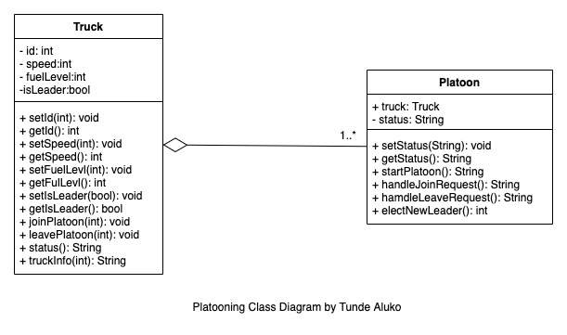
Platooning Class Diagram

Slide 11
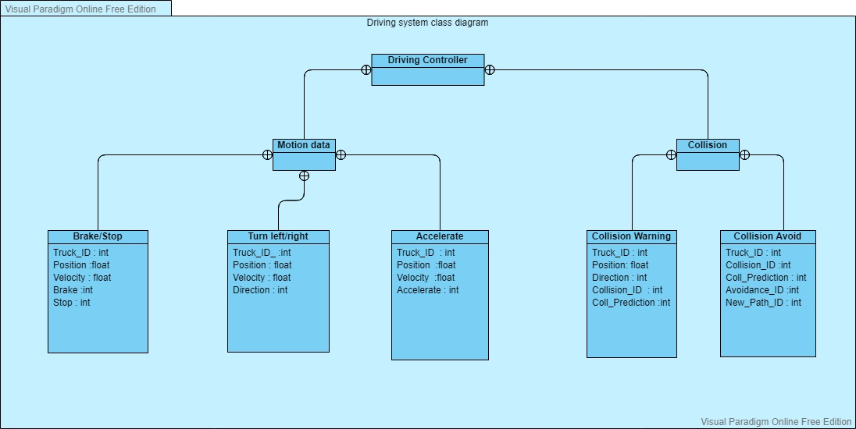
Truck Driving System Class Diagram

Slide 12
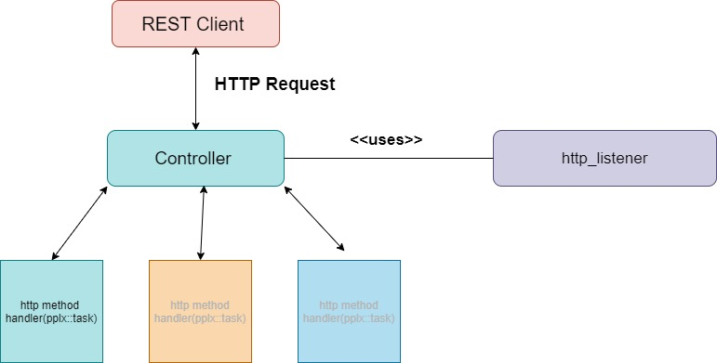
Solution suggestions
First suggestion: REST (JSON)

Slide 13
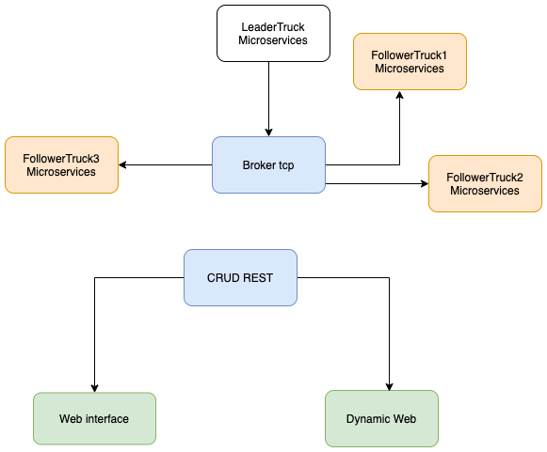
Second suggestion: MQTT

Slide 14
Third suggestion: Bully algorithm

Slide 15
Implementation and simulation

Slide 16
Summary
Implemented
REST (C++)
MQTT (C++)
Bully Algorithm (C++)
Dynamic web interface (Json, JS, CSS, HTML)
Further improvement
Making the system more stable
Creating more microservices
Connecting MQTT to the web interface
Connecting the Bully algorithm to the web interface

Slide 17
Questions?

Slide 18
Thank you

