Slide 1

Motivation
https://www.ttnews.com/articles/developers-seek-advance-truck-platooning-through-higher-automation-global-demonstrations

Slide 2
Description of the problem

Slide 3
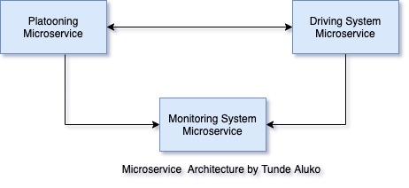
Architecture / Microservices
Architecture Patterns
Programming Languages
Frameworks
DevOps tools

Slide 4
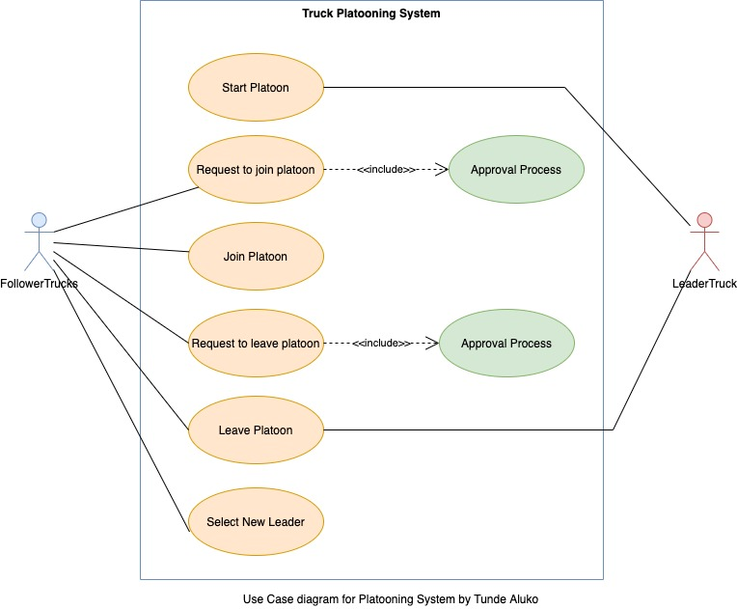
Approach to solution

Slide 5
Solution suggestions
Election algorithms
2nd suggestion

Slide 6
Implementation

Slide 7
Conclusion

