Slide 1
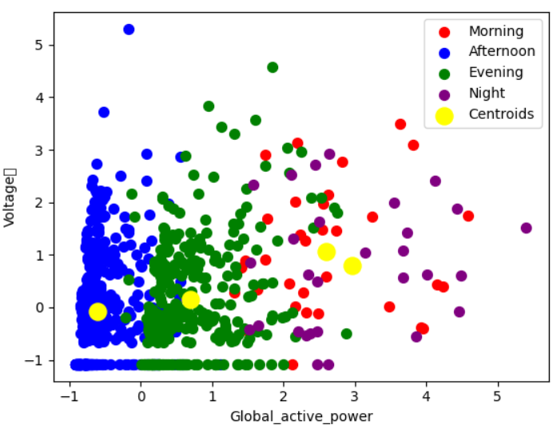
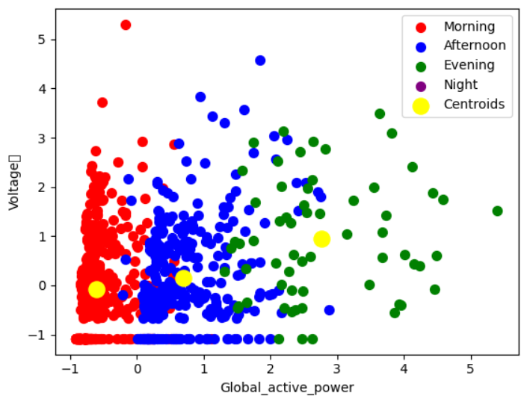
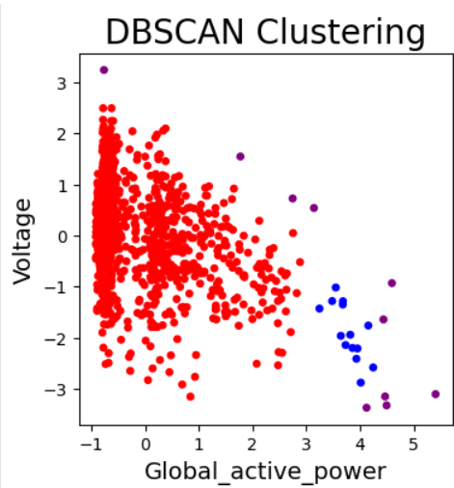
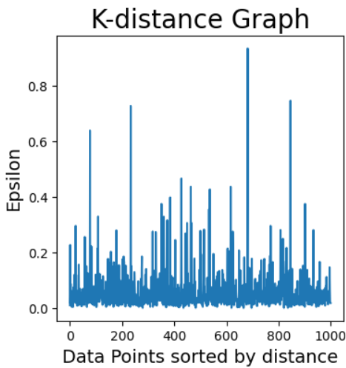
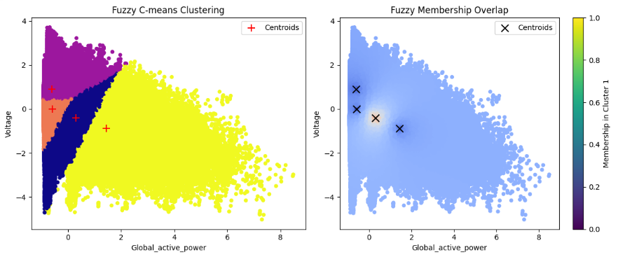
INTRODUCTION
CLUSTERING MODELS RESULTS
TEST AND SARIMA MODEL RESULTS
Data has been collected from UC Irvine and originally has 2.07 million rows and 9 columns.
Measuremets of electric power consumption in just one household with a one minute sampling rate over a period in Dec.2006 to Nov.2010. It shows different electrical quantities and some sub-metering values which kitchen stuffs, laundry room and water heater and air conditioner. This data represents household electricity consumption by one household usage so it will be include housing data category. But the data uploaded has 1.04 million rows, 9 columns for two years due to computer did not have enough raw. In the future, results will be based on the uploaded data.
Household electricity consumption patterns have been identified by clusters, and electricity consumption is projected to increase until 2028 by time series model.
K-means
Data has been clustered into 4 groups. Household electricity consumption in the morning and at night is higher than in the afternoon and evening, with even more usage during that time average power consumption is 2.5 to 3.4. In despite of Afternoon usage reaching to lowest level. During the evening, average power consumption is 0.8.
The elbow method and Silhouette score were used to determine how many clusters suit the data. The elbow mothed showed optimal cluster number is 4. The Silhouette score showed that 3 clusters will predict better, at 42 percent.
K-Meidod
Data has clustered into four categories, where nighttime electricity consumption is low, and morning and evening are significantly increased.
DBSCAN
Maximum K-distance is 0.4, min points are 6. In case, optimal labels has three categoriesories which 0 is 963, minus 1 is 30, 1 is 7. Household electricity consumption is usually lower. In some cases, when accidentally using high electricity around 4 to 4.5, the voltage is dropped to a normal level. About 30 is model-identified random usage.
FUZZY C-Means
Graph shows that massive power usage more than others but centroid recognized around 1.8. And mostly power usage around 0.3-0.7 which household power usage usually low, in other words, 70 percentage powers is low, 30 percent shows that normal usage and suddenly peak usage.
Graphs and compare the clusters and choose 2 and compare again, which cluster your gonna use, silhoute and davis what are difference? And compare result.
Dickey-Fuller test
The graph shows that the data is stationary due test result is 0.00000058 as reject the null hypothesis. But the data is seasonal because October to March electricity usage increased and constantly decreased from April, In despite June to August it reach low level. So, SARIMA model has been used further because the data is stationary but has seasonality.
METHOD
Missing values have been filled with the median. Data includes every single minute of electricity consumption, so it has been converted into four categories Morning, Afternoon, Evening, and Night. And I used StandardScaler because the data was in different units and had different variables. Used 4 clustering models which K-means, K-meidod, DSCCAN, FUZZYC-menas and SARIMA , Holt-Winters Exponential Smoothing for Time Series.
DESCRIBE STATISTICS AND GRAPHS

