Slide 1



bias
Linear
NonLinear

Slide 3
weighted sum
&
softmax
weighted sum
&
softmax

Slide 4
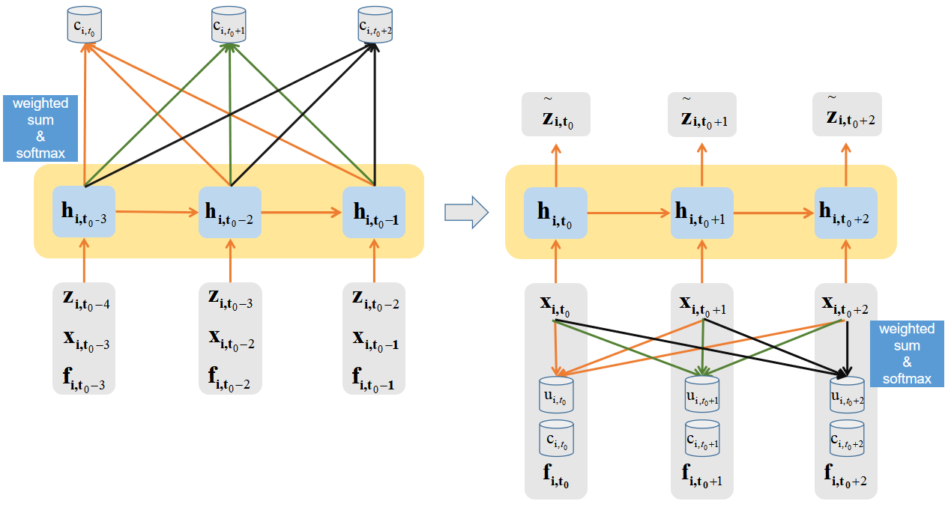
Decoding Phase
Encoding Phase

Slide 5


The Improved Seq2Seq Module
GRU
GRU
Encoding
Decoding
…
dual-attention
…
…
Get high-dimensional feature information
FM Module

Slide 6
weighted sum
score
softmax
match
score
softmax
match
weighted sum

Slide 7
GRU

Slide 8
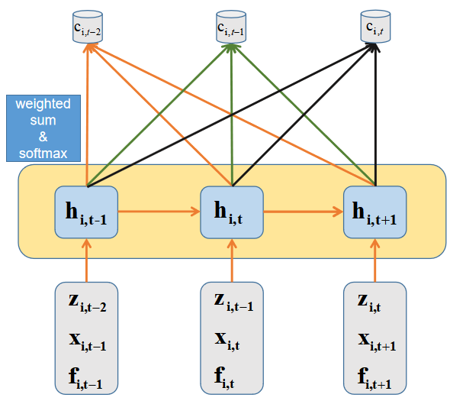
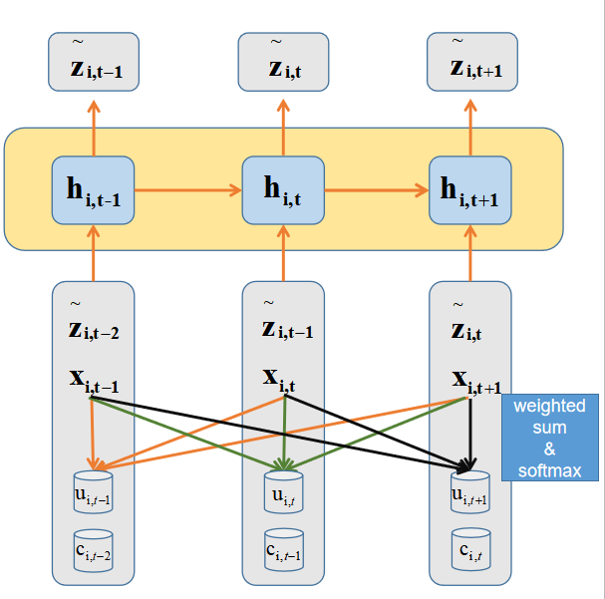

Slide 9
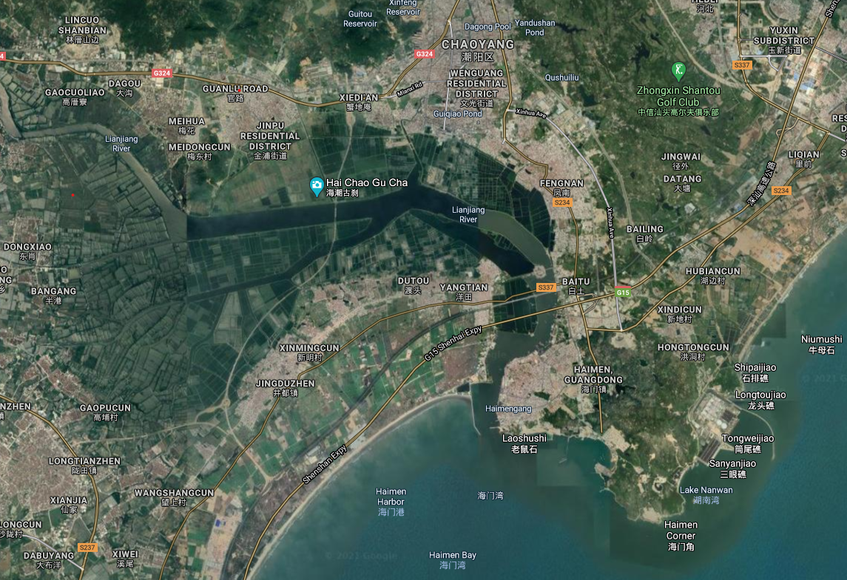

Lianjiang River
Haimen Bay monitoring station
N
1KM

