Slide 1
FY2025 SALES READOUT
APAC is the growth engine.
Churn is the risk.
$19.0M booked across four regions and three products, growing every quarter — but the retention story is not the one we expected.
$19.0M
+19.2%
3,619
FY2025 revenue
Revenue, Q1 → Q4
New customers
Exec readout · 10 minutes · Source: sales_2025.csv
Notes:
Ten-minute readout. Headline: $19.0M, up 19.2% from Q1 to Q4, growth in every quarter. APAC is the acquisition engine. One correction to flag up front: the churn risk is Europe, not LATAM.

Slide 2
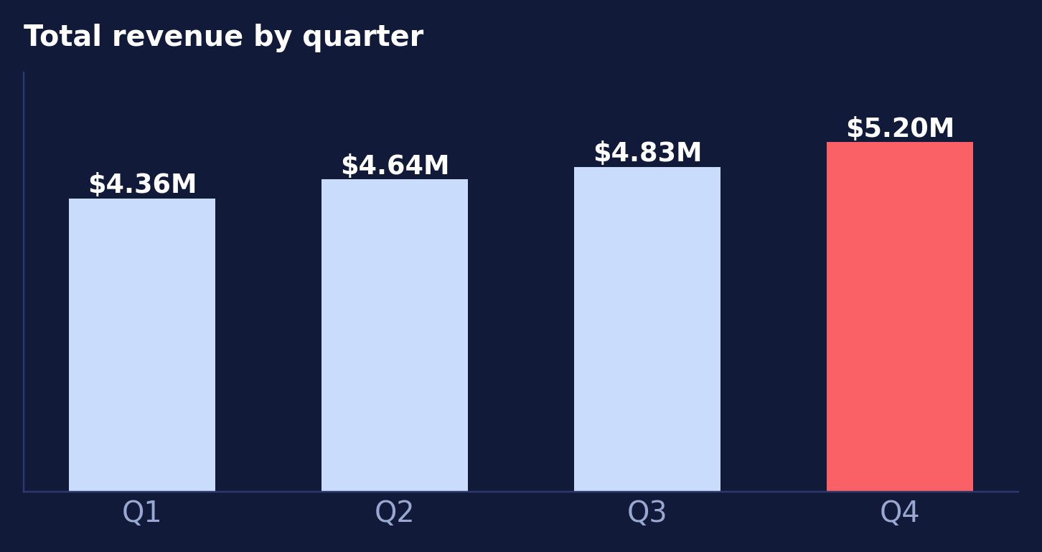
The year in one view
Revenue grew in all four quarters; Q4 was the strongest of the year.
$19.03M
Total FY2025 revenue
Four quarters, four regions, three products.
Enterprise = 60%
$11.33M of revenue
Pro $5.52M, Starter $2.18M.
+19.2%
Q1 → Q4 revenue growth
Q4 alone delivered $5.20M — 19.2% above Q1.
Every region grew double digits.
Notes:
Baseline slide. Growth is steady, not spiky. Enterprise carries 60% of revenue.

Slide 3
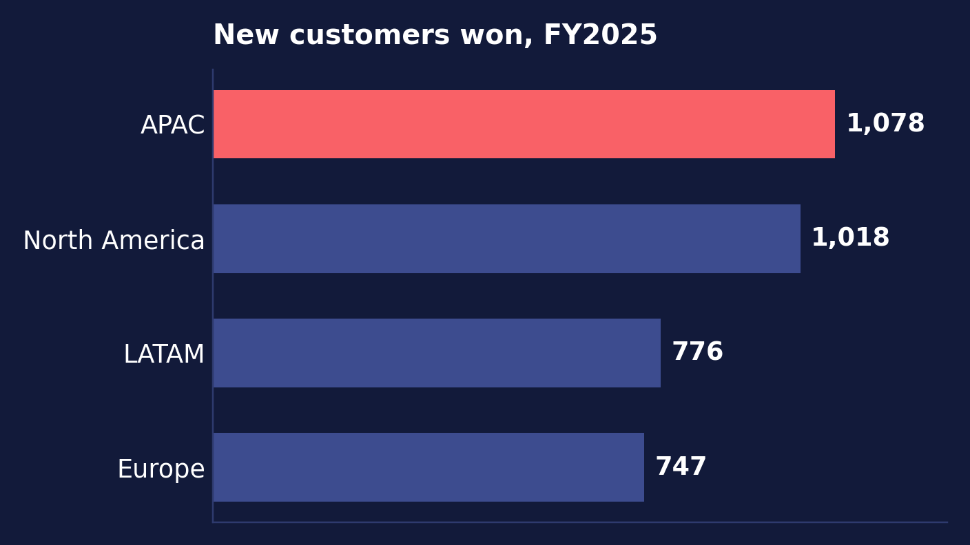
APAC is the growth engine
It wins more customers than any other region — and keeps them best.
WHY IT EARNS THE INVESTMENT
1,078 new customers
30% of everything we won this year — and 6% ahead of North America.
Lowest churn: 3.39%
The best average retention of any region across the four quarters.
Pro up +22.0%
Its fastest-growing product line, pointing to a clear land-and-expand motion.
Caveat: on revenue growth APAC is fourth (+16.8%). Its edge is volume and retention, not price.
Notes:
APAC leads on customer acquisition (1,078, ~30% of new customers) and has the lowest average churn at 3.39%. Be straight with the room: on pure revenue growth APAC ranks fourth at +16.8%. The engine is volume and retention.

Slide 4
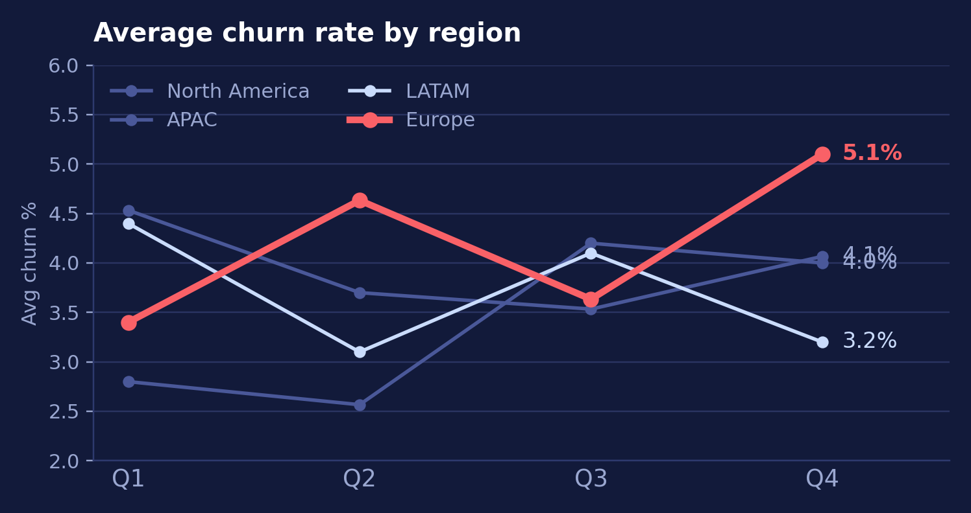
The churn risk is Europe — not LATAM
We came in expecting a LATAM problem. The data points somewhere else.
Europe: 3.4% → 5.1%
Worst average churn (4.19%) and the only clearly worsening trend, up 1.7 pts.
LATAM: 4.4% → 3.2%
Churn improved 1.2 pts — second-lowest for the year. The risk we assumed has receded.
NA & APAC: stable
North America flat at ~4.0%; APAC drifted up but still the lowest average.
Europe's Q4 churn of 5.1% puts ~$0.27M of annualised revenue at risk.
Notes:
This slide intentionally departs from the brief. LATAM churn fell from 4.4% to 3.2%; Europe rose from 3.4% to 5.1% and has the worst average at 4.19%. Recommend we redirect retention effort to Europe.

Slide 5
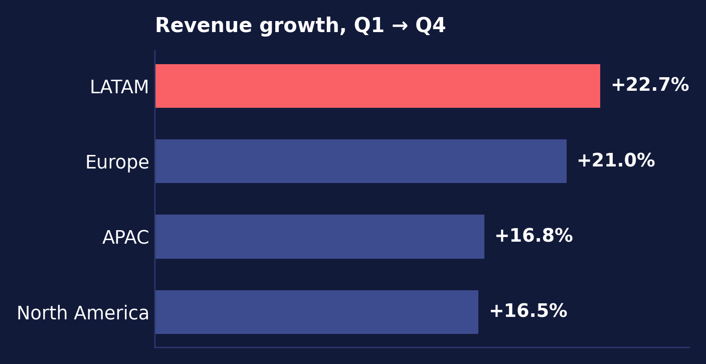
Growth was broad-based
No region carried the year alone — revenue share is near-identical at ~25% each.
Enterprise
Pro
$11.33M
$5.52M
60% of revenue
29% of revenue
Starter
Region spread
$2.18M
24.7–25.4%
11% of revenue
Share of total revenue
LATAM posted the fastest revenue growth of any region.
Takeaway: the portfolio is balanced, so retention — not new-region expansion — is the lever for FY2026.
Notes:
Every region grew 16–23% and every region holds about a quarter of revenue. LATAM was actually fastest at +22.7%. Enterprise is 60% of the book, so Enterprise churn is what moves the number.

Slide 6
THE ASK
Three recommendations
Fund APAC as the growth engine
01
Add two enterprise AEs and a partner lead in APAC for H1. It already wins 30% of new customers at the lowest churn in the business — capacity, not demand, is the constraint.
Stand up a Europe retention task force
02
Europe, not LATAM, is our churn problem: 3.4% → 5.1% across the year. Put a named owner on the top 20 at-risk Enterprise accounts and report weekly from Q1.
Defend the Enterprise book
03
Enterprise is 60% of revenue ($11.33M). Move executive sponsors onto every account above $500K and make renewal risk a standing item in the monthly business review.
Source: sales_2025.csv · 48 region–product–quarter records, FY2025
Notes:
Close on these three. One: fund APAC capacity. Two: Europe retention task force — this is the change from what we walked in believing. Three: protect Enterprise, which is 60% of revenue. Ask for headcount approval today.

