Slide 1
Daily Stock Report
Insights for 2025-05-05

Slide 2
Key Insights
Opening Price: $137.45
Closing Price: $111.96
Daily High: $230.38
Daily Low: $93.89
Volume Traded: 388,249
Daily Range: $136.49
Price Change: $-25.49

Slide 3
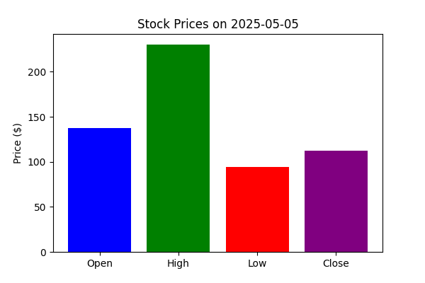
Stock Price Chart

