Slide 1
Sales Performance Analysis by Region and Product Type
Insights from 100 Sales Records on Revenue, Cost, and Profit | Source: data.csv

Slide 2
Overview of Sales Dataset
Dataset contains 100 sales records across multiple regions and countries.
Includes diverse product categories and sales channels (Online and Offline).
Key metrics: Units Sold, Unit Price, Unit Cost, Total Revenue, Total Cost, and Total Profit.
Order Dates range from 2010 to 2014, enabling temporal analysis.

Slide 3
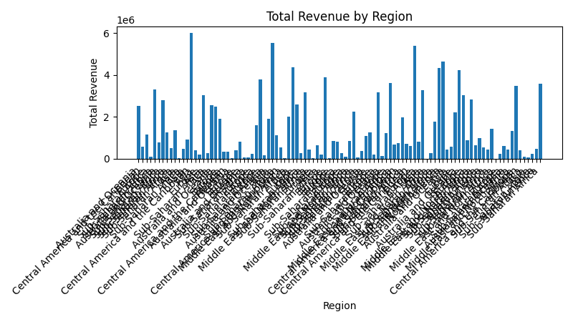
Sales Distribution by Region
Regions show varied total revenue contributions.
Some regions outperform others in sales volume and profitability.
Understanding regional performance helps target growth opportunities.

Slide 4
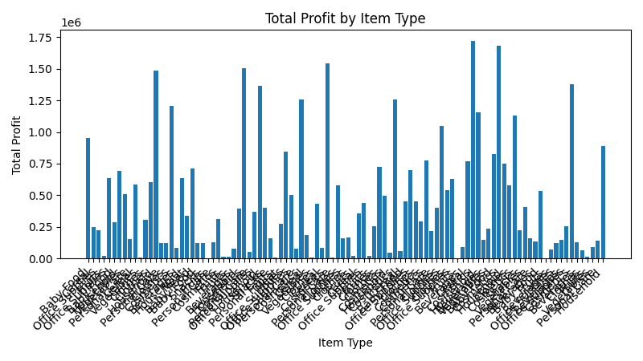
Product Category Performance
Different product types generate varying revenue and profit levels.
High-value items contribute significantly to total profit.
Identifying top-performing product categories aids inventory and marketing strategies.

Slide 5
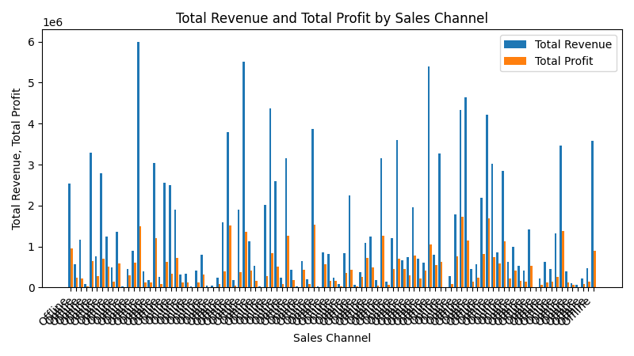
Sales Channel Impact on Revenue and Profit
Online and Offline channels show distinct sales patterns.
Channel choice affects total revenue and profitability.
Optimizing channel strategies can improve overall sales performance.

Slide 6
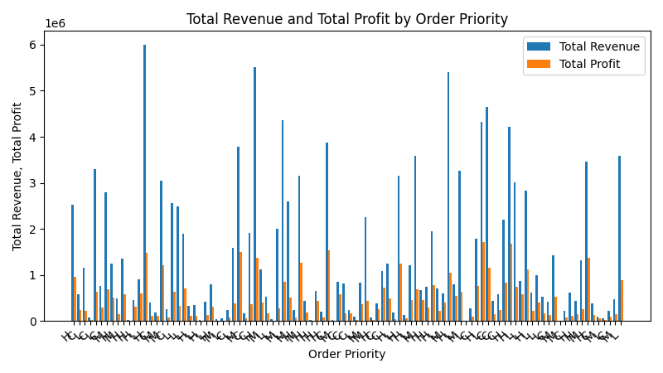
Order Priority Influence on Sales Metrics
Order priority levels (H, C, L) correlate with sales outcomes.
Higher priority orders tend to have higher revenue and profit.
Prioritization impacts operational focus and resource allocation.

Slide 7
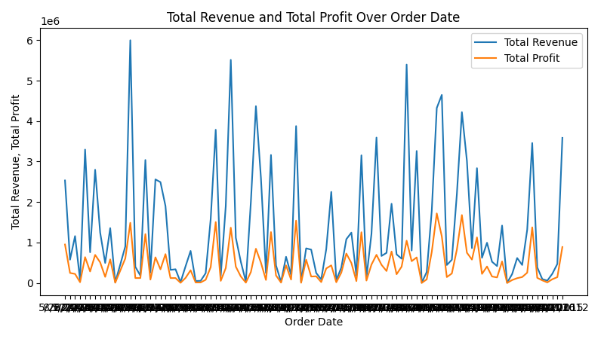
Sales Trends Over Time
Order dates span multiple years, allowing trend analysis.
Revenue and profit fluctuate over time, indicating seasonal or market effects.
Tracking trends supports forecasting and strategic planning.

