Slide 1
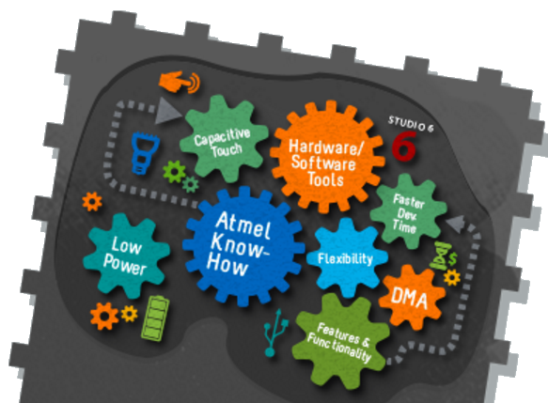
Embedded Artificial Intelligence Systems
Master’s on Applied Artificial Intelligence
1st Edition - 1st Semester

Slide 2
Summary
Curricular Unit Objectives
Curricular Unit Program
Prerequisites
Course structure
Teaching Load
Evaluation
Bibliography
Contacts

Slide 3
Curricular Unit Objectives
Wireless sensor data acquisition and TinyML is a cutting-edge field that brings the transformative power of machine learning (ML) to the performance- and power-constrained domain of tiny devices and embedded systems.
Successful deployment in this field requires intimate knowledge of applications, algorithms, hardware, and software.
What is expected:
Concepts of machine learning, deep learning, and embedded devices.
How to gather data effectively for training machine learning models.
How to use Python to train and deploy tiny machine learning models.
How to optimize machine learning models for resource-constrained devices.
How to conceive and design your own tiny machine learning application.
How to program in TensorFlow Lite for Microcontrollers.

Slide 4
Programme
1. Introduction to TinyML and Applications
1.1. Introduction to Edge Computing
1.1.1. Internet of things and concepts
1.1.2. Ultra-low power devices and real-time strategies.
1.1.3. Hardware platforms and software tools.
1.1.4. Communication technologies (Bluetooth/WiFi/Zigbee/802.15.4/LoRa/Sigfox).
1.1.5. Application layer protocols – HTTP, MQTT, CoAP, AMQP, OPC-UA.
1.2. Hardware for TinyML
1.3. Sensors and data capture
1.3.1. Discrete signals.
1.3.2. Continuous signals.
1.3.3. Basics of data capture.
2. Machine Learning Fundamentals
2.1. Model Training and Optimization
2.1.1. Network Pruning.
2.1.2. Quantization.
2.1.3. Post-Training.
2.2. Microcontroller Implementation
2.2.1. Examples of Decision Tree; SVM;
2.2.2. Random Forest; Kmeans; CNN; Linear
3. Security and Ethics in TinyML
3.1. Privacy challenges
3.2. Security in IoT
4. Final Project Development

Slide 5
Course evaluation
Evaluation (Theoretical and Practical)
Assessment Methodology:
The final classification of the students is obtained based on the following assessment elements:
70% - Final Project
20% - Online Quizz
10% - Continuous assessment and participation
The student will pass the subject when the average of the three elements of assessment (without rounding) is greater than or equal to 9.5 points.
If the student does not obtain the minimum grade in any of the situations mentioned above, he can always take the Exam of Appeal, and the final grade is the average of the three elements of assessment.

Slide 6

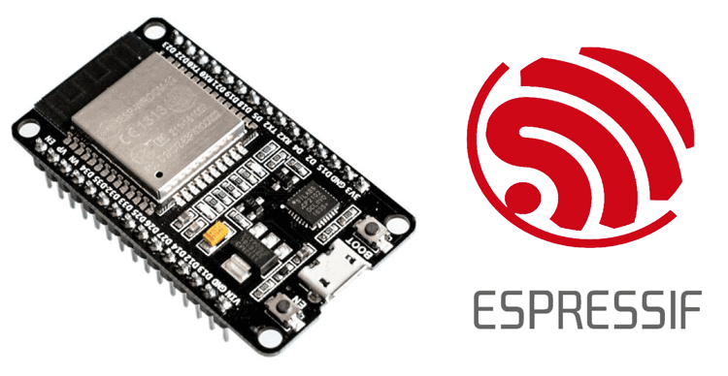


Final Project
TOPICS
Gesture Recognition
Person Fall detection
Surface recognition
Machine Anomaly
…
(open idea)
“a thing to save the day…”

Slide 7
Bibliography & Contacts
Main bibliography
“TinyML: Machine Learning with TensorFlow Lite on Arduino and Ultra-Low-Power Microcontrollers”, 2020, Pete Warden
“Hands-On Machine Learning with Scikit-Learn, Keras, and TensorFlow: Concepts, Tools, and Techniques to Build Intelligent Systems”, Aurélien Géron, 2019
Email contact
amoreira@ipca.pt

