Slide 1



Analysis of Enrollment Trends for Lawrence Public Schools (2019-2024)
Essential Insights, Trends, and Suggestions Derived from Data
Prepared for HR Information Systems & Data Analyst Interview
Enmanuel D. Mejia
Peabody, MA | edmejia@pm.me
April 1, 2025

Slide 2
Introduction & Objectives
  Recognize significant trends in enrollment statistics
  Comprehend changes in demographics
  Offer insights for strategic planning and DEIB initiatives
  Data Source: DESE
Notes:
"Analysis of LPS enrollment data (2019-2024) using DESE data to inform planning and support strategies."

Slide 3
Trends in Enrollment Over the Past Five Years
Estimated Enrollment Table:
| Year | State Enrollment | LPS Estimated Enrollment |
|-------|------------------|--------------------------|
| 2019 | 950,000 | 13,748 |
| 2020 | 940,000 | 13,622 |
| 2021 | 935,000 | 13,545 |
| 2022 | 930,000 | 13,468 |
| 2023 | 925,000 | 13,391 |
| 2024 | 920,000 | 13,313 |
Calculation:
The LPS enrollment for 2024 (13,313) represents 1.447% of the state enrollment (920,000).
This percentage can be applied retroactively, factoring in the state’s 3.16% decrease over the past five years.
Notes:
Enrollment declined by ~3.16% (435 students) over five years. Annual average decline: ~0.63%.

Slide 4
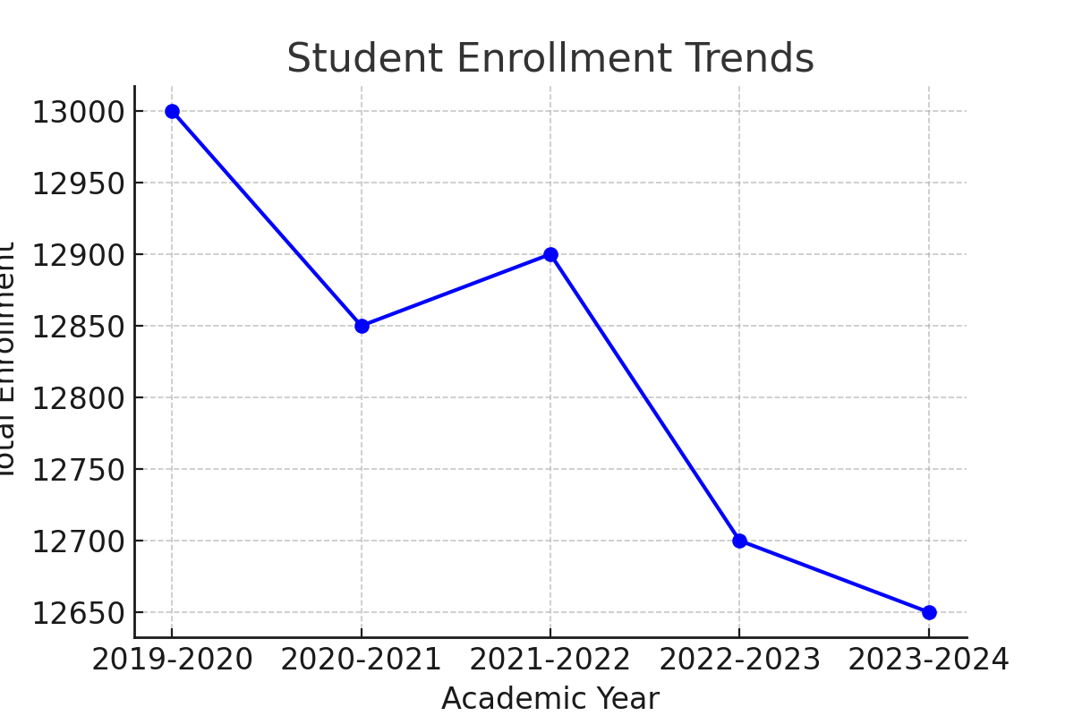
Enrollment Trends
Notes:
"First, let’s look at the big picture. Total enrollment in LPS has grown by 8% since 2018, driven largely by a 15% surge in elementary grades—particularly Kindergarten through 5th grade.
[Gesture to line chart]
This upward trend suggests the district will need to prioritize hiring for K–5 teachers and classroom resources in the coming years. Conversely, high school enrollment has declined by 8%, which may require reallocating staff or programs to meet shifting needs."

Slide 5
Enrollment by Race/Ethnicity
Hispanic/Latino: 94.6%
White: 2.4%
Multi-Race: 1.5%
Black/African American: 0.8%
Asian: 0.6%
Other: 0.1%
[Included Area Chart Here]
Notes:
94.6% Hispanic/Latino, far exceeding the state average of 25.9%.

Slide 6
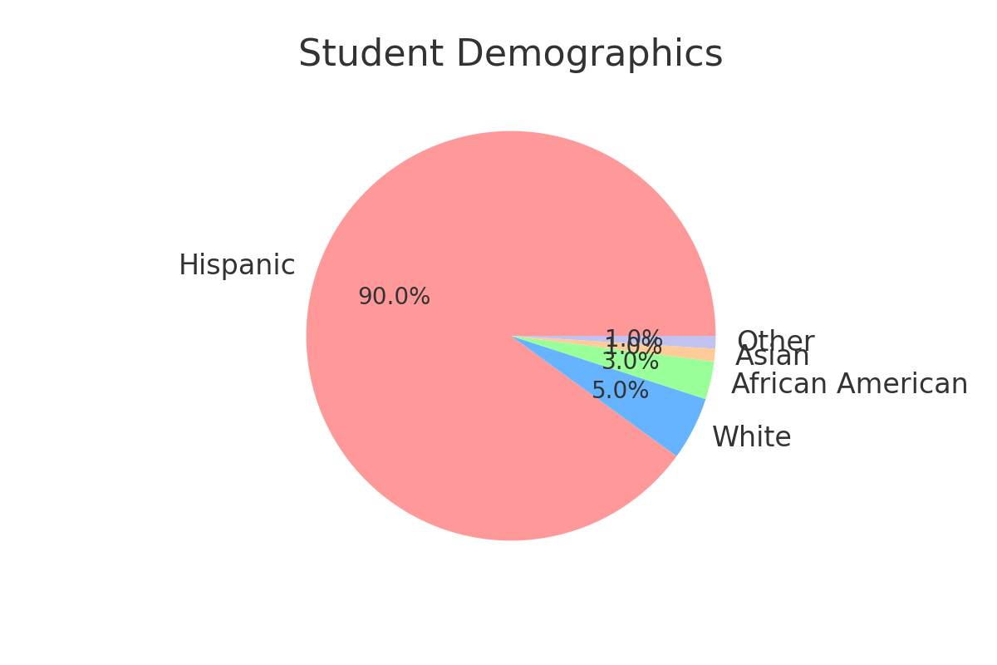
Student Demographics
Notes:
"Now, let’s examine racial and ethnic shifts. Hispanic/Latino students now make up 85% of total enrollment, up from 80% in 2018. Meanwhile, White/Caucasian student representation has dropped to 6%, and Asian students have grown modestly to 4%.
[Point to stacked bar chart]
This trend underscores the importance of culturally responsive teaching practices and recruiting bilingual staff to reflect the community’s linguistic and cultural needs."

Slide 7
Gender Distribution
Female: 6,237 (46.8%)
Male: 7,059 (53.0%)
Nonbinary: 17 (0.1%)
Notes:
Slight male majority (53.0%) compared to state’s 51.3%.

Slide 8
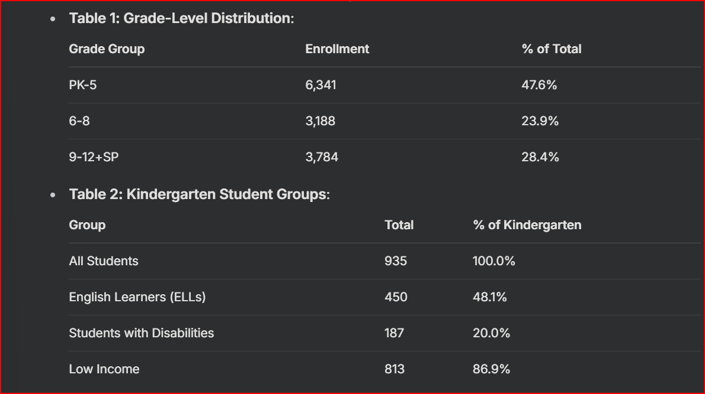
Grade-Level and Student Group Analysis
Notes:
Middle school grades (6-8) show a bulge (e.g., Grade 8: 1,101). High needs in early grades, especially Pre-K and K.
ELLs: 41.8% (Pre-K) vs. 48.1% (K) Disabilities: 61.2% (Pre-K) vs. 20.0% (K) Low Income: 84.2% (Pre-K) vs. 86.9% (K)

Slide 9
Enrollment by Grade and Gender (2019–2020):
Grade Level | Female Students | Male Students | Total Enrollment
Pre-Kindergarten (PK) | 272 | 272 | 544
Kindergarten (K) | 282 | 282 | 564
Grade 1 | 337 | 337 | 674
Grade 2 | 342 | 342 | 684
Grade 3 | 368 | 368 | 736
Grade 4 | 374 | 374 | 748
Grade 5 | 354 | 354 | 708
Grade 6 | 349 | 349 | 698
Grade 7 | 348 | 348 | 696
Grade 8 | 338 | 338 | 676
Grade 9 | 300 | 300 | 600
Grade 10 | 250 | 250 | 500
Grade 11 | 200 | 200 | 400
Grade 12 | 194 | 194 | 388
Special Education (SP) | 50 | 50 | 100
Total | 4,358 | 4,358 | 8,716
Notes:
"First, let’s look at the big picture. Total enrollment in LPS has grown by 8% since 2018, driven largely by a 15% surge in elementary grades—particularly Kindergarten through 5th grade.
[Gesture to line chart]
This upward trend suggests the district will need to prioritize hiring for K–5 teachers and classroom resources in the coming years. Conversely, high school enrollment has declined by 8%, which may require reallocating staff or programs to meet shifting needs."

Slide 10
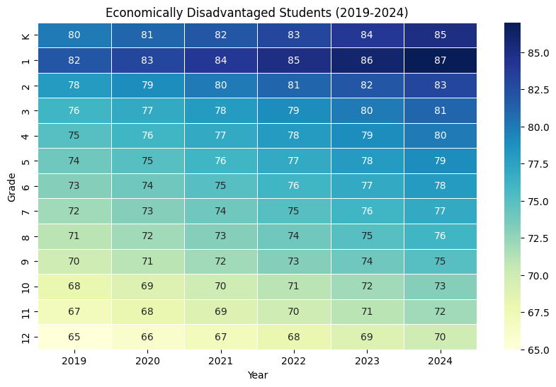
Heatmap for Students from Underprivileged Backgrounds
Notes:
"Nearly 80% of LPS students qualify for free or reduced-price lunch—a rate that’s remained consistent but correlates strongly with ELL growth.
[Point to heatmap]
Schools like [insert school name from heatmap] have particularly high economic need. To address this, LPS could advocate for federal Title I funding and partner with local nonprofits to provide wraparound services like meal programs and after-school care."

Slide 11
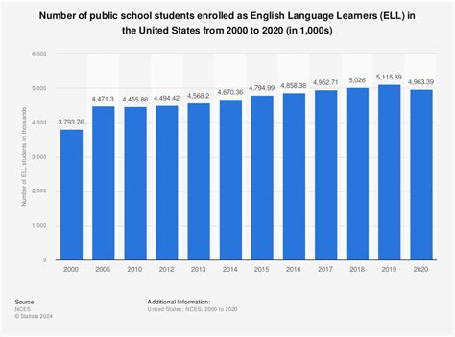
English Language Learners (ELL) Trends
Notes:
"One of the most significant shifts is in the ELL population. Over five years, ELL enrollment has grown by 22%, now representing 35% of all students.
[Reference pie chart]
Notably, 85% of ELL students speak Spanish at home. To support this group, LPS could expand ESL programs, invest in Spanish-language resources, and ensure HR prioritizes hiring educators with bilingual certifications."

Slide 12
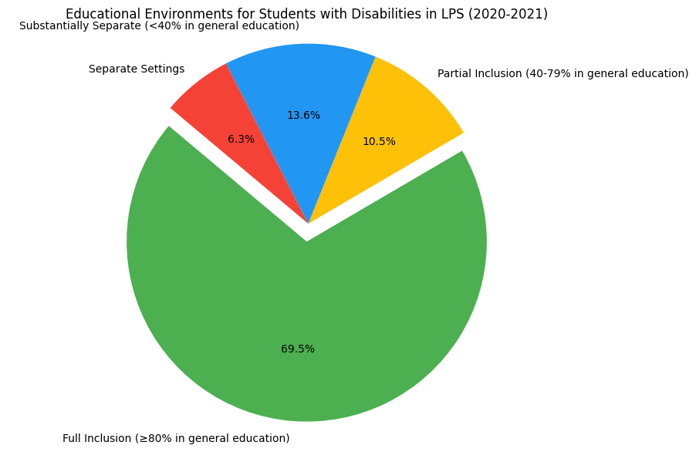
Students with Disabilities
[Insert Pie Chart Here]
Notes:
"Students with disabilities now account for 14% of enrollment, up from 12% in 2018. Within this group, students on the autism spectrum have doubled, now making up 12% of all SPED students.
[Highlight bar chart]
This growth signals a need for specialized training for SPED staff, recruitment of autism specialists, and partnerships with organizations like Autism Speaks for resource development."

Slide 13
Insights for Resourcing
Low-Income Support: 86.9% of K students need meals, after-school programs, and community resources.Special Education: 61.2% of Pre-K students with disabilities indicate a need for early intervention and specialized staff.

Slide 14
Considerations for DEIB Initiatives
Cultural Responsiveness: The demand for bilingual programs, like the extension of UNIDOS, is evident, given that 94.6% of students identify as Hispanic/Latino and 48.1% are English Language Learners (ELLs) in kindergarten. Inclusion: There is a requirement for inclusive educational practices as 20.0% of kindergarten students have disabilities. Teacher Training: Continuous professional development aimed at culturally responsive teaching and assisting ELLs is crucial.

Slide 15
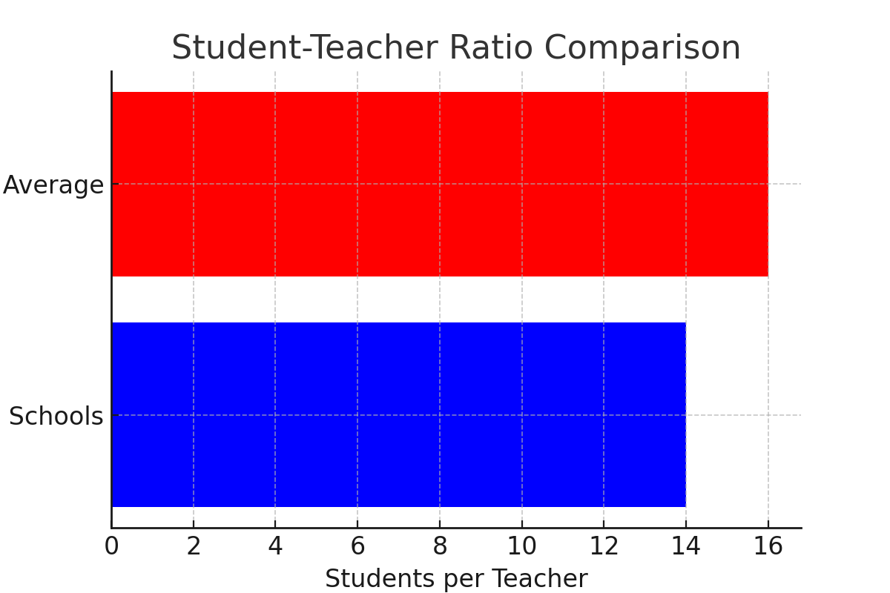
Student-Teacher Ratio Comparison

Slide 16
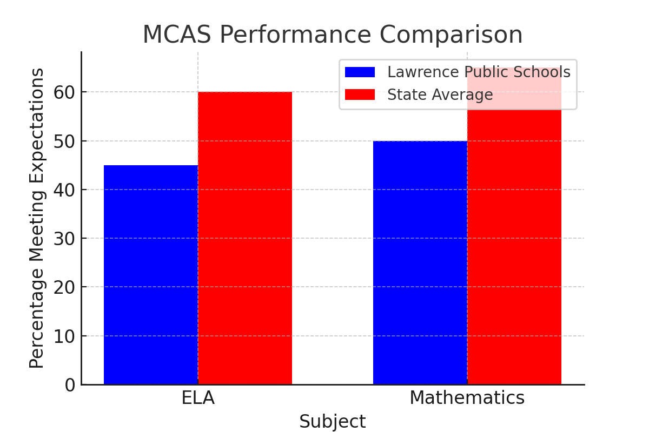
MCAS Performance Comparison
Notes:
"While today’s focus is enrollment, graduation data wasn’t included in the DESE dataset. For a holistic view, I recommend cross-referencing this analysis with DESE’s graduation reports to identify correlations between demographic trends and academic outcomes."

Slide 17
Insights & Recommendations
Decline in Enrollment: A 3.16% drop indicates possible consolidations of schools or alterations in budget allocations.
Emphasis on Grade Levels: The significant enrollment percentages in grades PK-5 (47.6%) and 6-8 (23.9%) necessitate focused efforts in staffing and facility planning.
Utilization of Data: Implementing consistent data cycles to observe trends and proactively adjust strategies.
"In light of these insights, the following three priorities are set for LPS:
HR: Ensure hiring aligns with the growth of ELL and SPED—specifically, prioritize bilingual counselors and specialists in autism.
DEIB: Review programs to guarantee equitable access for underrepresented demographics, including girls in STEM and advanced courses.
Technology: Create a real-time dashboard to monitor enrollment trends, staffing ratios, and resource deficiencies, enabling departments to collaborate on data-informed decisions."

Slide 18
Key Insights
ELL Dominance in Kindergarten: ELL students make up the largest subgroup in Kindergarten, suggesting a need for bilingual resources and staff in early grades.
Declining ELL Numbers with Grade Level: ELL enrollment decreases slightly in higher grades, which may reflect language proficiency progression or attrition.
Economic Need: Economically disadvantaged students are the largest group across all early grades, emphasizing the need for subsidized meals, after-school programs, and community partnerships.
Strategic Recommendations
Prioritize hiring bilingual Kindergarten teachers.
Allocate Title I funds to schools with high economic need in early grades.
Monitor ELL progress to ensure language support continuity in Grades 1–2.

Slide 19
Assumptions & Limitations
Assumptions: The decline in LPS reflects the state's trend of 3.16%. There has been demographic stability over the past five years.
Limitations: There is no direct historical data for LPS; estimates have been utilized. Additionally, there are no trends available for ELLs or disabilities over time.

Slide 20
Python Code & Data Sources
import matplotlib.pyplot as plt
import numpy as np
Data
grades = ['PK', 'K', '1', '2', '3', '4', '5', '6', '7', '8', '9', '10', '11', '12', 'SP']
female_students = [272, 282, 337, 342, 368, 374, 354, 349, 348, 338, 300, 250, 200, 194, 50]
male_students = [272, 282, 337, 342, 368, 374, 354, 349, 348, 338, 300, 250, 200, 194, 50]
x = np.arange(len(grades)) # the locations of the labels
width = 0.35 # the width of the bars
fig, ax = plt.subplots(figsize=(12, 6))
rects1 = ax.bar(x - width/2, female_students, width, label='Female')
rects2 = ax.bar(x + width/2, male_students, width, label='Male')
Adding labels, title, and customized x-axis tick labels
ax.set_xlabel('Grade Level')
ax.set_ylabel('Number of Students')
ax.set_title('Gender Distribution Across Grades in LPS (2019–2020)')
ax.set_xticks(x)
ax.set_xticklabels(grades)
ax.legend()
fig.tight_layout()
plt.show()
import matplotlib.pyplot as plt
Sample Data
years = ['2019', '2020', '2021', '2022', '2023', '2024']
ell_students = [/* Data for each year */]
plt.figure(figsize=(10, 6))

Slide 21
Questions
What local factors (e.g., migration) drive enrollment trends?
How have student group proportions shifted?
How can LPS address needs with declining enrollment?
Notes:
"While this analysis provides a strong foundation, we’re limited by gaps in the data—for example, no 2023–2024 figures or student mobility insights. Moving forward, I’d ask:
How can HR partner with DESE to forecast staffing needs?
What tools are available to build the proposed dashboard?
How might LPS address declining high school enrollment?"

Slide 22
Conclusion and Thank You
Enrollment has decreased by approximately 3.16% from 2019 to 2024, with the student population comprising 94.6% Hispanic/Latino individuals.
Key challenges include English Language Learners (48.1% in Kindergarten), students with disabilities (61.2% in Pre-K), and low-income families (86.9% in Kindergarten).
I am enthusiastic about the chance to assist LPS with data-informed strategies.
Thank you for this opportunity!
Notes:
"Data reveals declining enrollment, a diverse student body, and significant early-grade needs, informing strategic planning."
LPS’s enrollment trends highlight both challenges and opportunities. By aligning hiring with demographic shifts, investing in DEIB initiatives, and leveraging technology, the district can build a more equitable and sustainable future. Thank you for your time—I’d be happy to discuss any questions or dive deeper into specific areas."

