Slide 1
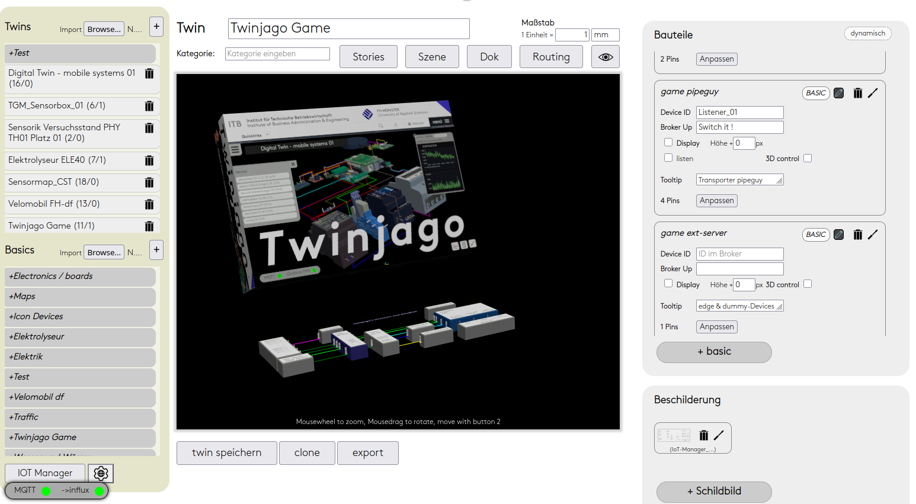
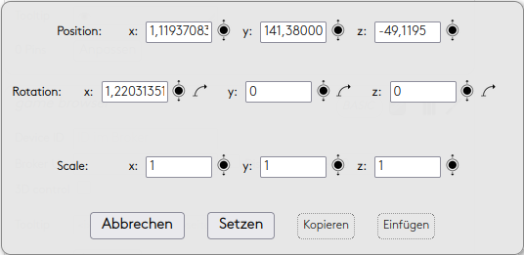
 | Story 1
 | Story 2
 | Story 3
 | » Sec 1
 | » Sec 2
 | » Sec 3
 | » Basic 1
 | » Basic 2
 | » Basic 3
 | »Track 1
 | »Track 2
 | »Track 3
 | » Sec 4
 | Story 4
 | Story 5
Stories Twin: Name
Editor
< Timeline >
event
event
event
■ ►

Slide 2
stories can be created
in a story sections can be created
in a section:
basics from the list of parts can be added, which should be animated
for each basic, timed events can be added
for each event
the start time and duration must be set
the basic can be edited in scene to define the state at the end of animation
for now position, rotation, scale, visibility can be edited
after saving a section can be played in the 3D view by clicking the section
play/pause, stop button

