Slide 1
SMKPIs
File created on: 10/01/2022 1.30.11

Slide 2


Slide 3
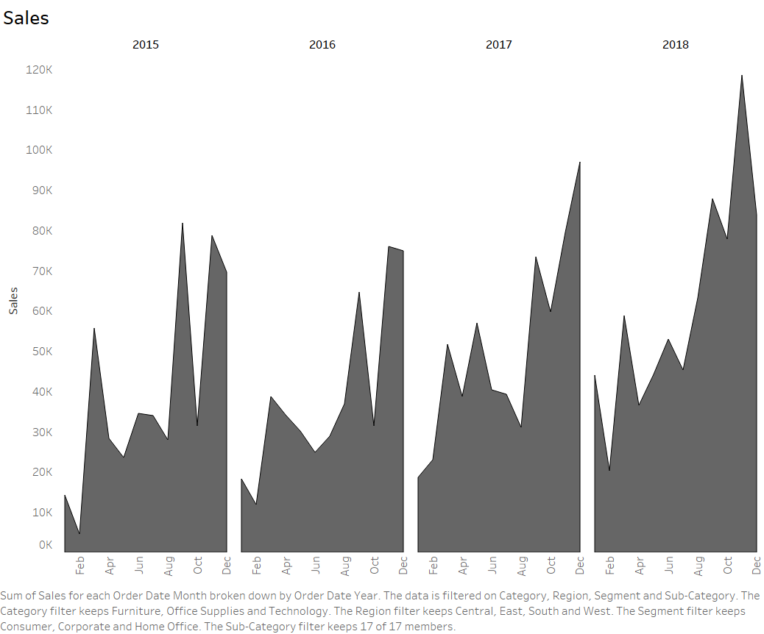

Slide 4
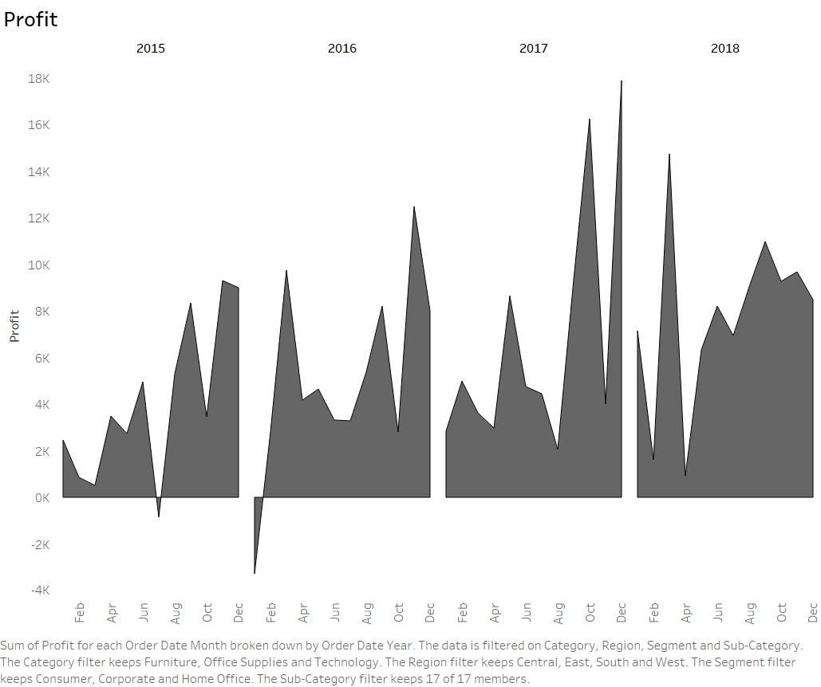

Slide 5
