Slide 1

ANALYZING THE FACTORS THAT AFFECT LIFE EXPECTANCY Presented by ADEDOKUN ENIOLA April, 2025

Slide 2


INTRODUCTION
An overview of life expectancy trends globally
Importance of understanding influencing factors (immunization rate, GDP, social factors and mortality rate)
Dataset covers 193 countries (2000–2015)

Slide 3

TABLE OF CONTENTS
1. Introduction
2. Aims and Objectives
3. Data Description
4. Data Source
5. Project Process
6. Data Presentation
7. Key Insight
8. Recommendation For Stakeholders
9. Project Limitation

Slide 4

AIM & OBJECTIVES
Prepare clean, accurate data with Power Query.
Analyze effects of GDP, immunization, mortality, and social factors.
Visualize insights with Power BI dashboards.
Identify key predictors of low life expectancy.
Enable data-driven strategies for better health outcomes.

Slide 5
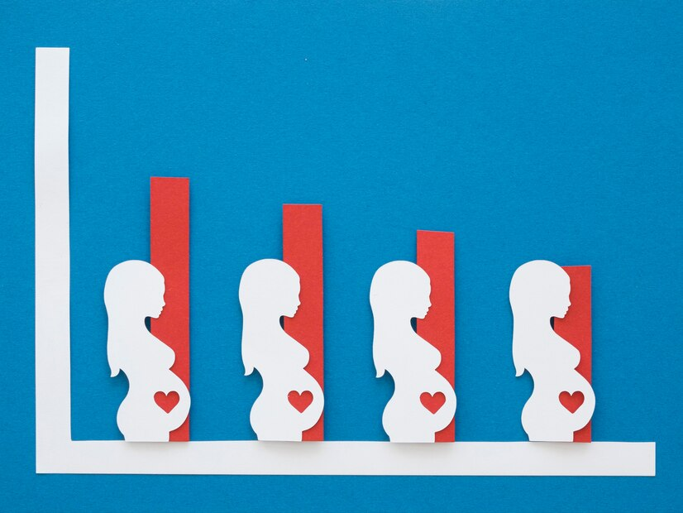



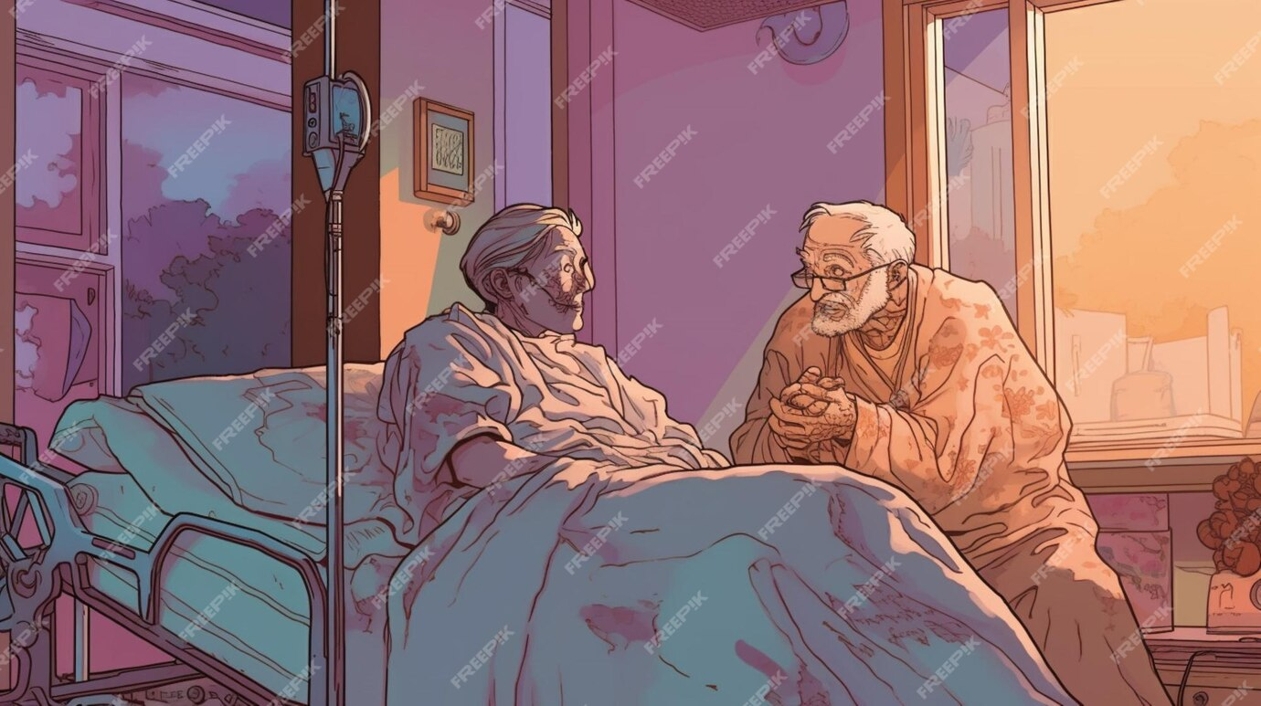

DATA DESCRIPTION
1. Life
Expectancy
4. Schooling
5. Adult Mortality
2. Hepatitis B
3. GDP
Expected years of life at birth.
Percentage of 1-year-olds immunized
Gross Domestic Product per capita (in USD).
Average years of education (age 25+).
Number of deaths per 1,000 aged (15–60)

Slide 6


DATA SOURCE
KAGGLE
The dataset, “WHO Life Expectancy Data,” was sourced from Kaggle and includes statistics from WHO, the UN, and other global organizations.

Slide 7

PROJECT PROCESS
Data Collection
Source Kaggle(WHO Life Expectancy Dataset)
Data Cleaning
Handled missing values & standardized formats using Power query
Transformation Created calculated columns and merged related indicators
DAX Measure Used to create custom calculations and perform advanced data analysis in Power BI
Insight Generation Identified key influencing factors and trends across countries
Visualization
Built interactive dashboards in Power BI

Slide 8
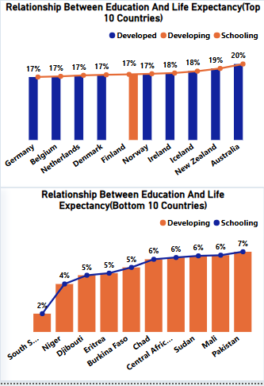
DATA PRESENTATION
Education and Life Expectancy
Top 10 Countries Developed nations like Australia (20%), New Zealand, and Ireland show high schooling rates linked to longer life expectancy.
Bottom 10 Countries Developing countries such as South Sudan (2%), Niger, and Chad have low education levels and shorter life expectancy.

Slide 9

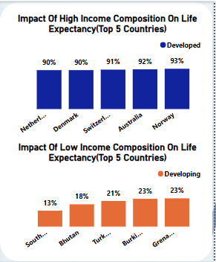
DATA PRESENTATION
Income Composition and Life Expectancy
Top 5 Countries (High Income Composition) Developed countries like Norway (93%), Australia, and Switzerland demonstrate high income composition, correlating with longer life expectancy.
Top 5 Countries (Low Income Composition) Developing nations such as South Sudan (13%), Bhutan, and Burkina Faso show low income levels, associated with shorter life expectancy.

Slide 10






KEY INSIGHT
Immunization
Higher vaccination coverage (Hepatitis B, Polio) Linked to Longer life expectancy.
Mortality Rates
Declines in adult & infant mortality Increases in life expectancy.
GDP & Health Spending
Higher GDP and Balanced health spending lead to Longer life expectancy.
Regional Trends
Developed countries Benefit from strong health systems.
Developing countries Face challenges due to limited resources.
Social Factors
Education and Income have Positive impact on longevity.
Higher alcohol use Does not always lower life expectancy.

Slide 11


RECOMMENDATION FOR STAKEHOLDERS
Invest in Immunization
Enhance Health Spending
Promote Education
Address Socioeconomic Disparities
Monitor Alcohol Consumption

Slide 12

PROJECT LIMITATION
Missing or inconsistent data affected accuracy.
Dataset only covers years up to a certain point — may not reflect present conditions.
Region-specific factors (culture, diet, lifestyle) were not included.
Healthcare quality and infrastructure were not captured.
Indicators like income and education were broad, hiding internal disparities.
External influences (politics, pandemics, climate change) were not considered.

Slide 13
THANK YOU FOR LISTENING

