Slide 1

Introduction

Slide 2
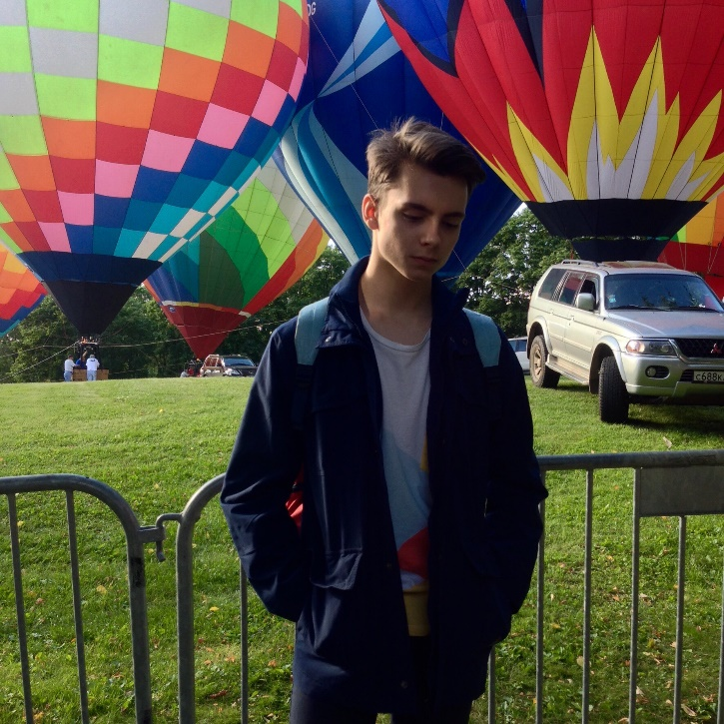
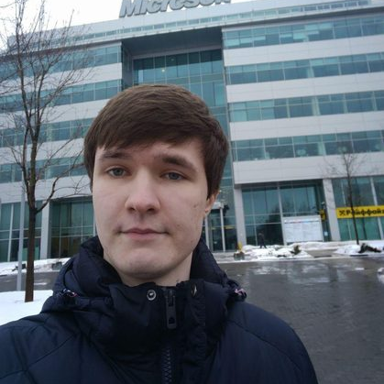

Who we are
Winners of Microsoft x2, IBM, WAVES, Blockchain Founder x2, Binary District hackathons
Have courses and master classes (HSE, Bauman University, MSU and some others)
Fullstack developers (Node.JS, React.js, ASP.NET, Xamarin and others) MSP (Microsoft Student Partners)
Solidity developers (BANKEX)

Slide 3
About

Slide 4

About

Slide 5
Why
?

Slide 6
Some use cases as example

Slide 7

Crowdfunding

Slide 8
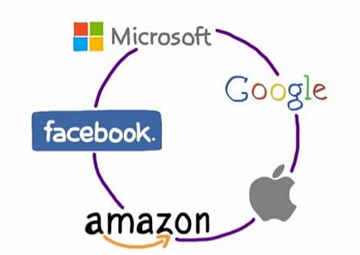
Exchange data between corporations

Slide 9
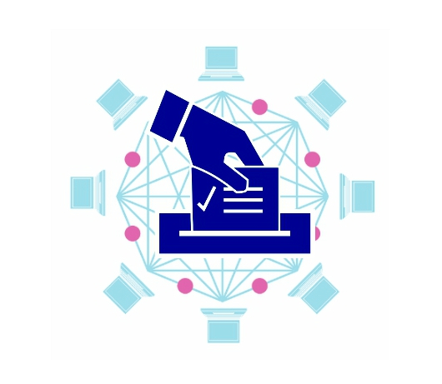
Secure voting solutions

Slide 10
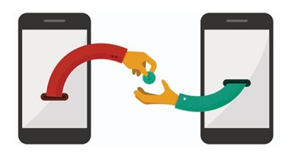
P2P payments

Slide 11
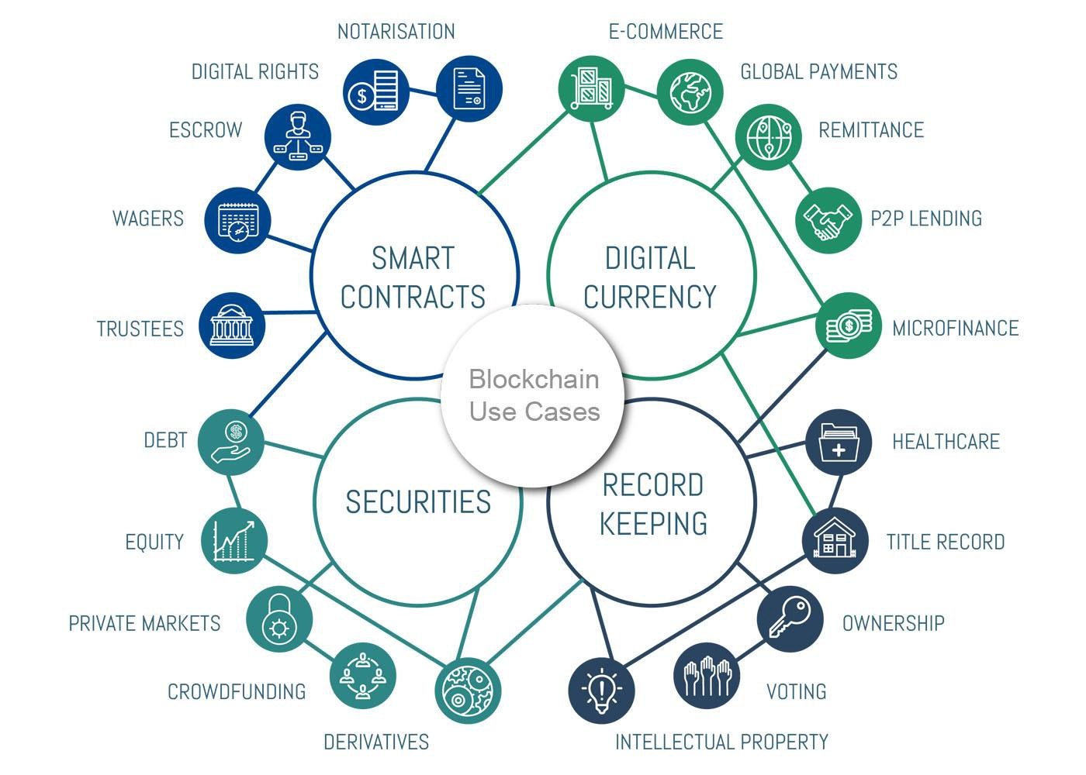

Slide 12
So, that’s why

Slide 13
Let’s start from our plan
Today
Tomorrow
Understanding of basics (PoW, Merkle tree, CAP and e.t.c)
Ethereum Solidity practice on some cases
Ethereum Solidity introduction on practice
Making DApp with web3.js
Best backend practices from DevOps position for DApps

Slide 14
Abstract blockchain

Slide 15
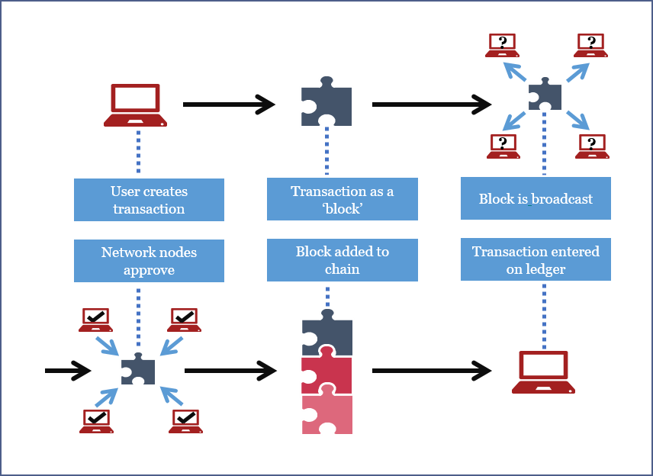
Transaction
Block
Network
Node
Chain of blocks
Ledger
europeanpaymentscouncil.eu

Slide 16
FIELD | Description | SIZE
Version nomber | Is 1 now | 4 bytes
In-counter | Positive integer VI = VarInt | 1 – 9 bytes
List of inputs | The first input of the first transaction is also called "coinbase" (its content was ignored in earlier versions) | Depends on inputs
Out-counter | Positive integer VI = VarInt | 1 – 9 bytes
List of outputs | The outputs of the first transaction spend the mined bitcoins for the block | Depends on outputs
Lock time | if non-zero and sequence numbers are<0xFFFFFFFF: block height or timestamp when transaction is final | 4 bytes
Transaction
Block
Network
Node
Chain of blocks
Ledger

Slide 17
FIELD | Description | SIZE
Magic number | value always 0xD9B4BEF9 | 4 bytes
Blocksize | Number of bytes following up to end of block | 4 bytes
Blockheader | 6 items : Version, hashPrevBlock, hashMerkleRoot, Time, Bits, Nonce | 80 bytes
Transaction counter | Positive integer VI = VarInt | 1 – 9 bytes
Transactions | List of transactions (non empty) | A lot of bytes
Transaction
Block
Network
Node
Chain of blocks
Ledger

Slide 18
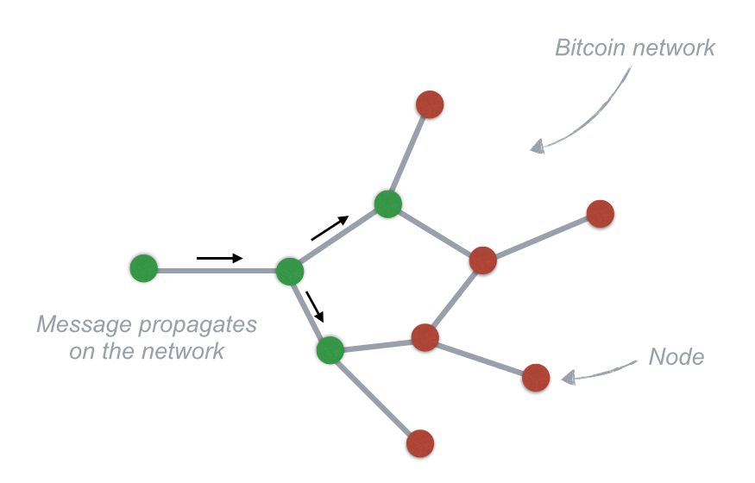
Transaction
Block
Network
Node
Chain of blocks
Any computer that connects to the Bitcoin network is called a node.
Ledger

Slide 19
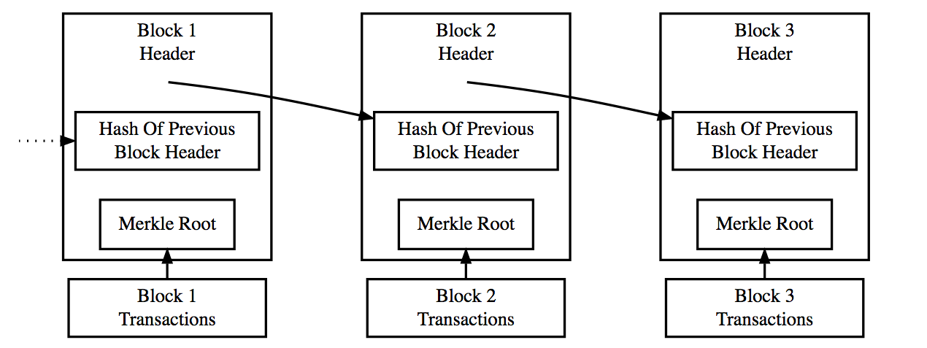
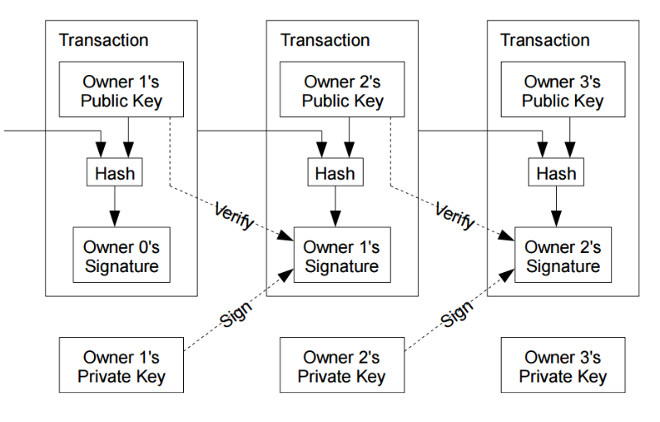
Transaction
Block
Network
Node
Chain of blocks
Ledger
steemit.com

Slide 20
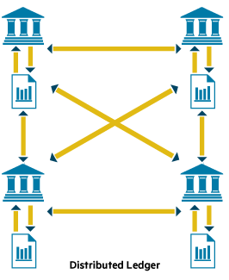
Transaction
Block
Network
Node
Chain of blocks
Ledger

Slide 21
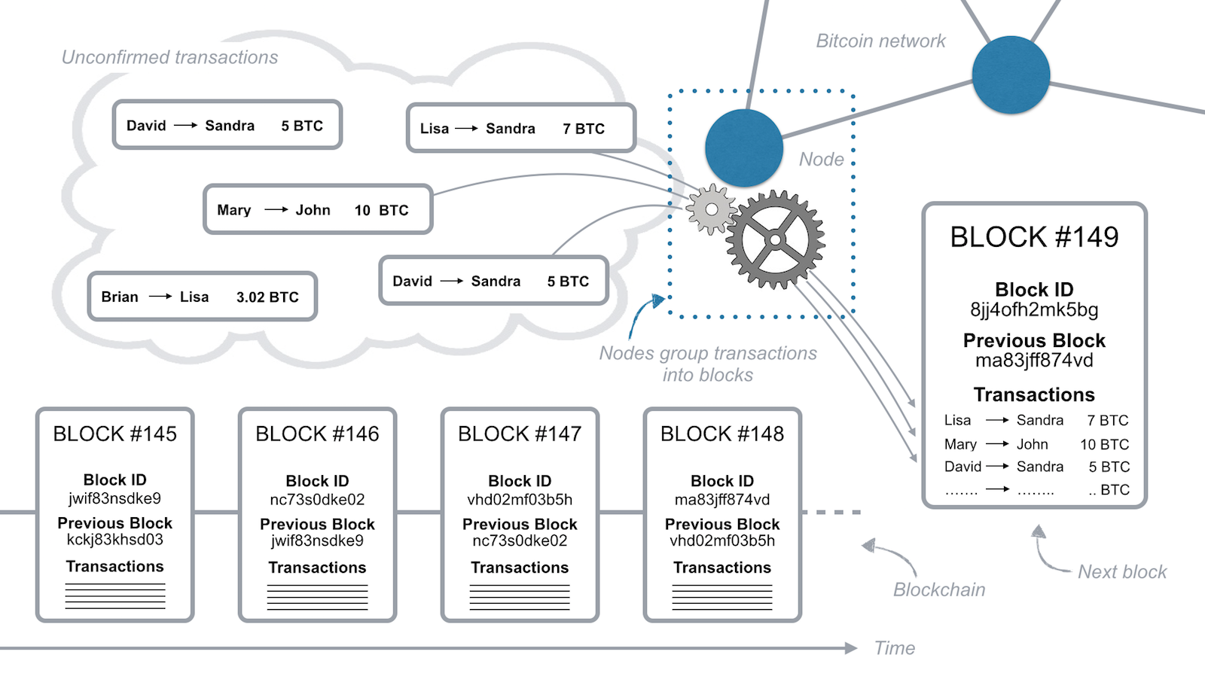
medium.com

Slide 22
🔄
📄 ➡️ 📑
👨🏾
📝📒
📦
✅
Transaction 1
Block
Checking the solution and update
🔒
📄 ➡️ 📑
📄 ➡️ 📑
👨🏻
Transaction 1
📝📒
🔄
✅
Creation
👨🏻
👩🏼
📝📒
Transaction 2
📄 ➡️ 📑
Transaction 2
Sending to all nodes
and
Solving consensus task
Checking the solution and update
📄 ➡️ 📑
📄 ➡️ 📑
✅
Transaction 3
🔄
Transaction 3
👱🏻
📝📒
Checking the solution and update

Slide 23
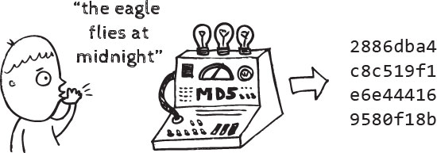
Hash functions

Slide 24
Hello
185f8db32271fe25f561a6fc938b2e264306ec304eda518007d1764826381969
hello
2cf24dba5fb0a30e26e83b2ac5b9e29e1b161e5c1fa7425e73043362938b9824
2cf24dba5fb0a30e26e83b2ac5b9e29e1b161e5c1fa7425e73043362938b9824
d7914fe546b684688bb95f4f888a92dfc680603a75f23eb823658031fff766d9
Hello MSU students
ea526da0ea9e2f472afbdb647ffad0cd63567f59fb9a4bfa12429f5dbfed5c1e

Slide 25
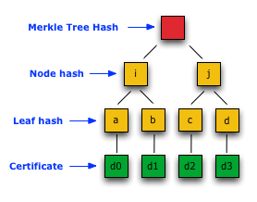
Merkle tree
KECCAK in Ethereum

Slide 26
PoW
“hello world!” = J and X = “0”
We have :
H("Hello, world!0")=1312af178c253f84028d480a6adc1e25e81caa44c749ec81976192e2ec934c64
Find X such that when we append X to J
We will have:
H("JX")= 0000c3af42fc31103f1fdc0151fa747ff87349a4714df7cc52ea464e12dcd4e9

Slide 27
CAP
Consistency, Availability, Partition tolerance
Согласованность данных
Доступность
Устойчивость к разделению
Can’t have all three!

Slide 28
Ethereum

Slide 29


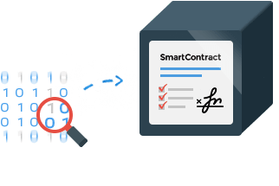
Two types of accounts
Controlled by code
Controlled by humans

Slide 30
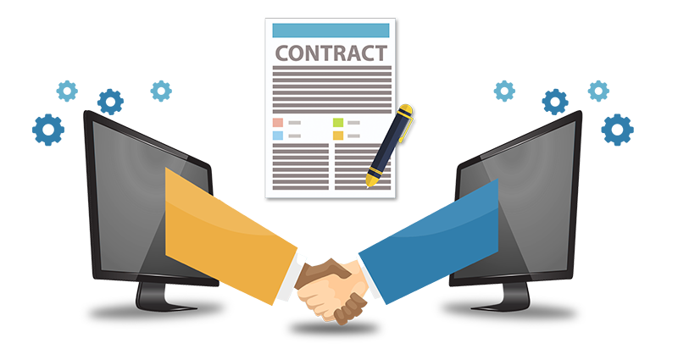
contract Option {
trikePrice = $50
holder = Alice
seller = Bob
asset = 100 shares of Acme Inc.
expiryDate = June 1st, 2016
function exercise ( ) {
If Message Sender = holder, and
If Current Date<expiryDate, then
holder send($5,000) to seller, and
seller send(asset) to holder
}}

Slide 31

Public
Open-source
Features smart contract (scripting) functionality
Blockchain-based distributed computing platform

Slide 32
Solidity
remix.ethereum.org

Slide 33
github.com/EnoRage/ssc

