Slide 1
Project Portfolio Management as a Form of Collaborative Value Management
By Giuseppe Mascarella
Enterprise Project Management
Manage Cost, Risk and Time.
Manage Benefits/Value
Projects Portfolio Management
Apply Rules
IT Budget Allocation
Collaborative Decision Making

Slide 2




Collaborative Challenges in IT Portfolio Decision Making
B O A R D
IT
Groups &
Suppliers
C I O
Business Unit
Managers
USERS
Notes:
© 2005 Microsoft Corporation. All rights reserved.
This presentation is for informational purposes only. Microsoft makes no warranties, express or implied, in this summary.
It spending represents at least 5% of Revenue

Slide 3

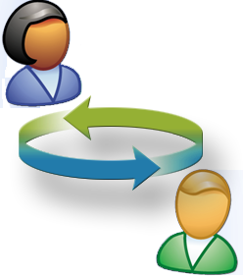

Projects Managers Need Governance!
Rules/
Process
To Generate the Desidered Behaviour in the Use of IT
Organizational
Decision Mechanism
Rights/Duties
Notes:
© 2005 Microsoft Corporation. All rights reserved.
This presentation is for informational purposes only. Microsoft makes no warranties, express or implied, in this summary.
So many different stakeholders with so many different point of view and needs require a professional approach to decision making.
Organization have discovered that setting the rules, rights and process before trying to make a decision is a very efficient way.
This domain is today called Governance

Slide 4

Five Major IT Decisions Need To Be Made
IT principles
High level statements about how IT is used in the business
Strategies for the base foundation for IT capability (both technical and human), shared throughout the firm as reliable services, and centrally coordinated (e.g., network, help desk, shared data)
IT architecture
IT infrastructure strategies
An integrated set of technical choices to guide the organization in satisfying business needs. The architecture is a set of policies and rules that govern the use of IT and plot a migration path to the way business will be done (includes data, technology, and applications)
Business
application needs
Specifying the business need for purchased or internally developed IT applications
IT investment and prioritization
Decisions about how much and where to invest in IT including project approvals and justification
techniques
Center for Information Systems Research
Notes:
© 2005 Microsoft Corporation. All rights reserved.
This presentation is for informational purposes only. Microsoft makes no warranties, express or implied, in this summary.
What are the components of top level IT governance?
IT governance involves decisions about five major IT domains
1) IT principles (or maxims) are high level statements about how IT will be used to create business value. They should be informed by the enterprise business maxims. For example J&J’s business maxim of ‘Develop partnerships with customers on a worldwide basis’ leads to several IT principles or maxims, including ‘Customer service reps must have ready access to a complete file of each customer’s relationship with the firm’ and ‘Data must be accessible through common systems to facilitate aggregation’.
2) IT infrastructure strategies describes the approach to building shared and standard IT services across the enterprise. For example, implementing the customer profiling approach requires the development and management of some shared and standard applications across the enterprise.
3) IT architecture is about the set of technical choices that guide the enterprise in satisfying business needs. In case of J&J, this means development of some agreed components of data architecture so that customer information can be meaningfully shared, together with selected standards to support the agreed architectural approach.
4) Business Applications Needs refers to applications that need to be acquired or built.
5) IT investment and prioritization covers the whole process of IT investment, including where they should be focused and the procedures for progressing initiatives, their justification, approval and accountability. (Adapted from Weill and Woodham 2002)
Action: Articulate and clarify the four major IT domains which provide the foundation and guidance for IT-enablement across the enterprise.
IT governance is about clarifying the decision and input rights for five major
IT domains.
Source: MIT Sloan CISR

Slide 5
ROB (Rithm Of Business) for ODM
Financial Month
Production Month
Week4
Week1
Week2
Week3
Week4
W1
Process / Tasks
Biz
Opportunity
Management
Portfolio
Review
ORB Commeete
Meeting
Resource Mngt
PRB
Time /Budget Controlg
Deployment
Teamo
Q&A
VRF

Slide 6
Process and Capabilities:
6 Step Workflow to Maximize Projects Value
3. Service Level
Objectives
4. Measure
Monitor
1. Define
Value
2. Define
Rules & ODE
of Portfolio
MIT
6. Negotiate& Communicate
Benefit Realization Plan
INFRASTRUCTURE
5. Optimize
Portfolio

Slide 7
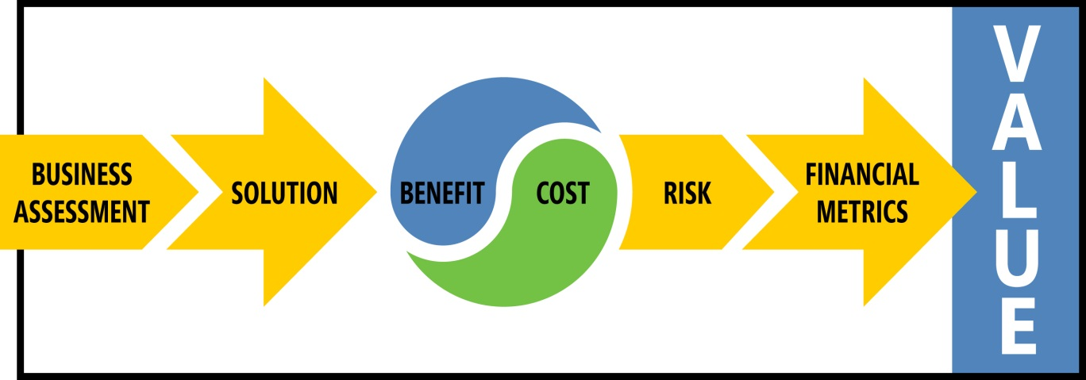
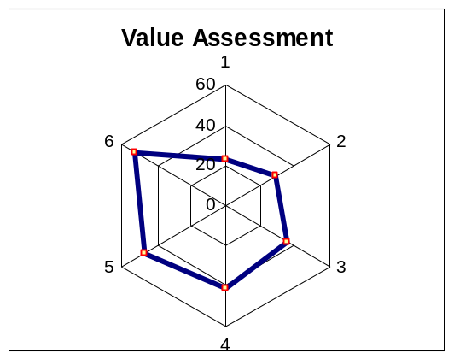
Step 1 : Define Value
Pilars
1. Strategic Alignment
2. Impact on Processes
3. Infrastructure Agility
4. Cost/Benefit (ROI)
5. Risk
5 Pillars/Parameters

Slide 8
Steps 2
3. Service Level
Objectives
Measure
Monitor
1. Define
Value
2. Define
Rules & ODE
of Portfolio
MIT
6. Negotiate& Communicate
Benefit Realization Plan
INFRASTRUCTURE
5. Optimize
Portfolio

Slide 9
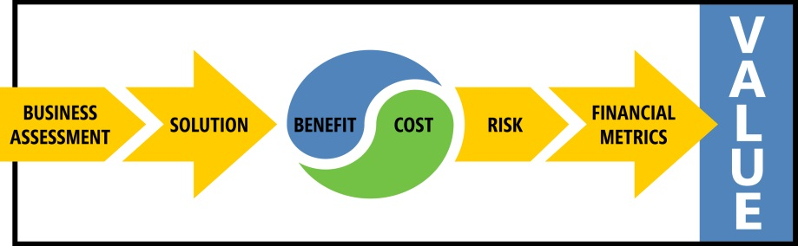
Step 2. Define Rules & ODE of Projects Portfolio
Project 1
Pilar | ODE | Weight
Strategic Alignment | Balance Scorecard Board | 35%
Impact on Processes | Biz Analysts Council | 15%
Infrastructure Agility | IT Architect Coucil | 15%
Cost/Benefit (ROI) | EVA Benchmarking Team | 25%
Risk | SOX SME, Risk Committee | 10%
Notes:
© 2005 Microsoft Corporation. All rights reserved.
This presentation is for informational purposes only. Microsoft makes no warranties, express or implied, in this summary.

Slide 10
Step 5
3. Negotiate Service Level Objectives
1. Define
Value
Define Rules and
Decision Mechanism
for Portfolio
4. Measure
Monitor
MIT
5. Optimize
Portfolio
6. Negotiate& Communicate
Benefit Realization Plan
INFRASTRUCTURE

Slide 11

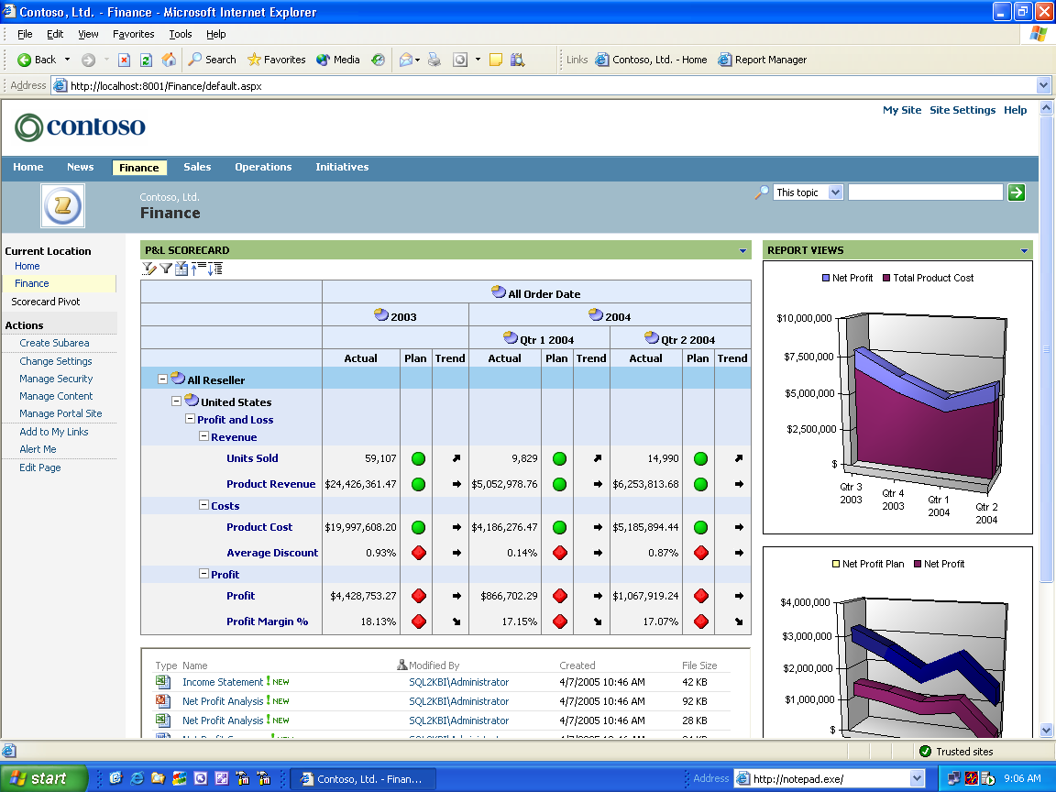

Technologies:
Integration with Business Scorecard Manager
Action-driven and collaborative application
Deep Personalized Insight
Immediate access to analysis and unstructured data
Drill down through KPIs for deeper insight
Empowerment and Productivity
Scorecard authoring and editing tool
Reduce reliance on IT for changes
and customization
Action-Driven and Collaborative
Work as a team to analyze issues
Add annotations and alerts to scorecards
Tight integration with Microsoft
collaboration platform
Integrated and Extensible
Add custom data to dashboards
Integrate into LOB applications
Extend through SharePoint Web Parts
Scorecard
Reports
Charting and Analysis
Notes:
© 2005 Microsoft Corporation. All rights reserved.
This presentation is for informational purposes only. Microsoft makes no warranties, express or implied, in this summary.

Slide 12

4. RAI Television Case Study
Television
CIO Challenges:
Move IT from Cost Center to Value Building Center
Do More Project with Less

