Slide 1
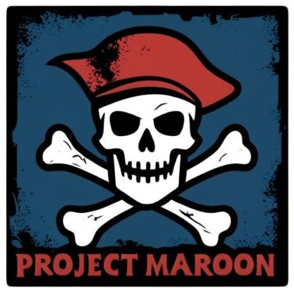
PegHead StoryBoard
Project Maroon

Slide 2

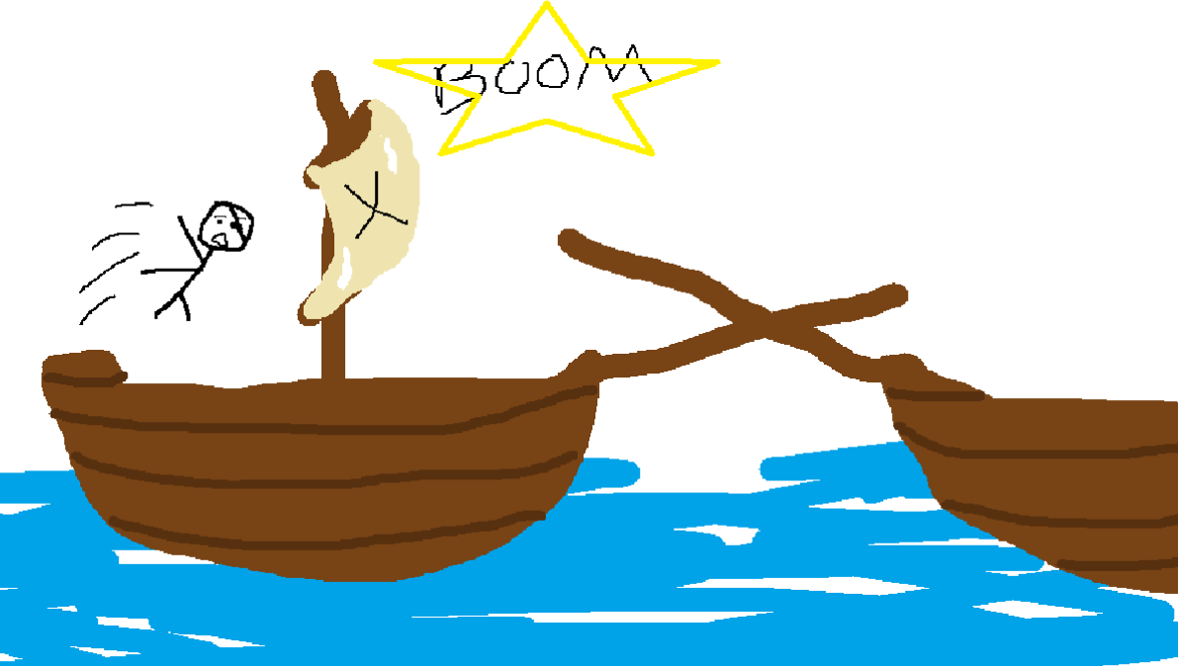
Josh: Storyboard
PegHead: The video game opens with a black screen and text introducing the background of the game
Dialogue: "While on a quest for treasure, suddenly a ship rams into yours, and you find yourself in the air. You land on your head and blackout..."

Slide 3
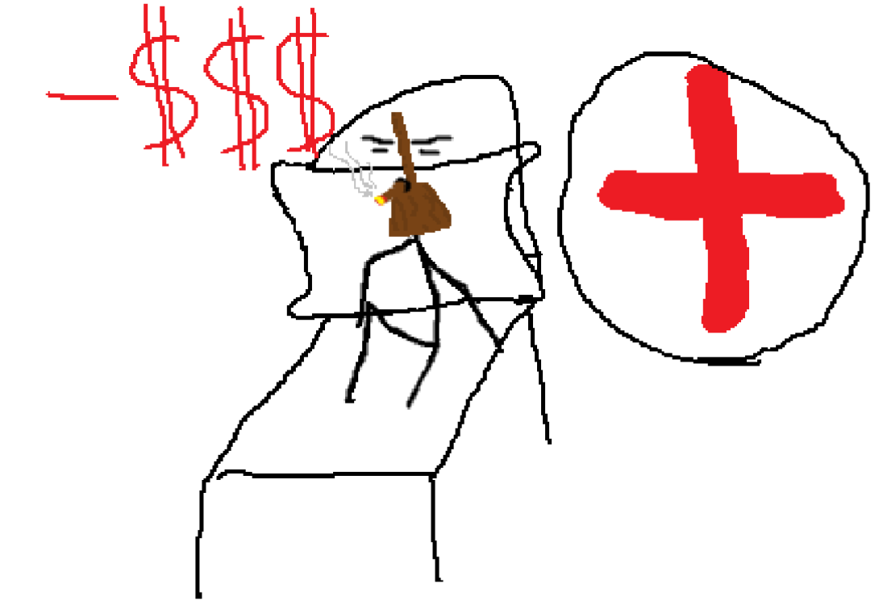
Josh: Storyboard
PegHead (post-op) (concept art)
PegHead: PegHead's head was so disfigured that he needed a head transplant (science has come a long way).
Thankfully, he had health insurance. However, his insurance claim got denied, so the only thing he could afford was a peg leg attached to his head.
Dialogue: "You wake up in an infirmary, but your head feels weird, let's hope you're okay, knock on wood."

Slide 4
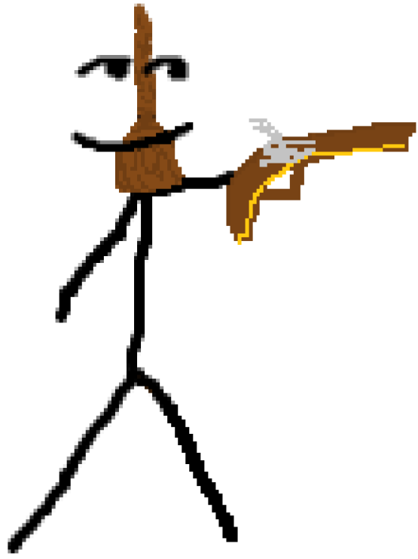
Josh: Storyboard
PegHead, armed to the teeth
PegHead: PegHead is VERY mad his insurance claim got denied. It's time to take matters into his own hands. Peghead leaves the infirmary, armed with a gun, trying to exact his revenge.
Action: Complete tutorial by moving, crouching, jumping, and shooting.
Dialogue: "You've been in the hospital for quite some time, you need to find your bearings before you begin your adventure."

Slide 5
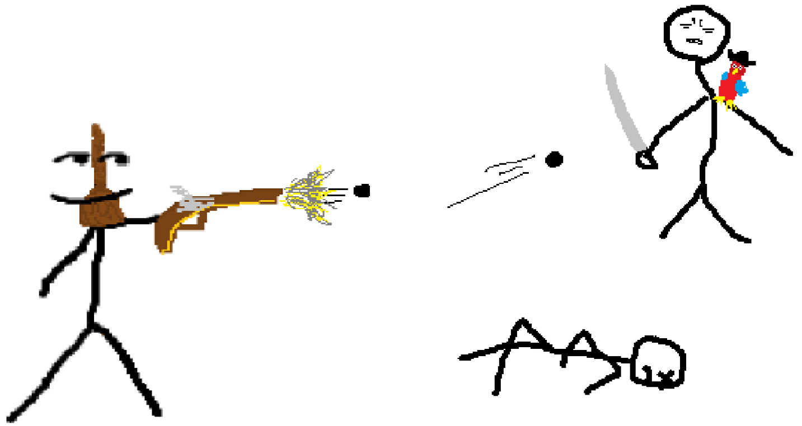
Josh: Storyboard
PegHead: PegHead plays level one, where he must defeat all goons to get one step closer to the person who wronged him.
Action: Complete level one by moving, shooting enemies, avoiding attacks, and ultimately reaching the end of the level.
Dialogue: "You enter the fray, with a vengeance, ready to slay any who stand in your way."

Slide 6
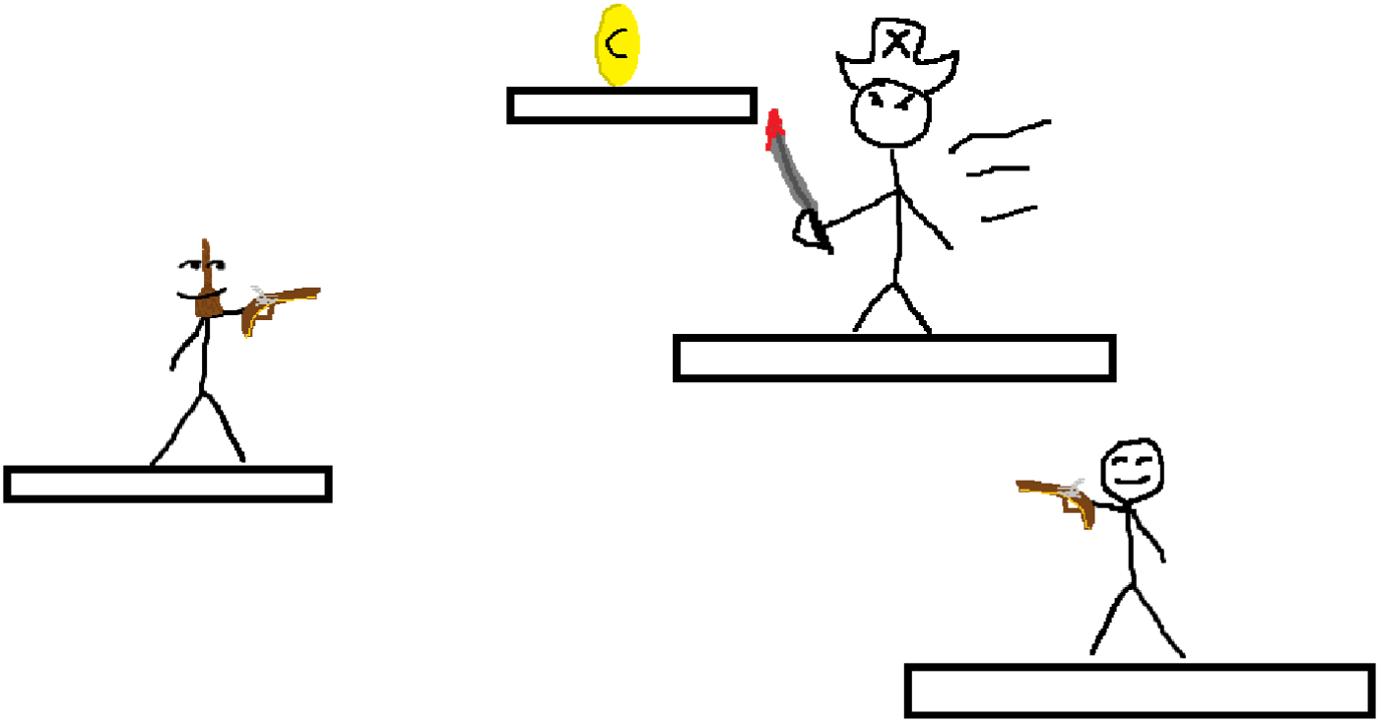
Josh: Storyboard
PegHead: PegHead enters level two. He feels he's getting closer to finding the person behind this.
Action: Maneuver around map, shoot enemies, dodge projectiles, use power-ups, reach the end of level.
Dialogue: "You see more waves of enemies, but the end is in sight."

Slide 7
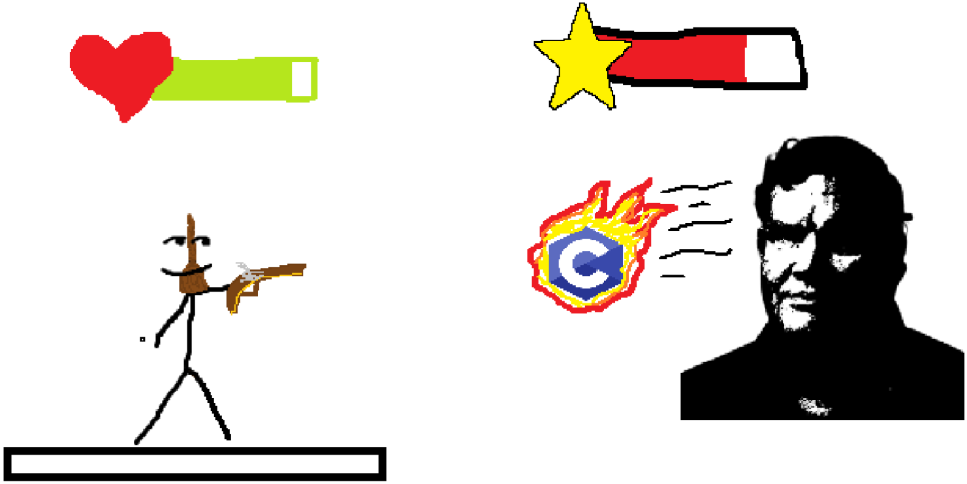
Josh: Storyboard
PegHead: PegHead encounters the final boss. The boss shoots out projectiles that deplete PegHead's vitamin C stores, causing death by scurvy.
Action: Dodge projectiles, maneuver around the arena, defeat the boss.
Dialogue: "You feel the ground shake as a towering figure emerges from the shadows. It's time to prove yourself once more."

Slide 8
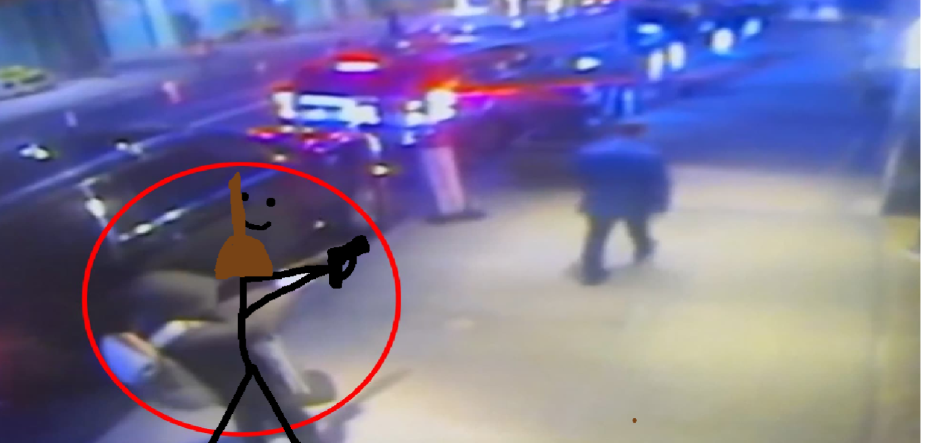
Josh: Storyboard
(final scene concept art, we do not condone violence)
PegHead: After defeating the final boss, PegHead finds and defeats the health insurance CEO, bringing an end to his treacherous journey.
Dialogue: "You lay your eyes on the CEO. With your flintlock in hand, you set out to finish what you've started."

