Slide 1
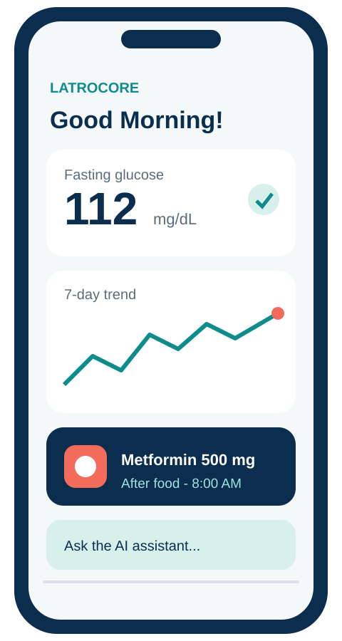
Healthathon 2026 | Idea Submission
Integrated diabetes care and medication management, so patients, pharmacists and doctors stay connected between visits.
Use case: 02 Long-term Care Engagement
Theme: HealthTech / Diabetes care
Category: Software (mobile + web)
Team name: LATRO CORE
Team Code: 7DSBDF

Slide 2
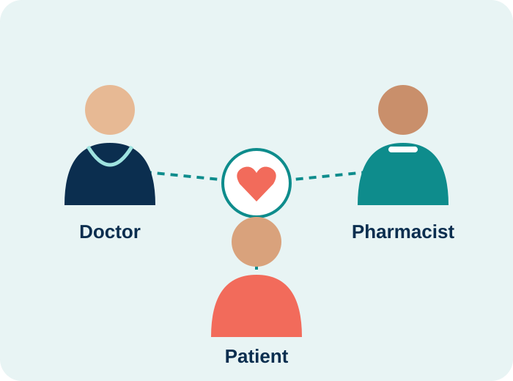
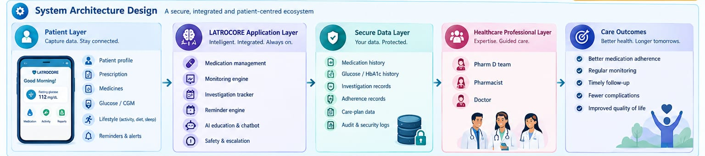
Proposed Solution
One app for the patient, with the pharmacist and doctor in the loop
Medication management: prescription-linked schedules, missed-dose log, refill alerts, interaction checks.
Diabetes monitoring: glucose, HbA1c, weight, BP and activity with trend graphs.
Investigation reminders: HbA1c every 3 months, lipid/LFT every 6, eye, kidney, foot and dental yearly.
AI health assistant: 24/7 education in English, Tamil, Hindi. Guides only, never diagnoses.
Human clinical support: Pharm D counselling and doctor follow-up on one shared record.
System architecture design
2

Slide 3
Technical Approach
Start with one modular application, add complexity only when needed
Frontend: React + Vite, TypeScript, Tailwind CSS, React Router, TanStack Query, React Hook Form + Zod, Recharts for glucose and adherence trends
Backend: Python FastAPI + Pydantic, REST APIs and workflow services
Database: PostgreSQL with SQLAlchemy + Alembic for care records and migrations; private object storage for reports
Reminders: Celery + Redis background jobs with controlled retries
AI: Hosted LLM API behind a backend adapter, retrieval from a clinician-approved knowledge base (PostgreSQL text search, pgvector later); speech chosen after English, Tamil, Hindi testing
Quality: Docker, CI pipeline, pytest and Playwright; no trained prediction model in v1
Prototype screen: glucose, trend, medicine reminder, AI help
3

Slide 4
Feasibility and Viability
Feasibility
Use cases
Challenges and solutions
Technical: digital prescriptions, glucose tracking, AI reminders, secure cloud
Clinical: links patient, doctor, pharmacist; supports counselling
Cost: cloud + smartphone only, modular
User: simple, multilingual app plus dashboards
Missed dose: reminder, then log and adherence history
Lab due: HbA1c or eye check reminder to patient
Doubt: AI education, else Pharm D follow-up
Warning signs: safety message, escalate to a professional
Privacy > encryption, role-based access
Data quality > validate glucose and prescription entries
Adoption > simple UI, user support
Integration > standard healthcare data
Connectivity > low-bandwidth mode
AI safety > decisions stay with professionals
Scalability > modular cloud
4

Slide 5
Impact and Benefits
Continuous, patient-centred care instead of prescription-only care
Social
Economic
Educational
Fewer missed doses and follow-ups; caregivers stay involved; English, Tamil and Hindi access.
Earlier pharmacist support means fewer complications; low-cost, smartphone-only rollout.
24/7 validated diabetes education, side-effect and interaction information.
Technological
Environmental
One shared care record, reminder engine, encrypted role-based access with audit logs.
Digital prescriptions and reports replace paper; fewer unnecessary trips.
Target audience: patients, caregivers, pharmacists, doctors
Healthathon Idea Submission | LATROCORE
5

Slide 6
Research and References
Feature | LATROCORE | Glucose logger apps | Pharmacy / telemedicine apps
Prescription-linked reminders | Yes | No | Partial
HbA1c / lab review reminders | Yes | Partial | No
Pharm D counselling | Yes | No | Partial
Multilingual AI education | Yes | No | Partial
Shared patient-pharmacist-doctor record | Yes | No | No
References
Anjana RM et al. ICMR-INDIAB study, Lancet Diabetes Endocrinol, 2023
IDF Diabetes Atlas, 11th ed.
ADA Standards of Care in Diabetes, Diabetes Care (latest)
WHO (2003) Adherence to Long-Term Therapies
WHO Global Strategy on Digital Health 2020-2025
ABDM and DPDP Act 2023 (India)
KOITA Healthathon, Use Case 02
8. American diabetes Association
Indicative comparison with common app categories
6

