Slide 1
Machine Learning in Finance
Cluster-Aware Sentiment and Multi-Meta Prediction for S&P 500
COMP5564 | CHIU Yee Lok (25012923G)
April 2026
Notes:
Open with the core thesis: two implementation designs, one system. Explain this is a deployment-focused ML in finance project.

Slide 2
Problem, Goal, and Presentation Blueprint
- S&P 500 prediction is nonlinear, noisy, and regime-sensitive.
- Classical econometrics underfits mixed technical + news signals.
- Goal: improve predictive utility and tradable signal quality.
- Scope stock universe: 505 names; focus examples: AAPL, AMZN, GOOG, MSFT, NVDA.
- Strict temporal protocol and lagged features to avoid leakage.
Talk Flow
- Dual-task architecture
- Implementation A: Cluster News design
- Implementation B: Multi-Meta Prediction design
- Results and robustness checks
- Limitations, controls, and deployment stance
Notes:
State the business problem and what this deck will prove: not only prediction accuracy but portfolio-level utility.

Slide 3
Dual-Task Architecture: Regression x Clustering
Task 1: Stock Price Regression
Task 2: Stock Clustering
- Predict next-day close with XGBoost.
- Features: technicals, sentiment, volatility, momentum.
- Metrics: MAE, RMSE, R2, directional hit ratio.
- Cluster 505 stocks by behavior.
- K-Means (K=6) selected by composite score.
- Cluster IDs used as signal routing structure.
Coupling insight: clustering is not an appendix. It routes sentiment information into prediction.
Notes:
Explain the system-level idea: unsupervised structure feeds supervised learning through cluster-aware information routing.

Slide 4
Implementation Design A: Cluster News Prediction
- Problem: direct ticker news is sparse and uneven across names.
- Design: aggregate peer-cluster news when direct news is missing.
- Scoring: semantic similarity x recency decay x source reliability x sentiment polarity.
- Stacked residual design isolates sentiment contribution over price baseline.
- Grid-searched decay remains stable around L=10 and lambda=0.2.
[Missing image: 02D_prediction_vs_actual_close_GOOG.png]
Observed impact
- AMZN MAE down about 47 percent; GOOG MAE down about 46 percent.
- Best stacked run: MAE 0.918, R2 0.999688, DHR 0.515.
Notes:
Present Design A as the first core innovation. Highlight sparsity conversion: cluster peers provide signal when direct ticker news is absent.

Slide 5
Implementation Design B: Multi-Meta Prediction
- Problem: single-horizon T+1 forecasts are not portfolio-horizon aware.
- Design: combine T+1, T+5, T+10, T+15 heads through a learned meta layer.
- Meta controls: regime filter, direction agreement, velocity alignment.
- Ridge meta model prioritized for stability; XGB meta as secondary benchmark.
- Outcome: stronger risk-adjusted return with lower drawdown.
Performance snapshot
- Learned Meta Ridge: Sharpe 8.10, Return +10.5 percent, MaxDD -0.8 percent, DHR 0.681.
- Learned Meta XGB: Sharpe 4.72, Return +6.5 percent.
- Buy-and-Hold baseline: Sharpe 6.09, Return +8.2 percent.
Interpretation: long-horizon heads provide regime confidence to modulate short-horizon exposure.
Notes:
Present Design B as the second core innovation. Emphasize that horizon fusion changes position conviction, not just forecast error.

Slide 6
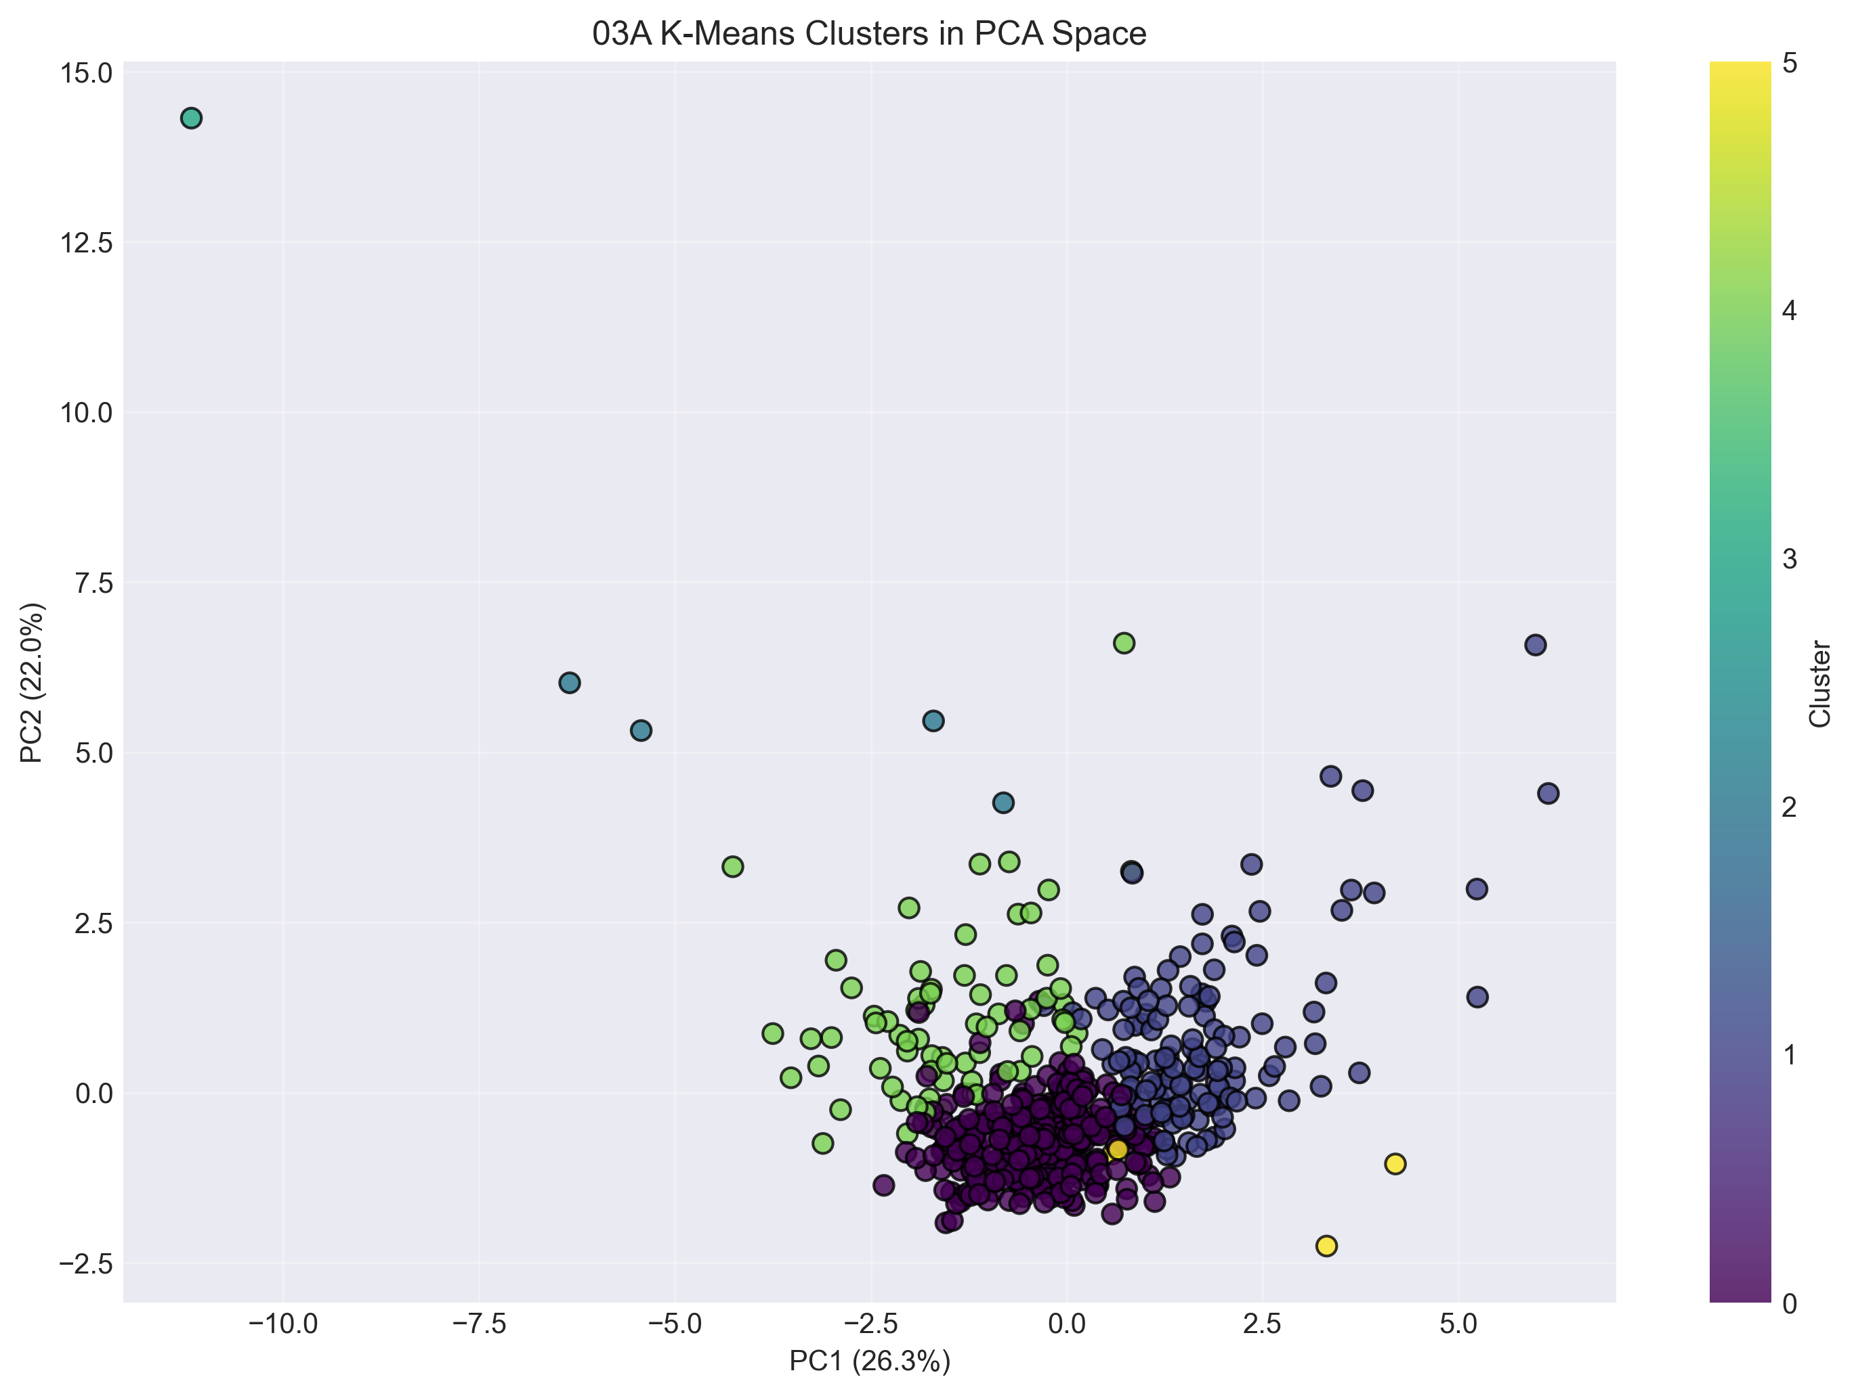
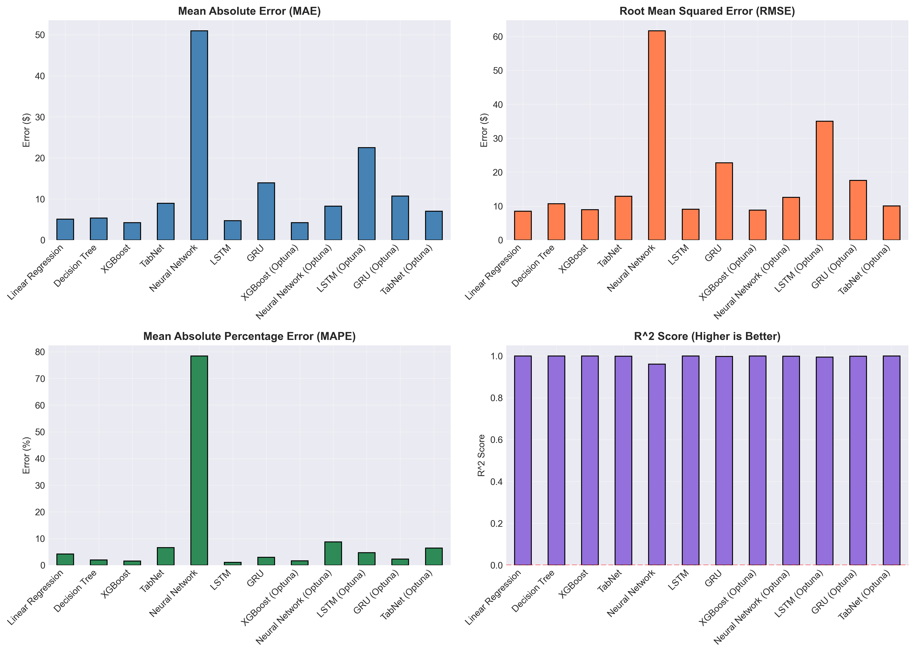
Core Empirical Results
Regression
Clustering
Trading
- XGBoost selected over deep models.
- Stacked MAE 0.918.
- R2 0.999688.
- DHR 0.515.
- K-Means chosen at K=6.
- Composite score 0.577.
- Silhouette 0.250.
- Zero noise ratio.
- Meta Ridge Sharpe 8.10.
- Return +10.5 percent.
- Max drawdown -0.8 percent.
- Outperforms buy-and-hold.
Notes:
Summarize performance on three layers: prediction, structure, and trading. Keep this slide quantitative and fast.

Slide 7
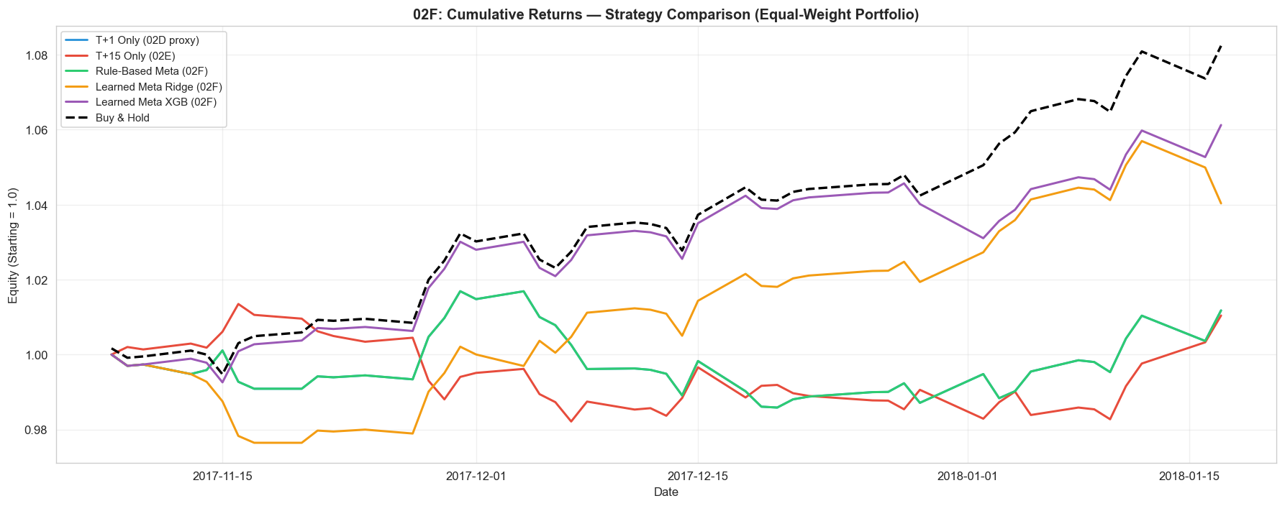
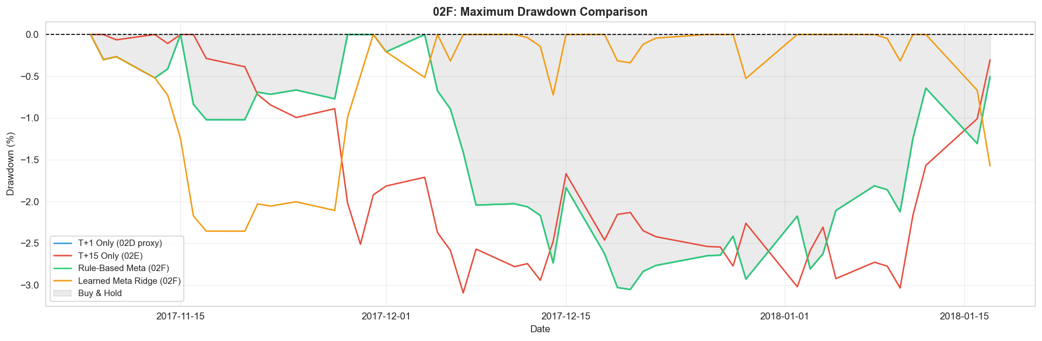
Trading Behavior, WFO Validation, and Alpha Diagnostics
- WFO comparison added to prevent fixed-split optimism in final reporting.
- IC and ICIR diagnostics included for cross-sectional stock-selection signal quality.
- Primary interpretation remains conservative until larger and multi-regime OOS confirms stability.
Notes:
Use this as the institutional validation slide: equity behavior, drawdown control, WFO realism, and IC/ICIR signal diagnostics.

Slide 8
Controls, Auditability, and Governance
Implemented controls
Remaining risks
- Temporal split and lag enforcement to prevent look-ahead leakage.
- Model comparison under shared protocol, not cherry-picked runs.
- Feature and strategy diagnostics documented in notebook outputs.
- WFO and uncertainty framing integrated into report narrative.
- Benchmark comparison includes passive baseline and risk metrics.
- No explicit slippage and impact model in current backtest.
- Static cluster topology may drift across regimes.
- Current OOS horizon is still limited for production confidence.
- Headline coverage quality varies by source and stock.
- Further stress testing needed for bear and shock windows.
Notes:
Balance strengths and open risks. This slide demonstrates institutional-grade skepticism and control awareness.

Slide 9
Limitations and Next Iteration Plan
- Current portfolio simulation excludes full transaction cost stack and market impact.
- Cluster structure is static; no online updating mechanism yet.
- Model confidence is point-estimate heavy; interval prediction is limited.
- Validation breadth should expand with longer OOS and additional market regimes.
Next iteration priorities
- Dynamic clustering with rolling updates and drift monitoring.
- Cost-aware backtesting with slippage, commissions, and liquidity penalties.
- Uncertainty-aware position sizing using prediction intervals.
- Regime-conditioned retraining cadence and model governance checkpoints.
Notes:
Present a credible roadmap. Prioritize what would be done before any real capital deployment.

Slide 10
Conclusion
- Design A (Cluster News) improves information coverage under sparse news conditions.
- Design B (Multi-Meta Prediction) improves risk-adjusted trading outcomes.
- Combined system delivers gains in both predictive and deployment-facing metrics.
- Evidence is promising, but deployment recommendation remains controlled and staged.
Core thesis: clustering serves as a structural signal router, not only an unsupervised analysis block.
Notes:
Close with one message: architecture-level coupling of clustering and forecasting is the source of edge, but deployment must remain risk-controlled.

Slide 11
Thank You - Q&A
Backup metrics for discussion
- Regression: MAE 0.918, R2 0.999688, DHR 0.515.
- Clustering: K-Means K=6, composite 0.577, zero noise ratio.
- Trading: Meta Ridge Sharpe 8.10, return +10.5 percent, max drawdown -0.8 percent.
Notes:
Use this slide to answer detail questions on assumptions, metrics, and robustness checks.

