Slide 1
Machine Learning in Finance
Stock Price Regression & Cluster-Aware Sentiment Analysis
COMP5564 – ML in Finance | S&P 500 Dual-Task Framework
CHIU Yee Lok (25012923G)
April 2026
Notes:
Title slide. Introduce yourself and state the course project topic: dual-task ML system for S&P 500 stock price regression and cluster analysis.

Slide 2
Introduction & Motivation
• S&P 500 large-caps: abundant data, high news coverage, yet hard to predict
• Classical econometrics (ARIMA, GARCH) cannot capture nonlinear dynamics
• ML methods combine heterogeneous signals: OHLCV, sentiment, cross-sectional structure
• Focus on 5 mega-cap stocks: AAPL, AMZN, GOOG, MSFT, NVDA
• Key question: Can cluster-aware sentiment routing improve both accuracy and trading utility?
Dataset Overview
• 505 S&P 500 stocks (full universe)
• Daily OHLCV + multi-source news headlines
• 228 test samples per stock
• 70 / 15 / 15 temporal split
• Strict no-leakage: all features lagged ≥ 1 day
Notes:
Motivate the problem: financial markets are hard to predict, classical methods are limited. ML enables combining price, volume, and NLP-derived sentiment. Introduce the 5 focal stocks and dataset.

Slide 3
Dual-Task Framework: Regression × Clustering
Task 1 — Stock Price Regression
Task 2 — Stock Clustering
• Predict next-day close price ŷ_{i,t+1}
• XGBoost with technical + sentiment features
• Evaluate: MAE, RMSE, R², Directional Hit Ratio
• Partition 505 stocks into behavioural peer groups
• 6 methods: K-Means, Hierarchical, DBSCAN, GMM, AE+KM, t-SNE+KM
• Winner: K-Means (K=6), Composite Score = 0.577
Coupling: Cluster membership → Peer sentiment pooling → Feature enrichment "Clustering is not just analysis — it is a structural signal router."
Innovation 1: Cluster News Prediction (情緒衰減 Sentiment Decay + 聚類感知 Cluster-Aware)
Innovation 2: Multi-Horizon Meta-Signal (Future Prediction for Overall Strategy)
Notes:
Explain the dual-task design. Task 1 is supervised regression, Task 2 is unsupervised clustering. The key insight is that Task 2 feeds Task 1 through cluster-routed sentiment. Mention the two innovations: cluster news prediction and multi-horizon meta-signal.

Slide 4
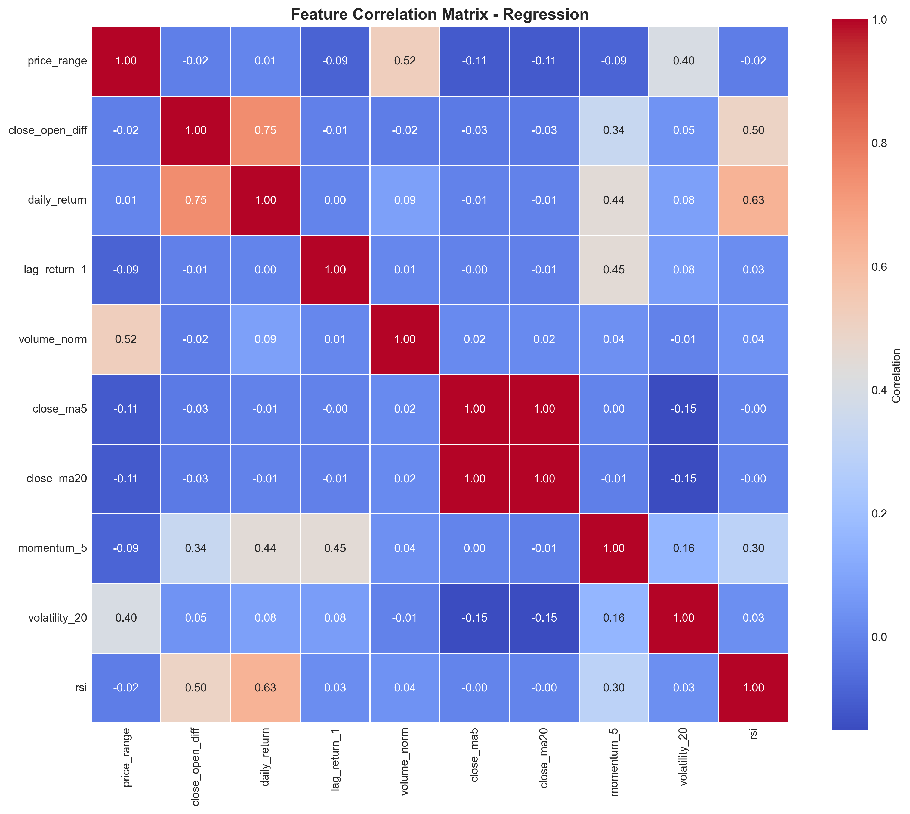
Feature Engineering & Sentiment Decay
Lagged Returns: Return_{t-1}, t-2, t-5 — momentum/mean-reversion
Moving Averages: MA5, MA10, MA20, EMA12, EMA26 — trend
Volatility: ATR, Bollinger %B, Historical Vol(20d)
Volume: Volume ratio, OBV, Volume MA — liquidity
Momentum: RSI(14), MACD, Stochastic %K
Direct Sentiment: Decay-weighted ticker news (FinBERT)
Cluster Sentiment: Peer-pooled sentiment — fills sparse days
Temporal Sentiment Decay (Grid-Searched)
• Weight: w_k = exp(-λ(k-1)) / Σ exp(-λ(m-1))
• Optimal: L* = 10 days, λ* = 0.2
• Grid-Search MAE = 4.8383
• Near-flat optimum → robust, not fragile artefact
Notes:
Walk through the 7 feature categories. Emphasise the temporal decay mechanism: instead of hand-picking lag, we grid-search L and λ on validation set. The near-flat optimum region means the result is robust.

Slide 5
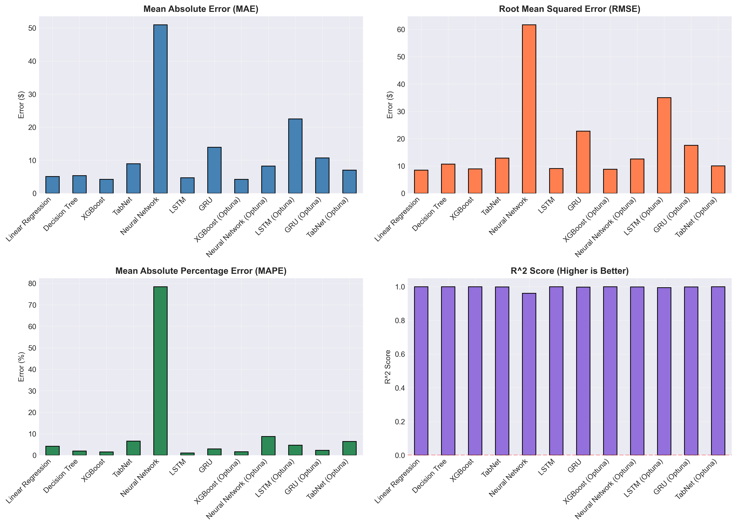
Model Selection: Why XGBoost?
4 candidates: Linear/Ridge, Random Forest, XGBoost, LSTM/GRU
XGBoost wins: best tabular fit, handles mixed features, fast, regularised
Deep models fail: training-validation divergence under strict temporal splitting
Optuna tuning: 50-trial Bayesian HPO over max_depth, lr, n_estimators, subsample
Data regime: limited per-ticker samples → gradient-boosted trees naturally robust
Notes:
Explain model selection. 4 families evaluated under identical temporal protocol. XGBoost selected because deep models overfit with small per-ticker samples. Optuna used for hyperparameter tuning with 50 Bayesian trials.

Slide 6
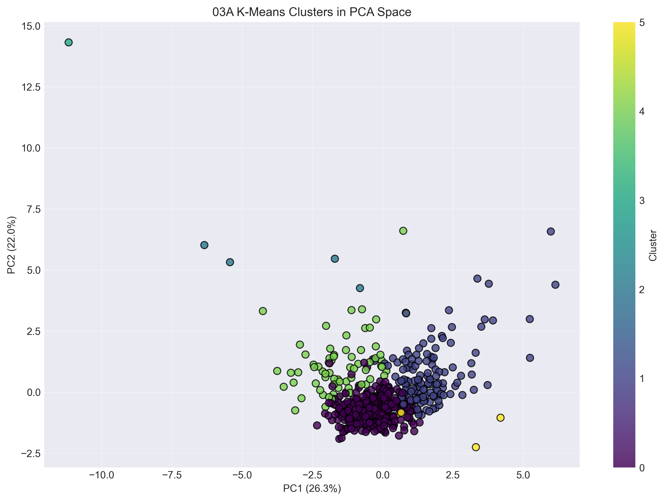
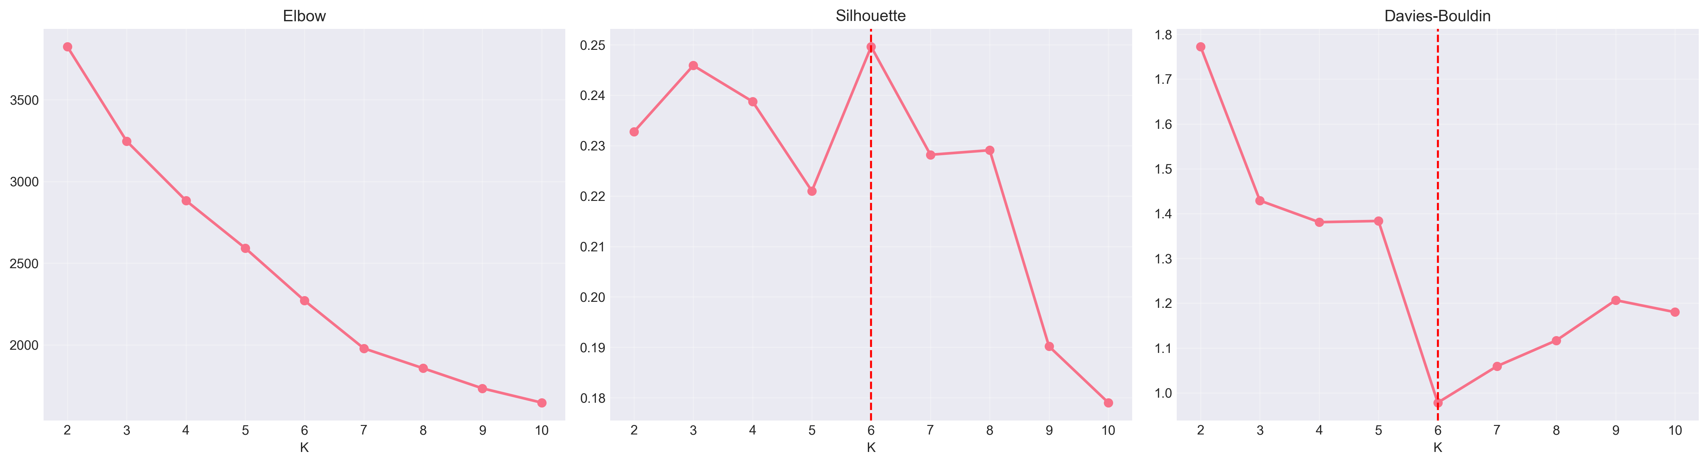
Clustering: K-Means Wins (K=6, Composite=0.577)
K-Means (K=6): Composite 0.577, Silhouette 0.250, 0% noise → Rank 1
DBSCAN: Highest silhouette (0.565) but 9.3% noise → unusable for routing
GMM: K=9, lowest silhouette (0.057), over-fragmented
Selection rationale: Zero noise critical for sentiment peer-group routing
Notes:
6 clustering methods compared. K-Means wins on composite score. DBSCAN has high silhouette but 9.3% noise means some stocks get no peer sentiment. PCA scatter shows clear cluster separability. K=6 chosen at elbow point.

Slide 7
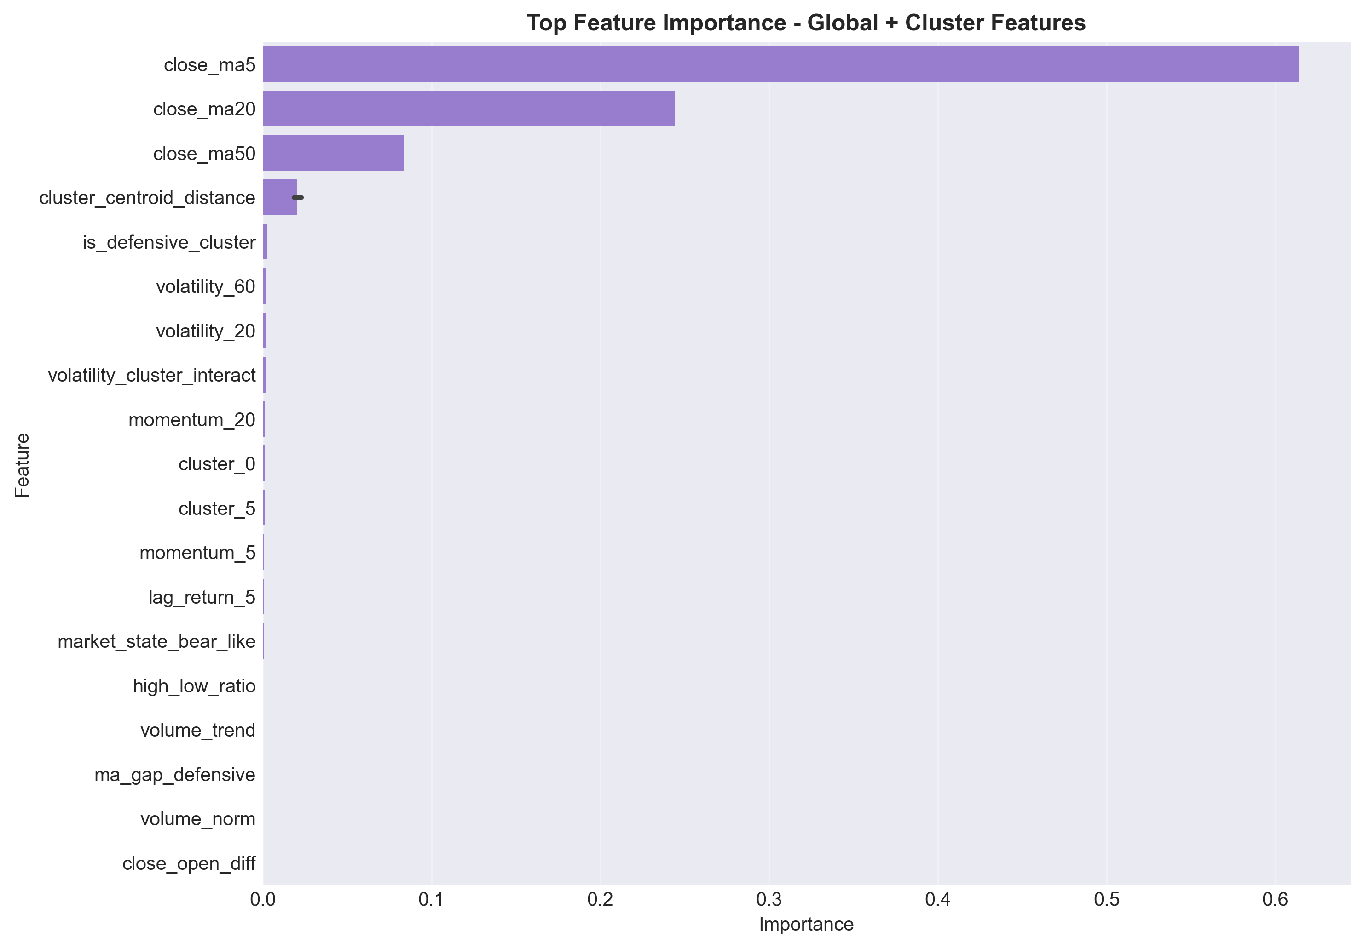
Section 3.5 — How 02B Cluster-Aware Regression Improves Prediction
Mechanism 1: Inject cluster_id and market_state one-hot signals into global XGBoost
Mechanism 2: Train cluster-specific XGBoost experts for each behavioural peer group
Mechanism 3: Blend global and expert outputs with validation-tuned alpha
Why it works: Reduces cross-regime parameter conflict and improves specialization
02B Impact Summary (Internal Notebook Comparison)
Setup
MAE
Improve
Global Baseline
3.7405
0.00%
Global + Cluster Features
3.4084
8.88%
Cluster-Specific Models
2.5557
31.68%
Blended (Global + Cluster)
2.5557
31.68%
Blend formula: y_blend = alpha*y_global + (1-alpha)*y_cluster
Notes:
This slide is the new report Section 3.5 in PPT form. Explain that 02B adds cluster context at both feature level and model level. The largest gain comes from cluster-specific specialization: MAE improves from 3.7405 to 2.5557 (31.68%). The blended setup keeps robustness while retaining this gain.

Slide 8
Innovation 1 — Cluster News Prediction (聚類感知)
Problem: Per-ticker news is sparse — most small/mid-caps have zero headlines on any given day
Solution: Route news through cluster peer set → transforms sparsity into abundance
3 channels: Direct ticker news + Peer-cluster news + Macro news
Weighting: TF-IDF cosine similarity × recency × source reliability × FinBERT polarity
Stacked residual: Sentiment explains only residual not captured by price baseline
[Image: 02D_prediction_vs_actual_close_GOOG.png]
Key Results (02D Hold-Out)
• Stacked Cluster-News: MAE = 0.918, R² = 0.999688, Dir. Acc. = 0.515
• vs Baseline: MAE = 0.909, Dir. Acc. = 0.509 (lower directional signal)
• AMZN MAE ↓ 47% (15.1 → 10.8), GOOG MAE ↓ 46% (15.0 → 8.1)
• Optimal decay: L* = 10, λ* = 0.2 (robust flat optimum)
Notes:
Innovation 1: cluster news prediction. The key insight is treating clustering as an information routing mechanism. When a stock has no direct news, peer cluster sentiment fills the gap. AMZN and GOOG show the largest MAE reductions (46-47%) because they benefit most from peer intelligence. Mention the Chinese term: 聚類感知 (cluster-aware) and 情緒衰減 (sentiment decay).

Slide 9
Innovation 2 — Multi-Horizon Meta-Signal
Problem: T+1 optimises point accuracy but ignores portfolio rebalancing horizon
Solution: Train T+5, T+10, T+15 XGBoost heads → combine via meta-learner
Meta-Score: T1Proxy × RegimeFilter × VelocityAlign
3 filters: VIX-conditional weighting, direction alignment, sentiment-velocity alignment
Ridge meta-learner: most stable; XGB meta-learner also profitable
Table 6: Multi-Horizon Backtest Performance
Strategy
Sharpe
Max DD
Return
DHR
Trades
T+1 Only (02D proxy)
2.42
−2.1%
3.3%
0.575
47
T+15 Only (02E)
−5.85
−7.6%
−7.4%
0.404
47
Rule-Based Meta (02F)
2.42
−2.1%
3.3%
0.575
47
Learned Meta Ridge ★
8.10
−0.8%
10.5%
0.681
47
Learned Meta XGB
4.72
−1.5%
6.5%
0.617
47
Buy-and-Hold
6.09
—
8.2%
—
—
Notes:
Innovation 2: multi-horizon meta-signal. The T+15 forecast acts as a directional confidence modifier for T+1. When horizons agree, conviction is amplified; when they disagree, it's suppressed. Learned Meta Ridge achieves Sharpe 8.10, beating buy-and-hold (6.09) with only -0.8% max drawdown.

Slide 10
Results at a Glance
Regression (02D Stacked)
Clustering (K-Means)
Trading (Meta Ridge)
• MAE = 0.918
• R² = 0.999688
• Dir. Accuracy = 0.515
• MSFT best: MAE = 0.594
• AMZN/GOOG: 46-47% improvement
• K = 6 (Elbow + Silhouette)
• Composite Score = 0.577 (Rank 1)
• Silhouette = 0.250
• Zero noise ratio
• Financially coherent peer groups
• Sharpe Ratio = 8.10
• Max Drawdown = −0.8%
• Total Return = 10.5%
• DHR = 0.681
• Beats Buy-and-Hold (6.09)
Per-Stock Highlights
AAPL: Best under 02D stacked (MAE=1.331) — cluster peers fill news gaps
AMZN/GOOG: Largest MAE drops via cluster-specific sentiment (↓46-47%)
MSFT: Lowest absolute MAE (0.594) — smooth trend, consistent coverage
NVDA: Highest R² (0.9886) — semiconductor peer group boosts fit
Notes:
Summary of all key results across three dimensions: regression accuracy, clustering quality, and trading utility. Highlight that AMZN/GOOG benefit most from cluster sentiment (46-47% MAE drop). The meta-signal beats buy-and-hold with Sharpe 8.10 and minimal drawdown.

Slide 11
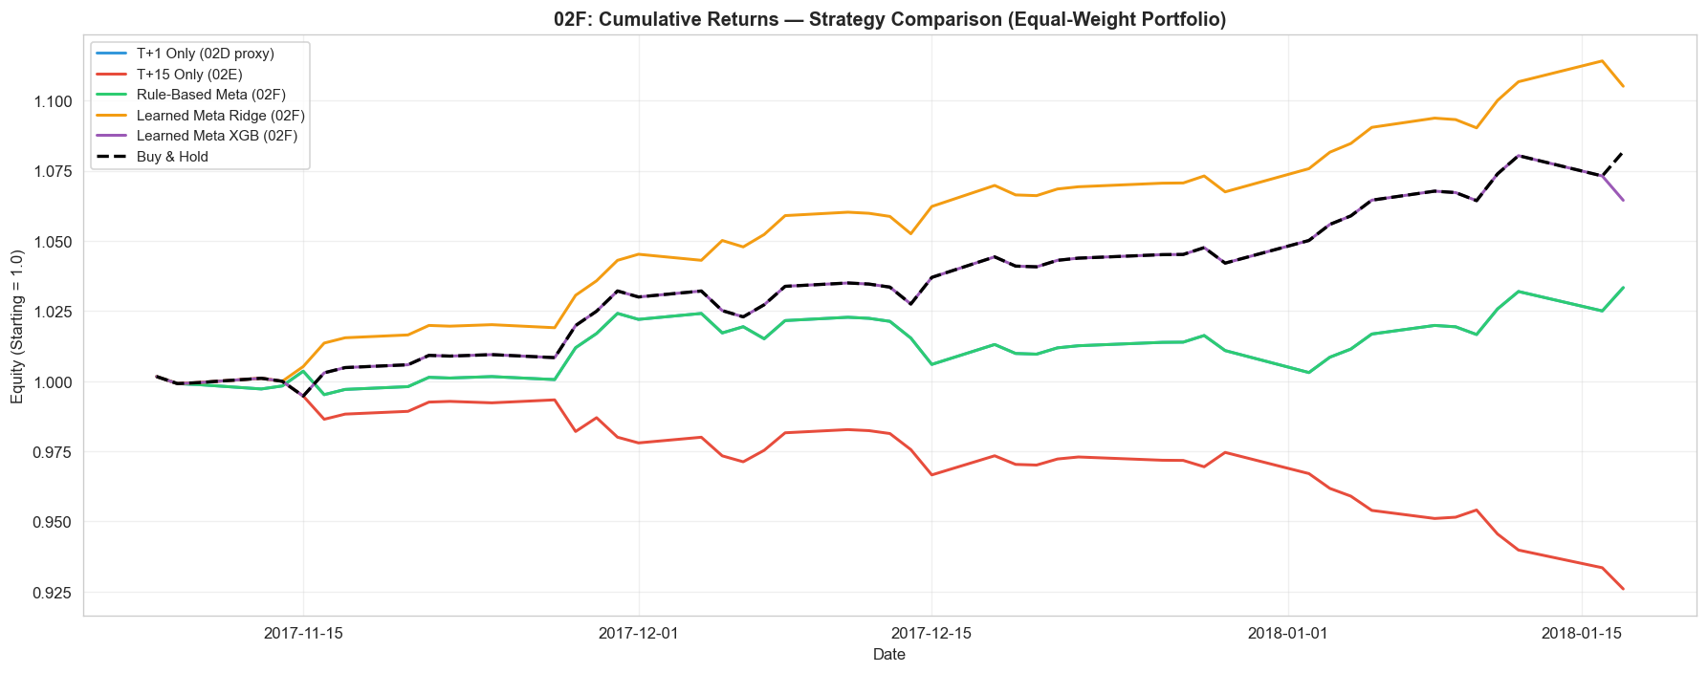
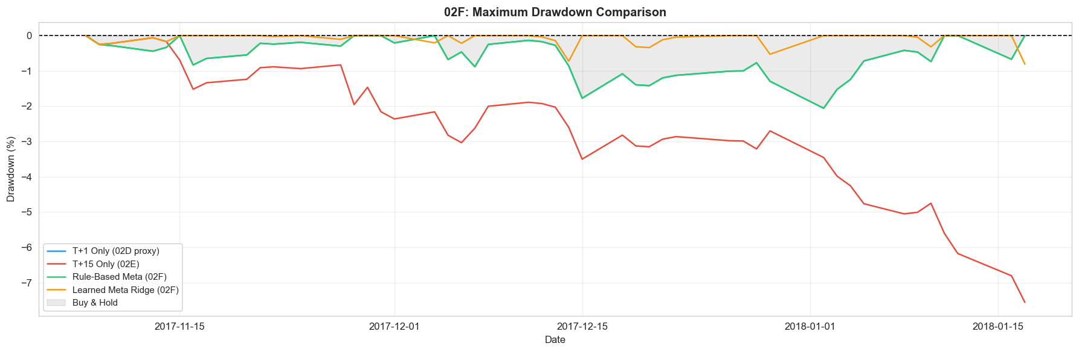
Trading Utility: Equity Curve & Drawdown
Learned Meta Ridge: Sharpe 8.10 | Return +10.5% | Max DD −0.8% | DHR 0.681 Buy-and-Hold: Sharpe 6.09 | Return +8.2% → Meta-Signal beats passive benchmark
Notes:
Show the equity curve comparison. The Learned Meta Ridge (green) shows the smoothest compounding and shallowest drawdown. Emphasise that even after transaction costs would reduce reported Sharpe, the directional advantage of multi-horizon combination remains clear.

Slide 12
Limitations & Future Work
Limitations
Future Work
• No transaction costs/slippage in backtest → Sharpe overstated in live trading
• Static cluster topology — correlations evolve over time
• Headline API coverage uneven vs institutional feeds
• Test period = broadly bullish — bear regime performance untested
• Dynamic/online clustering — rolling-window K-Means updates
• Regime-adaptive decay — VIX-conditioned λ function
• Uncertainty-aware predictions — conformal intervals for position sizing
• Latency-aware sentiment — intraday news timestamp modelling
• Alternative data — earnings transcripts, satellite, options IV
Hong Kong Context: This framework is directly applicable to HKEX stocks — cross-listing dynamics (A/H shares), Hang Seng Index constituents, and regional sentiment from SCMP/Caixin news feeds could strengthen the cluster routing layer.
Notes:
Be honest about limitations: no transaction costs, static clusters, bullish test window. For future work, highlight dynamic clustering and regime-adaptive decay as the most impactful. If asked about Hong Kong applicability, mention A/H share dynamics and regional sentiment sources.

Slide 13
Conclusion
• Core thesis validated: Clustering as signal router measurably improves both accuracy and trading utility
• Innovation 1: Cluster-routed sentiment fills news-sparse days → 46-47% MAE reduction for AMZN/GOOG
• Innovation 2: Multi-horizon meta-signal → Sharpe 8.10 (vs 6.09 buy-and-hold), MaxDD −0.8%
• XGBoost > LSTM/GRU under financial data constraints (limited per-ticker samples, temporal splitting)
• Dual evaluation protocol: Point-wise (MAE/R²) + Deployment utility (Sharpe/DHR/Drawdown)
"Clustering is not only an unsupervised analysis module — it functions as a structural signal router that converts sparse individual-news streams into cluster-informed predictive features."
Notes:
Restate the core thesis: clustering as signal router. Summarise both innovations with numbers. Emphasise the dual evaluation: we measure both prediction accuracy AND trading utility, preventing metric-singleton optimisation that could mislead deployment decisions.

Slide 14
Thank You — Questions?
CHIU Yee Lok | 25012923G | COMP5564 ML in Finance | April 2026
Quick Reference (Backup)
• 02D Stacked: MAE=0.918, R²=0.9997, DHR=0.515 | Best per-stock: MSFT MAE=0.594
• K-Means K=6: Composite=0.577, Sil=0.250 | Lag-Decay: L*=10, λ*=0.2, Grid-MAE=4.838
• Meta Ridge: Sharpe=8.10, Return=+10.5%, MaxDD=−0.8%, DHR=0.681 | B&H: Sharpe=6.09
Notes:
Q&A slide. Be prepared to answer about: transaction cost impact on Sharpe, why DBSCAN was rejected (noise ratio), how the meta-signal handles regime changes, and applicability to Hong Kong equities. Backup numbers are on screen for reference.

