Slide 1
MCUNet Tiny Deep Learning on MCUs
Enoch Richbert J
23/06/2026

Slide 2
Agenda
The Promise
What can MCUNet do?
The Process
How does MCUNet work?
Techniques that reduce peak SRAM
Techniques that reduce latency
The Playbook
How to integrate this into our MCU project?
The Possibilities
What next?

Slide 3
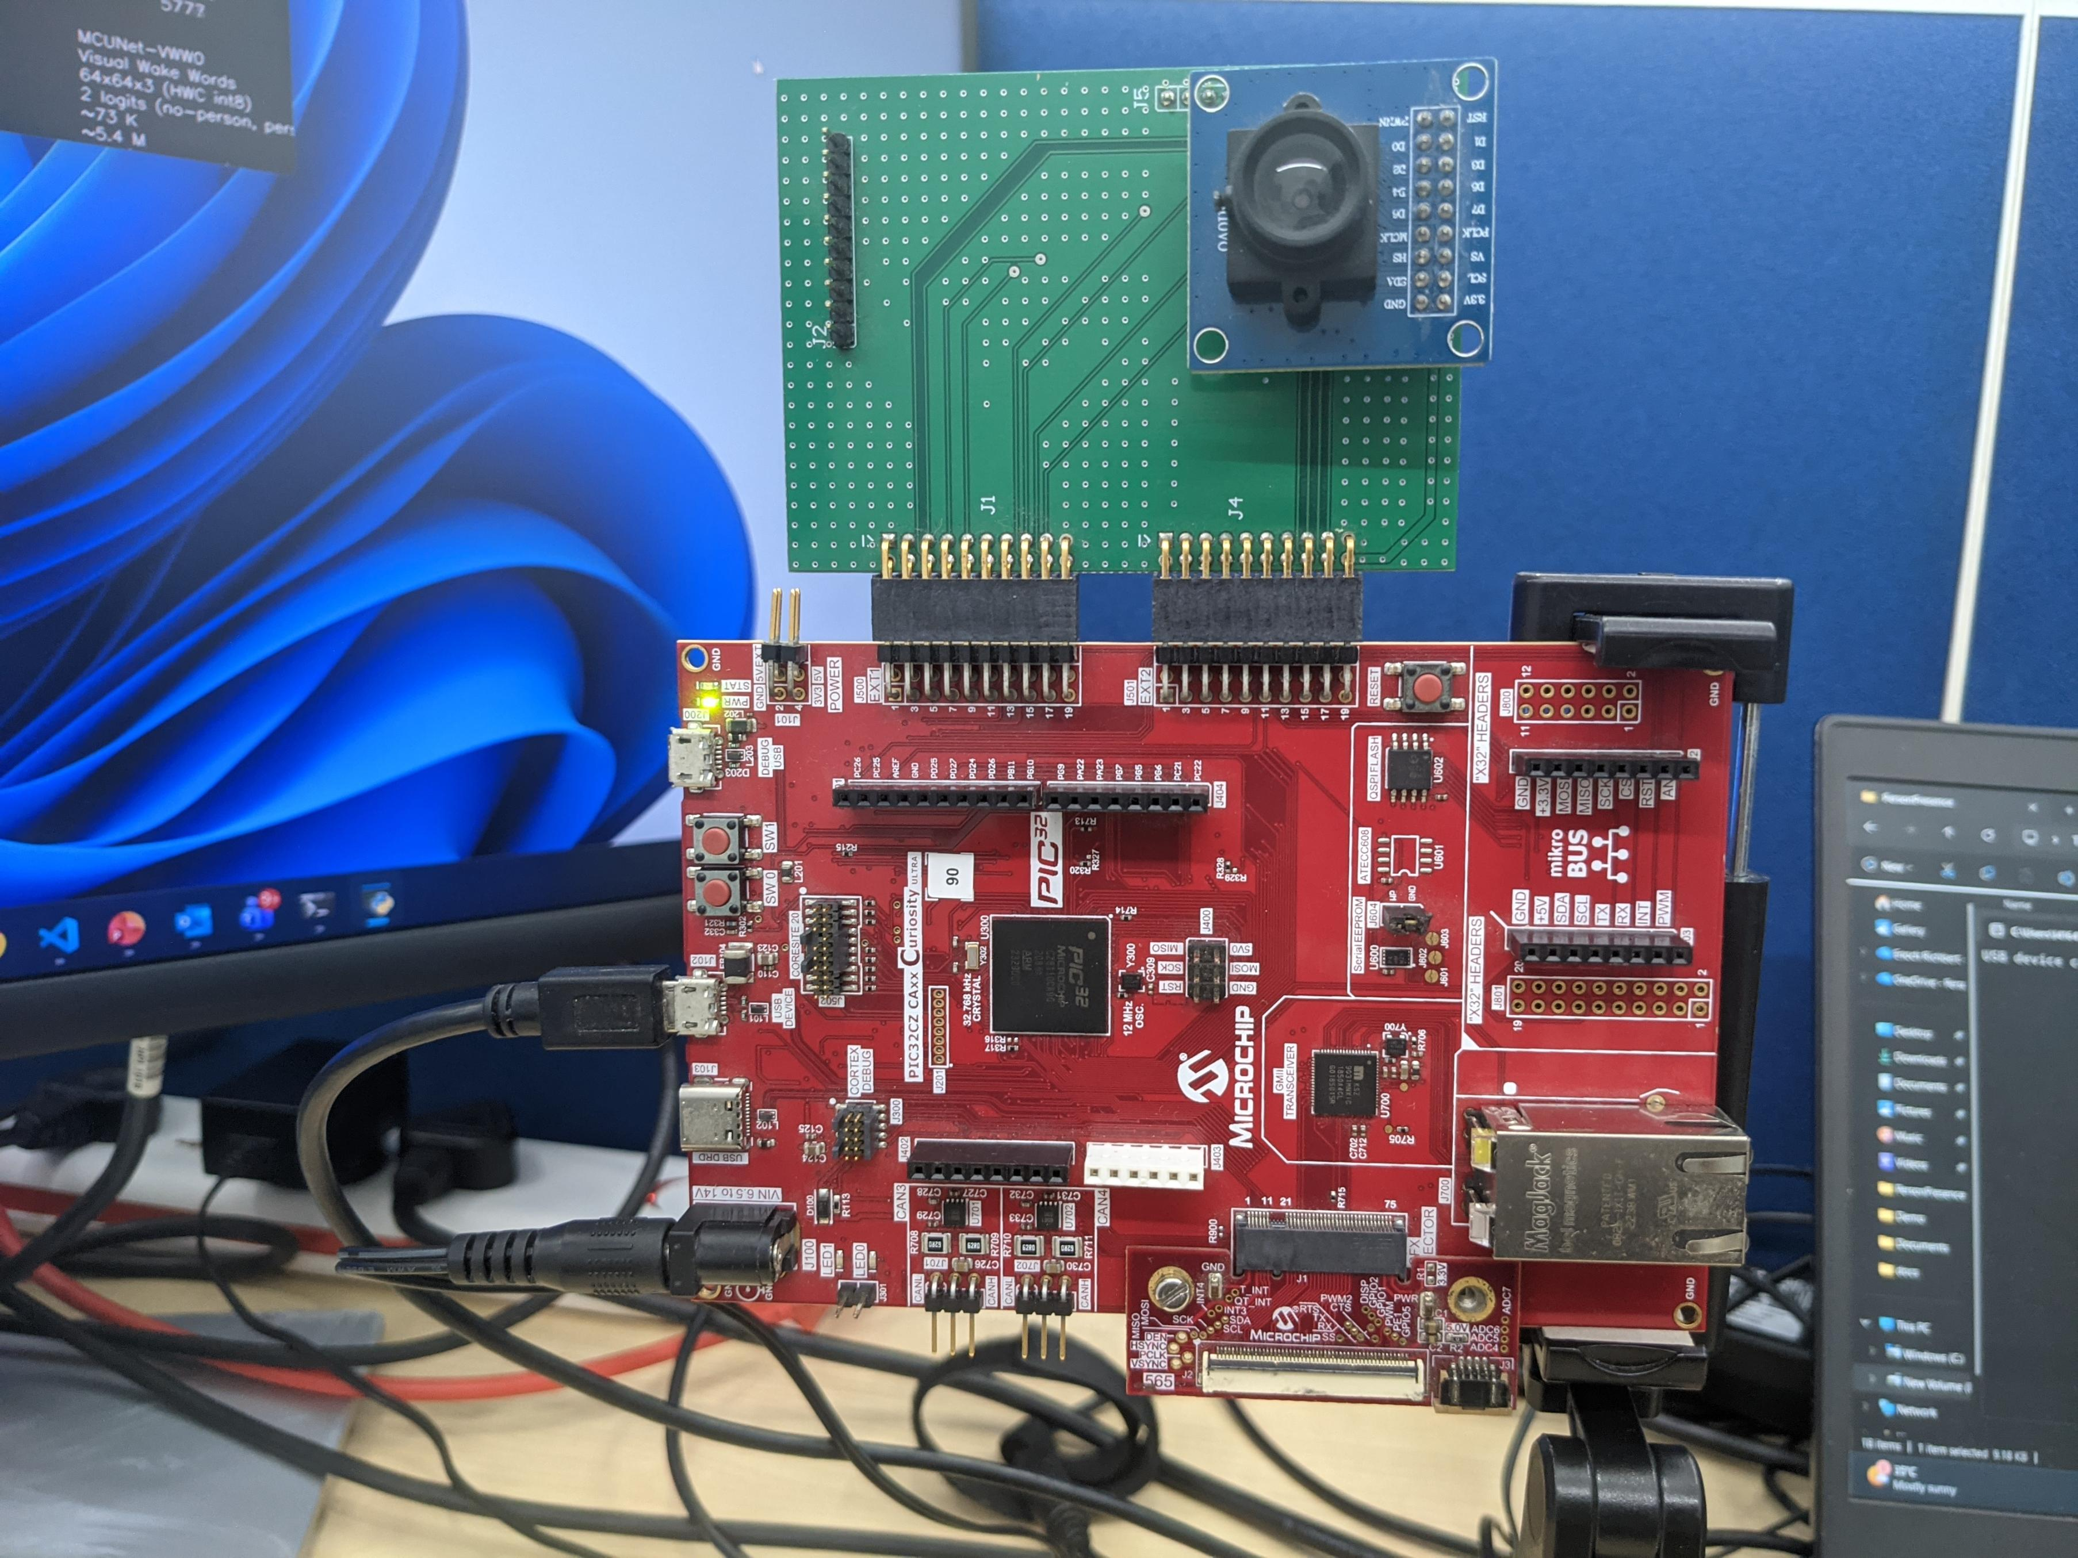
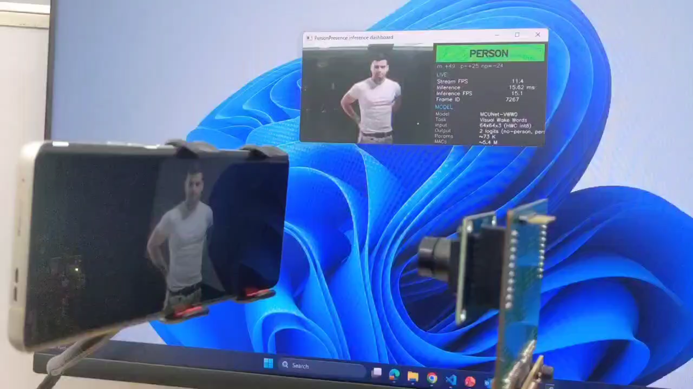
The Promise

Slide 4
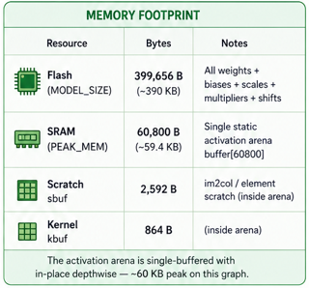
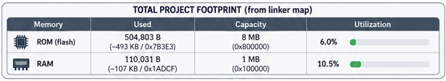

Slide 5
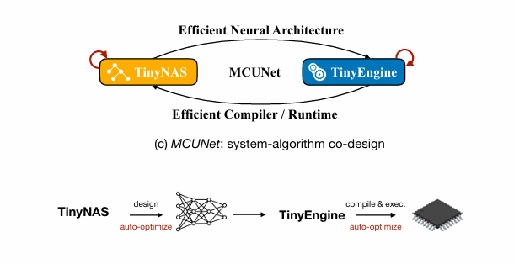
The Process
System-Algorithm Co-design

Slide 6
The Process
Peak SRAM Reduction
Patch-based inference
Global memory scheduling
In-place depthwise convolution
Static buffer placement
Latency Reduction
No interpreter
Specialized per-shape kernels
Cache friendly data layout
Loop optimizations

Slide 7
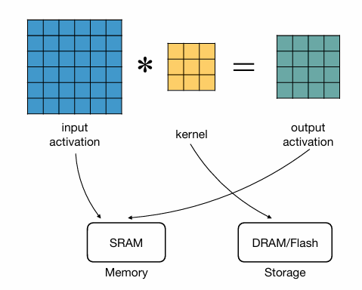
Peak SRAM Reduction

Slide 8
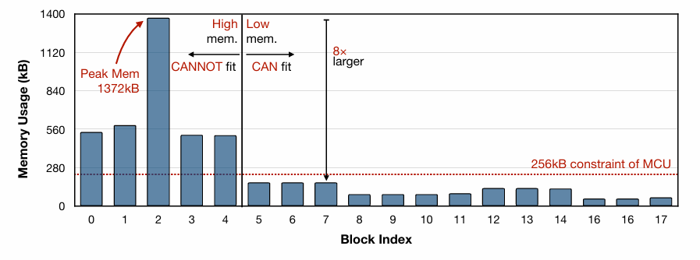
Patch-based inference
Imbalanced Memory Distribution of CNNs (MobileNetV2)

Slide 9
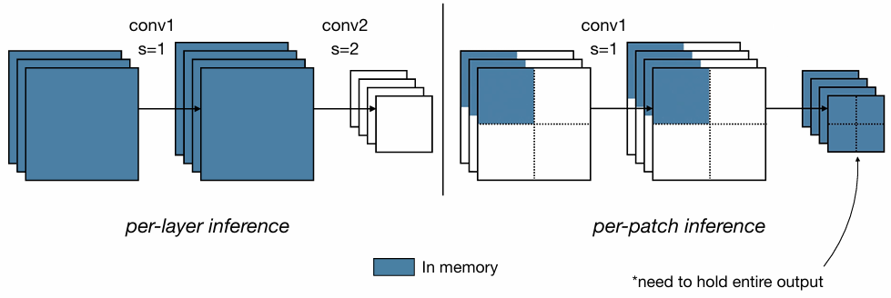
Patch-based inference
Notes:
Input image = 64 × 64 × 3 Conv1: 3×3 kernel
stride = 1
output channels = 16
64 × 64 × 16 = 65,536 bytes (if int8) ≈ 64 KB
+----+----+ | P1 | P2 | +----+----+ | P3 | P4 | +----+----+ 32 × 32 × 16 16 KB

Slide 10
Global memory scheduling
One static arena with compile-time offsets
Dead-tensor byte reuse via lifetime analysis
Zero runtime cost, large peak-SRAM reduction

Slide 11
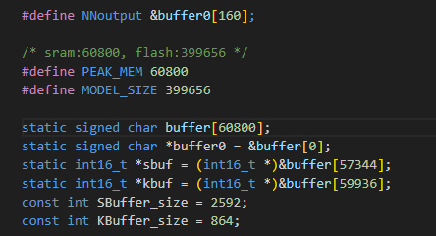
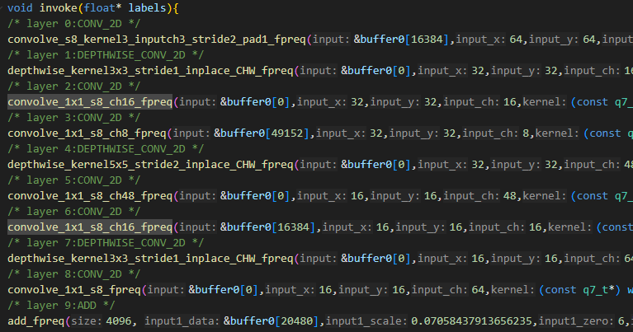
Global memory scheduling

Slide 12
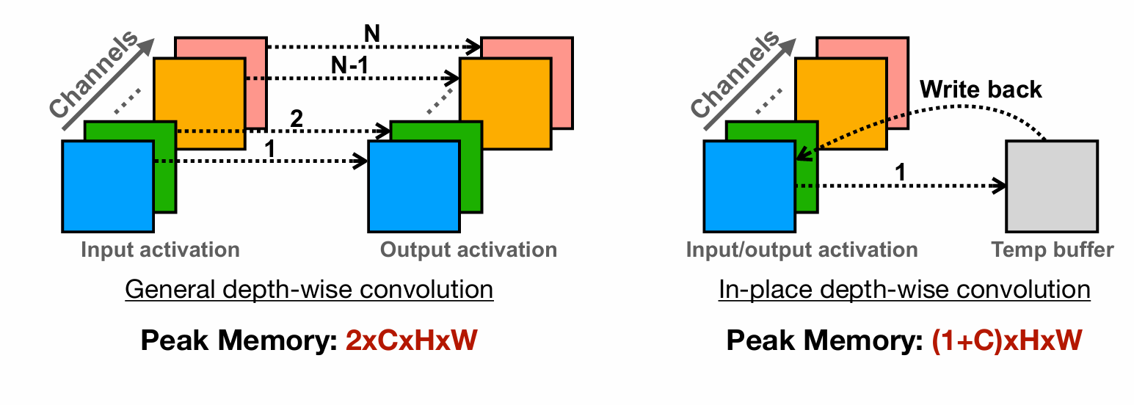
In-place depthwise convolution
Depthwise conv whose output buffer is its input buffer
Input tensor is overwritten as the layer runs
No extra compute, no accuracy change, just a different addressing pattern.

Slide 13
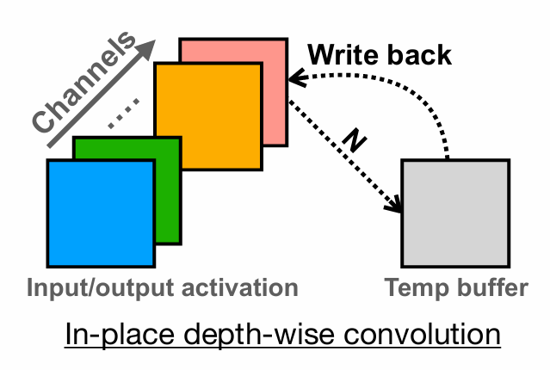
In-place depthwise convolution

Slide 14
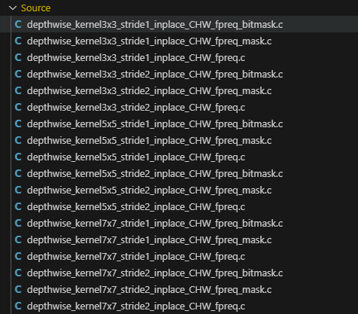
In-place depthwise convolution
Each of the 18 depthwise kernels is specially written so in-place computation can be done without write-back hazards.

Slide 15
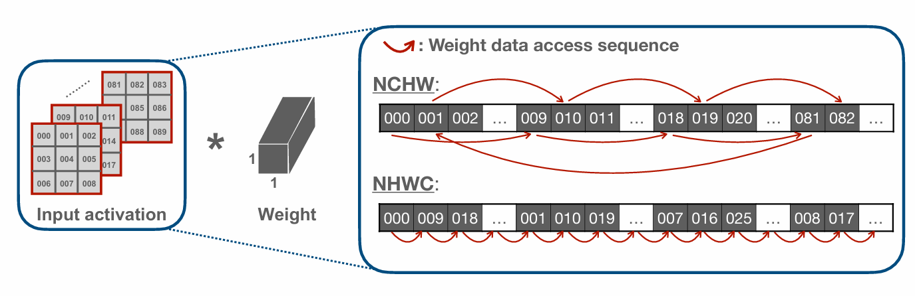
Latency Reduction
NHWC and NCHW
Use NHWC for Point-wise Convolution
For each pixel, all channels are stored contiguously, then move to the next pixel.
Use NCHW for Depth-wise Convolution
Store all of channel 0's pixels, then all of channel 1's pixels, then channel 2's

Slide 16
Latency Reduction
Loop optimization
Loop reordering
Optimizes locality by reordering the sequence of loops.
Compile-time loop bounds
Loop count is a constant stored in a register. Helps skip runtime bounds checks
Loop unrolling
Reduces branching overhead at the expense of its binary size.

Slide 17
Latency Reduction
Layer Fusion
Conv + BN + Activation + Requant all baked into one call
BN is fused at compile time
Requant + activation are fused into the inner loop of specialized kernel
Notes:
BN is learned standardization step inserted between layers..
Without fusion (e.g. naive TFLite Micro), the path looks like:
[input tensor] → Conv → [int32 tensor in DRAM]
→ Requant → [int8 tensor in DRAM]
→ BN → [int8 tensor in DRAM]
→ ReLU → [int8 tensor in DRAM]
↑ next layer reads this
Four passes over the data, four temporary buffers, four kernel dispatches.
With fusion (your code):
┌──────────────── one kernel ───────────────┐
[input] → MAC accumulate → ×scale → +offset → clamp → write int8 → next layer
(conv) (requant fused) (act fused)
BN folded into weights at codegen

Slide 18
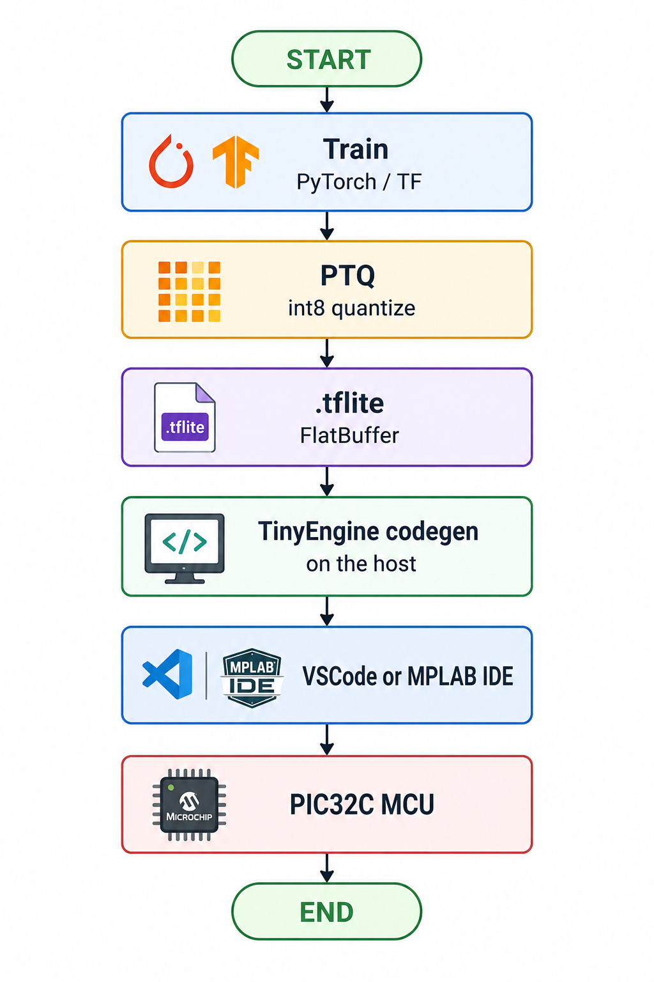
The Playbook

Slide 19
The Possibilities
On-Device Training
Object Detection
Temporal Shift Modules for complex gesture control

Slide 20
Thank You!

