Slide 1

Consumer Complaints
This analysis of consumer financial complaints collected through our dashboard system provides you with key metrics, trends, and critical insights derived from our extensive database of consumer feedback.
Throughout these presentation, we'll explore complaint volumes, geographic distributions, company response rates, and the evolving nature of how consumers submit their grievances. Our analysis aims to identify patterns that can help inform regulatory priorities and industry improvements.
The data presented offers a unique window into consumer protection challenges across the United States, highlighting both progress and areas requiring greater attention.

Slide 2

Overview of Consumer Complaints
62.5K
51
Total Complaints
States Covered
Comprehensive dataset covering consumer issues across multiple sectors and jurisdictions
Complete geographic coverage of all U.S. states and territories
9
7
Products Analyzed
Submission Channels
Diverse range of financial and consumer products evaluated
Multiple pathways for consumers to register their concerns
This report captures a substantial volume of consumer complaints, providing a comprehensive view of issues across the entire United States. The breadth of products analyzed allows for meaningful comparisons between different financial services and consumer goods, while the variety of submission channels ensures accessibility for all consumers regardless of technological proficiency.

Slide 3
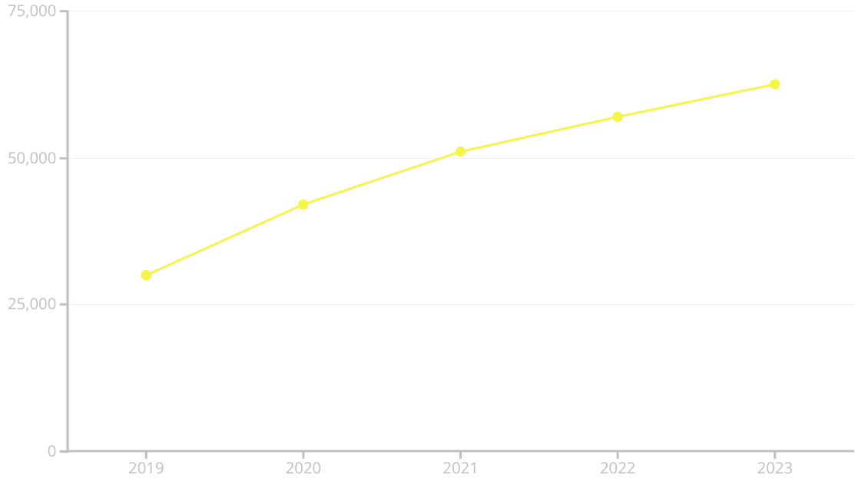
Trends in Consumer Complaints
The data reveals a consistent upward trajectory in consumer complaints over the past five years. This trend may reflect multiple factors, including increased consumer awareness, expanded access to complaint channels, and potentially growing issues within certain industries.
Month-to-month variations show seasonal patterns in complaint volumes, with notable fluctuations corresponding to specific market events or regulatory changes. The significant acceleration in complaints during 2021-2023 coincides with pandemic-related financial stresses and subsequent economic readjustments.

Slide 4
Geographic Insights
Highest Complaint States
Lowest Complaint States
Regional Variations
California, Texas, Florida, and New York consistently lead in complaint volume, accounting for approximately 40% of all complaints nationwide. These states' high volumes correlate with their large populations but also suggest potential regional regulatory challenges.
Wyoming, Montana, and North Dakota show the fewest complaints per capita. This may reflect smaller populations, different consumer behaviors, or potentially more effective local consumer protection mechanisms.
Coastal states tend to report more complaints about credit reporting and mortgages, while midwestern states show higher concentrations of debt collection complaints. Southern states demonstrate greater concerns with credit card issues.
The geographic distribution of complaints provides valuable insights for targeting regulatory resources and consumer education efforts. Population density explains some but not all variations, suggesting cultural, economic, and regulatory factors also influence complaint patterns.

Slide 5





Company Responses to Complaints
Closed with Explanation
Timely Response (94%)
Most resolved complaints fall into this category, where companies provide detailed explanations of the situation without offering specific relief.
The vast majority of companies respond to complaints within the designated timeframe, demonstrating industry commitment to addressing consumer concerns promptly.
2
1
Monetary Relief
3
A smaller percentage of cases result in financial compensation to consumers, varying significantly by industry and complaint type.
5
Pending Cases
4
A small fraction of complaints remain unresolved or in process at any given time.
Non-monetary Relief
Companies often resolve issues through policy changes, account adjustments, or other non-financial remedies.
The high timely response rate indicates that most companies take consumer complaints seriously. However, the resolution types suggest opportunities for improvement in providing more substantive relief rather than just explanations.

Slide 6





Complaints by Product Type
Credit Reporting & Repair
1
42% of all complaints
2
Mortgages
18% of all complaints
3
Debt Collection
15% of all complaints
4
Credit Cards
12% of all complaints
5
Other Products
13% of all complaints
Credit reporting and repair services generate by far the most consumer complaints, highlighting widespread issues with credit accuracy and the dispute resolution process. Mortgage complaints frequently relate to loan servicing and modification processes, while debt collection complaints often involve validation disputes and communication practices.
The dominance of credit-related issues suggests that consumers face challenges in this area, indicating the need for enhanced regulation
or industry reforms.

Slide 7




Submission Channels Used
Web-based submissions have become the predominant channel for consumer complaints, accounting for approximately 76% of all submissions. This digital shift provides benefits in terms of data collection and processing efficiency.
Traditional channels like phone (15%), email (5%), and postal mail (3%) remain important for ensuring access across all demographic groups, particularly older consumers and those with limited internet access. Fax submissions have declined to less than 1% of total volume.
The clear trend toward digital channels highlights the importance of maintaining accessible, user-friendly online interfaces for complaint submission while still preserving alternative channels for inclusivity.

Slide 8





Key Insights & Conclusions
Rising Complaint Volumes
The consistent year-over-year increase in complaints suggests growing consumer awareness and potentially increasing market issues requiring regulatory attention.
Geographic Concentration
The significant disparity in complaint volumes between states indicates a need for targeted consumer education and potentially enhanced regulatory oversight in high-complaint regions.
Company Responsiveness
While the 94% timely response rate is positive, the predominance of "explanation only" resolutions suggests room for improvement in
meaningful consumer relief.
Credit Issues Dominate
The concentration of complaints in credit reporting indicates a systemic industry issue that may warrant focused regulatory intervention and reform.
Digital Transformation
The shift toward web-based submissions demonstrates the importance of continued investment in digital infrastructure while maintaining
alternative channels.

